Slide 1


Open Information Extraction from Conjunctive Sentences
Swarnadeep Saha
IBM Research – India
and
Mausam
Indian Institute of Technology, Delhi

Slide 2
Open Information Extraction (Open IE)
Open IE extracts relational tuples from text
Without requiring a pre-specified vocabulary
By identifying relational phrases and arguments from the text only.
“When Saddam Hussain invaded Kuwait in 1990, the international…”
Open IE
(Saddam Hussain, invaded, Kuwait)

Slide 3
State-of-the-art Open IE Systems
Open IE 4.2
SRLIE – Semantic Role Labels based Extraction
RelNoun – Noun relations
BONIE – Numerical Relations
ClausIE
Clause-based extractions

Slide 4
Limitations
Lack of proper conjunction processing
Missed Recall
“Barack Obama visited India, Japan and South Korea.”
Open IE 4.2/ClausIE
(Barack Obama, visited, India, Japan and South Korea)

Slide 5
Goal
“Barack Obama visited India, Japan and South Korea.”
(Barack Obama, visited, India)
(Barack Obama, visited, Japan)
(Barack Obama, visited, South Korea)

Slide 6
Contributions
CALM (Coordination Analyzer using Language Model)
Disambiguates conjunct boundaries by correcting typical errors from dependency parses.
Single Coordinating Conjunction
Multiple Coordinating Conjunction – Use of Hierarchical Coordination Tree
CALMIE
New Open IE system
Uses output generated by CALM
Outperforms state-of-the-art Open IE systems on conjunctive sentences

Slide 7
Flow Diagram
“India”
“Japan”
“South Korea”
“Barack Obama visited India”
“Barack Obama visited Japan”
“Barack Obama visited South Korea”
CALM
Simple Sentences Generator
Simple
Sentences
Conjuncts
Open IE
system
Input Sentences
“Barack Obama visited India, Japan and South Korea.”
(Barack Obama, visited, India)
(Barack Obama, visited, Japan)
(Barack Obama, visited, South Korea)
Extraction Tuples

Slide 8
CALM: Only One Conjunction in Sentence

Slide 9
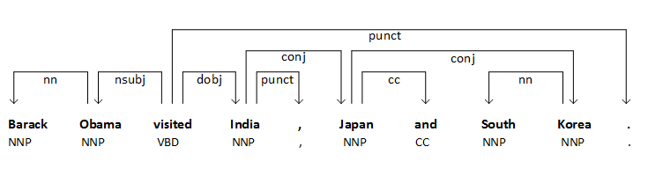
Rule-based Baseline
Conjunct Heads
Dependency Parser
1st Conjunct
2nd Conjunct
3rd Conjunct

Slide 10
Rule-based Baseline - Errors
“He is from Delhi and lives in Mumbai.”
He is from Delhi.
Lives in Mumbai.
Rule-based baseline
> 80 % of incorrect conjunct boundaries are longer than necessary

Slide 11
Language Model-based Algorithm
“He is from Delhi and lives in Mumbai.”
S1: Lives in Mumbai.
S2: He lives in Mumbai.
S3: He is lives in Mumbai.
S4: He is from lives in Mumbai.
P(S2) > P(S1)
P(S2) > P(S3)
P(S2) > P(S4)
Use Language Model to compute probabilities.
correction for length of simple sentences
Pick the configuration with the highest value.

Slide 12
Use of Linguistic Constraints
Each simple sentence must have a subject.
Named Entities should not be split.
If two verbs are adjacent, they must be light verb.
Verb categories VBD, VBZ and VBP must precede pre-defined POS tags.

Slide 13
CALM: Multiple Conjunctions in Sentence

Slide 14
Multiple Coordinating Conjunctions
Coordination Structure: The conjuncts associated with each conjunction.
Two coordination structures have to be either disjoint or nested.
Disjoint – No word in common.
Nested – One coordination structure is contained entirely within the span of one conjunct of the other coordination structure.
Partial intersections are ungrammatical: hence not possible
Joint disambiguation of all coordination structures.
Hierarchical Coordination Tree

Slide 15
Hierarchical Coordination Tree (HCTree)
“[(Jeff Bezos, an American [(electrical engineer) and ([(technology) and (retail)] entrepreneur)], founded [(Amazon.com) and (Blue Origin)]) and (his diversified business interests include [(books), (aerospace) and (newspapers)])].”
[(1-18), (20-29)
[(6-7), (9-12)]
[(15-15), (17-18)]
[(25-25), (27-27), (29-29)]
[(9-9), (11-11)

Slide 16
Multiple Conjunction Constraint
Create an initial HCTree from the parse.
In a bottom-up pass, fix the coordination structures.
Smaller conjuncts are easier to fix.
Search space is reduced by keeping the structure of HCTree unchanged.
Shortening of conjuncts ensure that the consistency of HCTree is not violated.

Slide 17
CALMIE: Open IE over Conjunctive Sentences

Slide 18
Flow Diagram
“India”
“Japan”
“South Korea”
“Barack Obama visited India”
“Barack Obama visited Japan”
“Barack Obama visited South Korea”
CALM
Simple Sentences Generator
Simple
Sentences
Conjuncts
Input Sentences
“Barack Obama visited India, Japan and South Korea.”

Slide 19
Simple Sentence Generator
Process the HCTree in a top-down order.
At each level, generate all possible sentences
from sentences in the previous level by concatenating parts of sentences that are not in any conjunct.
No duplication of sentences.

Slide 20
Un-splittable Conjunctive Sentences
Non-distributive conjunctions – “or”, “nor”.
“Adam’s nationality is French or German.”
Paired conjunctions – “either-or”, “neither-nor”.
Non-distributive triggers like “between”, “among”, “sum”, etc.
“The world cup final was played between Germany and Argentina.”
“The average of 3 and 5 is 4.”

Slide 21
Flow Diagram
“India”
“Japan”
“South Korea”
“Barack Obama visited India”
“Barack Obama visited Japan”
“Barack Obama visited South Korea”
CALM
Simple Sentences Generator
Simple
Sentences
Conjuncts
Open IE
system
Input Sentences
“Barack Obama visited India, Japan and South Korea.”
(Barack Obama, visited, India)
(Barack Obama, visited, Japan)
(Barack Obama, visited, South Korea)
Extraction Tuples

Slide 22
CALM - Evaluation
Previous work (Ficler and Goldberg, 2016) gives credit when the conjuncts for a sentence match exactly.
This is not ideal!
“Obama visited India and Japan and South Korea.”
Multiple correct interpretations depending on which “and” is considered the top level conjunction.
Compare resultant simple sentences, using traditional word overlap precision and recall.

Slide 23
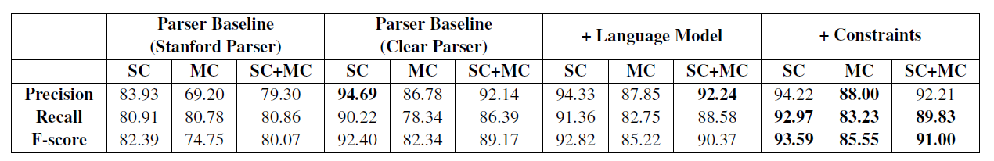
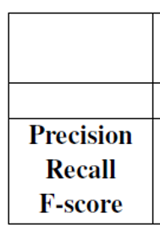
CALM Results – BNC Test Set
British News Corpus test set (publicly available).
577 conjunctive sentences.
391 Single Conjunction sentences.
186 Multiple Conjunction sentences.
Over 3 pt improvement in multiple-conjunction case.

Slide 24
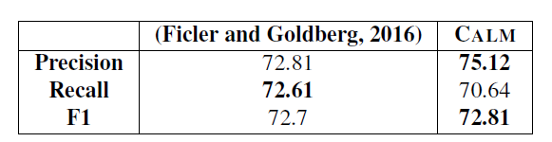
CALM Results – Penn Treebank
Comparison with SOA system on Penn Treebank dataset.
Comparison on only last two conjuncts
Evaluate using their metric – exact matches of conjunct boundaries.

Slide 25
CALM – Error Analysis
Inaccuracy of parsers (absence of ‘cc’ edge).
Missing contexts.
“Two years ago, we were carrying huge inventories and that was the big culprit.”
“Two years ago, we were carrying huge inventories.”
“That was the big culprit.”
Missing prefix context

Slide 26
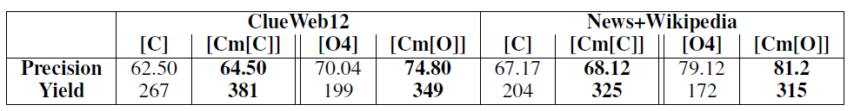
CALMIE Results: ClueWeb and News+Wiki
100 conjunctive sentences from ClueWeb12.
100 conjunctive sentences from an Open IE benchmarking dataset (Stanovsky and Dagan, 2016).
2 manual annotators.
[C] = ClausIE, [Cm[C]] = CALM + ClausIE.
[O4] = Open IE 4, [Cm[O]] = CALM + Open IE 4.

Slide 27
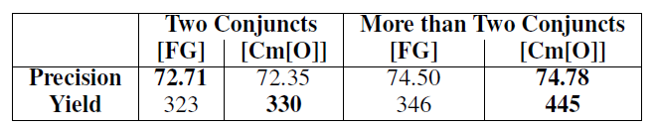
CALMIE Results – Penn Treebank
100 sentences with two conjuncts, 95 with > two conjuncts.
[FG] = Ficler + Open IE 4.
[Cm[O]] = CALM + Open IE 4.
Ficler’s system always outputs only two conjuncts.
CALMIE outputs all conjuncts.

Slide 28
CALMIE - Error Analysis
Difficulty in figuring out cases when not to split.
“Japan’s domestic sales of cars, trucks and buses in October rose by 18%.”
“The Perch and Dolphin fields moved their headquarters.”
“Germany and Argentina beat Brazil and Netherlands in the semis respectively.”
Fixing these can further improve CALMIE.

Slide 29
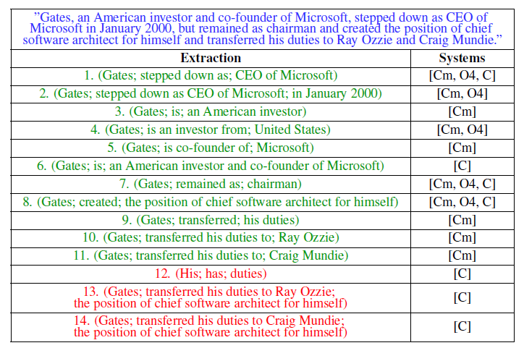
Comparison of Extractions in Open IE

Slide 30
Conclusion
SOA Open IE systems lose substantial recall due to ineffective conjunction processing.
Introduced CALM, a coordination analyzer that corrects conjunct boundaries from dependency parses.
Significant improvement in conjunction analysis
Developed CALMIE, which uses CALM generated simple sentences to improve SOA Open IE systems.
Huge boost in Open IE recall

Slide 31
Conclusion
Integrated CALMIE and BONIE (ACL ‘17) into Open IE 4.
Released Open IE 5.
Code available at https://github.com/dair-iitd/OpenIE-standalone.
Demo available at http://www.cse.iitd.ac.in/nlpdemo/web/oieweb/OpenIE5/.

