Slide 1
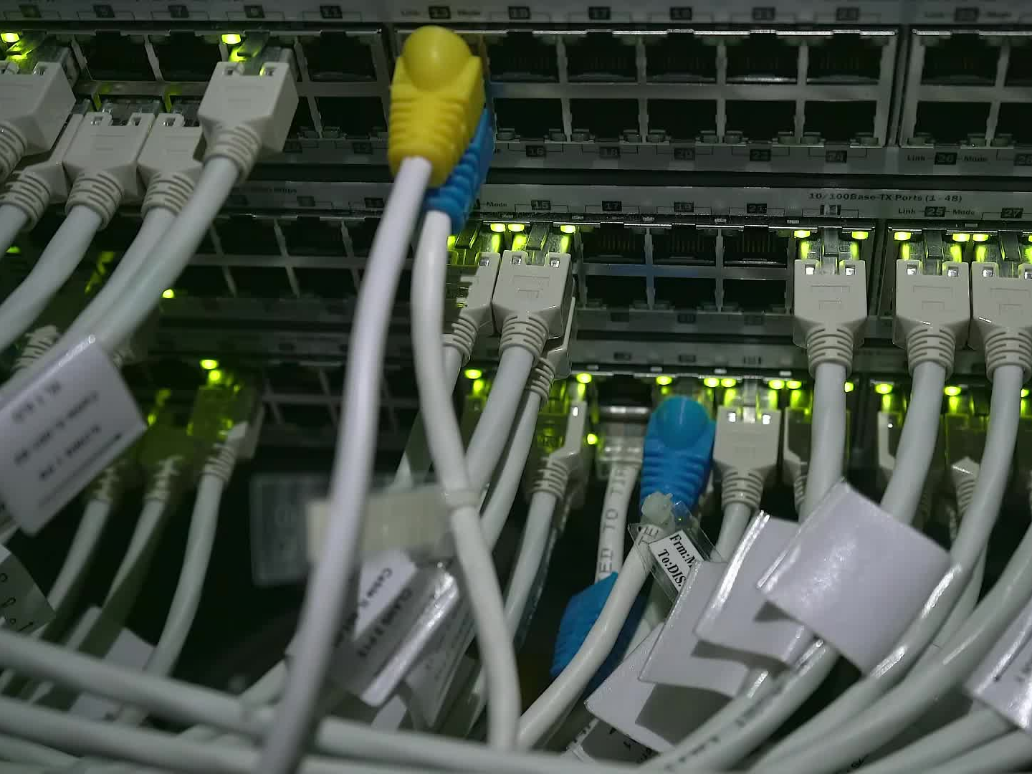
Telecom Churn Prediction
BY:
Swarna Rekha Komuravelly

Slide 2
PROBLEM STATEMENT
Customers in the telecom sector have a variety of service providers to choose from, and they can actively move between operators.
The telecommunications business experiences an average annual churn rate of 15% - 25% percent in this fiercely competitive market.
Retaining highly profitable clients is the top business objective for many established operators.
Telecom companies must identify the customers who are most likely to leave in order to decrease customer churn.
We will analyze customer-level data from a top telecom company for this assignment, create predictive models to find customers who are likely to leave, and pinpoint the key churn indicators.

Slide 3

MAIN OBJECTIVES
Recognize the data variables that contribute to churn.
Use ML algorithms to build the model and evaluate the accuracy of the model.
Finding out the best model for business case and provide executive summary.
Highlight the main variables/factors influencing the customer churns.

Slide 4
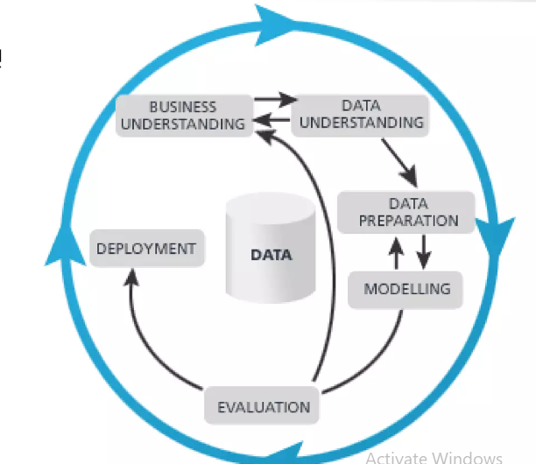
Method of Problem Solving
Identify problem statement
Data collection
EDA(Exploratory data analysis)
Feature engineering
Feature Selection
Handling imbalance data
Model selection
Business Recommendations

Slide 5
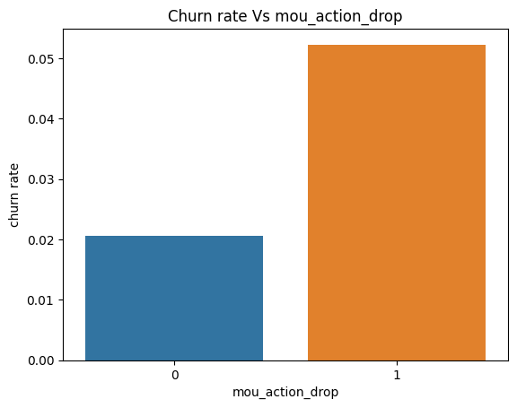
Data Understanding and EDA
The size of the Data Set is (99999, 226)
Number of Rows = 99999, Number of Columns = 226.
Dropping the columns in the table which are not helpful for the analysis.
Dropping Duplicates also, if any.
Treating the Columns that has null values.
EDA and Categorical Variable Relation
Columns dropped
date_of_last_rech_8
last_date_of_month_6
last_date_of_month_7
'last_date_of_month_8
date_of_last_rech_9
last_date_of_month_9
date_of_last_rech_6
date_of_last_rech_7
Churn rate for the customers
whose minutes of usage (mou)
decreased in the action phase
than the good phase is more.

Slide 6
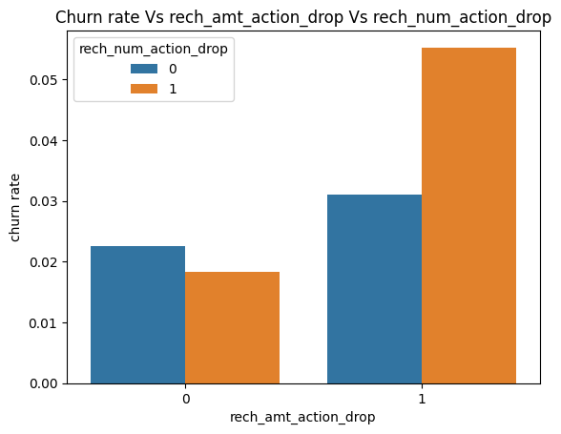
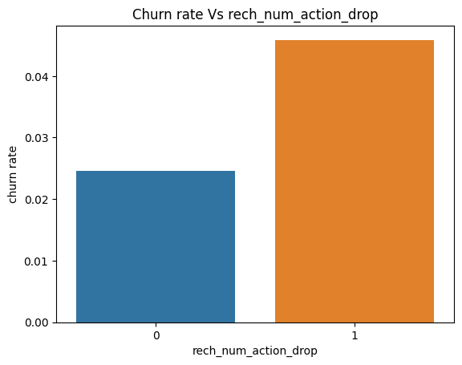
The accompanying graph demonstrates that consumers with lower recharge amounts and/or fewer recharges in the action phase compared to the good phase have higher churn rates.
The churn rate is higher for
customers whose numbers of
recharges during the action
phase is lower than their number
during the good phase as is to be
expected.

Slide 7
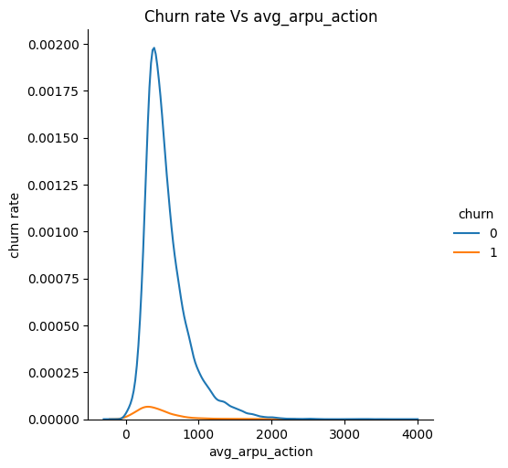
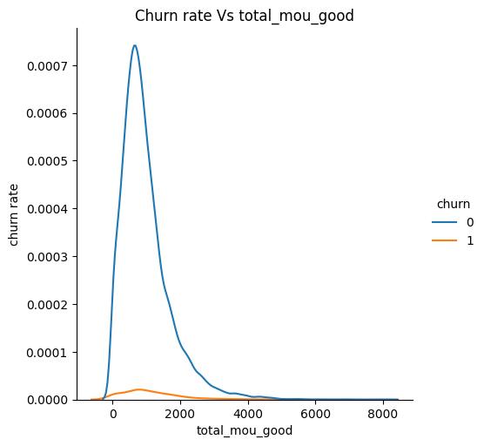
The range of every revenue per user (ARPU) for churned cutomers is primarily 0 to 900.Customers with higher ARPU are less likely to leave the company
The range ARPU for non churned clients is primarily 0 to 1000
The churn customer’s minutes of usage (MOU) are primarily in the 0 to 2500 range.
Less turnover is likely the stroner than MOU

Slide 8
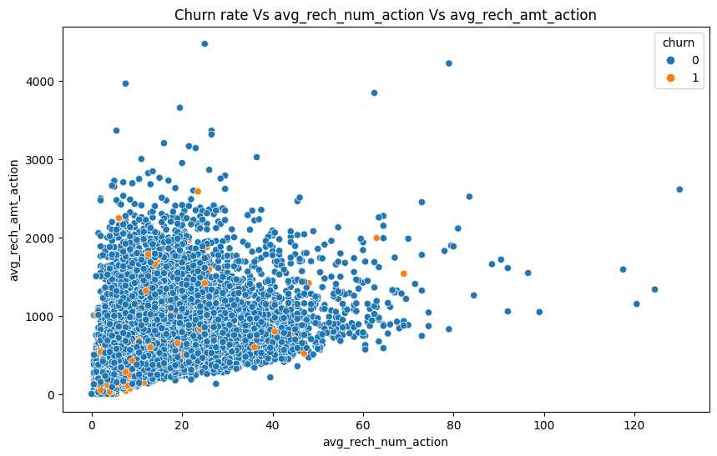
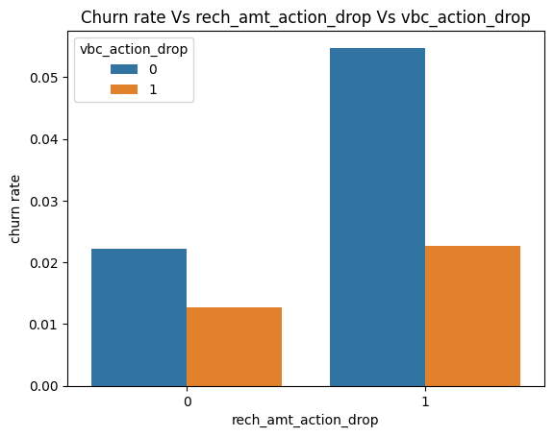
The pattern shown above demonstrates that the recharge quantity and amount are mostly proportional. The amount of the recharge increases with the number of recharges.
We can see that the churn rate is higher in
This instance as well for consumers whose
Recharge amounts are reduced as the volume based costs rise during the action month

Slide 9
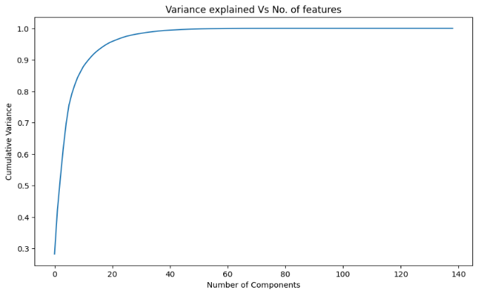
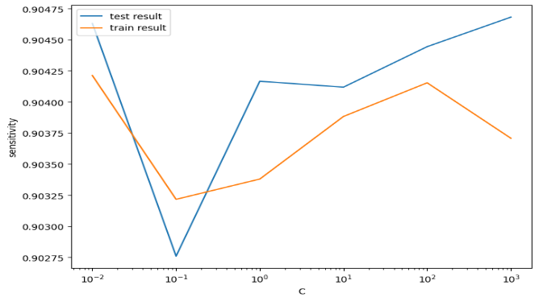
Overall the model is applying what it had learned from the train set well in the test set and is giving goo d performance
Metric | Train set | Test set
Accuracy | 0.84 | 0.77
Sensitivity | 0.9 | 0.9
Specificity | 0.76 | 0.78
We can observe that 40 components account for almost 90%of the data’s variation.
Thus, we will run PCA on 40 components

Slide 10
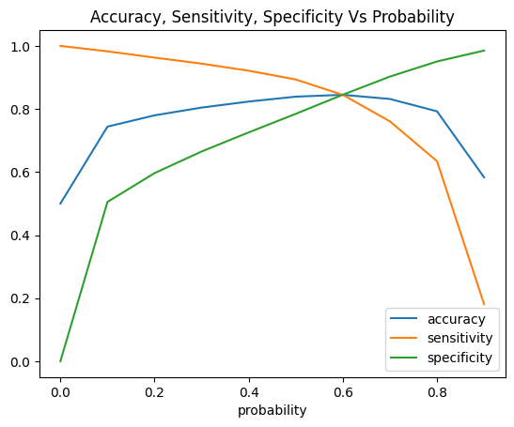
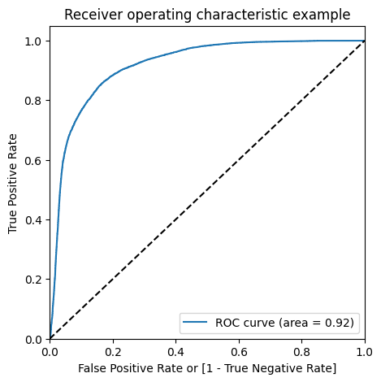
MODEL INTERPRETATION
We can see that there is accurate balance between sensitivity and specificity at 0.6, where the three parameters intersect.
Here sensitivity is more important than accuracy and specificity to us. Although 0.6 should be the ideal probability cutoff according to the above curve ,we are using 0.5 in order to get increased sensitivity, which is our primary objective.
We can observe that the ROC curve’s area is closer to 1 than it is to the model’s Gini coefficient.

Slide 11
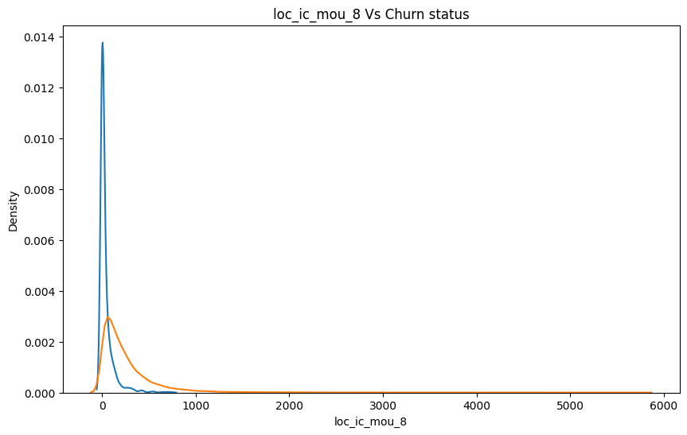
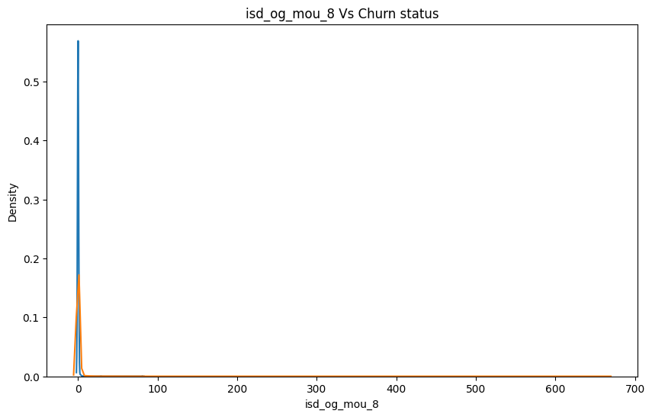
MODEL INTERPRETATION
We can see that the minutes of consumption for the churn customers throughout the month of August are typically lower than those for non-churn customers.
For August the number of monthly 3G data for turnover clients is quiet densely populated at around 1,yet it dispersed throughout various values for non-churn customers.
We may also plot the churn distribution for each variable that has greater coefficients.

Slide 12
BUSINESS RECOMMENDATION
During the action phase, concentrate on customers who use fewer minutes for outgoing ISD calls and incoming local calls. (mostly in the month of August).
Pay close attention to the customers who make larger July payments than August payments.
Additionally, customers who incur rising value-based costs during the action period are more likely to discontinue use than other clients.
Therefore, it might be a good idea to make an offer to these clients.
Customers have a greater chance to be churned if their monthly 3G recharge is higher in August.

Slide 13
Customers are more likely to churn if they used fewer STD incoming minutes on fixed T lines from provider T in August.
Customers are more apt to churn in August if they use less 2G data overall.
Customers are more likely to quit if they used fewer incoming minutes on fixed T lines from operators in August.
Variables in roam_og_mou_8 have positive coefficients (0.7135). This indicates that customers whose usage of roaming outbound minutes is rising are more apt to churn.

Slide 14

THANK YOU

