Slide 1
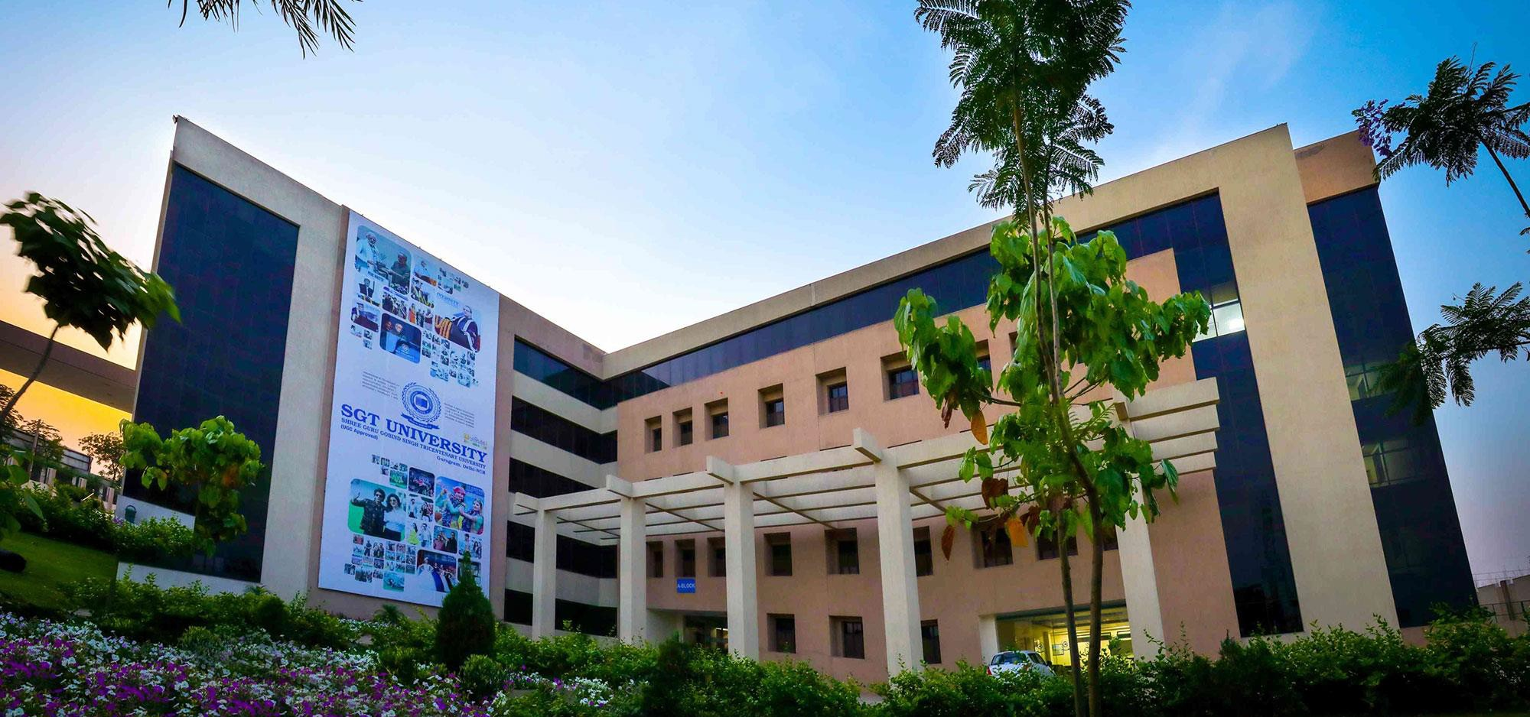
SUMMER INTERNSHIP
SEHAYAK (सहायक)
Inclusive Dyslexia Learning, CBSE Diagnostics & School Counselor Support Platform
INTERNSHIP DETAILS
Presenter Name: [Student Name]
Registration No.: [Enrollment / Roll No.]
Supervisor Name: [Faculty / Industry Guide]
Internship Org.: [Organization / SGT Dept.]
Program: BCA / MCA
Duration (Months): [e.g., 2 Months]
18-07-2026
Department of Computer Applications
1

Slide 2
Appendix — Presentation Outline
Part I: Context & Technical Stack
01. Organization Profile: Domain, vision & academic/industry context
02. Hardware & Software Stack: Compute specs, Python/Flask & ML dependencies
03. Project Background: Problem statement, objectives, roles & duration
04. Challenges & Scope: Existing educational barriers & 5-role coverage
05. System Process Flow: End-to-end diagnostic & remedial pipeline
Part II: Implementation & Outcomes
06. Technologies & Tools: Scikit-Learn, SQLite3, WCAG UI & Chatbot
07. Engineering Challenges: Privacy walls, schema evolution & UX clarity
08. Learning Outcomes: Full-stack ML, testing & inclusive design
09. Tangible Outcomes: Deployed SEHAYAK app, 33/33 tests & screenshots
10. Conclusion & Experience: Key takeaways, future roadmap & rating

Slide 3
Organization Profile
About Organization
Organization / Host: [Enter Organization Name or SGT University — Dept. of Computer Applications]
Focus Area: Applied Software Engineering, Educational Technology & AI-Assisted Solutions
Work Mode: [On-Site / Hybrid / Institution-Based Project]
Business Domain
Primary Domain: Smart Education (K–12 CBSE Inclusion & Remedial Analytics)
Mission Alignment: Ministry of Education PSB152 — Ethical Early Support Without Stigmatizing Labels
Target Audience: Schools, Teachers, School Counselors, Parents & Dyslexic Learners
Products / Services
Core Platform: SEHAYAK (सहायक) Web System
AI & Assessment: 15Q CBSE Sheet Digitizer, 30-Mark CBT & Question Logic Coach
Care Coordination: School Counselor Triage (Priority / Monitoring), 3-Way Inbox & Online Mini-Labs

Slide 4
Technologies Used
Hardware Requirements
Processor: 64-bit Intel Core i3 / AMD Ryzen 3 (or higher) @ 2.0 GHz+
Memory (RAM): 4 GB Minimum (8 GB Recommended for local ML training & testing)
Storage Space: 500 MB free SSD/HDD space for SQLite DB, uploads & artifacts
Audio & Input: Speakers/Headset (for Read-Aloud TTS audio) + Microphone (optional Speech-to-Text dictation in 30M tests)
Display: 1366x768 or higher responsive browser viewport
Software Stack
Operating System: Windows 10 / 11 or Linux (Ubuntu/macOS compatible)
Backend & Server: Python 3.12, Flask 3.1.3, Werkzeug 3.1.9 (PBKDF2 password hashing)
ML & Data Analytics: Scikit-Learn 1.9.1 (Random Forest), Joblib 1.6.0, Pandas 3.1.0, NumPy
Database & Charts: SQLite3 (data/sehayak.db, 9 relational tables) & Plotly 7.1.0
Frontend & QA: HTML5, CSS3 (Visdeurbel UI + Lexend/OpenDyslexic), Vanilla JS & Python unittest (33 tests)

Slide 5
Background — Project Overview
Problem Statement
Slow learners and dyslexic students are frequently overlooked in dense CBSE classrooms or labeled negatively.
Lost marks in Q1–Q15 exams are rarely translated into visual step-by-step logic or home parent exercises.
Objectives
Build a compassionate, multi-role web platform across 300 students (100 per teacher) with explainable AI risk scoring.
Provide AI question-by-question dyslexia logic, School Counselor priority triage, and interactive online exercises.
Internship Duration
Timeline: [Start Date] to [End Date] ([e.g., 6–8 Weeks / 2 Months])
Phases: W1–2 Analysis & DB | W3–4 ML & Portals | W5–6 AI Tutor, Counselor & QA
Roles & Responsibilities
Designed 9-table SQLite schema, Flask RBAC routes, and Random Forest + SHAP attribution.
Engineered Visdeurbel dyslexia-friendly UI, interactive mini-labs & 33 automated tests.

Slide 6
Background — Challenges, Need & Scope
Existing Challenges
Manual spreadsheets hide declining trends and reading-speed barriers (WPM < 95).
Standard portals lack dyslexia typography (Lexend/OpenDyslexic), reading rulers, or Irlen tints.
No structured loop connects Teacher referrals, Counselor triage & Parent home research.
Need of the Project
Early non-stigmatizing RTI screening ('Priority / Guided Support' instead of 'Fail').
Question-specific visual logic tricks (e.g., KCF Fractions, Balance Scale Equations, Z-Hunter Angles).
Transparent parent research links (Understood.org, Reading Rockets, PhET, Math Learning Center, CBSE).
Scope of the Work
5 Roles: Principal, 3 Teachers (100 students each), School Counselor, Students, Parents.
Assessments: 15-Q CBSE Answer Sheet Twin (50M) + 30-Mark Interactive Tests (5 subjects).
Counselor Hub: LD sectioning, Priority/Monitoring/Not-Priority marking, 3-way inbox & online exercises.

Slide 7
Background — System Process Flow
1. Data Input
300-student CSV
15Q CBSE sheet
30-mark CBT
2. Clean & Store
safe_float & ETL
9 SQLite tables
100/teacher cohort
3. ML + Rules AI
Random Forest (100)
0.6*ML + 0.4*Rule
SHAP driver card
4. Logic & Triage
15Q CRA logic coach
Priority / Monitoring
Online mini-labs
5. Portals
5-role sync
AI Chatbot
WCAG UI
Closed-Loop Privacy & Accessibility Feedback Layer
Feedback Cycle: Student practice logs (/exercise/<id>/practice) & 3-way Counselor check-ins update portal badges in real time.
Strict Governance: Principal sees macro institutional KPIs across all 300 students while private Teacher-Parent chats remain strictly isolated.

Slide 8
Technologies and Tools Used
Web Framework & Auth
Flask 3.1.3 (37 routes)
Werkzeug PBKDF2 hashing
Session RBAC decorators
ML & Explainability
Scikit-Learn RandomForest
StandardScaler & Joblib
Deterministic Rule Fallback
Database & Data Ops
SQLite3 (9 relational tables)
Pandas & CSV ETL cleaner
Idempotent schema migrations
Accessible UI & Online Labs
Visdeurbel design (#FDF7EF, #01463C borders, #9B74FF buttons)
Reading Ruler, Irlen Tints, Lexend/OpenDyslexic, Web Speech TTS
5 browser mini-labs (Highlighter, Balance Scale, Timer, Grid, Cards)
Developer & Testing Tools
Visual Studio Code (.vscode tasks & launch configs)
Python unittest discovery across 7 test suites (33/33 passing)
Plotly interactive cohort & feature-attribution charts

Slide 9
Challenges Faced During Internship
Key Engineering & Domain Challenges Overcome
1. Balancing AI Transparency with Model Flexibility: Resolved by blending Random Forest probability (60%) with transparent heuristic rules (40%) plus local SHAP-style cards and automatic fallback.
2. Eliminating Cognitive Overload for Dyslexic Students: Redesigned long vertical pages into zero-scroll sticky workspace tabs, 1-question interactive focus decks, and optional reading rulers/Irlen tints.
3. Offline-Safe AI Tutoring & Reliable Counseling Tools: Engineered deterministic MATH_15Q_LOGIC_BANK drills and 5 pure-browser mini-labs alongside verified external research websites (PhET, Math Learning Center, Understood.org).
4. Schema Evolution Without Losing Pre-Seeded Cohort Data: Implemented safe ALTER TABLE column checks and idempotent backfill functions inside init_db() across 300 student records.
5. Role Isolation & Privacy Boundaries: Enforced 100-student teacher cohort scoping and excluded private parent-teacher chats from Principal institutional dashboards.

Slide 10
Outcomes — Learning Outcomes
Technical Competencies Gained
Designed normalized multi-table SQLite schemas supporting 5 distinct authenticated user roles.
Built and serialized Scikit-Learn Random Forest risk pipelines with explainable feature weights.
Implemented dynamic server-rendered Jinja2 partials and interactive JS mini-labs without bloated frameworks.
Applied automated unit & integration testing (unittest) to catch regressions during rapid prototyping.
Professional & Domain Growth
Translated WCAG 2.1 AA/AAA accessibility and dyslexia pedagogy (CRA method) into concrete software features.
Practiced privacy-by-design engineering (isolating sensitive family communications from administrative KPI views).
Maintained clean modular code separation (app.py, models/, remedial/, utils/, tests/) and technical documentation.
Bridged BCA/MCA theory (Algorithms, Empirical SE, DBMS) directly into a working production prototype.

Slide 11

Tangible Outcomes & Software Artifacts
Delivered Tangible Software Outcomes
Complete Web Platform: SEHAYAK (सहायक) — 25 Python files (5,665 prod SLOC), 21 HTML templates, 37 Flask routes.
ML & AI Engines: Trained risk_classifier.joblib + 15-Q Dyslexia Logic Coach + Dual-Role AI Chatbot.
Counselor & Home Tools: LD sectioning, Priority/Monitoring/Not-Priority marking, 3-way inbox & 5 browser mini-labs.
Verified Quality Gate: 7 automated test modules passing 33/33 test cases with 0 errors.
Academic Documentation: Algorithm Complexity Report & Empirical Software Engineering Report drafts.
Artifact Preview (CBSE Sheet)

Slide 12
Conclusion & Future Scope
Conclusion
SEHAYAK proves that AI academic risk prediction can be compassionate, transparent, and dyslexia-friendly.
The 5-role workflow connects Principals, Teachers, Counselors, Students, and Parents on a single unified SQLite platform.
Online interactive exercises, verified parent research links, and Priority/Monitoring triage turn test scores into actionable support.
All 33 automated tests pass reliably across authentication, diagnostics, and portal rendering.
Future Scope
Integrate OCR / Handwriting Recognition to auto-populate Q1–Q15 marks directly from uploaded answer sheet photos.
Deploy school-district PostgreSQL scaling, regional Indian language voice packs (beyond English/Hindi), and offline PWA mobile caching.

Slide 13
Rate Your Internship Experience
1 — Worst
2 — Poor
3 — Average
4 — Good
[Tick / Highlight Your Score]
5 — Excellent
[Tick / Highlight Your Score]
Reflection Note (Optional)
Hands-on full-stack AI/ML engineering and real-world accessibility design provided strong industry-ready confidence.

Slide 14
Thanks!
Thank You for Your Attention
Project: SEHAYAK (सहायक) — Slow Learner, Dyslexia & Counselor Support System
Department: Department of Computer Applications, School of Engineering & Technology, SGT University
Questions & Live Demo: Available for interactive walkthrough across all 5 portals

