Slide 1
TestNG Framework

Slide 2
Version Control and Revision History
 | Name | Date
Prepared By | Manisha Mane | 01-Aug-2018
Reviewed By | Nisha Mendonsa | 02-Aug-2018
Approved By | Gauresh Gaitonde | 02-Aug-2018
Version No. | Date | Section Affected | Highlight of Changes
1.0.0 | 23-Mar-2017 | All | Original Version.
2.0.0 | 02-Aug-2018 | New topics added | Added Topics such as TestNG, Selenium with web driver

Slide 3








Iconic Representations.......
Test your Memory
Can you Solve?
Objective
Coffee Break
Queries
Recap
Need more Info
Brainstorm

Slide 4
TestNG
TestNG is an advance framework designed in a way to leverage the benefits by both the developers and testers. For people already using JUnit, TestNG would seem no different with some advance features. With the commencement of the frameworks, JUnit gained an enormous popularity across the Java applications, Java developers and Java testers, with remarkably increasing the code quality.

Slide 5
Features of TestNG
Support for annotations
Support for parameterization
Advance execution methodology that do not require test suites to be created
Support for Data Driven Testing using Data providers
Enables user to set execution priorities for the test methods
Supports threat safe environment when executing multiple threads
Readily supports integration with various tools and plug-ins like build tools (Ant, Maven etc.), Integrated Development Environment (Eclipse).
Facilitates user with effective means of Report Generation using ReportNG

Slide 6
TestNG versus JUnit
There are various advantages that make TestNG superior to JUnit. Some of them are:
Advance and easy annotations
Execution patterns can be set
Concurrent execution of test scripts
Test case dependencies can be set

Slide 7
TestNG Installation in Eclipse
Follow the below steps to TestNG Download and installation on eclipse:
Step 1: Launch eclipse IDE -> Click on the Help option within the menu -> Select “Eclipse Marketplace..” option within the dropdown.
Step 2: Enter the keyword “TestNG” in the search textbox and click on “Go” button as shown below.
Step 3: As soon as the user clicks on the “Go” button, the results matching to the search string would be displayed. Now user can click on the Install button to install TestNG.
Step 4: As soon as the user clicks on the Install button, the user is prompted with a window to confirm the installation. Click on “Confirm” button.
Step 5: In the next step, the application would prompt you to accept the license and then click on the “Finish” button.
Step 6: The installation is initiated now and the progress can be seen as following:

Slide 8
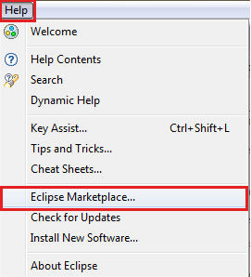
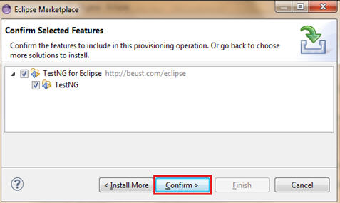
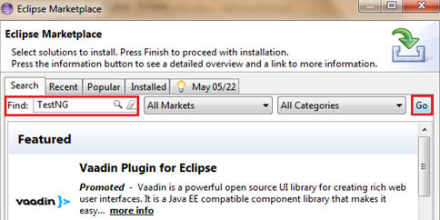
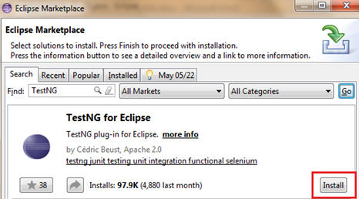
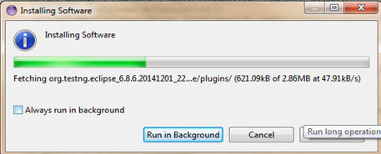

Slide 9
Test NG AnnotationDescription
@BeforeSuite
The annotated method will be run only once before all tests in this suite have run.
@AfterSuite
The annotated method will be run only once after all tests in this suite have run.
@BeforeClass
The annotated method will be run only once before the first test method in the current class is invoked.
@AfterClass
The annotated method will be run only once after all the test methods in the current class have run.
@BeforeTest
The annotated method will be run before any test method belonging to the classes inside the <test> tag is run.

Slide 10
@AfterTest
The annotated method will be run after all the test methods belonging to the classes inside the <test> tag have run.
@BeforeGroups
The list of groups that this configuration method will run before. This method is guaranteed to run shortly before the first test method that belongs to any of these groups is invoked.
@AfterGroups
The list of groups that this configuration method will run after. This method is guaranteed to run shortly after the last test method that belongs to any of these groups is invoked.

Slide 11
@BeforeMethod
The annotated method will be run before each test method.
@AfterMethod
The annotated method will be run after each test method.
@DataProvider
Marks a method as supplying data for a test method. The annotated method must return an Object[ ][ ], where each Object[ ] can be assigned the parameter list of the test method. The @Test method that wants to receive data from this DataProvider needs to use a dataProvider name equals to the name of this annotation.

Slide 12
@Factory
Marks a method as a factory that returns objects that will be used by TestNG as Test classes. The method must return Object[ ].
@Listeners
Defines listeners on a test class.
@Parameters
Describes how to pass parameters to a @Test method.
@Test
Marks a class or a method as a part of the test.

Slide 13
Example
let’s create a sample class whose methods will be unit-tested using testNG.
Below is the sample class we will use in this example.
package com.websystique.testng; public class Calculator { public double add(double a, double b){ return a+b; } public double subtract(double a, double b){ return a-b; } public double multiply(double a, double b){ return a*b; } }

Slide 14
Nothing special about this Calculator class, which provides methods for common arithmetic operations. We will unit test each of these methods.
package com.websystique.testng;
import java.lang.reflect.Method;
import org.testng.Assert;
import org.testng.annotations.AfterClass;
import org.testng.annotations.AfterMethod;
import org.testng.annotations.BeforeClass;
import org.testng.annotations.BeforeMethod;
import org.testng.annotations.Test;
public class TestCalculator {
Calculator calculator;
@BeforeClass
public void beforeClass(){
System.out.println("@BeforeClass: I run only once, before first test start.");
calculator = new Calculator();
}

Slide 15
@AfterClass
public void afterClass(){
//Ideal place to perform some cleanup of setup which is shared among all tests.
System.out.println("@AfterClass: I run only once, after all tests have been done.\n");
calculator = null;
}
@BeforeMethod
public void beforeEachTestMethod(Method method){//Parameter are optional
//May perform some initialization/setup before each test.
//E.g. Initializing User whose properties may be altered by actual @Test
System.out.println("\n@BeforeMethod: I run before each test method. Test to be executed is : "+method.getName());
}

Slide 16
@AfterMethod
public void afterEachTestMethod(Method method){//Parameter are optional
//May perform cleanup of initialization/setup after each test.
System.out.println("@AfterMethod: I run after each test method. Test just executed is : "+method.getName()+"\n");
}
@Test
public void testAdd(){
System.out.println("@Test add");
Assert.assertEquals(calculator.add(2, 3), 5.0);
}
@Test
public void testSubtract(){
System.out.println("@Test subtract");
Assert.assertTrue(calculator.subtract(5, 3) > 1, "Subtract test failed");
}

Slide 17
@Test
public void testMultiply(){
System.out.println("@Test multiply");
Assert.assertEquals(calculator.multiply(5, 3) , 15.0);
}
}

Slide 18
Output
@BeforeClass: I run only once, before first test start.
@BeforeMethod: I run before each test method. Test to be executed is : testAdd
@Test add
@AfterMethod: I run after each test method. Test just executed is : testAdd
@BeforeMethod: I run before each test method. Test to be executed is : testMultiply
@Test multiply
@AfterMethod: I run after each test method. Test just executed is : testMultiply
@BeforeMethod: I run before each test method. Test to be executed is : testSubtract
@Test subtract
@AfterMethod: I run after each test method. Test just executed is : testSubtract
@AfterClass: I run only once, after all tests have been done.
PASSED: testAdd
PASSED: testMultiply
PASSED: testSubtract
===============================================
Default test
Tests run: 3, Failures: 0, Skips: 0
===============================================
===============================================
Default suite
Total tests run: 3, Failures: 0, Skips: 0
===============================================

Slide 19
Suite Test
In TestNG, we cannot define a suite in testing source code, but it is represented by one XML file, as suite is the feature of execution. It also allows flexible configuration of the tests to be run. A suite can contain one or more tests and is defined by the <suite> tag.
<suite> is the root tag of your testng.xml. It describes a test suite, which in turn is made of several <test> sections.
Example:
1.create two classes with name Test1 ,Test2 whose methods will be unit-tested using testing.
2.Configure the suit test in an xml file.
Testng.xml:
<?xml version = "1.0" encoding = "UTF-8"?>
<!DOCTYPE suite SYSTEM "http://testng.org/testng-1.0.dtd" >

Slide 20
<suite name = "Suite1">
<test name = "exampletest1">
<classes>
<class name = "Test1" />
</classes>
</test>
<test name = "exampletest2">
<classes> <class name = "Test2" />
</classes>
</test>
</suite>

Slide 21
Ignore a Test
If a test method is annotated with @Test(enabled = false), then the test case that is not ready to test is bypassed.
Example:
Class Demo
{
String name=“admin”;
@Test(enabled = false)
public void testLogin()
{
System.out.println("Inside Login");
Assert.assertEquals(name,”admin”);
}
}

Slide 22
Group Test
Group test is a new innovative feature in TestNG, which doesn’t exist in JUnit framework. It permits you to dispatch methods into proper portions and perform sophisticated groupings of test methods.
Not only can you declare those methods that belong to groups, but you can also specify groups that contain other groups. Then, TestNG can be invoked and asked to include a certain set of groups (or regular expressions), while excluding another set.

Slide 23
Dependency Test
Sometimes, you may need to invoke methods in a test case in a particular order, or you may want to share some data and state between methods. This kind of dependency is supported by TestNG, as it supports the declaration of explicit dependencies between test methods.
TestNG allows you to specify dependencies either with −
Using attribute dependsOnMethods in @Test annotations, OR.
Using attribute dependsOnGroups in @Test annotations.
Example:
public class Demo2 {
@Test
public void test_login() {
System.out.println("login tested");
}

Slide 24
@Test(dependsOnMethods={"test_login"})
public void test_compose(){
System.out.println("Compose tested");
}
}

Slide 25
Parameterized Tests
Another interesting feature available in TestNG is parametric testing.
Parameterized tests allow developers to run the same test over and over again using different values.
TestNG lets you pass parameters directly to your test methods in two different ways −
With testng.xml
With Data Providers

Slide 26
Example:
public class ParameterizedTest1
{
@Test @Parameters("myName")
public void parameterTest(String myName)
{
System.out.println("Parameterized value is : " + myName);
}
}

Slide 27
Testng.xml
<?xml version = "1.0" encoding = "UTF-8"?>
<!DOCTYPE suite SYSTEM "http://testng.org/testng-1.0.dtd" >
<suite name = "Suite1">
<test name = "test1">
<parameter name = "myName" value="manisha"/>
<classes>
<class name = "ParameterizedTest1" />
</classes>
</test>
</suite>

Slide 28
Passing Parameters with Dataproviders
When you need to pass complex parameters or parameters that need to be created from Java (complex objects, objects read from a property file or a database, etc.), parameters can be passed using Dataproviders.
A Data Provider is a method annotated with @DataProvider. This annotation has only one string attribute: its name. If the name is not supplied, the data provider’s name automatically defaults to the method’s name. A data provider returns an array of objects.
Example:
1.Create a class Calculator.java
public class Calculator {
public int add(int a,int b){
return a+b;
}

Slide 29
2. Create Test Case Class
public class TestCase {
Calculator calc = null;
@BeforeClass
public void create_calcinstance(){
calc= new Calculator();
}
@Test(dataProvider = "dpAdd")
public void test_Add(int a, int b, int Expected_result) {
Assert.assertEquals(calc.add(a,b),Expected_result,"Actual result not equal to Expected result");
}

Slide 30
@DataProvider (name= "dpAdd")
public Object [][] getData(){
Object[][] table = new Object[][]{
{10,30,40},
{50,10,80},
{20,20,40},
{40,50,120},
{34,20,54},
{30,40,234}
};
return table;
}

Slide 31
@AfterClass
public void close_calcinstance(){
calc=null;
}
}

Slide 32
Questions

