Slide 1
Agile

Slide 2
Objectives
After completing the session participants will able to
Overview of Agile and Scrum Methodology
Agile Culture
Agile Mindset
Scrum Framework
How Scrum is deployed and execute in State Street client

Slide 3
What is Agile?
”Agile is an umbrella term used to encompass dozens of different techniques and disciplines (e.g. Scrum, XP, KANBAN, etc.), all aimed at the iterative, incremental development of software.
Agile is about
Agile is NOT about
Collaborative working with Business, Technology and Vendor Partners
Immediate Savings
Iterative, incremental development
Value Driven Development
Regular delivery of Minimum Marketable Features
Replacement for Waterfall
Easy to Implement
Delivering before time
Continuous prioritization of requirements
Taking controls away – scope etc.
Work performed by motivated, self-organizing teams
Cutting Corners
Agile doesn’t guarantee success – it increases the Likelihood of Success

Slide 4
Agile Software Development – Who?
Business
Success of Agile Software Development lies not only with one entity
Success lies in all the three entities coming together and working in close collaboration
It’s a whole team model rather than Us vs. They
Success or Failure of the project depends on the whole team
Technology
Partners

Slide 5
Agile Iron Triangle
Agile will require a fundamental shift for AET and the Business.
In an Agile project, requirements change throughout the project life cycle, in contrast to traditional waterfall projects, where requirements are fully defined at the beginning with intentions to keep them static throughout the project
Requirements (Scope)
Fixed
Time
Resources (Cost)
Value Driven
Plan Driven
Time
Resources (Cost)
Variable
Requirements (Scope)
Requirements are fully specified and fixed
Time to develop solution is projected
Resources vary to reduce cycle time
Requirements specified at high level & prioritize and evolve as project progress
Time boxed development
Resources fixed & managed to deliver at estimated costs
The flexible management of prioritized business requirements is the key to achieving delivery results that meet business needs for the estimated cost

Slide 6
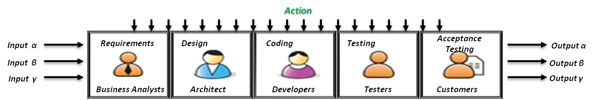





Standing Team – From Project Culture to Team Culture
Become a function with focus on addressing a broader array of erratic project demand challenges and support long-term growth objectives. (i.e., a complete customer-centric feature, across all components and disciplines).
EXISTING
Team ramp-up and ramp-down as project progress
Team dismantled after project completion
The visibility for any role is restricted only to the stage where they play a primary role
TRANSITION TO
LONG LIVED STANDING TEAM
Continuously working on backlog of work items and not on any projects)
Self Organizing, Cross functional team members
High visibility on project progress to all team members
Collaborative ways of working
Frequent Delivery
Input β
Output β
What it means:- Bring projects to Agile team rather than bringing teams to the project.

Slide 7
Agile
Agile Manifesto

Slide 8
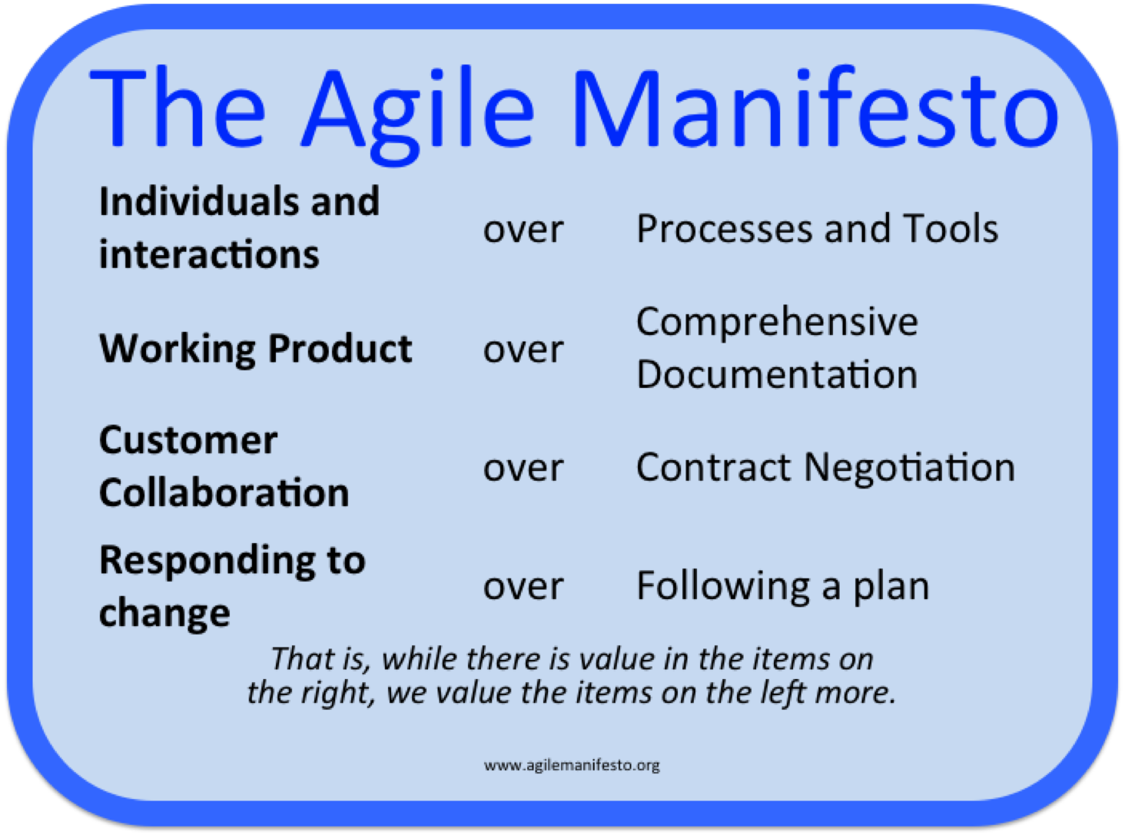
Agile Manifesto – Agile Values

Slide 9
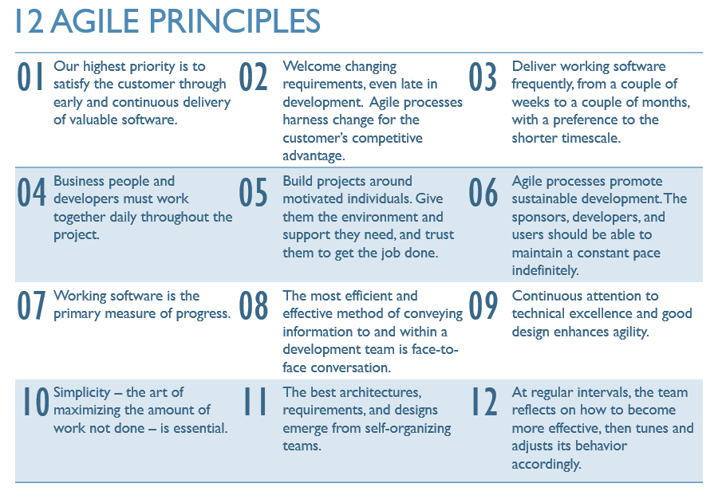
Agile Principles

Slide 10
Scrum Framework
What is Scrum?

Slide 11
What is Scrum?
Scrum teams deliver value incrementally and iteratively.
Incremental Development
Incremental development is to build small increment of a full fledges product. Each increment adds more software value – like Adding package to a Software Product. After lot of increments, you have got a big Software Product.
Iterative Development
Iterative development is to build something, to get some feedback, then refine it to make better, keep doing that until the product is good enough.

Slide 12

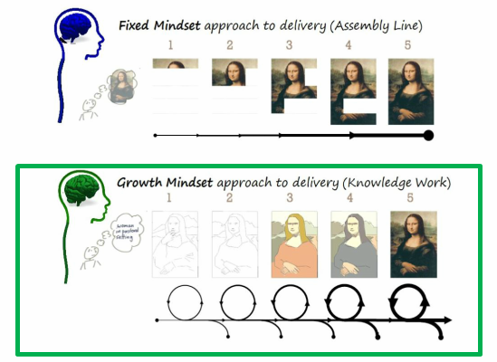
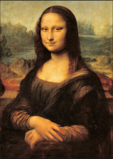


Agile Mindset -S
2. When can you ship it?
1. How to manage uncertainty (scope, technology, etc.)?
Manager
start
2. Only at the end!
1. Need to know everything upfront
Goal
1. Let’s figure out together
2. Any time!
Notes:
Fixed and Task-Oriented Mindset:
1. Need to know everything upfront before starting because we are afraid of handling ongoing changes. “I don’t know what to build”, thus forcing customer to “tell me everything upfront”. This mindset results in:
Limited innovation or exploration in order to succeed
No change possible
2. Even though we can produce incremental deliveries we cannot ship it until everything is build.
Knowledge & Growth Mindset:
1. Figuring out what we need by building things together. Also, we concentrate on Learning & Discovery.
For example when we start writing an article we don’t know exactly the outcome, only certain ideas. We write a draft and through iterations of updates improve it. Using boundaries we can determine when we are done, i.e. the best I can do now, good enough, etc.
2. We value not just incremental deliveries, but also ability to ship it to the customer for adoption !!!

Slide 13
Scrum Framework
Scrum Roles

Slide 14

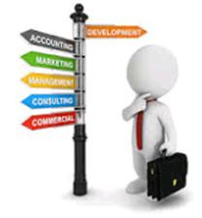








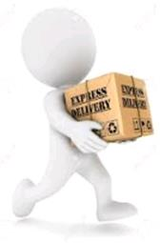



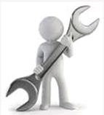

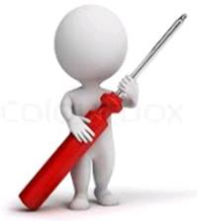


Roles of Scrum
Business Sponsor
Agile Coach
SRT team
Business Integration
SME
Scrum Master:
Who will help us?
Business Unit 1
IT Deployment
Manager
Business Unit 2
Product Owner:
Decides what we are building
Self Organizing Team:
How will we build it incrementally?
Delivery Manager
Core SCRUM Team
Business Unit 3
Support
Architecture Lead
QA Manager
Domain Expert
Notes:
Product Owner:
Traditionally the customer.
PO is single point of contact for the team to the various business units and the stakeholder community.
More commonly someone who is delegated to serve the role.
Creates high level Business Process Model (BPM).
Continuously creates and prioritizes epics and stories in the product backlog to reflect the latest need.
Has a responsibility to provide establish priority in a way that allows the team to maximize value achieved.
Creates releases roadmap in order to delivery business process improvements.
Responsible for selecting the work for an iteration in manner that does not exceed team’s velocity.
Participates in a project full-time.
Should be a good collaborator and courageous.
Scrum Master:
Facilitates the Scrum process.
Servant to the Team and Product Owner.
Mentor in the creation of stories and maintenance of the backlog.
Owner of the empirical governance process.
Shields the team from external interference and distractions to keep it in group flow (a.k.a. the zone).
Enforces time boxes.
Keeps Scrum artifacts visible.
Promotes improved engineering practices.
Remover of obstacles and barriers.
Self Organizing Team:
A cross functional team responsible for the implementation and testing of stories in the back log.
The responsibilities of Tester, Developer and Business Analyst are preferably shared.
Owner of velocity.
Has a responsibility to optimize both velocity and quality for the purpose of maximizing return of investment over the life of the software project.
Typical team size is 5 to 9 members.

Slide 15
Scrum Framework
Scrum Artifacts

Slide 16
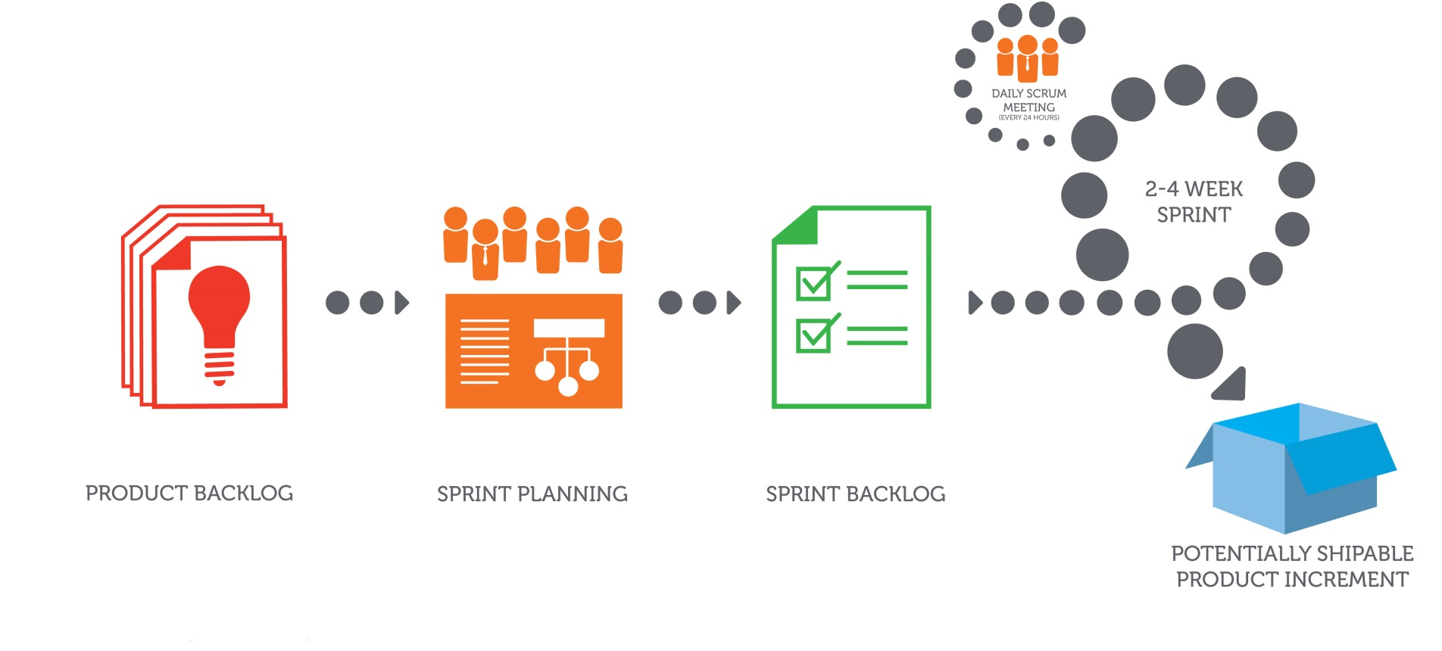
Scrum Artifacts
Notes:
Scrum Artifacts:
Product Backlog
Sprint Backlog
Potential Shippable Product Increment
Product Backlog:
The Product Backlog is an ordered list of everything that might be needed in the product and is the single source of requirements for any changes to be made to the product. The Product Owner is responsible for the Product Backlog, including its content, availability, and ordering. Items in the product backlog are called “Product Backlog Items (PBI)”.
Each product backlog item would have
Description – Details of the item
Value – What business value this item would provide
Estimate – Effort estimate to build this item
Order – The order in which the items should be worked in
Product Backlog contains all items required to accomplish the product vision
Sprint Backlog:
The Sprint Backlog is the set of Product Backlog items selected for the Sprint, plus a plan for delivering the product Increment and realizing the Sprint Goal.
The Sprint Backlog is a forecast by the Development Team about what functionality will be in the next Increment and the work needed to deliver that functionality into a “Done” Increment.
Potential Shippable Product Increment:
Every sprint produces a product increment, the most important scrum artifact. A product increment is the “goal line” for each sprint and, at the end of the sprint, it must:
Be of high enough quality to be given to users
Meet the scrum team’s current definition of done
Be acceptable to the product owner with properly tested, completed in full shape and ready to use.

Slide 17
Scrum Framework
Scrum Ceremonies

Slide 18
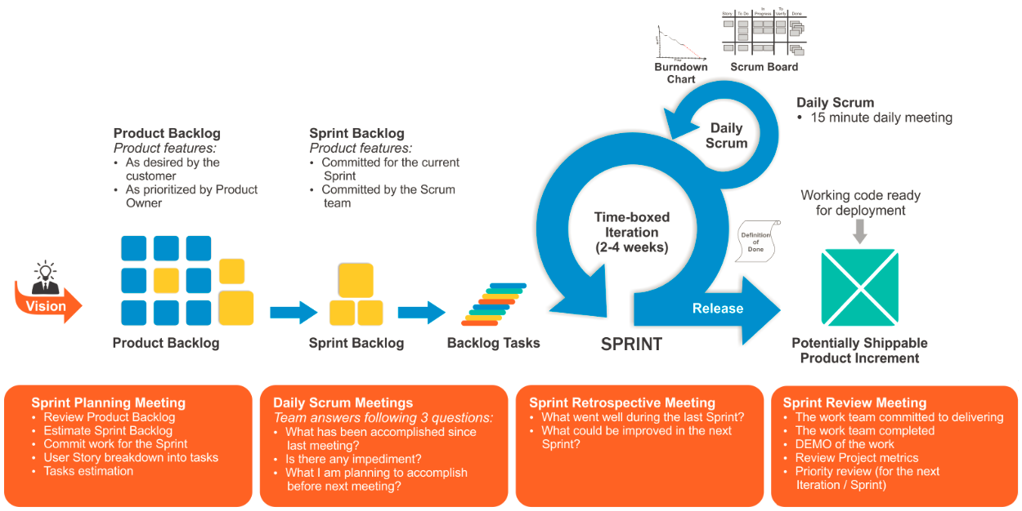
Scrum Ceremonies

Slide 19
Agile
Agile Customer Perspective

Slide 20





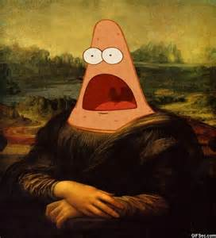







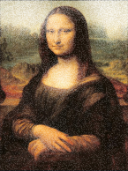
History of Agile at State Street
SDLC | Customer has a need | Requests to address it
Traditional Approach (Waterfall)
Discovered Approach (Agile)
Various departments and organizations work on it separately
Sometime later customer gets a result often too late or not what they wanted
Documents Writer
Requirements
Architect
Design
Builder
Implementation
Quality
Control
Customer
(Product Owner)
Verification
Product Owner
Team & Product Owner work on it incrementally together
Customer gets final product
Team
Product Owner
Scrum Master
Customer
(Product Owner)
Product Owner
Notes:
State Street is undergoing a significant Transformation that is heavily dependent on Information Technology. State Street initiated a review of its methodologies for Software Development Lifecycle Management in Q2’ 2013. The analysis resulted in a recommendation to implement a customized version of Agile called Industrialized Agile. State Street ADM organization has initiated pilots and found Agile to be very effective.

