Slide 1
Introduction to Software Engineering
Software Engineering Introduction

Slide 2
Version Control and Revision History
 | Name | Date
Prepared By | Manisha Mane | 27-Jul-2018
Reviewed By | Nisha Mendonsa | 27-Jul-2018
Approved By | Gauresh Gaitonde | 27-Jul-2018
Version No. | Date | Section Affected | Highlight of Changes
1.0.0 | 01-Mar-2017 | All | Original Version
2.0.0 | 27-Jul-2018 | None. | Annual Review 2018. No changes made.

Slide 3
Objectives
After completing the session participants will able to
To introduce Software Engineering
Make participants familiar with Software Development Life Cycle
Understand and Compare different Process Models

Slide 4
Content
Software
  Definition
  Classification
Software Engineering
  Definition
SDLC
  Phases
  Process Models

Slide 5

Software
Definition :
  Set of programs used to complete a desired task using computer.
  Consist of Front End and Back End.
  Group of Components.
  Software As A Services
Notes:
There are many definitions of Software.
We will look at them at Evolution View Point.
When Automation Started in 1970s using Mainframe System a software is defined as set of programs.
As per the client server architecture a software is consist of Front End and Back End.

Slide 6
Software
Qualities :
  User’s point of view
    Reliable
    Efficient
    Easy to Use
  Developers point of view
    Verifiable
    Maintainable
    Portable
    Extensible
    Productive
    Customizable
    Easy to Control
Notes:
There are many definitions of Software.
We will look at them at Evolution View Point.
When Automation Started in 1970s using Mainframe System a software is defined as set of programs.
As per the client server architecture a software is consist of Front End and Back End.

Slide 7
Classification of Software
Software
System Software
Application Software
Operating System
User Program
Software Product
Device Drivers
Tools and Utilities
DBMS
Notes:
System Software interacts with Hardware Devices and provide Services to other applications
Application Software are used by end used to complete a specific task
User Programs are the Software Solutions developed as per the user requirements
e.g. Payroll System, Inventory System, Banking Systems, etc.
Software Product are the Off-the-Shelf applications available in the market
e.g. Tally, MS-Office, etc.

Slide 8
What is Software Engineering?
The systematic approach to the development, operations and maintenance of the software.
Systematic and process oriented way of developing software
Software engineering covers technical and management aspects of development

Slide 9
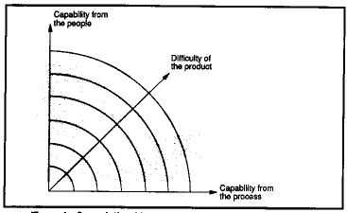
3Ps of Software Engineering
People - Find people who know the product and can work in the process
Process - How we go from the beginning to the end of a project
Product - The product is the result of a project

Slide 10
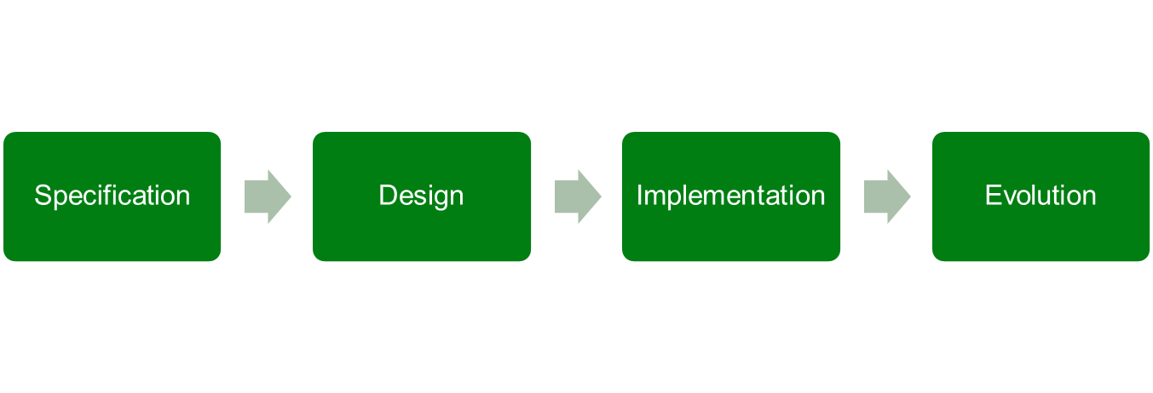
Software Development Life Cycle
A set of activities whose goal is the development or evolution of software
Generic activities in all software processes are:
Notes:
Specification - what the system should do and its development constraints
Development - production of the software system
Validation - checking that the software is what the users want
Evolution - changing the software in response to changing demands

Slide 11
The Software Development Lifecycle
Lifecycle is an orderly set of activities conducted and managed for each development project.
All development follows a software development lifecycle, which defines:
  The modeling approach taken (object approach or structured approach).
  The order (or phases) for carrying out activities which in turn defines:
    What development artifacts are to be delivered and when.
    Resource allocations.
    How to measure and monitor project progress.
    Deployment, training and maintenance.
    Guide to planning future projects

Slide 12
Life Cycle for Software Development
Problem
Definition
activity
System
Development
activity
System
operation
activity
Planning
Analysis
Design
Implementation
Testing
Coding
Notes:
There are several representation of SDLC

Slide 13

Development Activities
Specification
What is must do
Requirements
What it mustn’t do
Design
Functional Requirements
Non Functional Requirements
Architecture
Functional components
Maintenance
Coding
Bug fixes
New features
New platforms
Versions
Individual components
Synergy
Testing
Black-box testing
Deployment
White-box testing
Acceptance
Packaging
Marketing
Acceptance testing
Documentation
Integration
Requirements and specification
OS variations
Design decisions
Interworking
User documentation
Communication
Notes:
Functional requirements
Functional user requirements may be high-level statements of what the system
should do; functional system requirements should describe the system
services in detail
Examples
The user shall be able to search either all of the initial set of databases or
select a subset from it
The system shall provide appropriate viewers for the user to read documents
in the document store
Non-functional requirements
Requirements which specify that the delivered product must behave in
a particular way, e.g. execution speed, reliability etc.

Slide 14

Who are involved…………
Project
Manger
Support
Team
Business
Analyst
User
Software
Development
Tester
Technical
Architect
Developer
Configuration
Manager
Notes:
Functional requirements
Functional user requirements may be high-level statements of what the system
should do; functional system requirements should describe the system
services in detail
Examples
The user shall be able to search either all of the initial set of databases or
select a subset from it
The system shall provide appropriate viewers for the user to read documents
in the document store
Non-functional requirements
Requirements which specify that the delivered product must behave in
a particular way, e.g. execution speed, reliability etc.

Slide 15
SDLC Phases

Slide 16
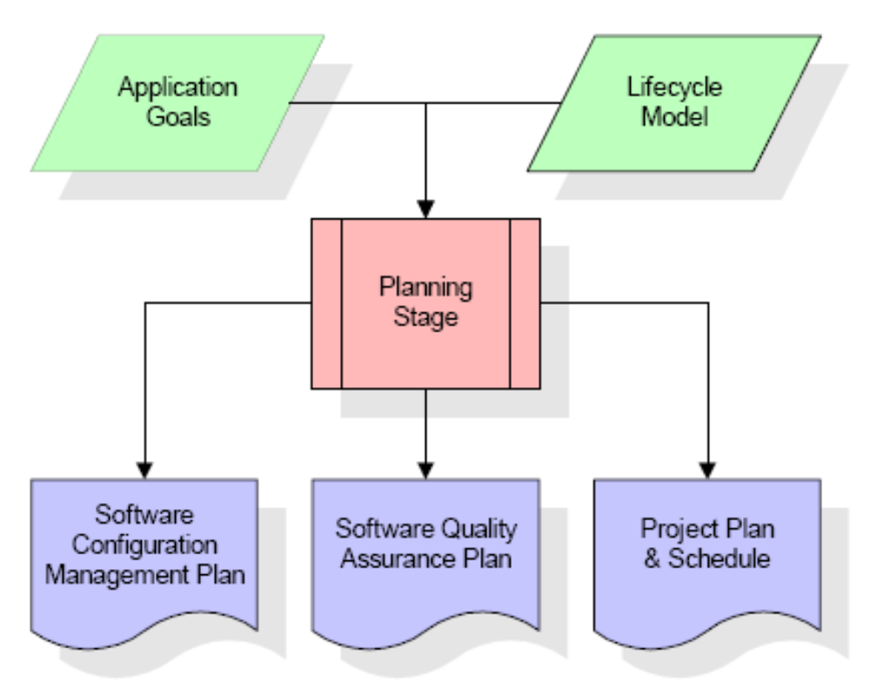
Planning Stage
Notes:
software configuration management (SCM) is the task of tracking and controlling changes in the software. Configuration management practices include revision control and the establishment of baselines.
SCM concerns itself with answering the question "Somebody did something, how can one reproduce it?" Often the problem involves not reproducing "it" identically, but with controlled, incremental changes.
Software Quality Assurance (SQA) consists of a means of monitoring the software engineering processes and methods used to ensure quality. It does this by means of audits of the quality management system under which the software system is created. These audits are backed by one or more standards, usually ISO 9000
A project plan is "A formal, approved document used to guide both project execution and project control. The primary uses of the project plan are to document planning assumptions and decisions, facilitate communication among stakeholders, and document approved scope, cost, and schedule baselines. A project plan may be summary or detailed."

Slide 17
Business Analysis Phase
During this phase, the business analysis or requirements analysis is done.
This includes:
  Requirement Anticipation
  Requirement Determination
  Requirement Specification
GAP Analysis
Notes:
Done Business Analyst
Requirement Anticipation – Identify End User, Process, Documents, Market Survey
Requirement Determination – Done by different Fact Finding Techniques
Requirement Specification – SRS/BRD

Slide 18
System Design
Blueprint of System
POC
Prototype
Designs include:
  High Level Design / Architectural Design
  Low Level Design / Detailed Design

Slide 19
Testing
Unit Testing
System Testing - exercise new code in combination with code that already has been integrated.
User Acceptance Testing
Notes:
? Implementation means:
coding, testing, and debugging individual software components
integration of the software components system test.
Deliverable: working software system.
The phase in the software life-cycle where the actual software is implemented. The result of this phase consists of source code, together with documentation to make the code more readable.

Slide 20
Integration and Deployment
Incremental development implies incremental integration and deployment of software modules.
Module integration must be carefully planned:
  Main Difficulty
    Intertwined circular dependencies between modules.
    OO systems must be designed for integration and deployment.
      Modules should be as independent as possible.

Slide 21
Operation & Maintenance
Operation signifies changeover from the existing business solution.
Maintenance accounts for near about 75% of lifecycle time.
  Housekeeping-
    Routine maintenance tasks necessary to keep the system both operational and accessible to users.
  Adaptive maintenance-
    Monitoring and auditing the system’s operation, adjusting its functionality, adapting it to meet performance targets.
  Perfective maintenance-
    Redesign/ modify the system to accommodate new requirements.

Slide 22
Evolution
Changing the software to fix defects meet new requirements.
Most development today is really evolution.
Differs from initial development-
  Significant investment in existing code.
  Many SE techniques focus on making evolution easier.

Slide 23
Quality Control Vs Quality Assurance
Quality Control – ensure to produce right product
  Uses different test strategies
Quality Assurance – ensure to follow right way
  Uses different process models and audits

Slide 24
What is a software process model?
A simplified representation of a software process, presented from a specific perspective
Examples of process perspectives are
  Workflow perspective - sequence of activities
  Data-flow perspective - information flow
  Role/action perspective - who does what
Generic process models
  Waterfall
  Evolutionary development
  Formal transformation
  Integration from reusable components

Slide 25
SDLC Models
Linear Models
  Waterfall Model
  V-shaped Model
Iterative and Incremental Model

Slide 26
SDLC Models
Waterfall Model

Slide 27
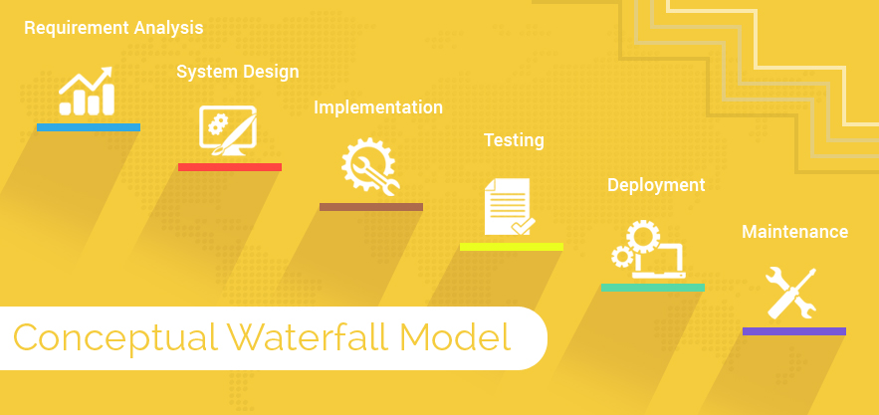
The SDLC Waterfall Model

Slide 28
The SDLC Waterfall Model
Project planning:
Allocate resources, complete specification of the software system.
O/P => Project Plan
Requirement:
Defines needed information, function, behavior, performance and interfaces.
O/P => System Requirement Specification
Design:
Data structures, software architecture, algorithmic details.
O/P => Architectural Design

Slide 29
The SDLC Waterfall Model
Development:
Source code, database, user documentation, unit testing.
Integration & Testing:
Check that modules interconnect correctly.
Installation & Acceptance:
When a software has been built and completed, installing the software & delivering to client.

Slide 30
Advantages of Waterfall Model
Easy to understand, easy to use.
Provides structure to inexperienced staff.
Milestones are well understood.
Good for management control (plan, staff, track).
Works well when quality is more important than cost or schedule.

Slide 31
Deficiencies of Waterfall Model
All requirements must be known upfront.
Deliverables created for each phase are considered frozen- inhibits flexibility.
Can give a false impression of progress.
Integration is one big bang at the end.
Little opportunity for customer to preview the system (until it may be too late).

Slide 32
When to use the Waterfall Model
Requirements are very well known.
Product definition is stable.
Technology is understood.
New version of an existing product.
Porting an existing product to a new platform.

Slide 33
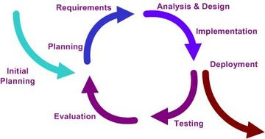
Iterative and incremental development
Iterative and Incremental development is a cyclic software development process developed in response to the weaknesses of the waterfall model. It starts with an initial planning and ends with deployment with the cyclic interaction in between.

Slide 34
Iterative Model Weaknesses
Requires good planning and design.
Requires early definition of a complete and fully functional system to allow for the definition of increments.
Well-defined module interfaces are required.
Total cost of the complete system is not lower.

Slide 35
When to use the Iterative Model
Risk, funding, schedule, program complexity, or need for early realization of benefits.
Most of the requirements are known up-front but are expected to evolve over time.
A need to get basic functionality to the market early.
On projects which have lengthy development schedules.
On a project with new technology.

Slide 36
Classical Models Vs Iterative Models
With Classical Models a phase needs to be completed before starting next one
Iterative model allows to take small set of requirements and complete them
Classical Models are suitable for Structure System Analysis and Design
Iterative Model complements Object Oriented Analysis and Design (Component Based Software Engineering)

Slide 37
Linear Vs Iterative
Key idea is to get changes approved by the client on a short timescale
  Avoid mis-understandings propagating down the process.
  Change can give the illusion of progress…
  Needs lots of client involvement and enthusiasm.
  …but constantly having new things to show will help do this.
  Getting the architecture wrong is disastrous- but that’s true of any process.
Rapid prototyping means you don’t proceed without an implementation having been seen by the client
  Client knows what they’ll get- or at least what it’ll look like
  No route to later stages in the process except through concrete demonstration
Notes:
1)The waterfall life cycle model is the most traditional of them all. This model has a top-down, or linear, ordering to it. Normally no phase is repeated, however, there may be overlapping between the different phases if necessary. Generally, the output of each stage becomes the input for the next.
2)The incremental build life cycle model provides progressive development of operational software, with each release adding new capabilities. It is unique from the spiral life cycle in that it divides the product into builds, where sections of the project are created and tested separately.
3)The rapid application development (RAD) life cycle model focuses on building applications in a very short amount of time with compromises in usability, features, and/or execution speed. The emphasis on speed helps ensure that clients’ requirements do not change before the cycle is complete, as was often the case when applying the waterfall life cycle model in the past.

Slide 38
So which Lifecycle is correct?
Does everyone understand the goals?
  Do we need a prototype to get things straight?
  Do the users need to see what they might get in order to decide what they want?
How dynamic is the organization?
  Will requirements change over the course of development?
  Will they ever be fixed?

Slide 39
Iterative Incremental Model Strengths
Develop high-risk or major functions first.
Each release delivers an operational product.
Customer can respond to each build.
Uses “divide and conquer” breakdown of tasks.
Initial product delivery is faster.
Customers get important functionality early.
Risk of changing requirements is reduced.

Slide 40
So which Lifecycle is correct?
Will the project be long-lived?
  Does it justify large-scale investment of time on management?
What level are the users?
  Can they do their own maintenance?
Is there substantial risk in decisions?
  Do we have the information to make them?
  What is their impact?

Slide 41
Comparison of Waterfall and Agile Model

Slide 42
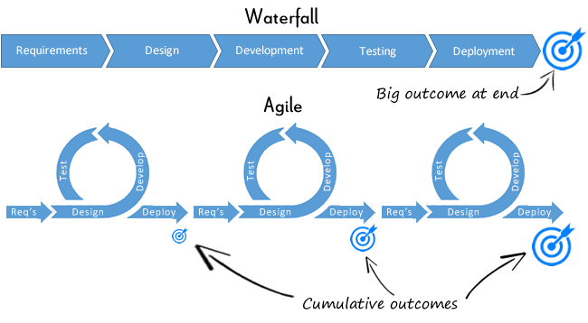
Comparison of Waterfall and Agile

Slide 43
Agile Iron Triangle
Agile will require a fundamental shift for AET and the Business.
In an Agile project, requirements change throughout the project life cycle, in contrast to traditional waterfall projects, where requirements are fully defined at the beginning with intentions to keep them static throughout the project
Requirements (Scope)
Fixed
Time
Resources (Cost)
Value Driven
Plan Driven
Time
Resources (Cost)
Variable
Requirements (Scope)
Requirements are fully specified and fixed
Time to develop solution is projected
Resources vary to reduce cycle time
Requirements specified at high level & prioritize and evolve as project progress
Time boxed development
Resources fixed & managed to deliver at estimated costs
The flexible management of prioritized business requirements is the key to achieving delivery results that meet business needs for the estimated cost

Slide 44
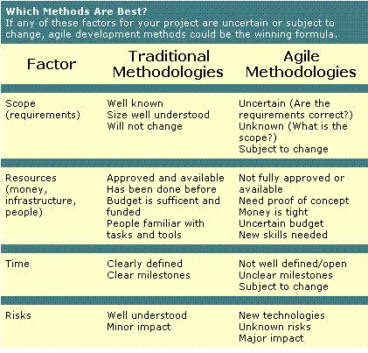
Comparison of Waterfall and Agile

