Slide 1
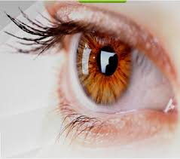
“Multimodal detection of glaucoma using deep learning on data from the UK Biobank”
Swarnalata Patra
Masters in Artificial Intelligence
Computer Science Dept., Leuven.

Slide 2


Internship in VITO
Flemish research organisation in Mol, Belgium.
Health unit of VITO
Work on solutions for better and earlier detection of retinal diseases such as diabetic retinopathy, glaucoma, etc.

Slide 3
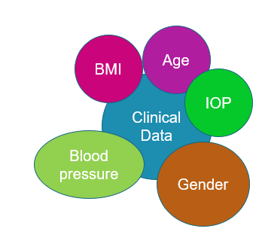

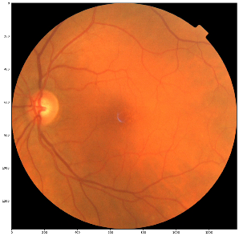
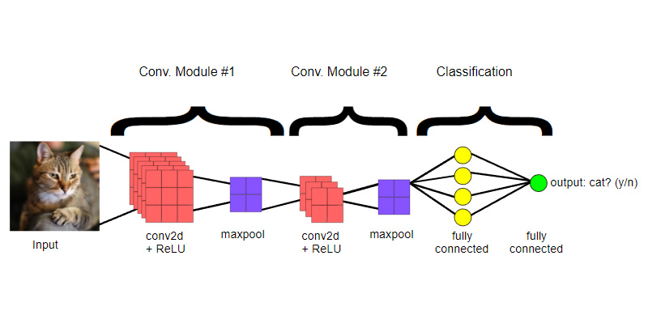

Motivation
Corneal hysteresis
State-of-the-art performance of accuracy 98% with deep CNN [1]
References:
[1] U. Raghavendra, H. Fujita, S. V. Bhandary, A. Gudigar, J. H. Tan, and U. R. Acharya. Deep convolution neural network for accurate diagnosis of glaucoma using digital fundus images.

Slide 4
Hypothesis
Combining meta-information along with fundus images will improve the performance of glaucoma detection.
Which metadata are most useful ?
Multi-modal Approach
Screening Context

Slide 5
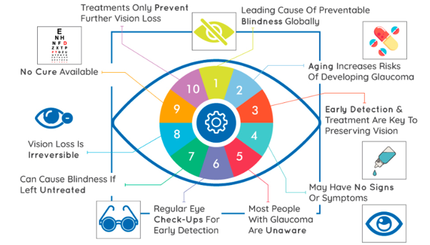
What is Glaucoma ?
References:
R. et al. Who | glaucoma is second leading cause of blindness globally. https://www.who.int/bulletin/volumes/82/11/feature1104/en/.

Slide 6
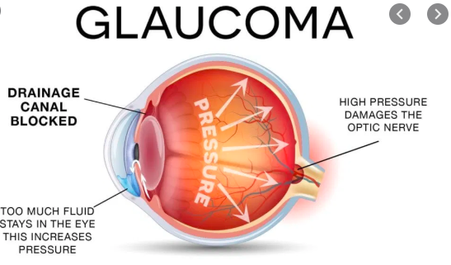
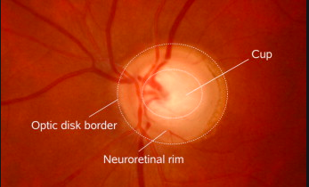
Causes of Glaucoma
Detection using color Fundus images.
Larger CDR value indicates increased risk of glaucoma.
Structure Driven ~vs~ Data driven

Slide 7

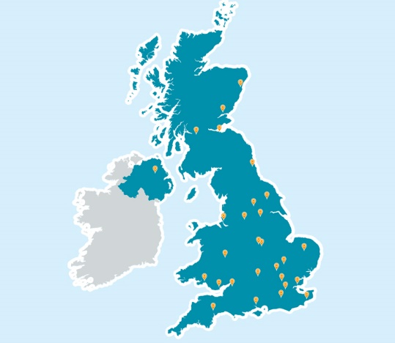
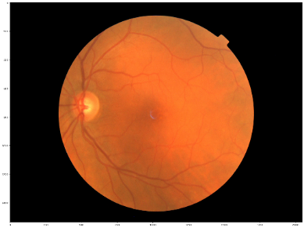
UK Biobank Data (1/3)
Supported by the National Health Service (NHS).
Aims to improve the prevention, diagnosis and treatment of a wide range of serious and life-threatening illnesses.
85730 participants (UK Residents, age-group 40-69).
Data collected from 22 assessment centres over a span of multiple visits.
598 unique features for each patient.
Diagnosed diseases
Self-reported Questionnaires
Meta-data

Slide 8
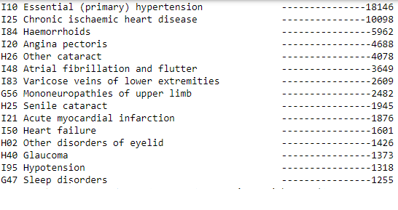


UK Biobank Data (2/3)
Most Frequently Occurring Diseases (Diagnosed):
International Statistical Classification of Diseases (ICD10)

Slide 9
UK Biobank Data (3/3)
“Has a doctor told you that you have following problem with your eyes?”
Possible Explanations:
Missing / poor-quality fundus images – incorrect diagnosis.
Diagnosis was not performed.
Glaucoma surgeries.
1783 patients reported glaucoma.
1653 of those reported an age when glaucoma was diagnosed.
1975 reported which eye was infected by glaucoma.
26 patients reported at least one of their eyes was operated for glaucoma

Slide 10
Implementation strategy:
1. Ground truth creation
2. Data pre-processing
3. Feature Importance
5. Multi-modal Approach:
Combining important features with CNN model predictions
4. CNN Model

Slide 11
Implementation strategy:
1. Ground truth creation
2. Data pre-processing
3. Feature Importance
5. Multi-modal Approach:
Combining important features with CNN model predictions
4. CNN Model

Slide 12
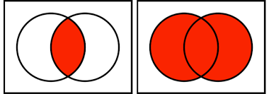
Ground truth Creation
intersection
union
ICD10
Self-
reported
Self-
reported
ICD10
Why Union ?
minimize the chance of missing glaucoma patients.
claiming glaucoma patients as healthy is more dangerous.
less imbalance in class distribution
Huge Imbalance Ratio: 2253 glaucoma patients
83477 healthy participants

Slide 13
Implementation strategy:
1. Ground truth creation
2. Data pre-processing
3. Feature Importance
5. Multi-modal Approach:
Combining important features with CNN model predictions
4. CNN Model

Slide 14
Data Pre-processing(1/2)
Train-validation-test split (60-20-20) for meta information and fundus images on a patient level.
Meta-data:
One-hot label encoding.
13 columns giving definite glaucoma information are dropped.
Ex – which eye had glaucoma, whether patient had glaucoma surgery, etc.

Slide 15

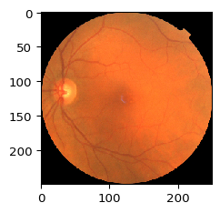
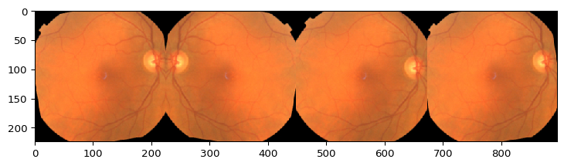
Data Pre-processing(2/2)
Fundus Images:
(250x250x3)
Opencv
contours
imgaug
(224x224x3)
each

Slide 16
Implementation strategy:
1. Ground truth creation
2. Data pre-processing
3. Feature Importance
5. Multi-modal Approach:
Combining important features with CNN model predictions
4. CNN Model

Slide 17
Feature Importance(1/3)
Aim: Find out features that are important for glaucoma detection.
RFC trained with 585 features
AUC = 0.519
Importance values computed
(ranks features by how well
they improve node purity.)
40 most important features selected
New RFC trained with 40 features
AUC = 0.527

Slide 18
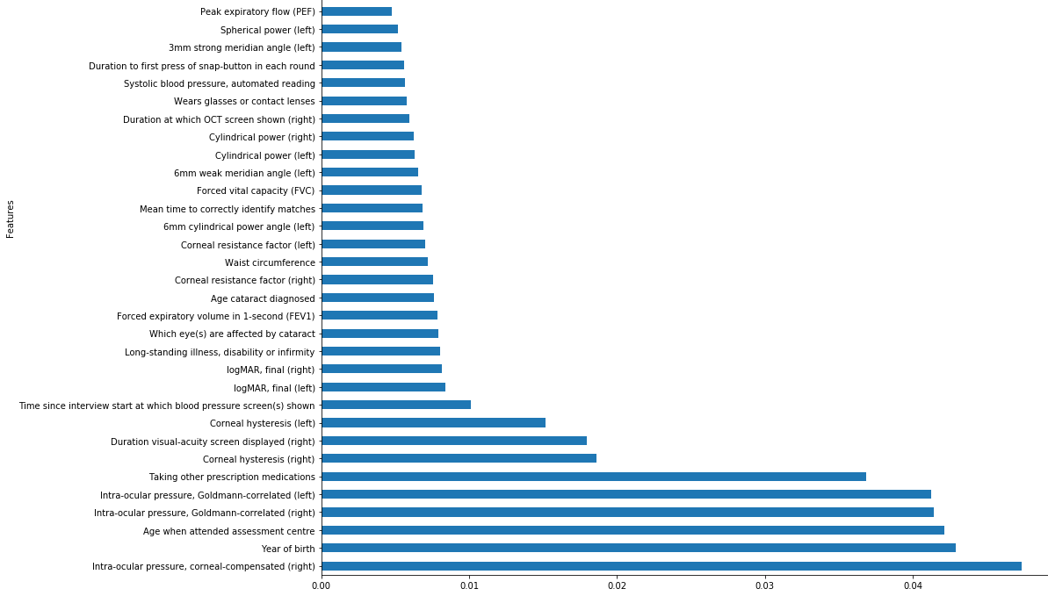
Feature Importance (2/3)
Feature importance plot

Slide 19
Feature Importance(3/3)
1. Present in ophthalmologists records:
Age, IOP, corneal hysteresis, corneal resistance factor.
2. Relevant features not in specialists records:
Waist circumference, blood pressure, age when started smoking, peak expiratory flow(PEF), force vital capacity(FVC)
3.Probably implies Glaucoma:
Other prescription medications, long standing illness.
4.Not so relevant:
Duration of screen displayed, wears glasses, spherical power, meridian angle

Slide 20
Implementation strategy:
1. Ground truth creation
2. Data pre-processing
3. Feature Importance
5. Multi-modal Approach:
Combining important features with CNN model predictions
4. CNN Model

Slide 21
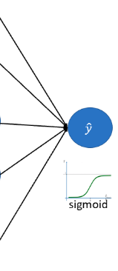







CNN Model (1/2)
(224x224x3)
Mobile-net v2
.
.
..
.
G
Global average pooling
7x7
x1024
NG
78
Trained using left and right eye fundus images.
Binary cross-entropy, Adam optimizer.
Model trained multiple times – with gradually imbalance data and class weights.

Slide 22
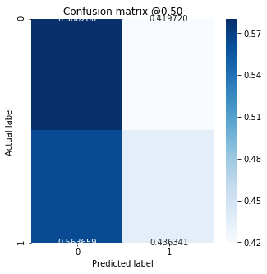
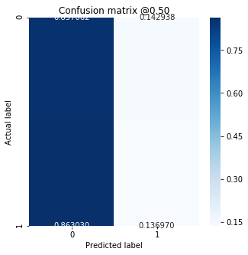
CNN Model (2/2)
AUC of 0.694 on validation data.
Image level predictions to patient level.
AUC of 0.496, which is below the performance of a random predictor.
Any misclassification in image-level is penalized twice in patient level.
Image-level
Patient-level

Slide 23
Implementation strategy:
1. Ground truth creation
2. Data pre-processing
3. Feature Importance
5. Multi-modal Approach:
Combining important features with CNN model predictions
4. CNN Model

Slide 24
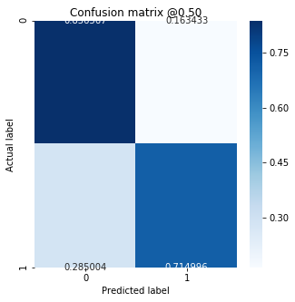
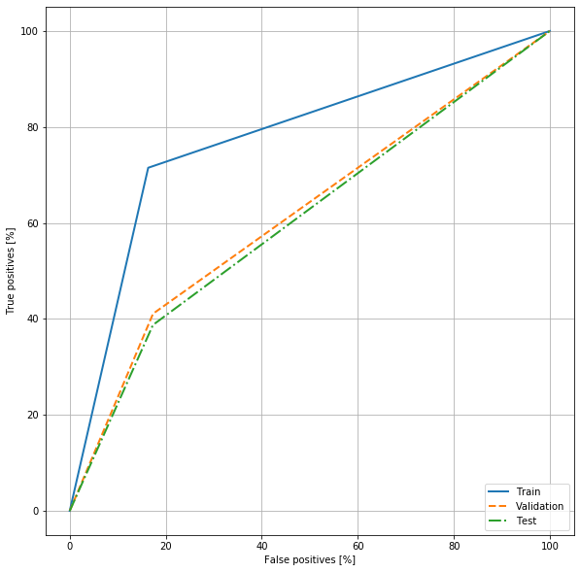
Multimodal deep learning model
CNN model output.
AUC = 0.496
Metadata – imp. features like age, IOP, etc
AUC = 0.527
Model with AUC 0.611 with 11.5% improvement in performance over CNN model.

Slide 25
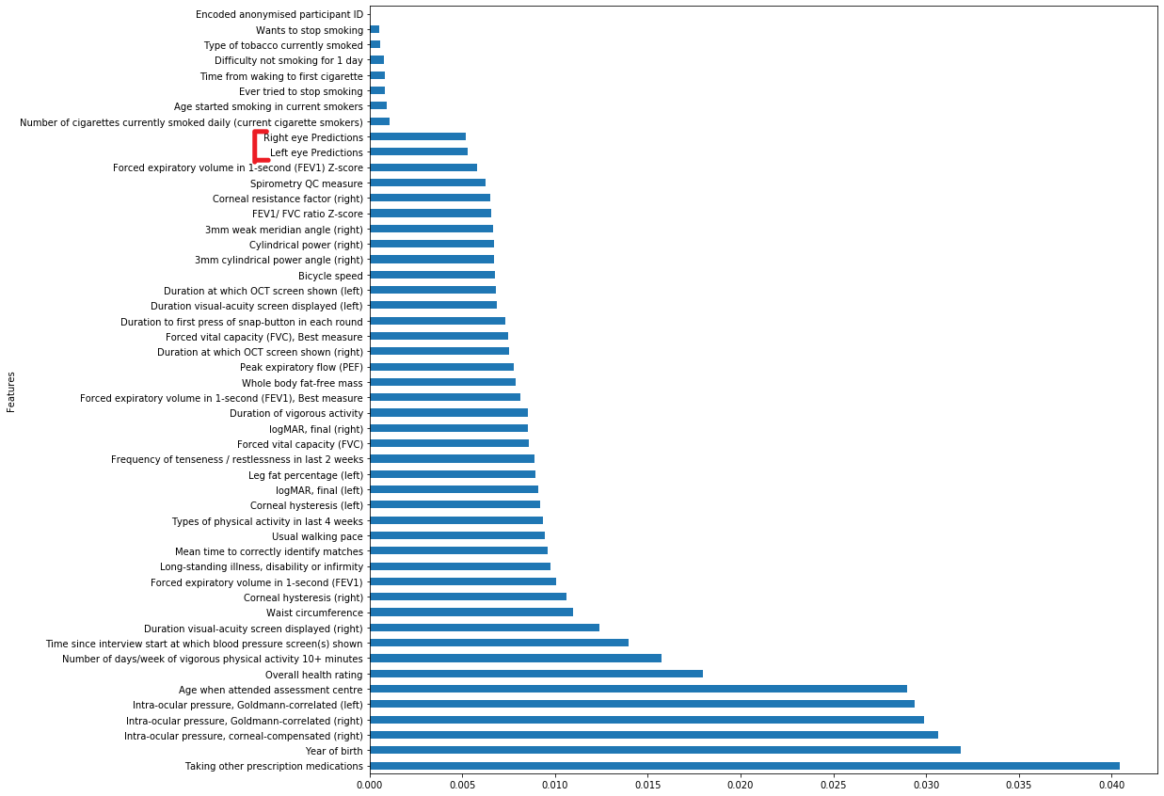
Feature importance plot
with CNN model predictions
CNN predictions have less
Importance value than expected.

Slide 26
Challenges & Future work
Challenges:
Scope for Future Work:
We can filter out correlated features for computing feature importance.
Hyper-parameter tuning for improving CNN model predictions.
Better ground truths by hiring specialists.
OCT images and fundus images together.
1
Poor CNN model performance.
2
Unreliable Ground truth.
3
Imbalance class distribution.

Slide 27
Conclusion & Remarks
Hypothesis proved:
Combining meta information with CNN model predictions with fundus images, improves the performance from an AUC of 0.496 to 0.611.
Contributions:
Interesting meta-information helpful for glaucoma detection.
Glaucoma detection in screening context.
Reducing loads on doctors by multimodal approach.

Slide 28
Thank you for listening !! ☺

Slide 29
“Multimodal detection of glaucoma using deep learning on data from the UK Biobank”
Swarnalata Patra
Masters in Artificial Intelligence
Computer Science Dept., Leuven.

