Slide 1

EXPLORATORY DATA ANALYSIS - RETAIL
BY
SWARNASHEE DUTTA

Slide 2
ABOUT THE DATASET:
This dataset consists of 9995 rows and 13 columns.
ATTRIBUTES:
Ship Mode
Segment
City
State
Region
Category
Sales
Quantity
Discount
Profit
Main problem statement: How can weak areas(less profitable area) make more profit.?
The data is to be analysed for desired purposes and analysis is to be presented in form of dashboard by Ms Excel.

Slide 3
OBJECTIVES:
From this point of view how can investor increase their profit up to a standard level:
1. To find out the region wise sum of sales of product, by using category.
2. To find top 3 city in terms of highest profit and sales.
3. To find category wise percentage of profit contribution for each region.
4. To find in terms of low performance(negative profit), bottom 5 state and city.
5. To find out sum of discount of all category wise product.
6. To find most usage ship mode.

Slide 4
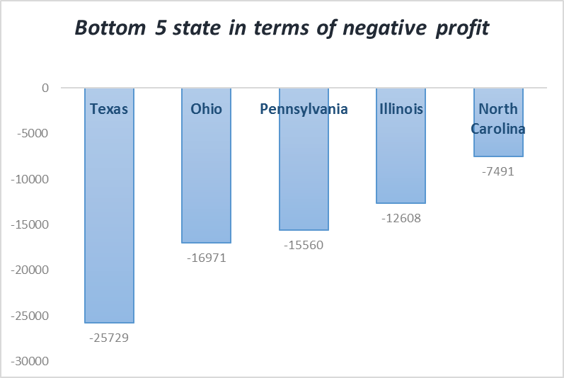
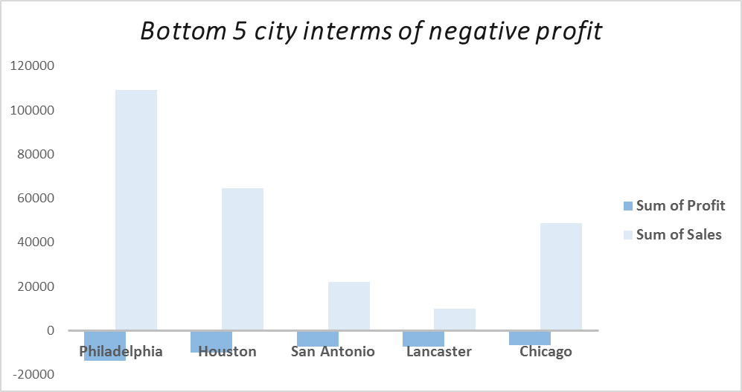
KEY FINDINGS:
As can be seen from column chart Texas is highest in terms of negative profit, followed by Ohio, Pennsylvania and rest.
In next column chart we can see that, at city level Philadelphia’s performance is very low followed by Houston and rest, though their sales is quite good.

Slide 5
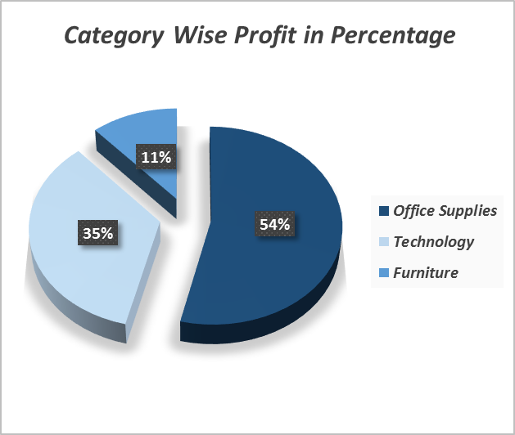
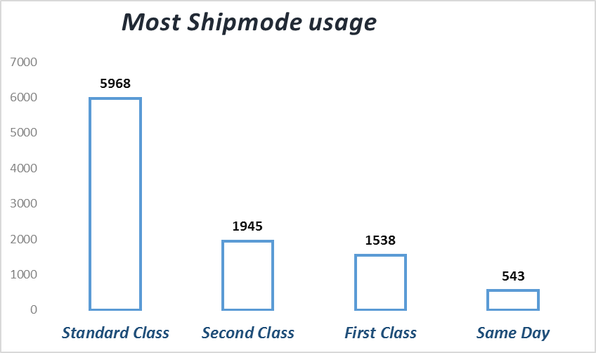
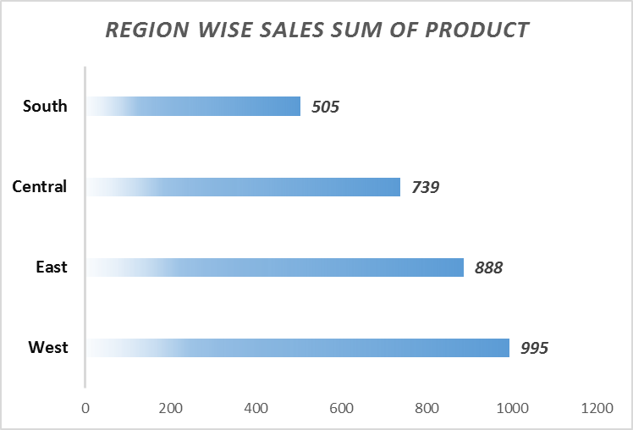
KEY FINDINGS:
From this pie chart, as can be seen that major share of profit come from technological product followed by office suppliers, from furniture percentage of profit is very low. So investors should focus on that part.
From next column chart can be seen that standard class mode, is most usable than first class and same day may be because of difference in cost.
As can be seen from bar chart in west, sales of product much higher than other part, followed by East region then rest.

Slide 6
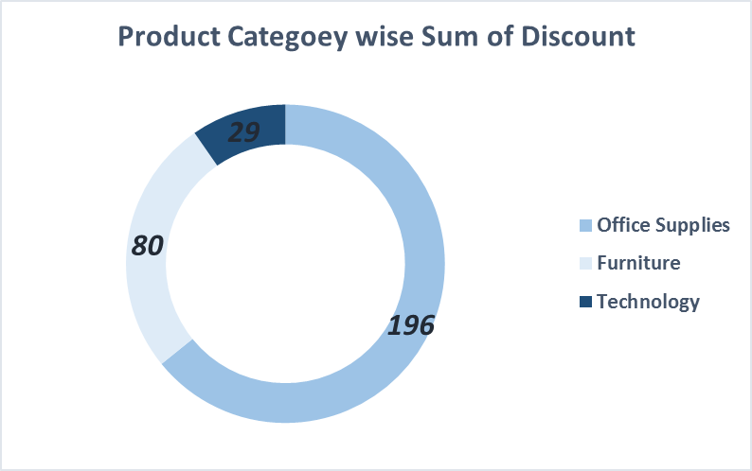
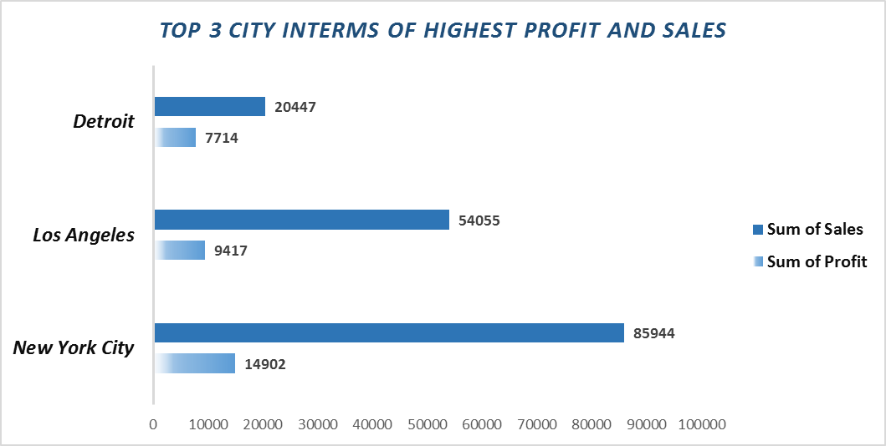
KEY FINDINGS:
As can be seen from doughnut chart, discount of technological product is much low than all other product may be because of these now on more demanding category than others and from furniture we get more discount.
From below bar chart as can be seen that sales from New York City higher than all city where Detroit is third highest in terms of sales and profit.

Slide 7
BUSINESS INSIGHTS:
Every investors in USA wants to maximize their profit in weak areas. For this purpose we can suggest three proposition, that are:
Proposition 1: As we see that many city and state has negative profit though the sale is not very low may be because of customers are not satisfied from product quality or price range, they may returned the product. So for this purpose have to increase quality of product, need to focus on price range also.
Proposition 2: From category of furniture, contribution of profit is very low so we need to focus on that part also by creating a good marketing strategy.
Proposition 3: From all segment ,in south the sales of product is very low and central also, for this area have to improve local marketing strategy by increase quality of product in affordable price and also make more advertise by using local media and have to target all segment.

Slide 8
THANK YOU

