Slide 1
Comprehensive Security Assessment of IT Services Company Network Infrastructure
Penetration Test Report
Date- 04/08/25 Prepared by – Swarnav Das

Slide 2
Agenda
1. Introduction
2. Executive Summary
3. Key Findings
4. Proof of Findings
5. Conclusion
6. Recommendation

Slide 3
Introduction
Penetration Testing Report Comprehensive Security Assessment of Network Infrastructure
Key Points: • Objective: Evaluate security posture of critical systems • Scope: Test conducted on webserver(testphp.vulnweb.com) and localhost system (DESKTOP-3RRTG48) • Methodology: Combination of automated scanning and manual testing
Conducted by: Swarnav Das
Prepared for: ECITA- Kanpur Cybersecurity Ethical hacker-25 4th August 2025

Slide 4
Executive Summary
Security Assessment Overview
Test Duration: 25 Jul 2025 - 04 Aug 2025
Testing Methodology: Grey Box approach
Vulnerability scanning + manual penetration testing
OWASP Top 10 & MITRE ATT&CK framework

Slide 5
Key Findings
Vulnerability Summary

Slide 6
Key Findings (cont’d)
Exploitable Vulnerability
PHP Unsupported Version Detection
Exposed Sensitive Directories and Files
Insecure Storage of User Credentials
Over-Privileged Database User
Insecure Cross-Domain Policies Vulnerable Stored Routines
Missing HTTP Security Headers
SMB Protocol Version 1 Enabled
SQL Injection
Exposed Database Structures

Slide 7
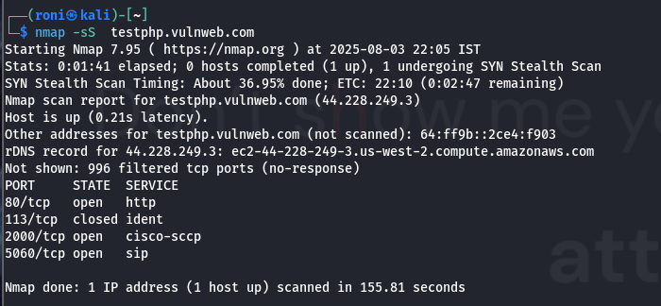
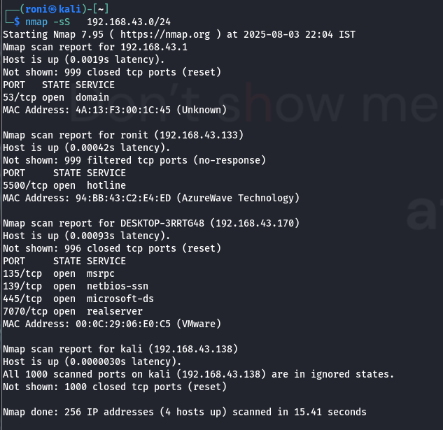
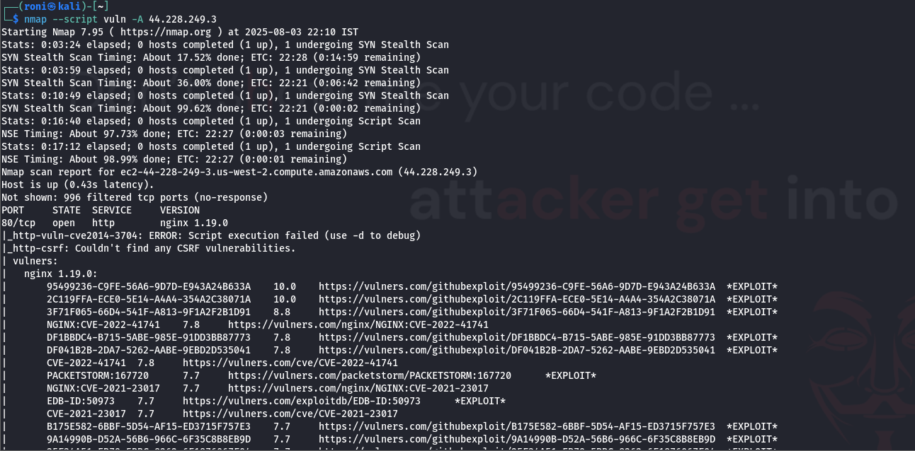
Proof of Findings
Nmap
Check result - nmap-result

Slide 8
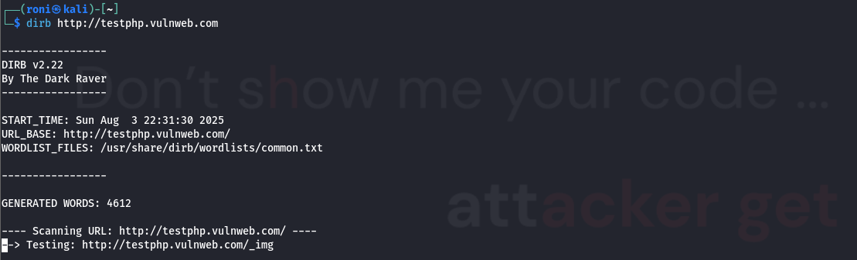
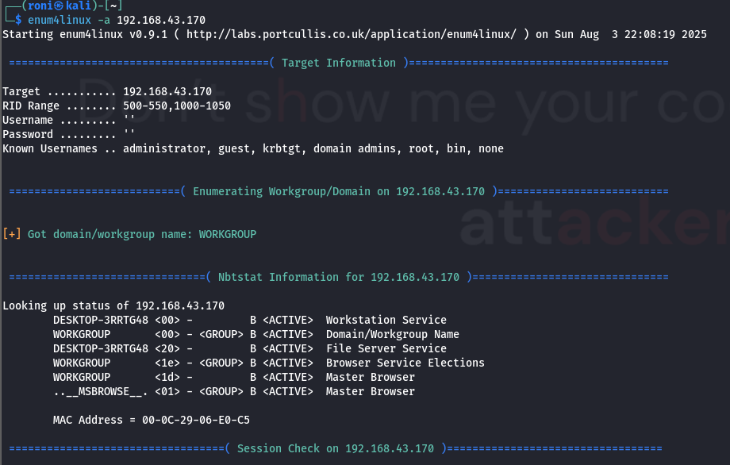
dirbuster
enum4linux
Check result - durb/enum-result

Slide 9
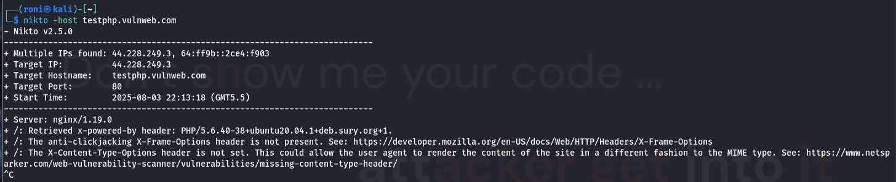
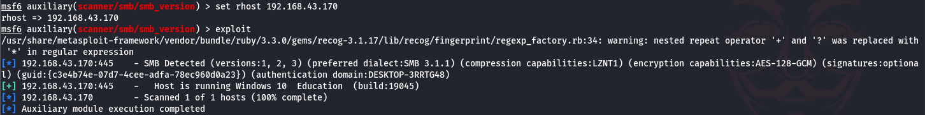
nikto
msfconsole
Check result -result

Slide 10
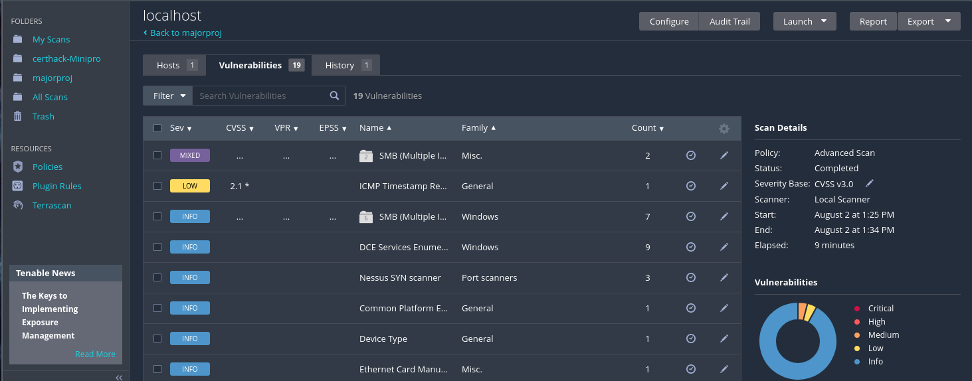
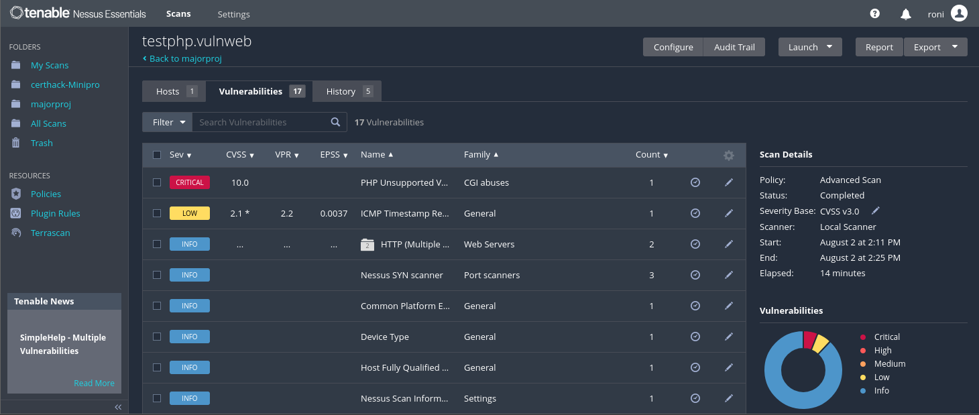
nessus
Check result - nessus-result

Slide 11
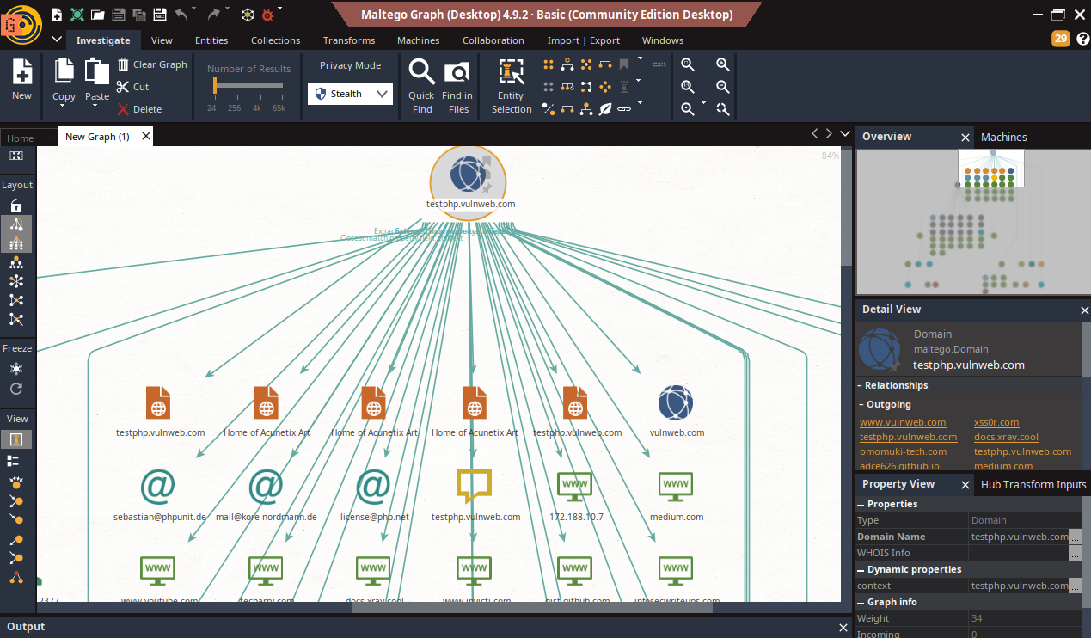
maltego
Check result -maltego-result

Slide 12
Conclusion
This penetration test of the web server and localhost environment has revealed several critical and high-severity vulnerabilities. While some foundational security controls are in place, the presence of exploitable flaws, such as those related to SQL injection, weak authentication, and unpatched software, indicates a need for immediate remediation.
The key findings highlight that attackers could potentially gain unauthorized access, exfiltrate sensitive data, and disrupt services. The identified vulnerabilities are not theoretical; they represent real and present risks to the integrity and availability of the system and services.

Slide 13
Recommendations
Upgrade PHP Version
Restrict Sensitive Directory Access
Secure Cross-Domain Policies.
Secure Database Metadata
Implement HTTP Security Headers
Filter ICMP Timestamp Requests
Enable the latest IDS and Firewall

Slide 14
References
https://github.com/swarnavdas15/CEHv13-MajorProject.github.io/tree/main/Findings/Sqlmapresult
https://github.com/swarnavdas15/CEHv13-MajorProject.github.io/tree/main/Findings/dirbresult
https://github.com/swarnavdas15/CEHv13-MajorProject.github.io/tree/main/Findings/maltego
https://github.com/swarnavdas15/CEHv13-MajorProject.github.io/tree/main/Findings/nessusresult
https://github.com/swarnavdas15/CEHv13-MajorProject.github.io/tree/main/Findings/niktoresult
https://github.com/swarnavdas15/CEHv13-MajorProject.github.io/tree/main/Findings/nmapResult

Slide 15
Thank
You ...
जागृतं श्रेयः,
न तु पराजयः।

