Slide 1


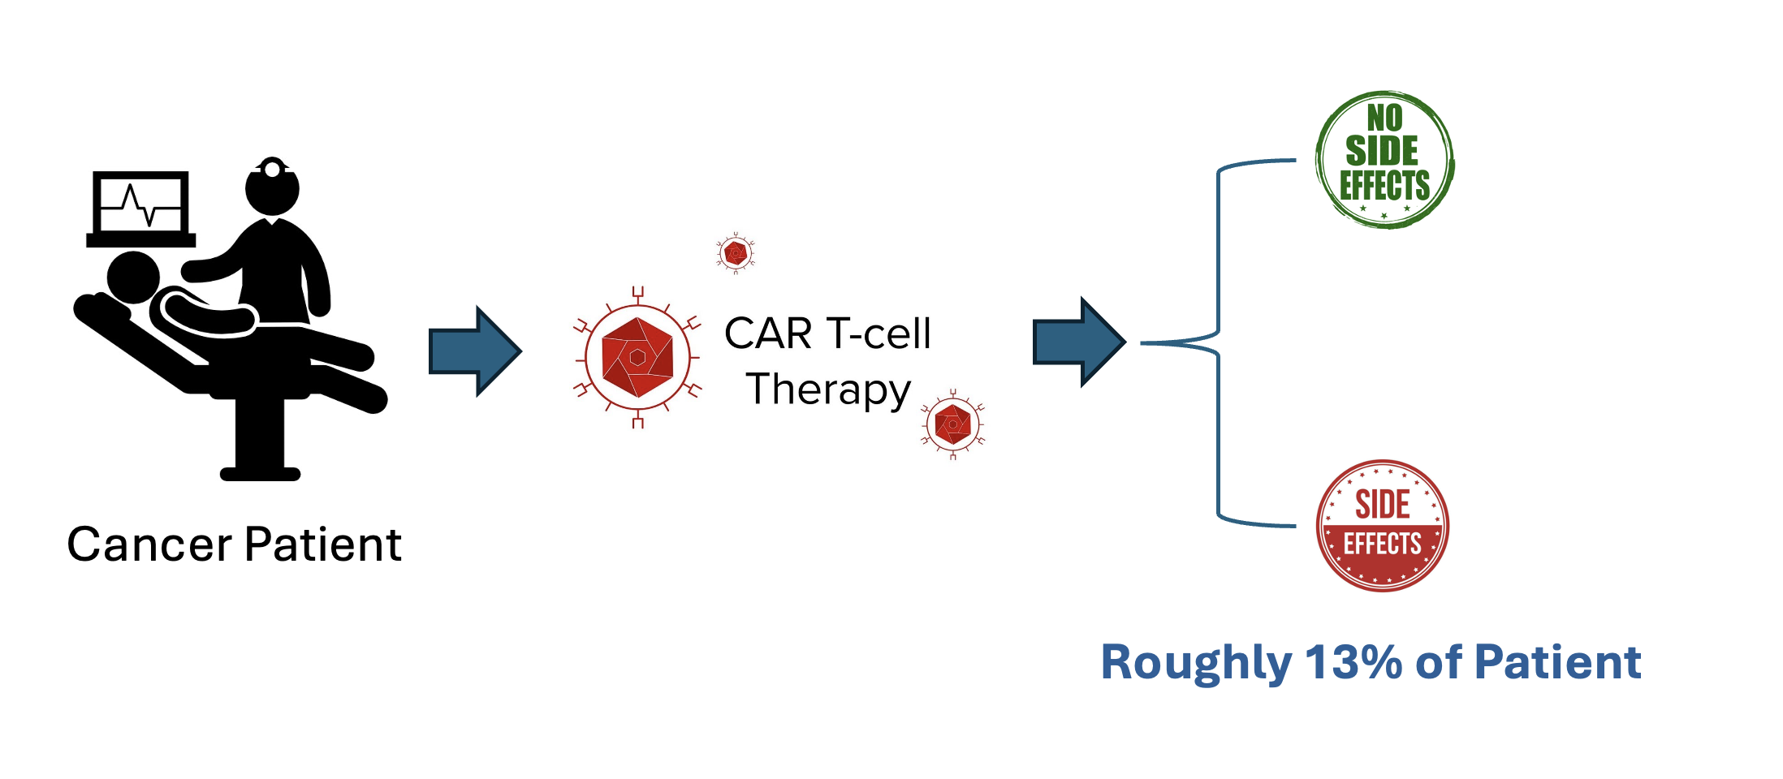
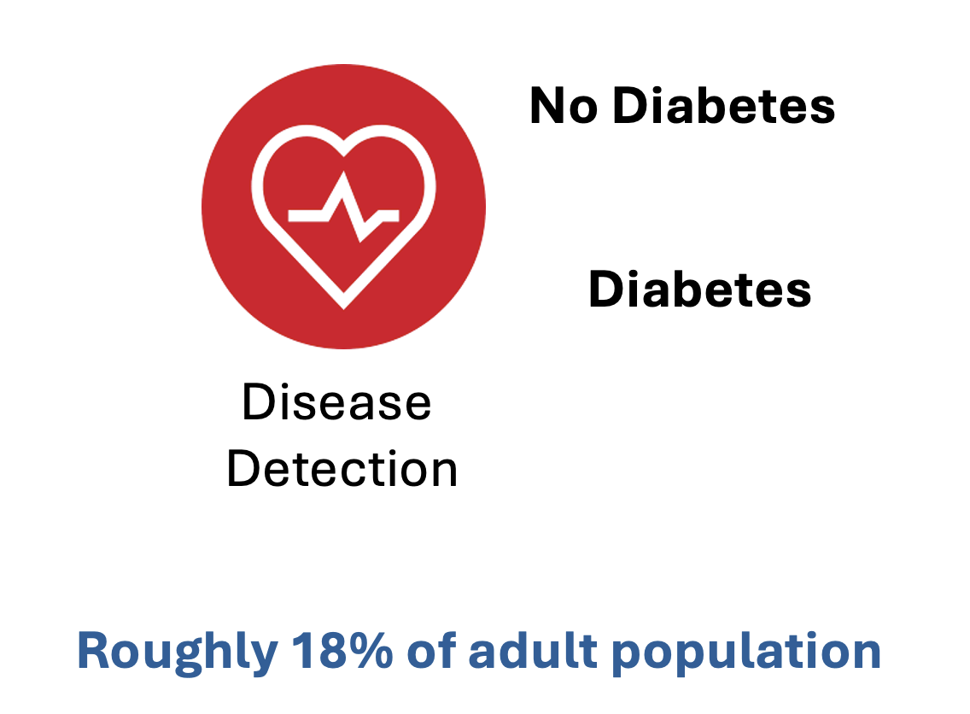
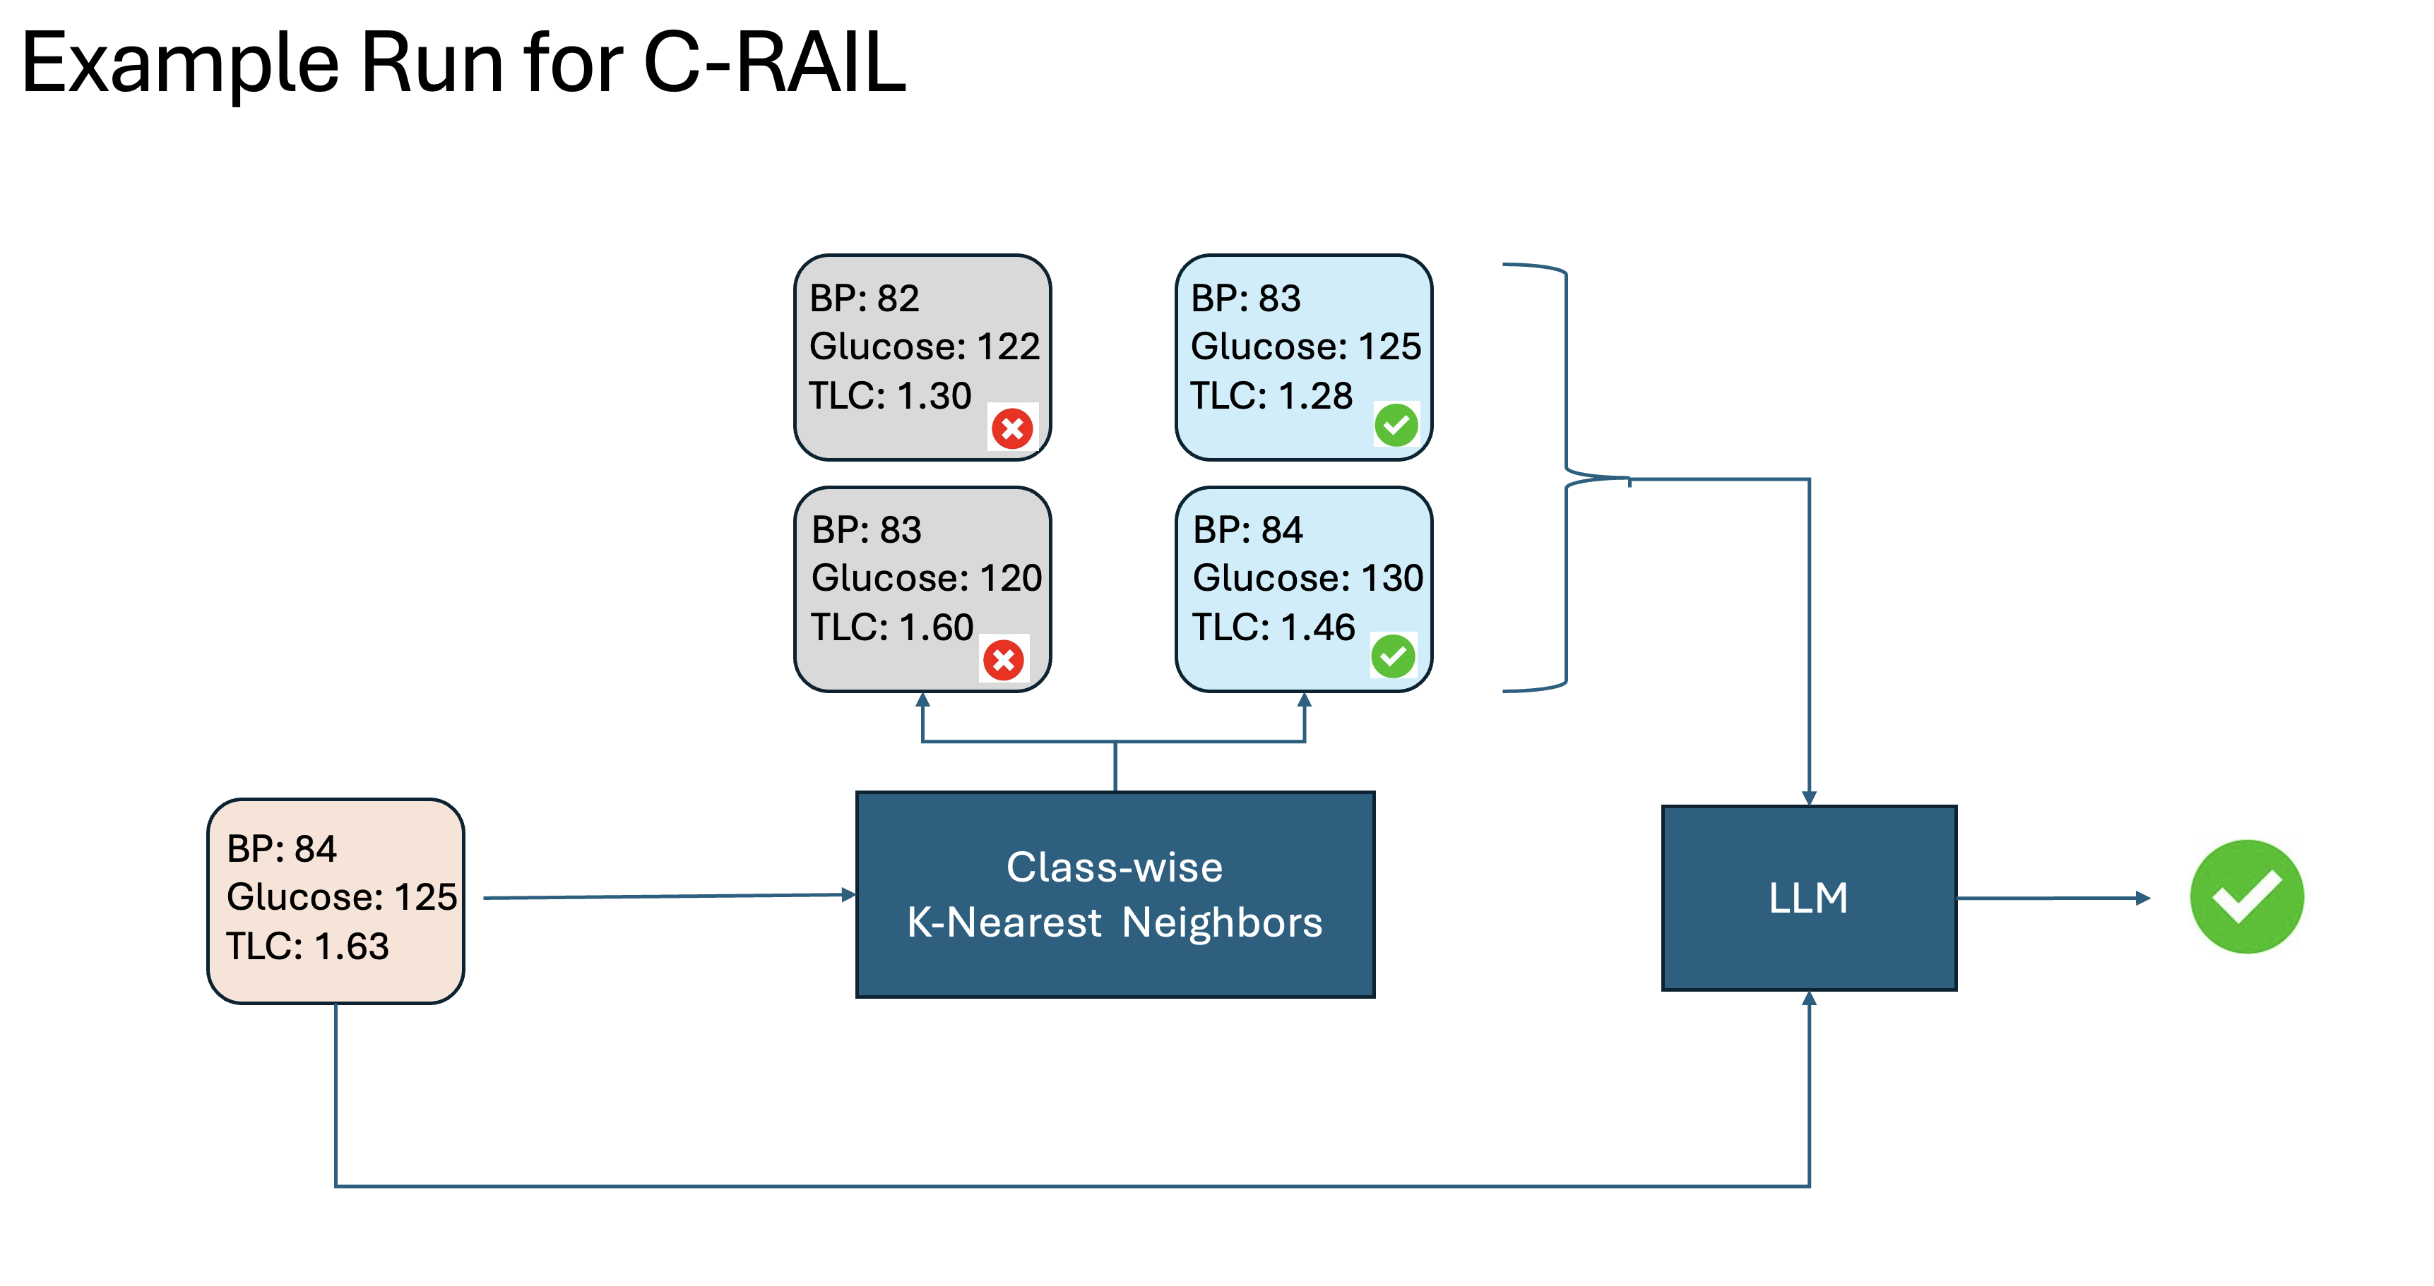
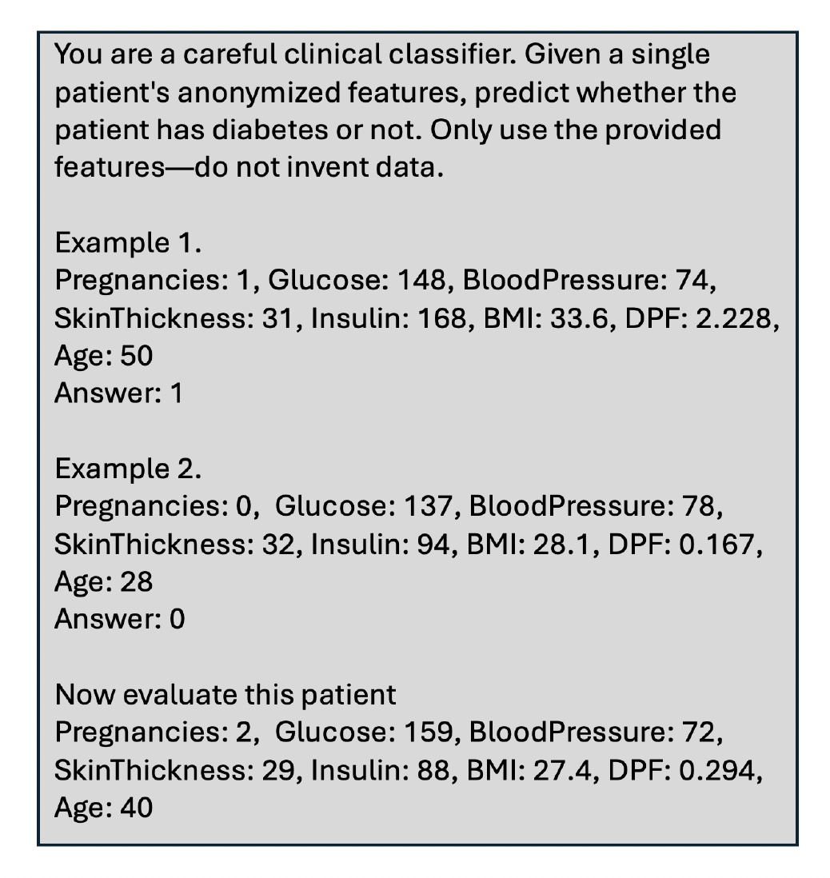


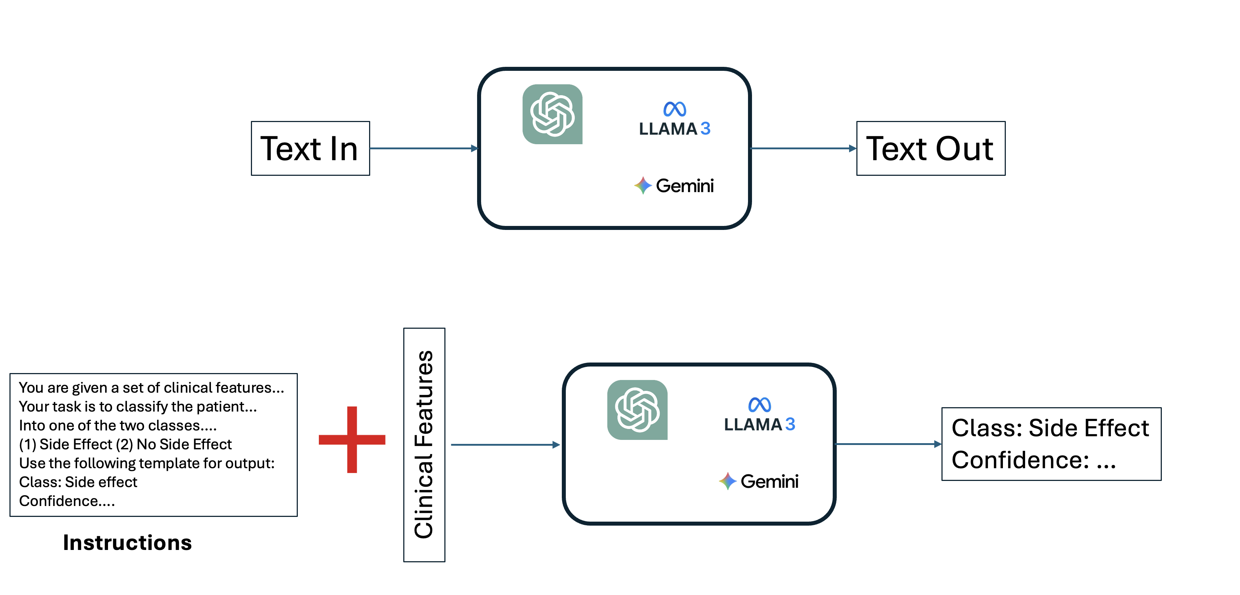
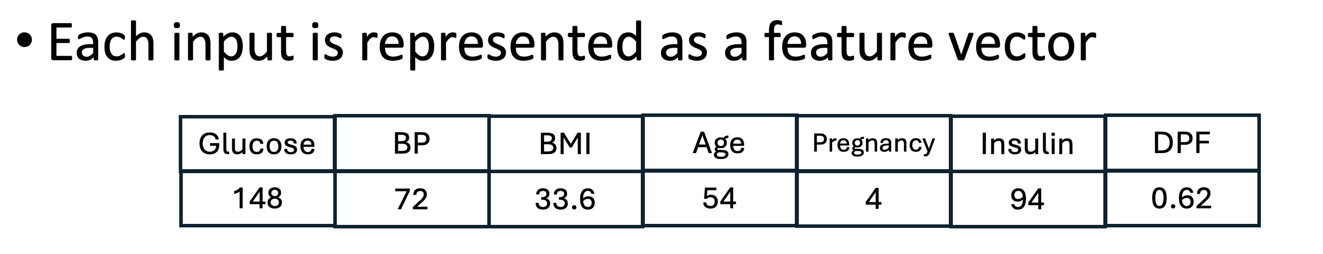
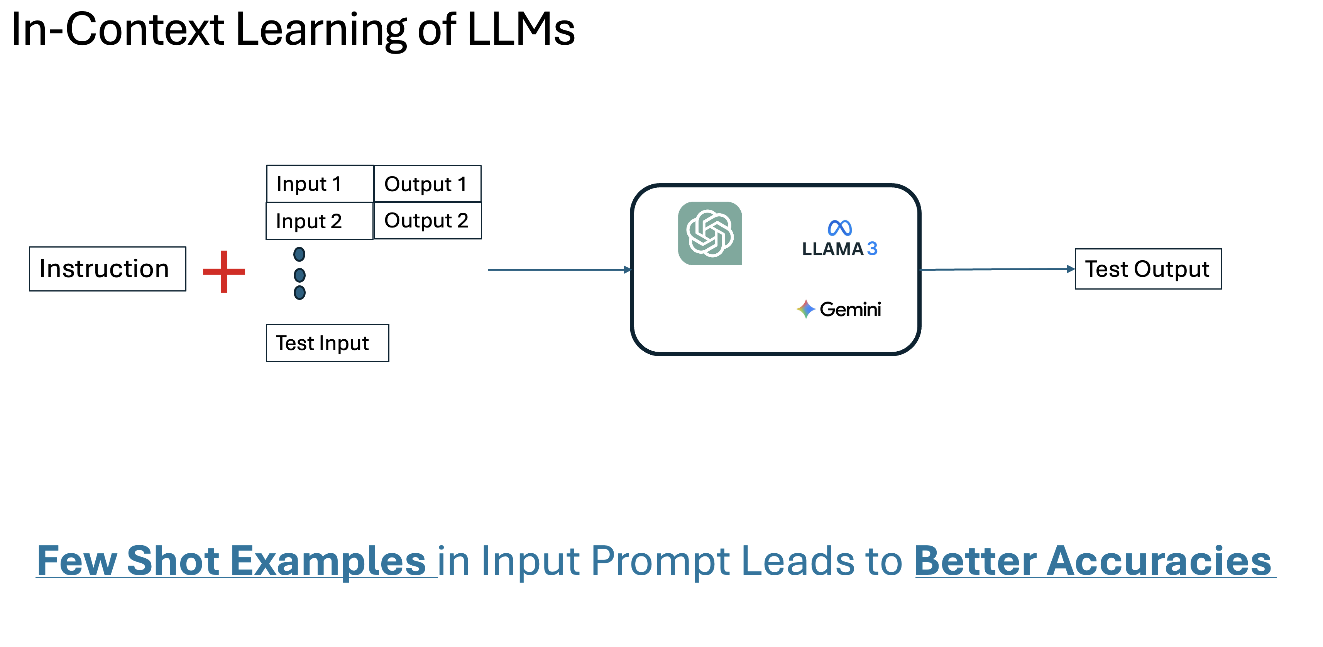
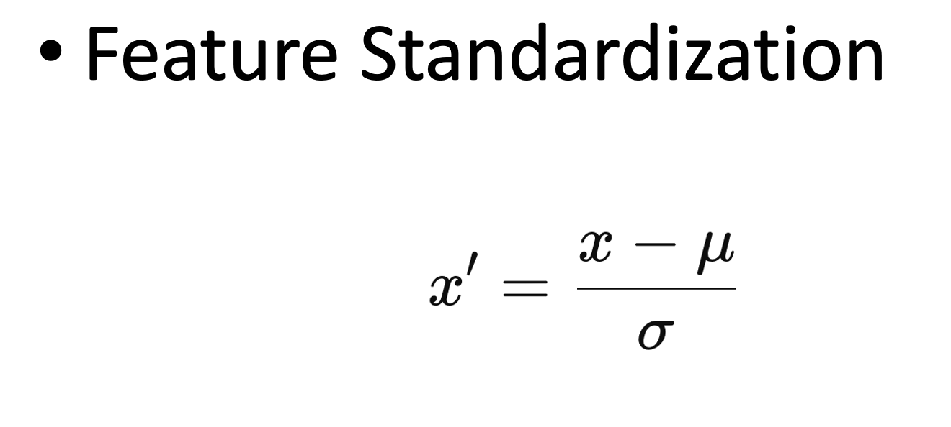
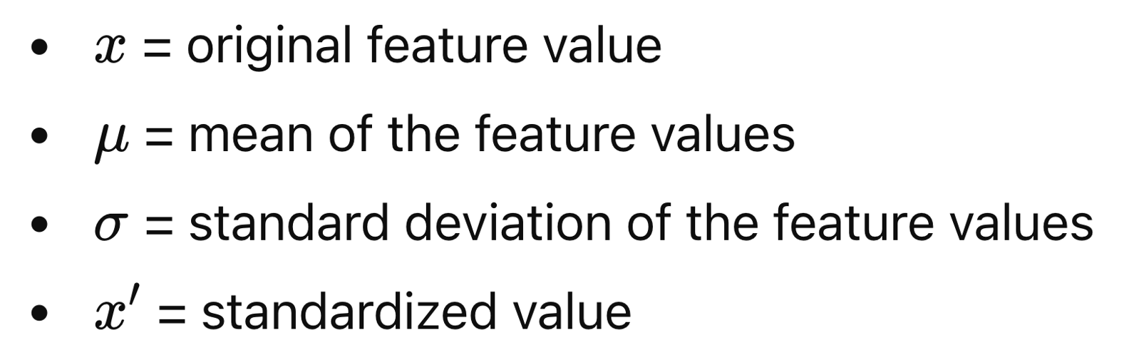
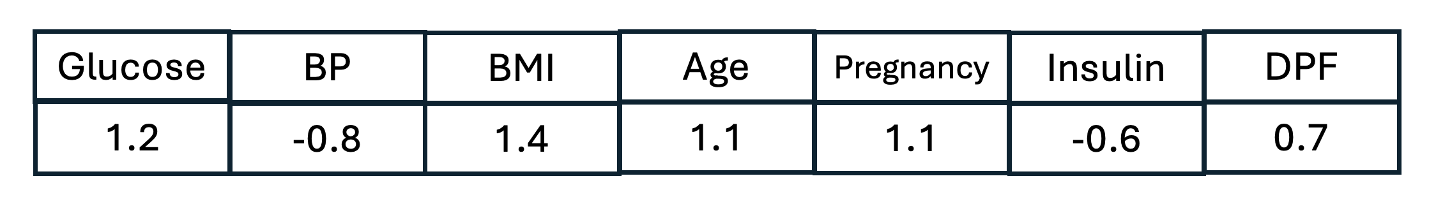
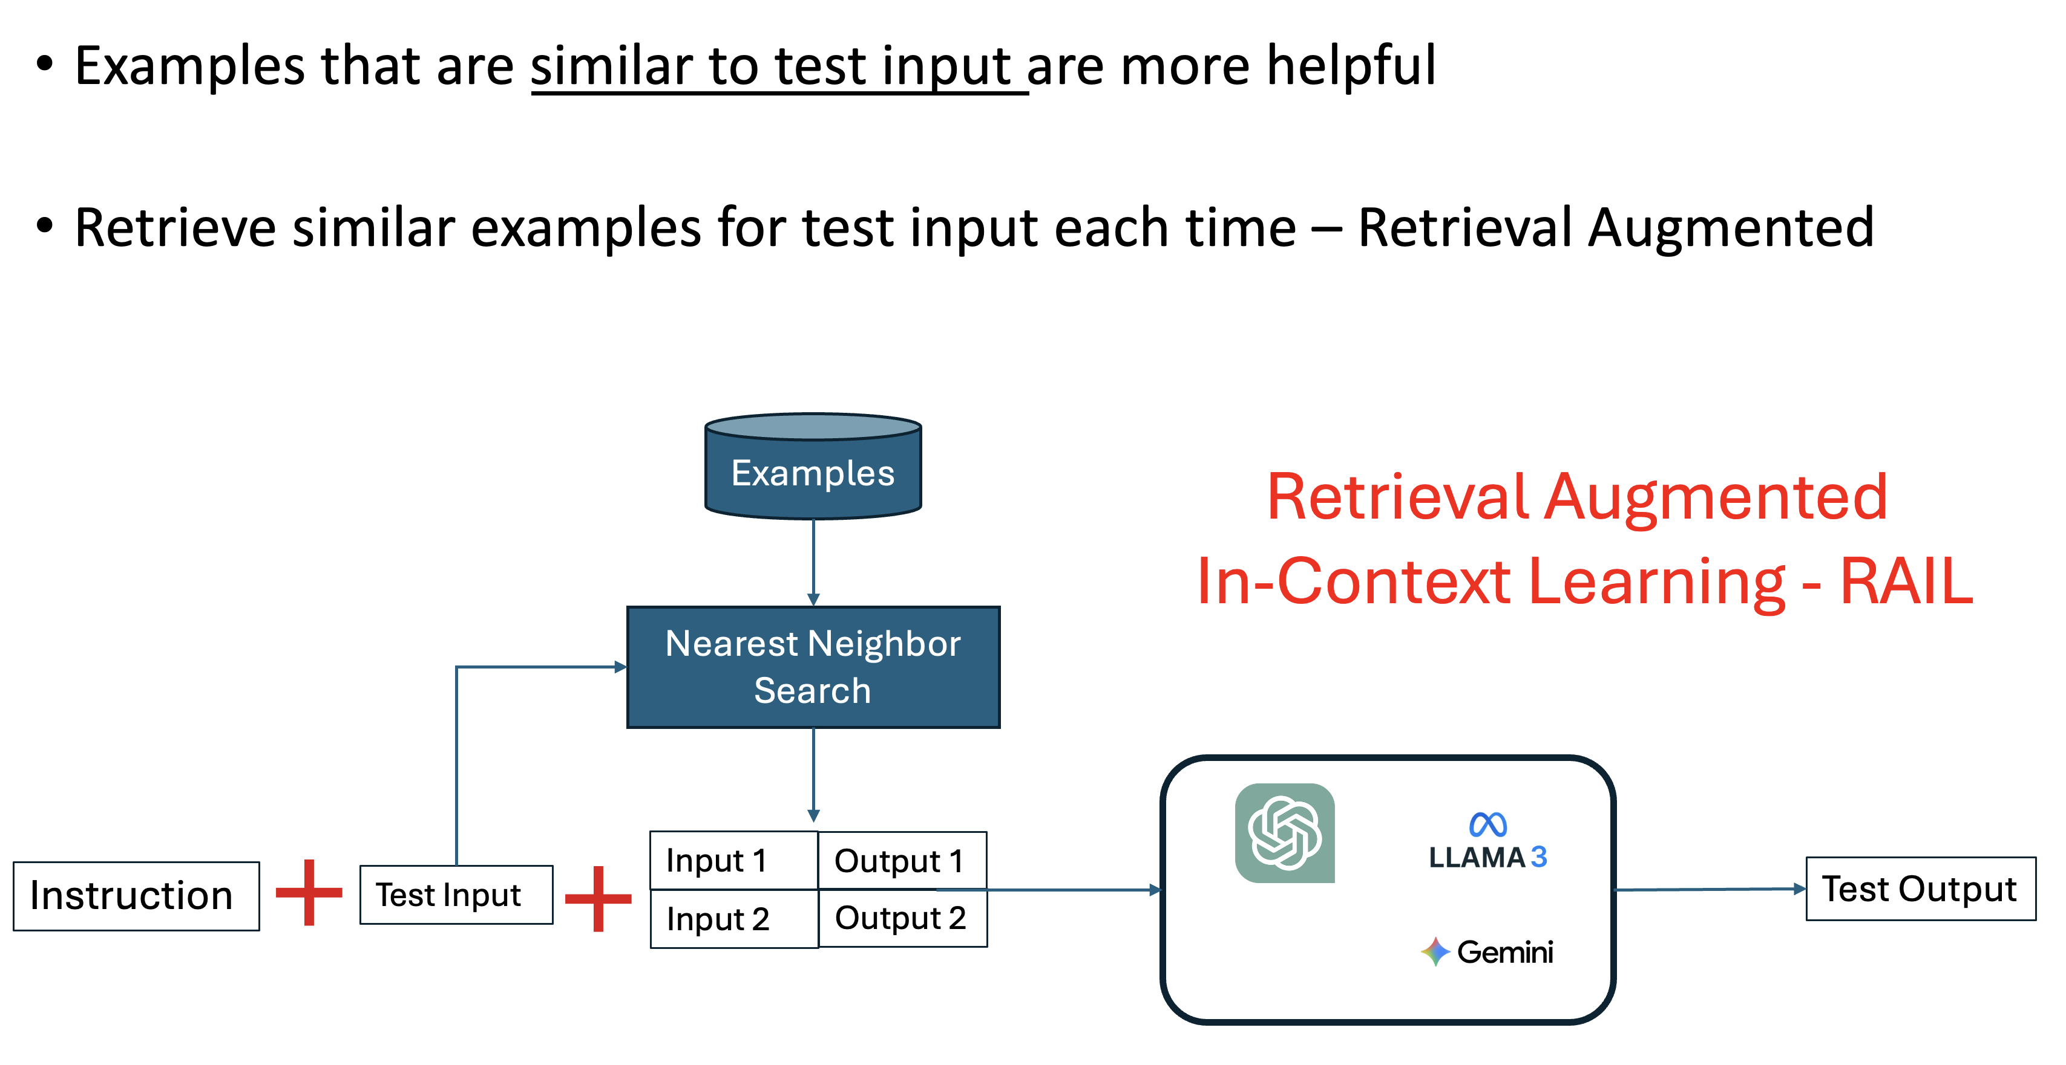
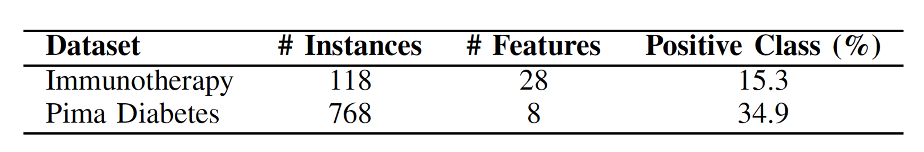
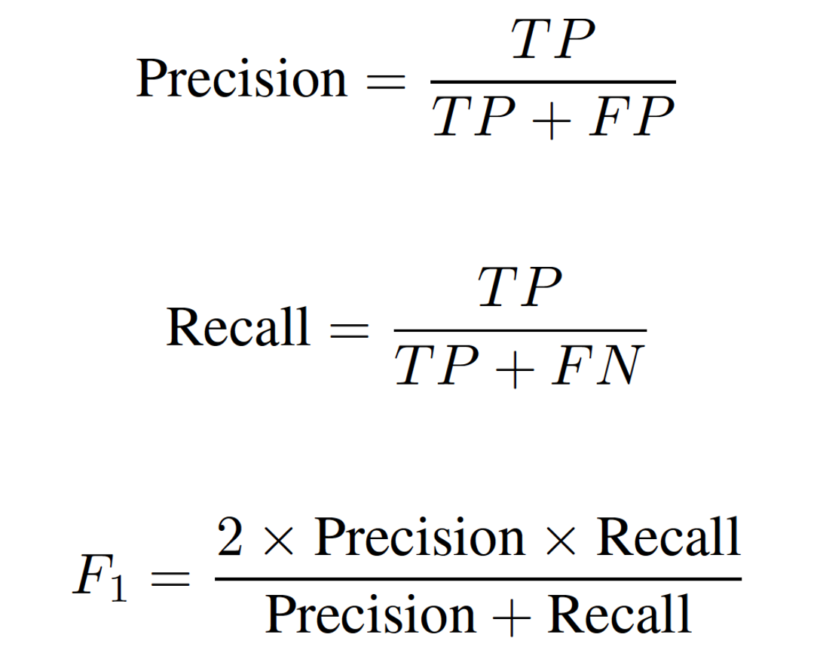
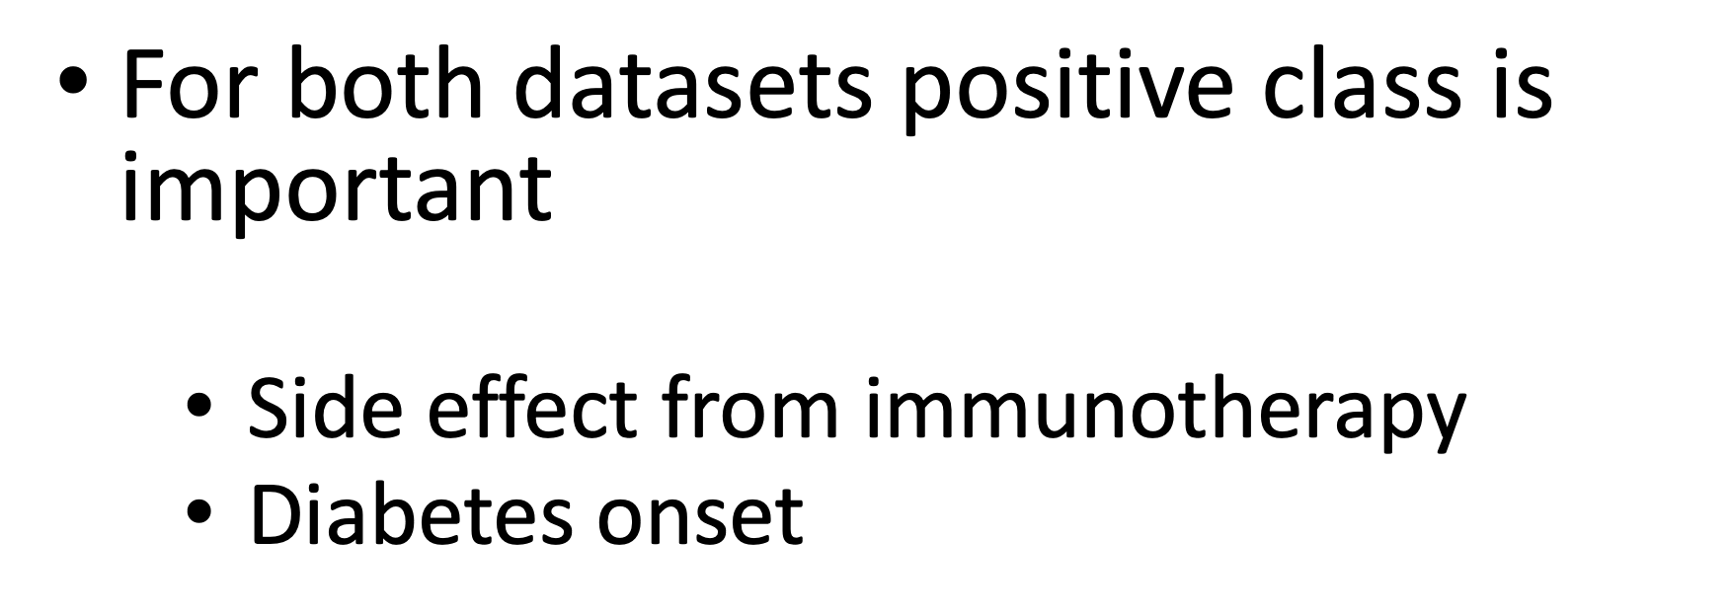
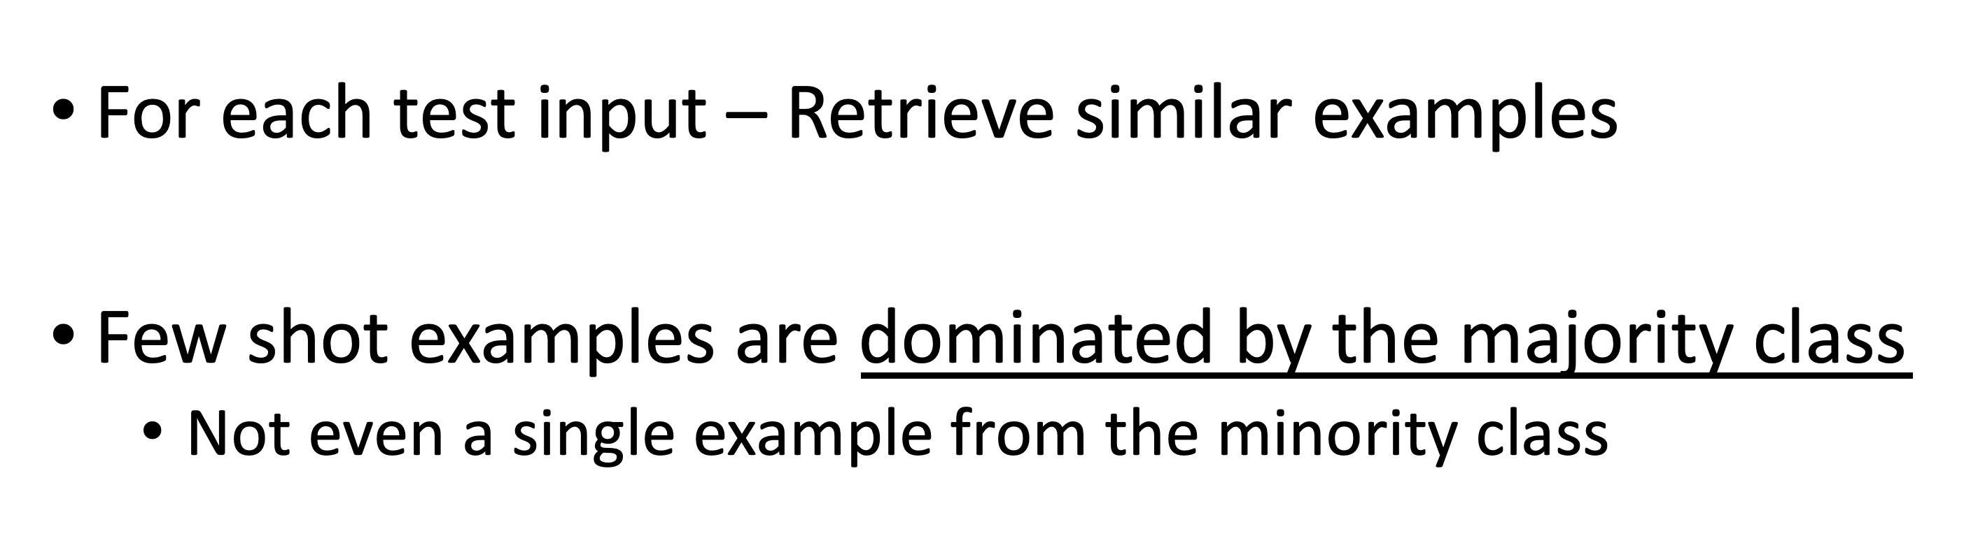
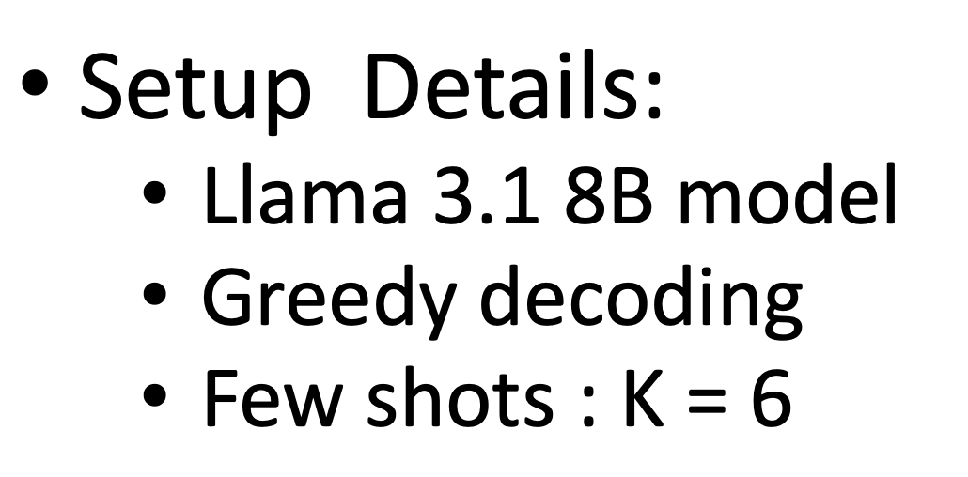
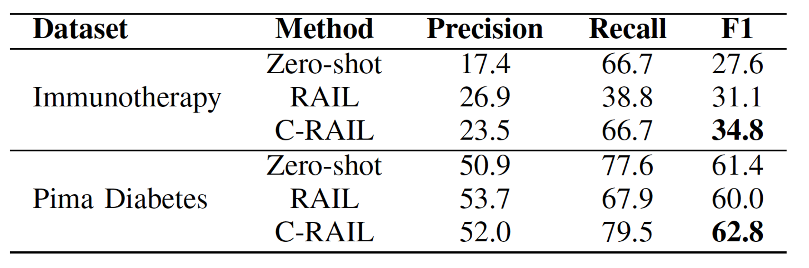
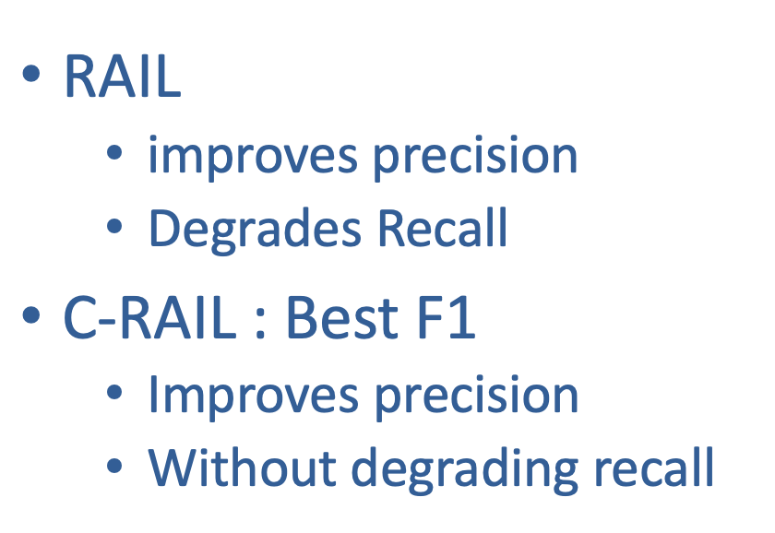
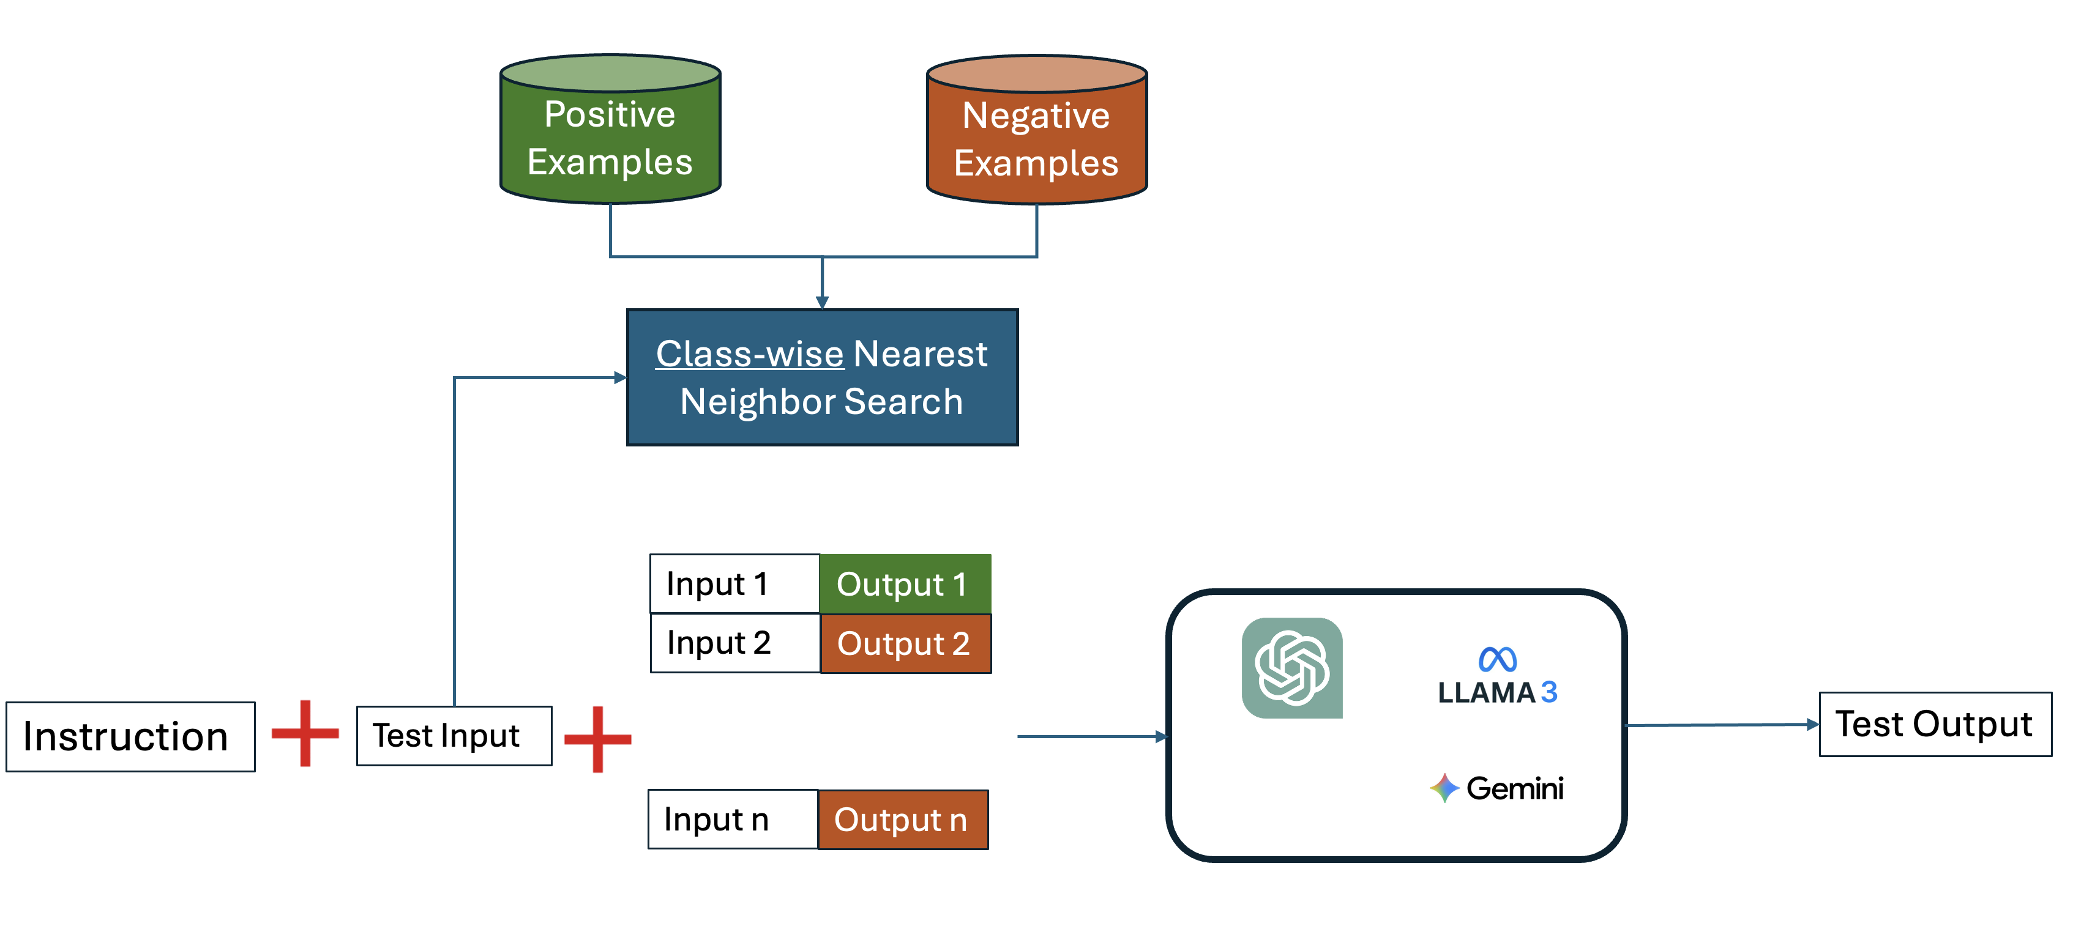
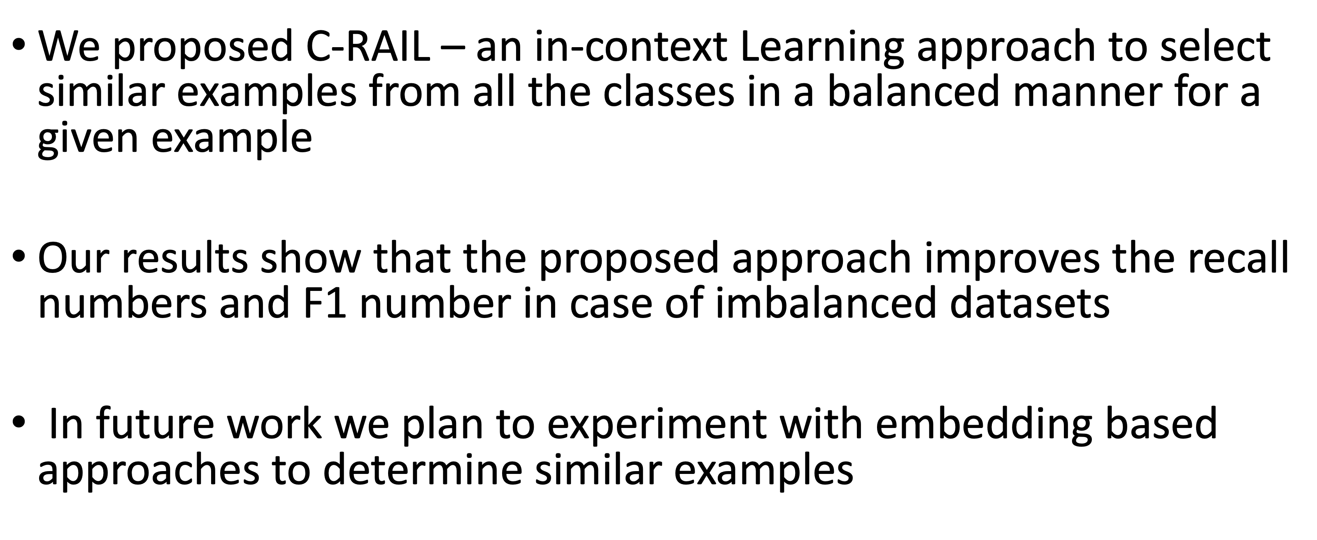
Contrastive Retrieval Augmented In-Context Learning
for Medical Classification Tasks with Imbalanced Data
Swarnika Joshi¹ , Kshitij S. Jadhav²
¹Scottish High International School, Gurgaon India, ²Indian Institute of Technology, Bombay
Introduction
Finding Similar Examples
Classification Tasks in Medical Domain
Large Language Model as Classifier
Standardizing Feature Vectors for Similarity Computation
In Context Learning of Large Language Models
Contrastive Retrieval Augmented Learning
Experiments
Retrieval Augmented In Context Learning : RAIL
Dataset Used
Evaluation Metrics
Problems with Retrieval Augmented In Context Learning
Experimental Setup and Results
Contrastive Retrieval Augmented In Context Learning : C-RAIL
Summary

