Slide 1
Robust Cost Sensitive Support Vector Machine
-Aditya Singh Bisht
-Shubhika Jain
-Swarnika Sharma

Slide 2
TOPICS
Outline of paper
Introduction
L₂ Norm and L_{inf} Norm
Robust Classification And Regularization
Proposed Algorithm RCSSVM
Conclusion

Slide 3
OUTLINE OF PAPER
We provide basic background information on robust optimization.
Show equivalence between robust SVM and regularized SVM.
Discuss specific regularized SVMs i.e Standard non-robust SVM, elastic net SVM and provide explainations on the properties of each classifier from robust classification perspective.
Then make robust cost sensitive support vector machine for imbalanced learning(data corrupted with noise) and provide computational results.

Slide 4
INTRODUCTION
Our project was to make a support vector machine robust and cost sensitive i.e we are taking into account the uncertainity in data and then training our machine.
This helps mainly in Imbalanced Data Learning.
In real life problems, data is always corrupted with some error or measurement noise, so we are characterizing data by uncertainity set.
Intuitively, robust optimization takes in account for all points within uncertainity set and solves for worst possible case, thus creating a solution robust to uncertainity of data. (HOW?)
Cost sensitive SVM
Regularized SVM

Slide 5
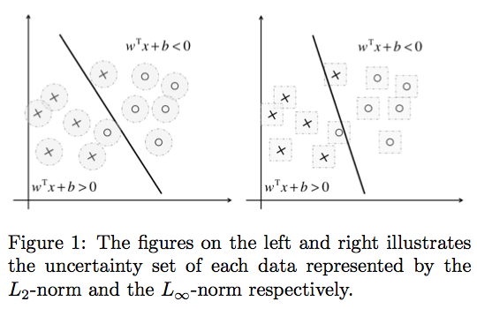
L₂ Norm and L_{inf} Norm

Slide 6
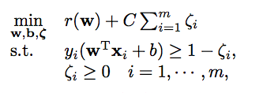
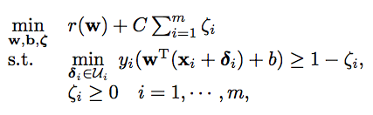
Robust Classification And Regularization
Assume data lie within uncertainity set, so equations can be written into following robust classification form -

Slide 7
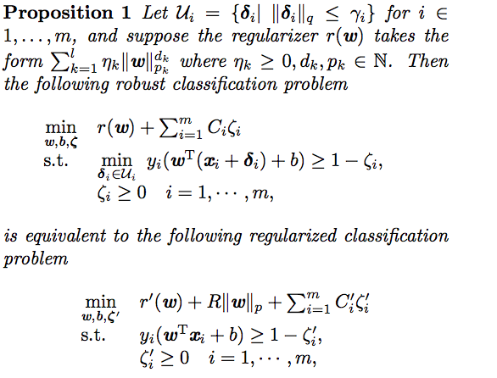
Proposition 1
2 classification problem equal and so it tells robust classification problem with different uncertainity set sizes are equivalent to a regularized classification problem.

Slide 8
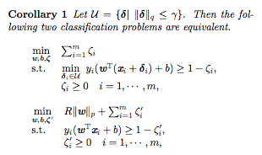
Corollary for better understanding proposition 1

Slide 9
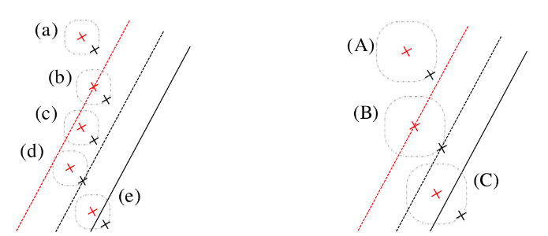
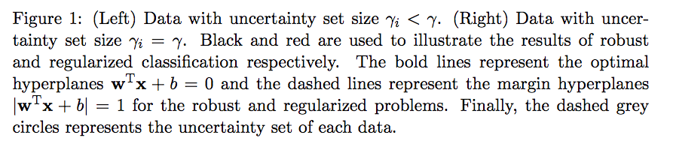

Slide 10
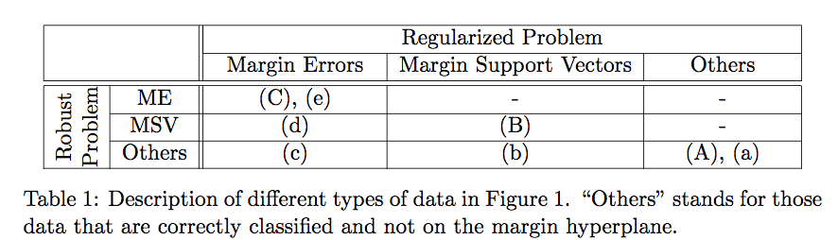

Slide 11
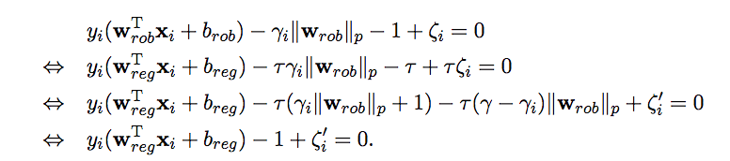
Proposition 1 (continued)
Solution to the 1st KKT condition
Similarly we proved for all KKT conditions and hence proved robust classifier is equivalent to regularizer classifier.

Slide 12
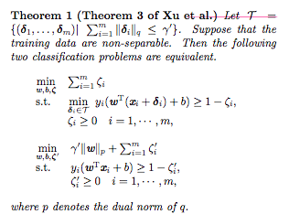
Connections to existing classification
1) Robust classification of Xu et al
How sublinear aggregated uncertainity set is replicated by a constraint wise uncertainity set where perturbation on each data are smaller i.e Y ’ < Y.

Slide 13

Proposed Algorithm RCSSVM
2 non regularized robust cost sensitive SVMs where uncertainity sets are given as L₂ Norm and L_{inf} Norm.
Objective function –
Set C⁻ = 1, assign 2 different uncertainity sets for minority and majority class.
RCSSVM L_{inf} is equivalent to
Where 2 uncertainity sets U⁺ and U^{-.}
Intuition behind this is – since minority class has less data compared to majority class, we consider minority class to be less credible

Slide 14
Constarints Used
C was [10⁻⁵,10⁵] and C- =1
Gamma was [10⁻³,10⁻¹] and gamma⁺ > gamma⁻
Accuracy measurement is donr used f-measure

Slide 15
Conclusion
Investigated relationship between robust and regularized SVM classfication.
And proves equivalence between robust C-SVM, non regularized SVM.
Robust classification models could be applied to cost sensitive learning and imbalanced data learning.
We used L₂ and L_{inf} Norm in our model and L_{inf} norm uncertainity set achieve automatic feature selection
Github link - https://github.com/swarnikasharma/rcssvm

