Slide 1

DESIGN PROJECT
PROJECT TITLE:
bipartite matching
GROUP MENTOR:
dr.manasi kulkarni
GROUP MEMBERS:
Gaini om prakash 201951061
Ganugachintala rajasekhar 201951062
dharavath Rajeev Gandhi 201951186
Jammula Jyothi Swaroop kumar 201951189

Slide 2



contents
Introduction
Motivation
About Bipartite graph
Problems
Hungarian Algorithm
Implementation
Applications
Future Scope
Conclusion

Slide 3


Motivation
We are facing many real world problems in our daily life which can be solved using Bipartite matching.
One such example would be that of job positions vs job applicants.
Our interest in this tool was motivated by several reasons which we now discuss. First, bipartite matching problems, often termed assignment problems in the operations research literature, arise naturally in a variety of applications where optimal assignments are to be determined, including personnel assignment scheduling problems and many more.
We came up with an idea to solve all the bipartite matching problems in our tool.

Slide 4
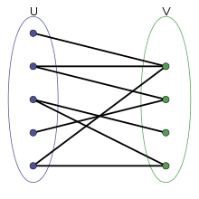
Introduction
This project is about bipartite graph matching, which finds matching algorithms for a given bipartite graph.
In graph theory, a matching in a graph is a set of edges that do not have a set of common vertices.
Bipartite matching arises in many applications, like marriage problem, roommates problem where the underlying graph could be a weighted or an unweighted graph.

Slide 5

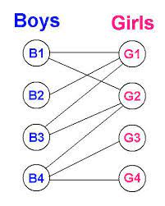
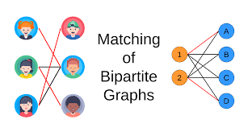

What is bipartite graph?
Bipartite Graph:
A Graph G = (U,V) whose vertices can be divided into two disjoint sets U and V such that every edge connects a vertex in U to one in V.

Slide 6


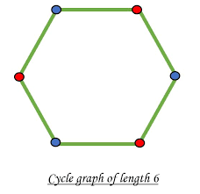
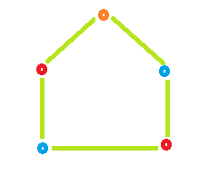
Problems Implemented using Bipartite matching
Testing Bipartiteness of given graph.
Checking perfect matching.
Maximum matching problem.
Minimum weighted matching using Hungarian algorithm.
Maximum weighted Matching using Hungarian algorithm.

Slide 7
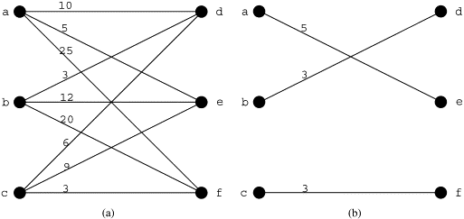
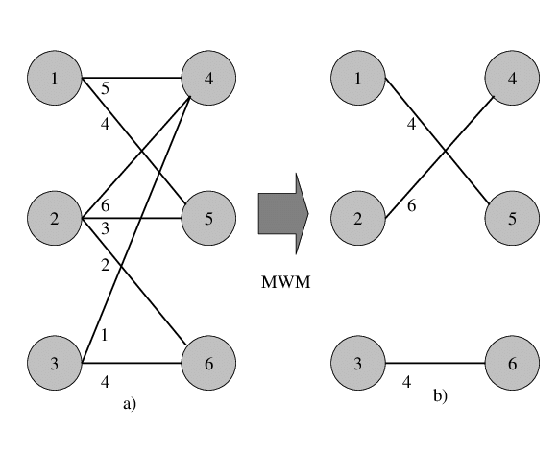
Weighted matching using Hungarian algorithm
Maximum weight matching :
The maximum weight matching problem is the problem of finding, in a weighted graph, a matching in which the sum of weights is maximized.
Minimum weight matching :
The minimum- weight matching problem is to find a perfect matching M in which the sum of weights is minimized.
Minimum weighted Matching
Maximum weighted Matching

Slide 8
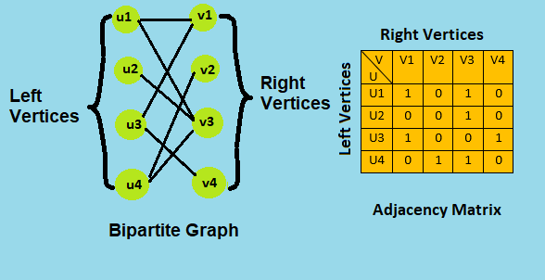
Implementation
Bipartite graph was implemented using Adjacency matrix and adjacency list.
Checking bipartiteness of given graph can be checked using BFS.
Maximum matching was implemented using Ford Fulkerson algorithm.
Maximum weighted matching and minimum weighted matching was implemented using Hungarian algorithm.

Slide 9
Applications
Scheduling problems such as assigning M jobs to a N number of applicants. What may be the maximum number of jobs can be assigned to applicants.
Applications of bipartite graph matching can be found in different fields including data science and computational biology.
In real world: scheduling the Advertisements.
Scheduling the trains on the tracks.
Used to represent binary relations between two types of objects.
Bipartite graph can be used in the medical field in the detection of lung cancer, throat cancer etc.

Slide 10

Graph Traversal Algorithms
In addition to bipartite matching algorithms we implemented some other useful algorithms like Breadth First Search, Depth First Search and Travelling Salesman Problem.
The traveling salesman problem (TSP) is an algorithmic problem tasked with finding the shortest route between a set of points and locations that must be visited.
In the problem statement, the points are the cities a salesperson might visit. The salesman‘s goal is to keep both the travel costs and the distance traveled as low as possible.

Slide 11

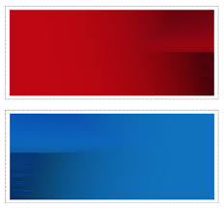
BFS And DFS
Depth first Search:
Depth-first search is an algorithm for traversing or searching tree or graph data structures.
The algorithm starts at the root node and explores as far as possible along each branch .
It can be implemented using a stack.
Breadth first Search:
The Breadth First Search ( BFS ) is an algorithm for traversing or searching tree or graph data structures.
It explores all the nodes at the present depth before moving on to the nodes at the next depth level.
It can be implemented using a queue.

Slide 12

FUTURE SCOPE
This project is very much useful in our daily life.
This tool can also be developed using different languages for better performance and efficiency.
The knowledge is ever expanding and so are the problems which the mankind strives to solve.
It is hoped that current activity will lead to further enhancement. In future we try to implement some other matching algorithms.
This tool can be further developed like updating algorithms to better data structure and minimizing the bugs by constant updates.

Slide 13
CONCLUSION
This is a one stop solution for all bipartite matching problems, and very convenient and easy to use interface.
Bipartite graph finds a very large number of applications in science, engineering and technology and medical fields.
The bipartite graphs and perfect matching algorithms can solve many problems in cloud computing and cognitive radio networks. The research work in future focuses on modeling the cloud computing problems and cognitive radio network problems.
Our techniques show that by utilizing lower bound costs and pruning rules, it is possible to terminate sooner while computing fewer expensive exact costs.

Slide 14


CODE

