Slide 1

V2V COMMUNICATION : ENHANCING SAFETY AND TRAFFIC FLOW

Slide 2
TABLE OF CONTENT:
SL.NO | TITLE
01. | NEED STATEMENT, INTRODUCTION
02. | LITERATURE SURVEY
03. | PROBLEM DEFINITION,OBJECTIVES
04. | PROJECT PLANNING
05. | FLOW CHART,BLOCK DIAGRAM
06. | SOFTWARE TOOLS
07. | HARDWARE SPECIFICATIONS
08. | OPTIMIZATION
09. | REUSLTS
10. | APPLICATIONS AND FUTURE SCOPE
11. | CONCLUSION
12. | REFERENCES

Slide 3
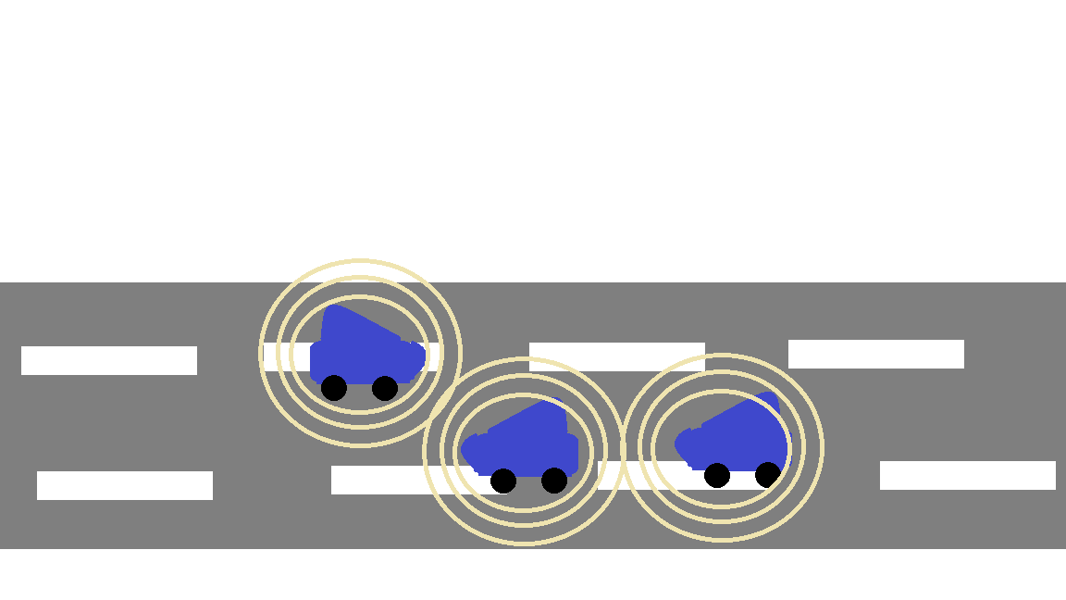
NEED STATEMENT:
As traffic congestion grows, the lack of real-time communication between vehicles leads to delayed responses, increased accidents, and inefficient traffic flow. This growing challenge highlights the need for better ways to address road safety and improve traffic management.
INTRODUCTION:
Traffic congestion and safety challenges are straining traditional systems.
V2V communication allows vehicles to share real-time data.
This improves road safety and traffic efficiency.
V2V is vital for the future of smart and safe transportation.

Slide 4
LITERATURE SURVEY:
TITLE | YEAR | AUTHORS | METHODOLOGY | LIMITATIONS
Simulation-Based V2V and Base Station Communication | 2024 | Rashid Ali, Dil Nawaz Hakro , M. Rizwan Tanweer, Amjad Ali Kamboh | Simulated road scenarios (square, triangle, straight) using MATLAB 2017 Used DSRC with Massive MIMO for V2V communication. GSM towers monitored real-time vehicle data like speed and location. | GSM towers have limited coverage, leading to potential communication gaps. Simulation-based, lacking real-world validation. Scalability issues with increasing traffic and infrastructure demands.
Agent-Based Scheduling Scheme for IEEE 802.11p | 2020 | Shiann-Tsong Sheu, Yen-Chieh Cheng, Ping-Jung Hsieh, and Jung-Shyr Wu | ABS scheme divides SCH into Contention (C-SCH) and Service (S-SCH) channels. Location-Based Backoff (LBB) elects the closest OBU(On Board-Unit) as the Agent to minimize collisions. Agent schedules OBUs for contention-free communication. | Reliance on accurate Agent selection; errors may disrupt the system. Extra control frames introduce overhead, reducing efficiency. Dependency on precise GPS data, which may suffer from inaccuracies.
Real-time V2V Communication Device for Enhanced Road Safety | 2021 | Velugula Charan Pallav, Samarth S, Srijith C Shetty, Pappa M, Sabrish B, and Sridevi S. | Data Collection and Transmission: Acquire GPS data via NEO-6M module, process it with Arduino Uno, and transmit through nRF24L01 transceivers. Wireless Communication: Ensure peer-to-peer data exchange among vehicles using reliable encoded packets. Hazard Detection and Alerts: Analyze received data for proximity and speed risks, triggering real-time visual/audio alerts. Map Integration: Display real-time vehicle data and alerts dynamically on a web-based map using Leaflet.js | Limited range of communication (up to 100 meters). Performance affected by interference in urban areas. GPS accuracy issues near tall buildings. Latency in hazard detection, especially in urban settings.

Slide 5
TITLE | YEAR | AUTHORS | METHODOLOGY | LIMITATIONS
On Field Performance Analysis of IEEE 802.11p and WAVE Protocol Stack for V2V & V2I Communication | 2019 | Vivek N, S.V. Srikanth, Saurabh P, T.P. Vamsi, and Raju K.. | Conduct field tests for V2V and V2I communication using DSRC-enabled hardware. Measure parameters like delay, jitter, and packet loss under various conditions. Analyze performance impacts of distance, channel load, and interference. Evaluate real-world feasibility for vehicular safety and ITS applications. | Packet Loss: Increased distance between units and environmental factors lead to high packet loss, especially beyond 200 meters. Cross-Channel Interference: Adjacent channel traffic significantly impacts communication reliability, causing higher packet error rates. Line of Sight Dependency: Communication performance is greatly affected by the absence of direct Line of Sight (LOS). Environmental Sensitivity: Real-world environmental conditions, such as dips in the road and physical obstructions, degrade signal quality.
Development of V2V Communication | 2022 | Soundari D V , Varshini G, Santhosh Vimal R , Vijayalakshmi G , Sarankumar. S , Selva Kumar D | Li-Fi Technology offers high-speed data transfer (>1 Gbps) using visible light, providing a faster, safer, and eco-friendly alternative to Wi-Fi. V2V Communication with Li-Fi improves road safety by enabling vehicles to exchange data such as speed, direction, and distance. Smart Highway Systems use microcontrollers (like Atmega328) and LEDs to transmit road data, which is displayed via LCDs at the receiver end. Indoor Li-Fi Communication enables data transfer from camera hubs to users using special roof structures and Li-Fi handsets. Lattice Grid Concept proposes a vehicle network where LEDs and photodiodes facilitate real-time communication, requiring clear line-of-sight. | Line-of-Sight Dependency Limited Range Environmental Sensitivity Low Penetration Capability Receiver Alignment Requirement Limited Data Reception During Motion Dependency on External Light Source Lack of Standardization and Scalability
An Accurate Vehicle-to-Vehicle Instant Alert System Using Directional Antennas | 2021 | Chia-Yu Lin , Fu-Ming Kang , Po-Min Hsu , Chiao Tung Jen-Jee Chen ,Yu-Chee Tseng | Vehicle Detection & Localization (VID Module): Combines CAM messages (speed, GPS) and camera-based object detection to accurately identify and localize surrounding vehicles relative to the host vehicle. Dangerous Event Prediction (VSA Module): Predicts future trajectories of nearby vehicles and the host vehicle; if a potential collision is detected, it generates a Decentralized Environmental Notification Message (DENM). | Dependence on Accurate Sensor Data: The system's performance heavily relies on accurate camera detections and GPS information; any error in sensing or localization may lead to false alerts or missed collision predictions. Directional Antenna Constraints

Slide 6
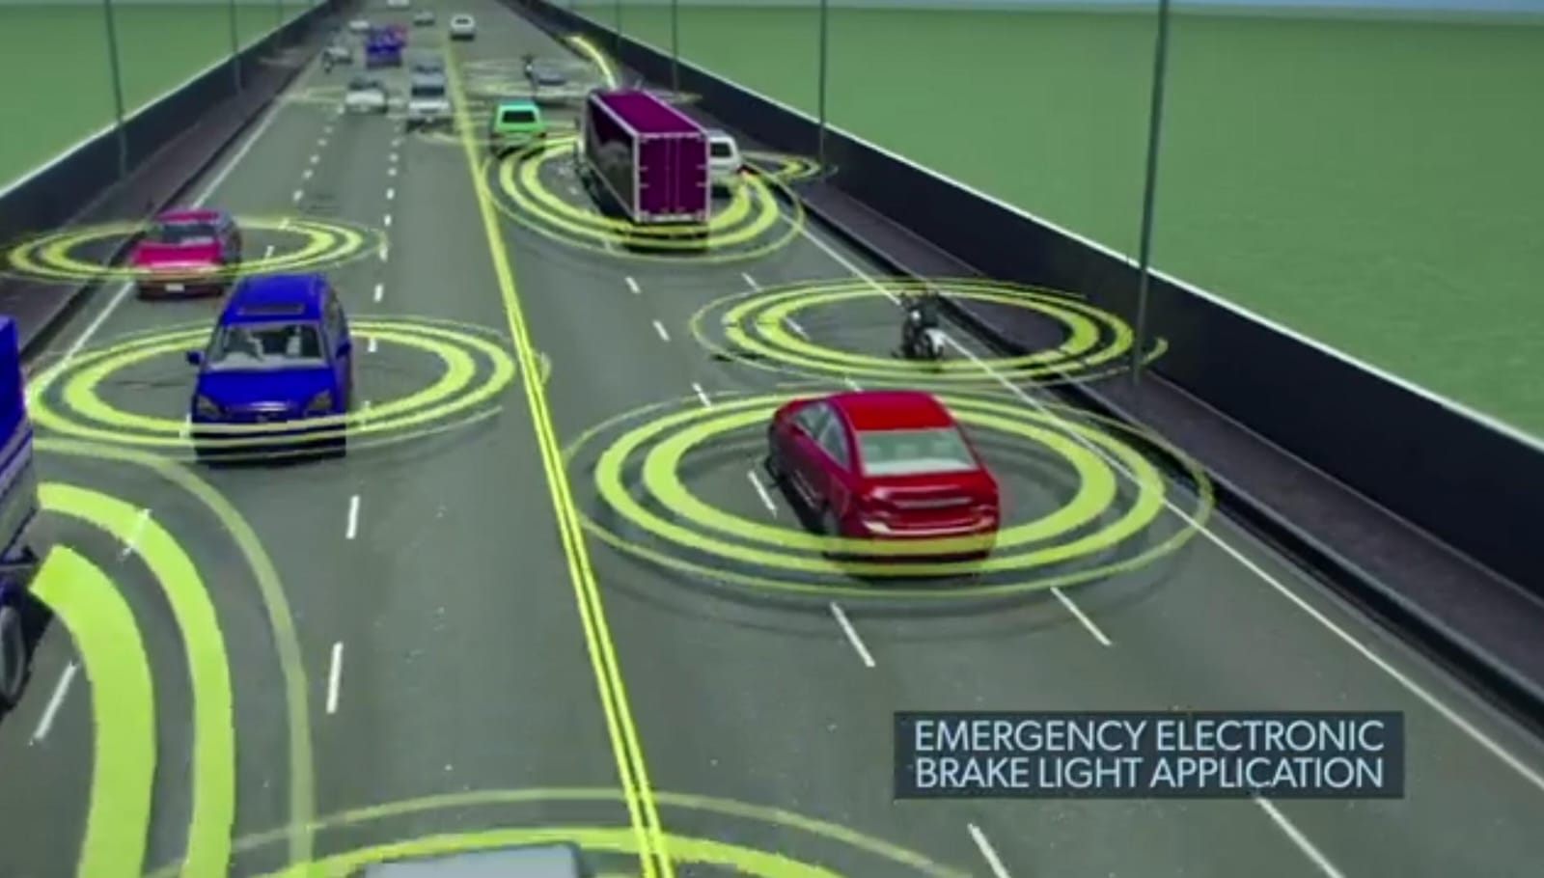
PROBLEM DEFINITION:
Design and demonstrate the V2V communication system using wireless protocol.
OBJECTIVES:
V2V communication.
Exchange real-time data.
Wireless communication.
Minimize the risk of accidents.
Optimize traffic flow.
Smarter , more connected transportation system

Slide 7
PROJECT PLANNING

Slide 8
WORK BREAKDOWN STRUCTURE
SMART DRIVING ASSISTANT
Project Initiation
Planning and Analysis
Development and Implementation
Monitoring and
optimization
Project Closure
Define project scope
System Design
Sensor Integration
Data analysis and reporting
Documentation
Project plan
Information gathering
Actuator Integration
Optimization
Final testing
Risk Management
Cost estimation
Code Setup
Testing
Project review
System Testing & debugging
Technical Analysis

Slide 9
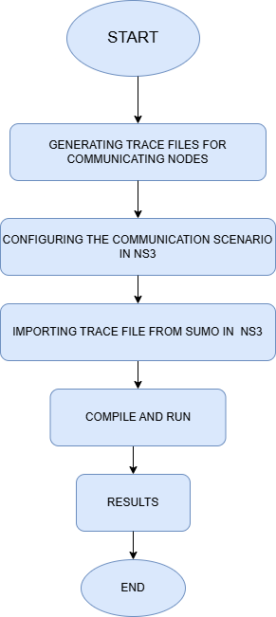
FLOWCHART:

Slide 10
DETAILED BLOCK DIAGRAM:
1.Importing trace files to NS-3.
2.Compilation and execution of NS-3 simulation.
3.Network visualization with Netanim.
4.Performance plotting using GNUPLOT
1.OpenStreetMap(Add cars, bikes, trucks, traffic rules)
2. Generate scenario.
3. Generate trace file.
1. Integrate SUMO with NS-3.
2. Export mobility trace file.(traceExporter.py).
2. Routing protocol performance comparison (vanet-compare.cc).
SUMO
VANET
NS-3(3.43)

Slide 11
SOFTWARE TOOLS:
1. SUMO (Simulation of Urban Mobility)
Open-source traffic simulator
Generates realistic vehicle movement using OSM maps
Simulates traffic rules, signals, and routing
Exports trace files for network simulators
2. VANET Framework
Integrates SUMO and NS-3 for V2V simulations
Converts mobility traces for NS-3
Analyzes routing protocols (AODV, DSR, DSDV)
vanet-compare.cc for protocol performance
3. NS-3 (Network Simulator 3)
Discrete-event network simulator (C++/Python)
Simulates wireless communication (e.g., 802.11p for V2V)
Evaluates network performance: throughput, delay, packet loss
Visualization: NetAnim
Graphing: Gnuplot

Slide 12
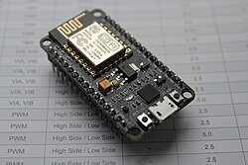
HARDWARE SPECIFICATIONS
ESP8266 Hardware Specifications
Processor: Single-core Tensilica L106, 80 MHz (overclockable to 160 MHz)
RAM: Approximately 160 KB available
Flash Memory: 512 KB to 4 MB (varies by module)
Wi-Fi: 802.11 b/g/n (2.4 GHz)
Bluetooth: Not supported
GPIO Pins: Up to 17 (varies by module; e.g., ESP-01 has 2, NodeMCU has 11 usable)
ADC Channels: 1 (10-bit resolution)
PWM Channels: Software-based PWM
Interfaces: SPI, I2C, UART, I2S
Operating Voltage: 3.0 to 3.6 V (typically 3.3 V)
Power Consumption: Low power with support for deep sleep
Security Features: WPA/WPA2, SSL/TLS (software-based)
ESP8266

Slide 13
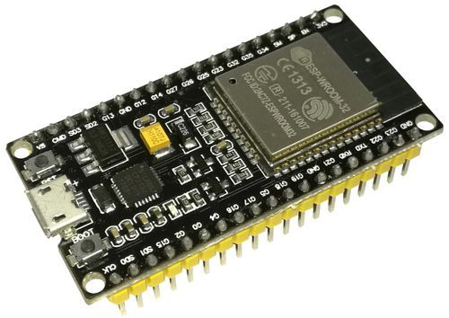
ESP32 Hardware Specifications
Processor: Dual-core Tensilica Xtensa LX6, up to 240 MHz
RAM: 520 KB SRAM
Flash Memory: Typically 4 MB (varies by module)
Wi-Fi: 802.11 b/g/n, HT40
Bluetooth: Supported (Classic Bluetooth and BLE)
GPIO Pins: Up to 34 (configurable for various functions)
ADC Channels: 18 (12-bit resolution)
DAC Channels: 2 (8-bit resolution)
PWM Channels: Up to 16
Touch Sensors: 10 capacitive touch inputs.
ESP32

Slide 14
BILL OF MATERIAL
SL NO. | COMPONENTS | QUANTITY | PRICE(Rs.)
01. | ESP32 | 1 | 450
02. | JUMPER WIRES | 1 SET | 150
03. | ESP8266 | 1 | 375
TOTAL | 3 | 3 | 975

Slide 15

OPTIMIZATION:
Protocol (Full Form) | Throughput | Overhead | Receive Rate
DSR (Dynamic Source Routing) | High | Low | High
AODV (Ad hoc On-Demand Distance Vector) | High | Moderate | High
OLSR (Optimized Link State Routing) | Moderate | High | Moderate
DSDV (Destination-Sequenced Distance Vector) | Low | High | Low

Slide 16
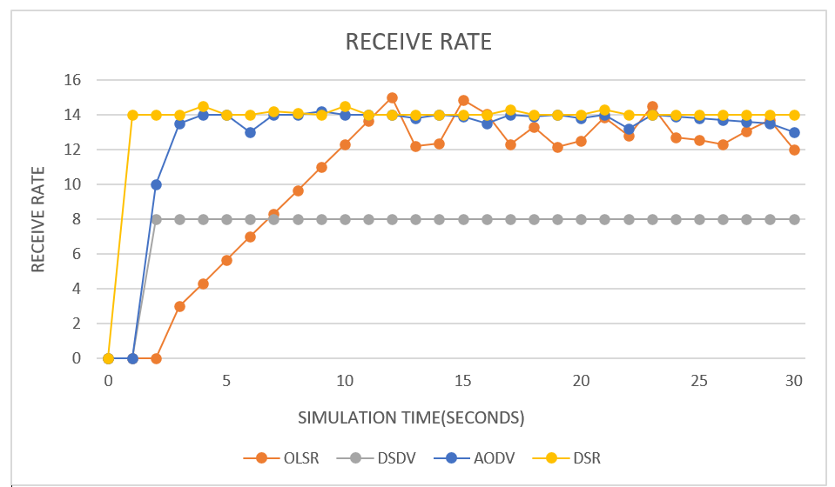
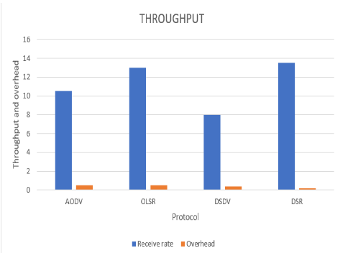
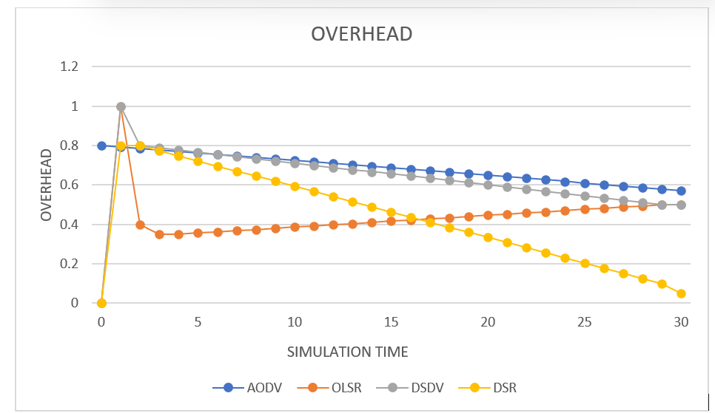
RESULTS
Fig(1)
OVERHEAD
Fig(2)
RECEIVE RATE
Fig(3)
THROUGHPUT

Slide 17
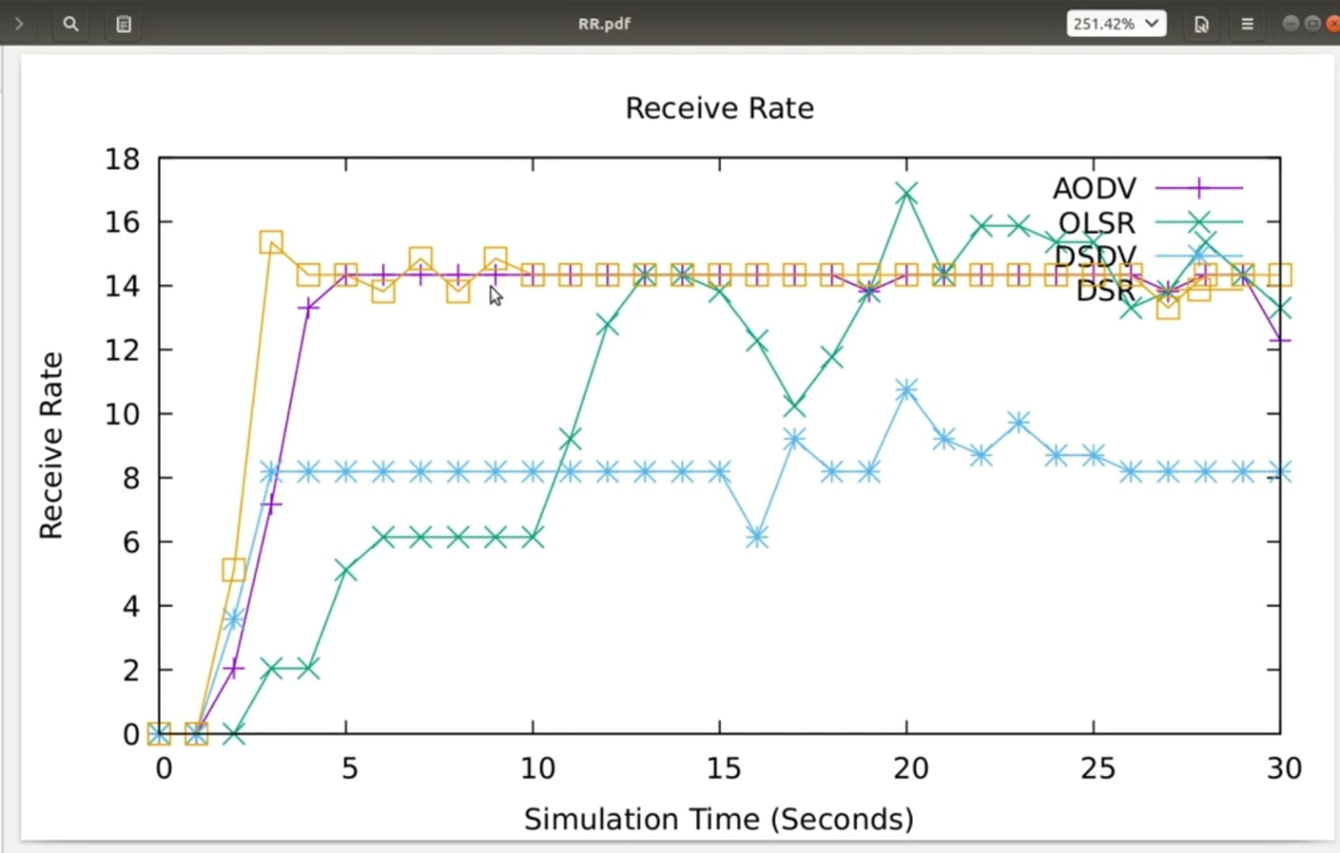
Receive rate v/s Simulation Time

Slide 18
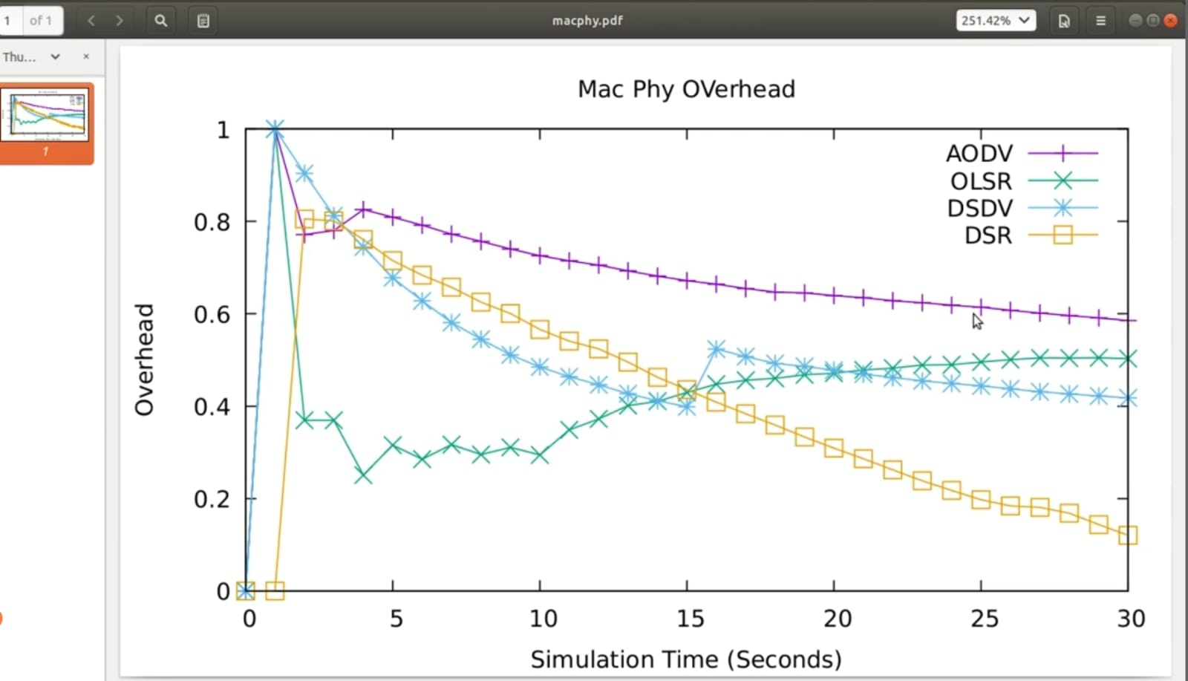
Overhead v/s Simulation time

Slide 19
Throughput

Slide 20
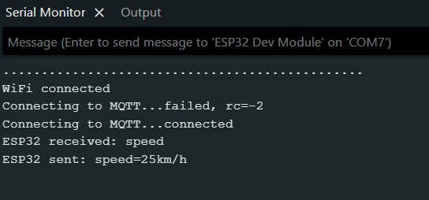
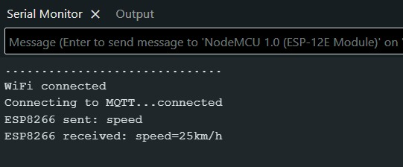
HARDWARE RESULTS:

Slide 21
APPLICATIONS:
Traffic Flow Optimization
Simulating real-world road scenarios with SUMO and analyzing communication protocols helps in designing systems that reduce congestion and improve vehicle flow efficiency.
Accident Prevention and Safety Enhancement
By modeling communication between vehicles (VANET) and simulating it in NS-3, you can evaluate how real-time alerts and data sharing help to prevent collisions and ensure road safety.
Smart City Traffic Management
Integrating vehicle communication with infrastructure and simulation tools supports smart city planning and intelligent traffic light control systems.
Protocol Performance Analysis
Comparing routing protocols in vehicular environments (e.g., AODV, DSR) helps in selecting the most efficient ones for different urban or highway conditions.
Autonomous Vehicle Research
Supports testing how autonomous or semi-autonomous vehicles interact and make decisions based on networked communication and simulated conditions.

Slide 22
FUTURE SCOPE:
Enable real-time collision avoidance and emergency alerts to improve road safety.
Integrate with 5G and AI for faster communication and smarter, predictive decision-making.
Expand to V2X communication to connect vehicles with infrastructure, pedestrians, and networks.
Enhance autonomous vehicle coordination for efficient platooning and traffic flow management.
Improve traffic congestion management and emergency vehicle priority through seamless data exchange.

Slide 23
CONCLUSION:
V2V communication is crucial for improving road safety and traffic flow.
Real-time data exchange between vehicles can reduce accidents and enhance driver awareness.
Using DSRC (Dedicated Short-Range Communications), V2V communication can be effectively implemented for reliable, low-latency communication.
V2V will play a key role in future smart transportation systems.
Implementing V2V with DSRC is essential to address current traffic management challenges.

Slide 24
REFERENCES:
[1] M. Alsudani, “The wireless communication between vehicles: exploring the potential of v2v and v2x communication for improved efficiency, safety, and sustainability: wireless communication between (v2v) and (v2i, v2x),” Journal of Millimeterwave Communication, Optimization and Modelling, vol. 3, no. 1, pp. 9–13, 2023.
[2] M. El Zorkany, A. Yasser, and A. I. Galal, “Vehicle to vehicle “v2v” communication: scope, importance, challenges, research directions and future,” The Open Transportation Journal, vol. 14, no. 1, 2020.
[3]M. Khanafer, F. Khalil, K. Waleed, R. Hamed, A. Rezk, and M. El Abd, “Roads: Road assistance for driver safety,” in 2024 IEEE Global Conference on Artificial Intelligence and Internet of Things (GCAIoT), pp. 1–6, IEEE, 2024.
[4 ]A. Zubow, C. Laskos, and F. Dressler, “Toward the simulation of wifi fine time measurements in ns3 network simulator,” Computer Communications, vol. 210, pp. 35–44, 2023.
[5] M. Alsudani, “The wireless communication between vehicles: exploring the potential of v2v and v2x communication for improved efficiency, safety, and sustainability: wireless communication between (v2v) and (v2i, v2x),” Journal of Millimeterwave Communication, Optimization and Modelling, vol. 3, no. 1, pp. 9–13, 2023.
[6] M. El Zorkany, A. Yasser, and A. I. Galal, “Vehicle to vehicle “v2v” communication: scope, importance, challenges, research directions and future,” The Open Transportation Journal, vol. 14, no. 1, 2020.
[7]M. Khanafer, F. Khalil, K. Waleed, R. Hamed, A. Rezk, and M. El Abd, “Roads: Road assistance for driver safety,” in 2024 IEEE Global Conference on Artificial Intelligence and Internet of Things (GCAIoT), pp. 1–6, IEEE, 2024.
[8]A. Zubow, C. Laskos, and F. Dressler, “Toward the simulation of wifi fine time measurements in ns3 network simulator,” Computer Communications, vol. 210, pp. 35–44, 2023.

