Slide 1
Sarcasm & Irony Detection
Team 15 Satya Swaroop Gudipudi
Aditya Raghuvanshi
Rohan Chowdary

Slide 2
Problem Statement & Challenges
In the realm of social media forums and chats, the pervasive use of figurative language (FL) like sarcasm, irony, and metaphor presents a significant challenge to sentiment analysis. The inherent contradictory and metaphorical nuances in these FL expressions complicate their identification in short texts. Particularly, sarcasm, defined as a figure of speech where the literal meaning is replaced by a figurative one – often opposite to the original – stands as a notable challenge in natural language processing. The task at hand is to effectively identify and interpret these FL forms. *Only baselines are available with no code access to reproduce the results mentioned in the reference paper.

Slide 3
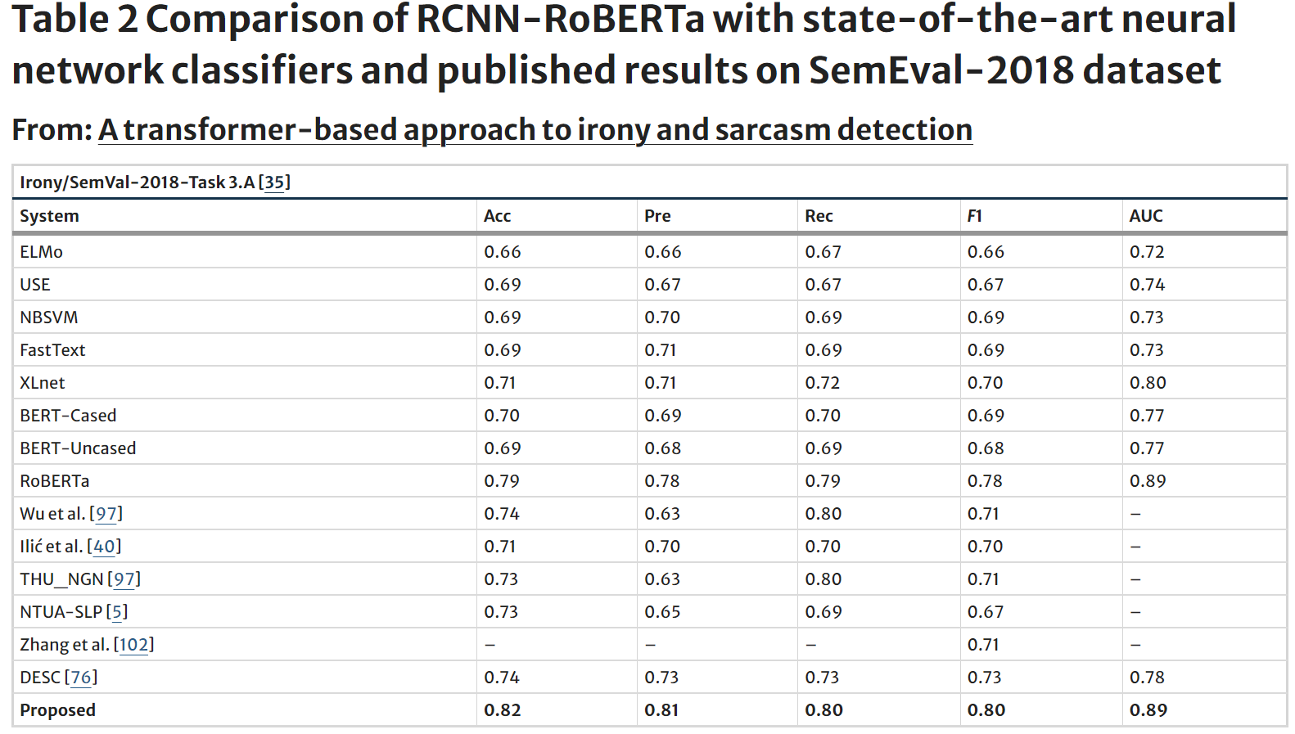
Baselines and Benchmark

Slide 4
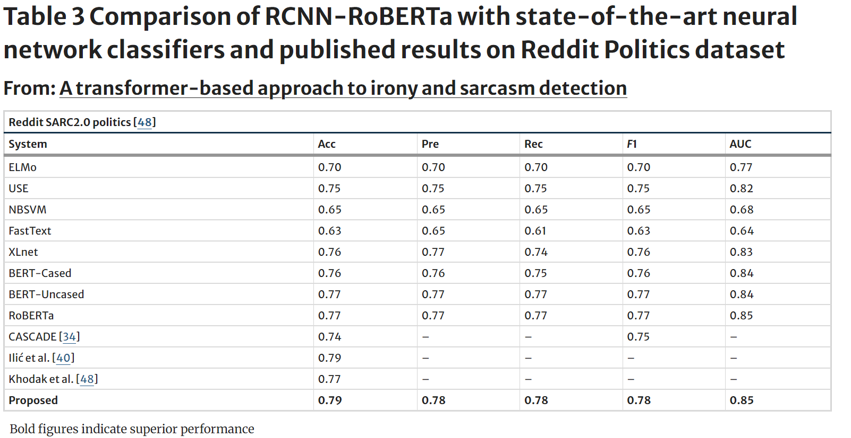
Baselines and Benchmark contd…

Slide 5
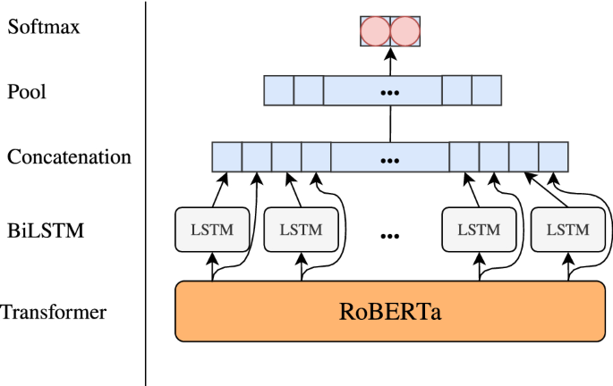
Benchmark Model architecture for reference

Slide 6
Observations on benchamarks
From the above tables referred from this paper, the proposed method that is RCNN-Roberta marginally exhibits improved confusion metrics over Roberta. And both Roberta and RCNN-Roberta have same AUC values. Our observation is even with proper threshold tuning Roberta model itself can perform equivalent to proposed and adding additional BiLSTM, Attention, Pooling layers may not be necessarily adding any value.

Slide 7
Experiment approaches

Slide 8
Data Centric Approach
Applied standard approaches like following:
Remarks:
The idea is to first look into the data and enrich it with reference to standard architectures
BiLSTM on pretrained static embeddings like Word2vec and FastText
Encoder based Transformer architecture with hyper parameter tuning and cross validation
We have heavily performed data preprocessing activities inorder to clean the tweeter data and identify if any special tokens can be added as special signals for the models like ‘[EMOTICON]’, ‘[ELONGATED]’. And grouped hashtags into special categories like abusive, feminist as additional hashtags.
Able to achieve AUC upto 0.702 on these standard architectures

Slide 9
Task Specific Positional Encoding
Decaying Exponential Positional Encoding
The positional encoding designed such that later positions in a sequence get a higher weight, and this weight decays exponentially towards the beginning of the sequence. This could be treated as a task-specific design choice for the problem of detecting irony, where the end of the sentence might hold more importance.
Remarks:
The Bert model is finetuned to detect irony or not using the custom exponential positional encoding. During this fine-tuning, the weights of all layers in the BERT model can be updated based on the new task-specific objective(irony detection) for the new dataset.
This finetuned bert performs better than the bert variant recorded in the paper.
But this finetuning approach is poorly performing or other transformer architectures like Roberta, Deberta etc.

Slide 10
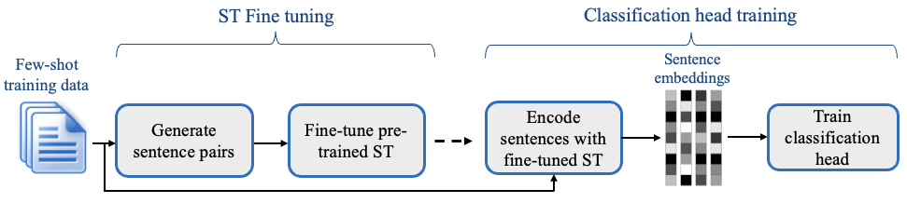
SetFit Efficient Few Shot Learning with Sentence Transformers
Setfit first in the intial fine tuning phase, it makes use of the limited labeled input data by contrastive training, where positive and negative pairs are created by in-class and out-class selection.
The sentence transformer model generates dense vectors per sentence. In the second step, the classification head trains on the encoded embeddings with their respective labels.
We additionally added voting classifier with soft voting to improve the performance.
We are able to achieve promising results with this approach almost beating all the baselines with performance on par with benchmark.

Slide 11
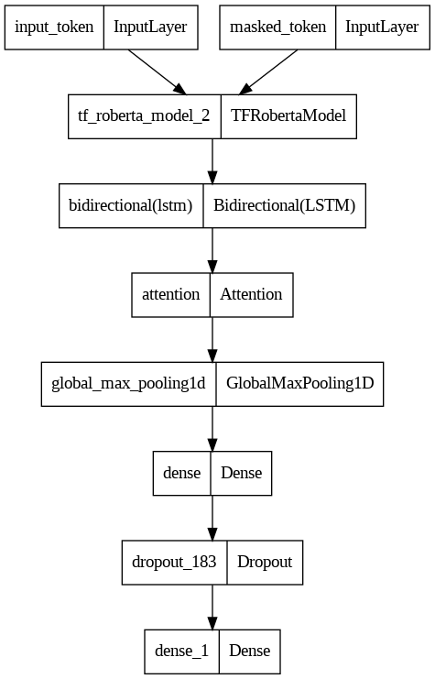
Fusion architectures & Transfer Learning
We referred to similar problem statements like hate-intensity prediction(regression) from this paper and have modified it to train with classification objective.
The results are not significantly different from finetuning foundation models.
We also attempted transfer learning approach by finetuning on tweeter pretrained model “BerTweet” for irony detection but performance is suboptimal

Slide 12
Results Revisited

Slide 13
Model Experiments revisited – irony detection
#Exp No | Model | Description | Accuracy | F1 | AUC
1 | BiLSTM with attention with word2vec embeddings | hid_dim: 256, num_layers:2, lr: 0.001, Adam optimizer | 0.4337 | 0.5723 | 0.5858
2 | BiLSTM with attention with fasttext embeddings | hid_dim: 256, num_layers:2, lr: 0.001, Adam optimizer | 0.5255 | 0.6092 | 0.6638
3 | Transformer Encoder | emsize = 200 d_hid = 200 nlayers = 2 nhead = 2 dropout = 0.1 | 0.6454 | 0.6128 | 0.7028
4 | Bidirectional encoder | hidden_size=256, num_attention_heads=4, num_hidden_layers=2, intermediate_size=1024, | 0.6429 | 0.5018 | 0.6619
5 | Bert BiLSTM | Bert_dropout = 0.1, LSTM_units = 512, dense_units = 50 | 0.61 | 0.16 | 0.673
5 | Bidirectional Encoder with Exponential Positional Encoding | d_model = 768, Bert configurations | 0.719 | 0.69 | 0.81
6 | SetFit with sentence-t5-base body and voting classifier head | Num_epochs = 1, num_iterations = 25 | 0.769 | 0.746 | 0.85
7 | Baseline (RCNN – Roberta) | Baseline | 0.82 | 0.80 | 0.89

Slide 14
Model Experiments revisited – Sarcasm detection
#Exp No | Model | Description | Accuracy | F1 | AUC
1 | Bidirectional encoder | hidden_size=512, num_attention_heads=4, num_hidden_layers=3, intermediate_size=2048, hidden_dropout_prob=0.1, attention_probs_dropout_prob=0.1, | 0.6866 | 0.7644 | 0.7277
2 | Baseline (RCNN – Roberta) | Baseline | 0.79 | 0.78 | 0.85

Slide 15
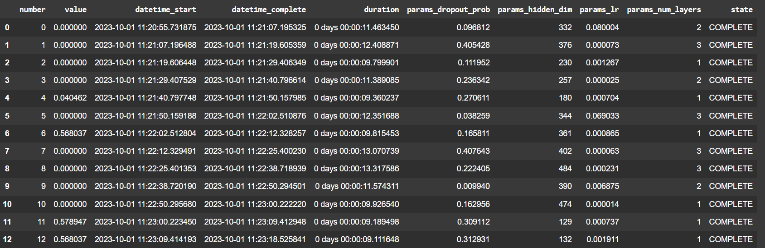
Hyper parameter trials with optuna and ray

Slide 16
Achievements and Learnings
Our Bert variant finetuning with novel exponential task specific encoding is marginally outperforming Bert variant mentioned in the reference paper.
We are able to achieve promising results on benchmark datasets with alternative unexplored frameworks outperforming most of the model architectures mentioned in the reference paper here.
We have approached the problem holistically to incrementally improve the performance of model right from data centric to fusion architecture approaches by experimenting simple to complex models.
We have successfully applied our learning to an interesting code mix data “Hinglish” for irony detection.

Slide 17
Further improvements
"After closely studying the problem, we identified several potential improvements worth exploring:
RPE (Relative Position Encoding): This was introduced in the Transformer-XL model. Unlike traditional positional encodings that assign absolute positional embeddings, RPE calculates embeddings based on the relative positions between tokens.
1D Convolutional Layers: While these aren't technically positional encodings, introducing a few 1D convolutional layers before inputting data into the Transformer could help the model capture local patterns. This is because convolutions inherently consider the relative positions of adjacent tokens.
Data Cleaning: Clean the label errors with state of the art confident learning algorithms that estimate label noises.
Decoding with LLM-based Models: It might be intriguing to explore how LLM-based models perform in decoding for classification tasks.
Hyperparameter Tuning: We also recommend further tuning of hyperparameters, especially when experimenting with different model embeddings.“

Slide 18
Conclusion
We started with basic implementations like BiLSTMs as baseline and incrementally experimented with simple to complex architectures like task specific positional encoding, fine-tuning, transfer learning, few shot training and fusion models, where we improved the auc from 0.585 to 0.85. We are able to achieve almost equivalent results of benchmark[1] and our novel model architecture implementations are beating some of the baselines mentioned in [1] despite not having code access to the benchmark models. We have applied experiments on Irony and Sarcasm datasets and compared with benchmarks. We also successfully trained irony and sarcasm detection for code mix “Hinglish” data.
References:
1. SemEval-2018 Results
2. Reddit Politics Dataset results
3. Hate intensity prediction

