Slide 1

Semantic Textual Similarity (STS)
Team 4
Satya Swaroop Gudipudi, Harinie Sivaramasethu, Aditya Raghuvanshi

Slide 2
Index
Problem Statement
Approaches
Model designs
Experiment results
Explainability
Extensibility
Conclusion

Slide 3
Problem Statement
The objective of this project is to design and develop an algorithm for measuring the semantic similarity score (STS) between paired snippets of text. These text snippets can range from short to long in length. The STS score is a numerical representation of the degree of semantic equivalence between the two texts and will be measured on a scale of 0 to 5.
Approach1: Calculate cosine similarity: Once we have vector representations of the text, we will calculate their cosine similarity. Cosine similarity measures the cosine of the angle between two vectors, and ranges from -1 (opposite directions) to 1 (same direction).
· To convert this value to a scale of 1 to 5, we will use the following formula:
STS score = (cosine similarity + 1) * 2.5
Approach2: Approach1 may not scale well to support long texts and it may not capture enough latent semantic relationships in the text. We can extend by feeding these embeddings as inputs to bidirectional LSTM that learn forward representation and backward representation of the texts. It will be a regression task and will use mean squared error as the loss function.

Slide 4
Model Designs
Design1: BiLSTM Sentence Embedding
Padded Sentence1
BiLSTM
Input Embedding
MLP
Output as Regression scores
Padded Sentence2
BiLSTM

Slide 5
Model Designs
Design2: Mean averaged Word2Vec BiLstm Attention
1
2
3
Sentence1 mean
input embeddings
BiLSTM
Self Attention
Output as Regression scores
Word Embeddings
2
8
10
Sentence2 mean
concat
Word Embeddings

Slide 6
Model Designs
Design3: Siamese BiLSTM neural network with self attention
Word2vec embeddings of sentence1
BiLSTM
Soft Attention
FC Linear Layer
Output as Regression scores from 0 to 1
Word2vec embeddings of sentence2
BiLSTM

Slide 7
Model Designs:
Design4:
Load Pretrained models and fine tune for the current dataset like:
Fine tune Doc2vec model on current dataset
Fine tune BERT model to achieve state of art like results

Slide 8
Model Designs:
Design5:
SVD approach for cross lingual:
Get fast text embeddings for source and target language
Concatenate them and create a common matrix
Now apply SVD normalization
The normalized matrices can be used for common embeddings for both the source and target languages.

Slide 9
Experiments
Exp No | Model Name | Design Type | Optim Func | Train Data r value | Val Data r value | Test Data r value
1 | Word2vec Mean Embeddings | Approach1 | Normalized Cosine Score | 0.64 | 0.68 | 0.55
2 | Doc2Vec Embeddings | Design3 | Normalized Cosine Score | 0.52 | 0.61 | 0.52
3 | Pretrained BERT Embeddings | Design4 | Normalized Cosine Score | 0.87 | 0.79 | 0.76
4 | FineTuned BERT Model | Design4 | MSE | 0.96 | 0.85 | 0.81
5 | Word2vec Mean BiLSTM, GRU, Attention | Design2 | MSE | 0.97 | 0.38 | 0.34
6 | Sentence Encoder BiLSTM -MLP | Design1 | MSE | 0.4 | 0.01 | -0.04
7 | Doc2Vec BiLSTM, GRU, Attention | Design4 | MSE | 0.9 | 0.38 | 0.33

Slide 10
Experiments Contd…
Exp No | Model Name | Design Type | Optim Func | Train Data r value | Val Data r value | Test Data r value
8 | Siamese BiLSTM | Design3 | PearsonLoss | 0.18 | 0.09 | 0.13
9 | Cross Lingual Siamese BiLSTM for en-es | Design3 | MSE Loss | 0.153 | 0.08 | 0.103
10 | Cross Lingual SVD Based | Design4 | Cosine Similarity | 0.15 | 0.07 | 0.08

Slide 11
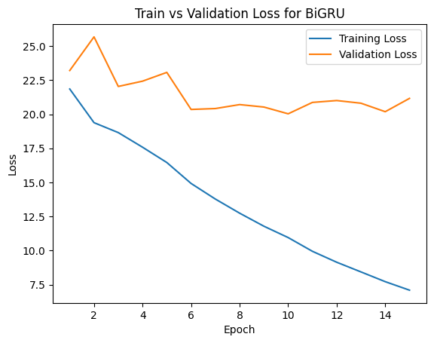
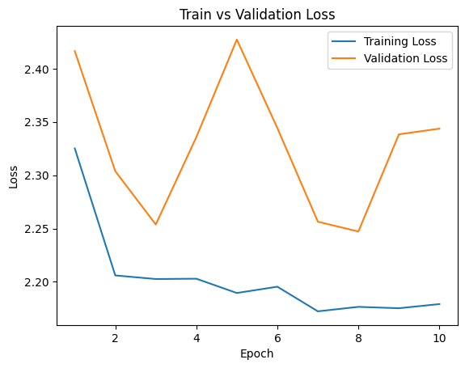
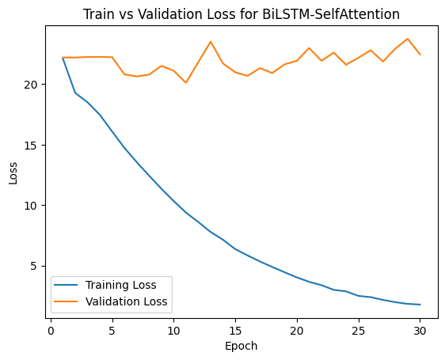
Train vs Validation Losses
Observation: Neural networks are overfitting due to less data as training data is only 5749 sentence pairs with vocab size of 8306

Slide 12
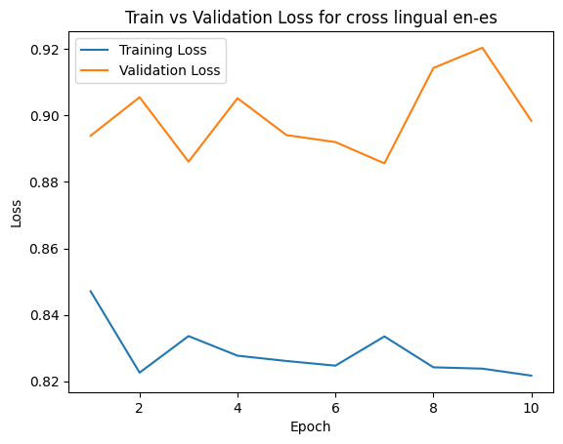
Train vs Validation Losses Contd
Observation: It appears that the training loss and validation loss are fluctuating and not decreasing consistently over the 10 epochs. This suggests that the model may not have converged to the optimal solution yet.

Slide 13
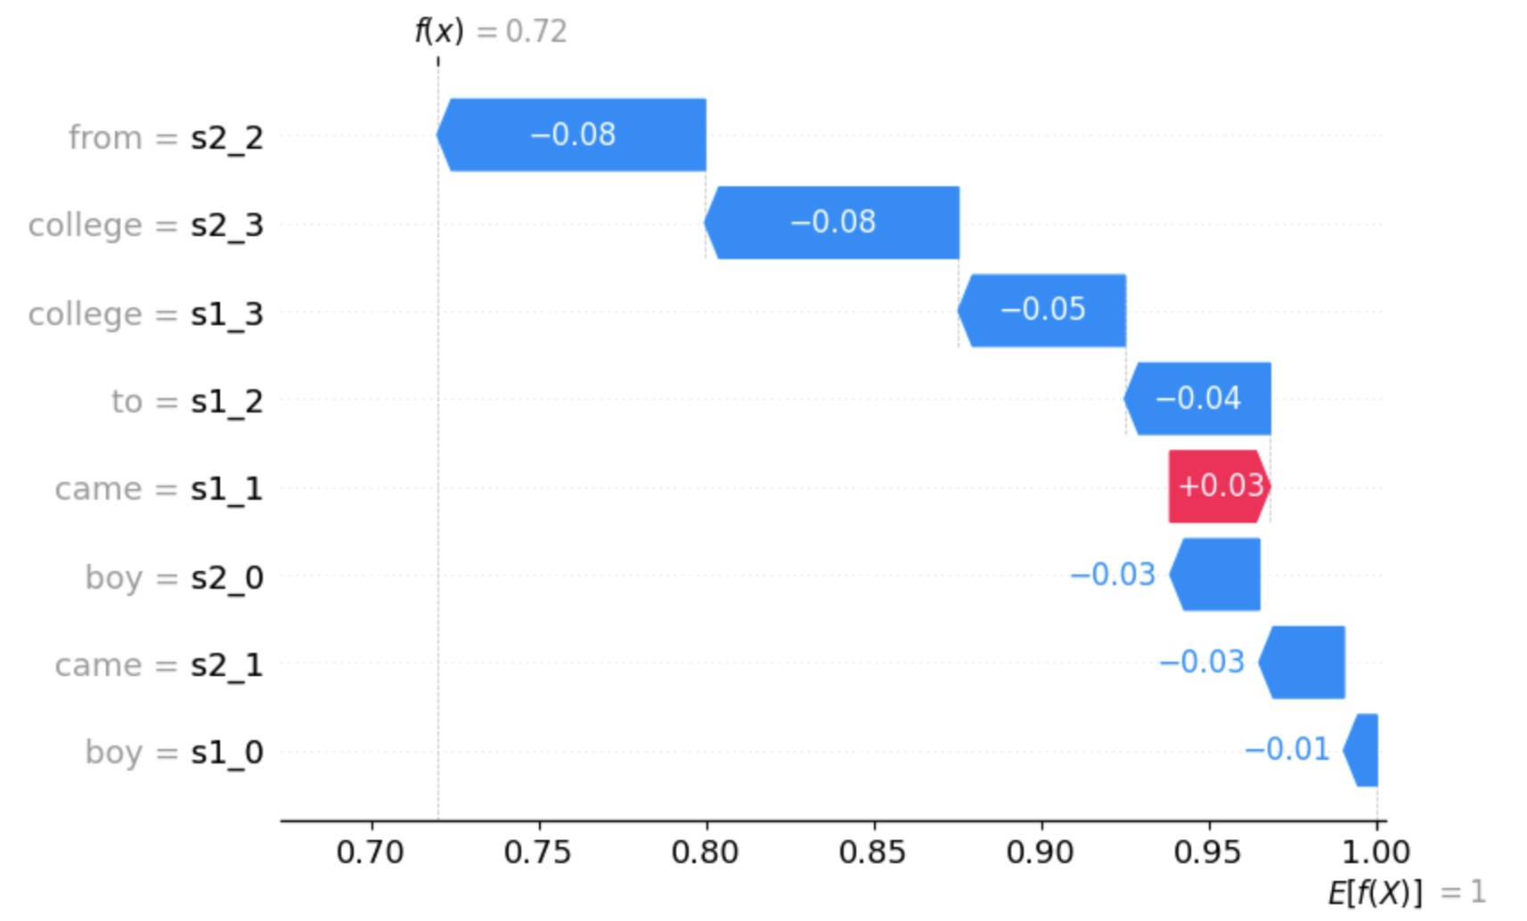
Explainability
As per RAI guidelines, all ML models needs to be explainable.
But neural networks are less interpretable hence we need to use black box based explanation frameworks like SHAP to understand which words are playing how much contribution in the similarity score generation.
Along with explainability to end users this analysis would also be really helpful in debugging the model as post-hoc analysis
Interpretation:
The words “from” and “to” are the top contributing features and they are opposite in their contribution to similarity score. Logically meaningful.
Input:
Sent1: “boy came from college”
Sent2: “boy came to college”

Slide 14
Extensibility
Semantic search is a very powerful and fundamental to real world applications like question-answering. Sent1: “Where is Swaroop going” Sent2: “Swaroop is going to college” Based on input query and similarity score the most matching sentence to be retrieved
Existing explainability frameworks are not effective in explaining how models works especially LLM and neural network models. More research to be conducted to generate human friendly explanations through counterfactual explanations.

Slide 15
Conclusion
In this project we have applied various deep learning and traditional model architectures to generate sentence similarity scores. We have demonstrated and documented reproducible experiments for reference. Overall we have explored 4 types of designs.
We trained models on both multi lingual (en-en, es-es) and cross lingual (en-es) sentence pairs and generated semantic similarity scores.
Explainable STS: We also researched and extended our implementation with explainability and generated shap waterfall plots for the same.

