Slide 1

Meet Tom. Every night his kitchen fills a bin, and nobody knows what is in it.
Wall-B is the little robot on the wall above the bin: it weighs every tip, sees what it is, and tells the team what to change tomorrow.
290 million ton
1 in 5
36 kg
food wasted by restaurants, canteens and hotels in 2022
of all food available to consumers ends up wasted
wasted in food service per person per year, worldwide
Source: UNEP Food Waste Index Report 2024 (data for 2022).
Notes:
0:00-0:30 Meet Tom. Tom is head chef in a canteen that serves 400 meals a day. Every night his team carries out a full bin of food, and every morning Tom asks: what did we actually throw away? Nobody knows. And Tom isn't alone: restaurants, canteens and hotels wasted 290 million tonnes of food in 2022. A full bin tells you nothing: not which food, not how much, not why. So we built Tom a new kitchen helper: Wall-B.

Slide 2
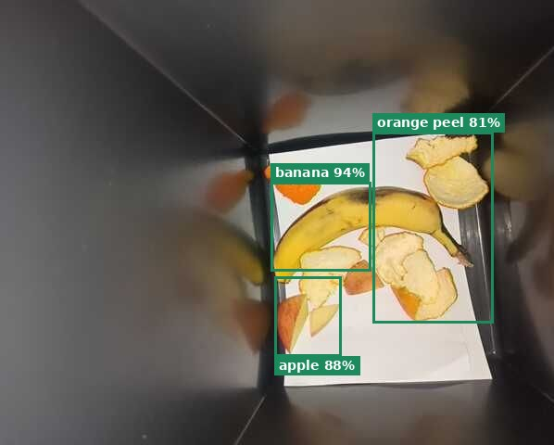
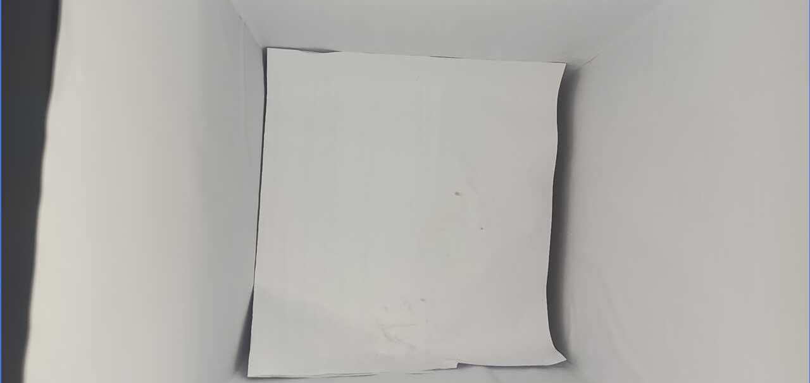
One tip, one touch, one record
Wall-B
What happens every time someone throws food into the bin
1
2
3
4
5
Tip
Weigh
Recognise
Type
Record
Cook tips waste in as usual
Load cell weighs this tip only
Camera cuts out what was added and names it, on site
One touch: preparation, spoiled or plate
Time, grams, type, food, photo
1 Preparation
2 Spoiled
3 Plate
Prototype: ESP32 + HX711 + 5 kg load cell under the bin insert, a phone as camera, recognition on a laptop (open CLIP model, works offline).
Menu-aware: each kitchen gets its own item list; new items are taught with a few photos.
Notes:
0:30-0:55 When a cook tips something in, Wall-B weighs that single tip, the camera compares before and after and names what was added, locally, no cloud and no faces. The cook presses one button: preparation, spoiled or plate. One tip, one touch, one record: time, grams, type, food and photo.

Slide 3
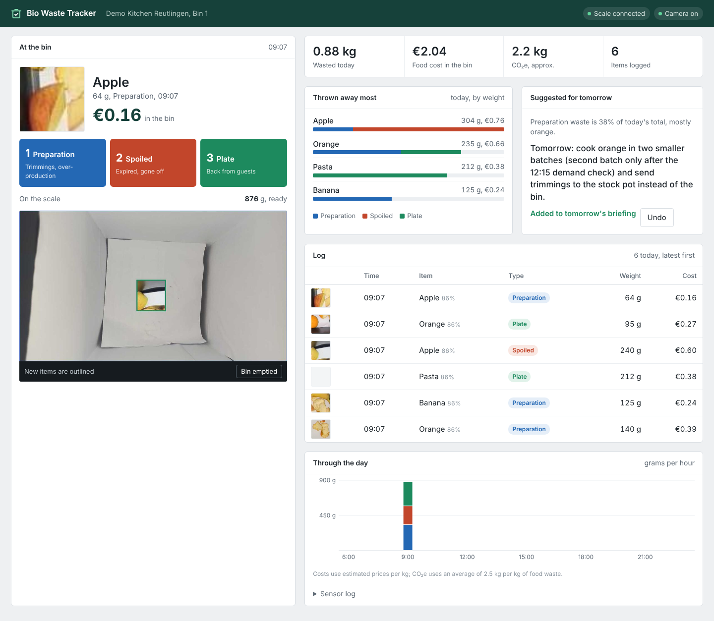
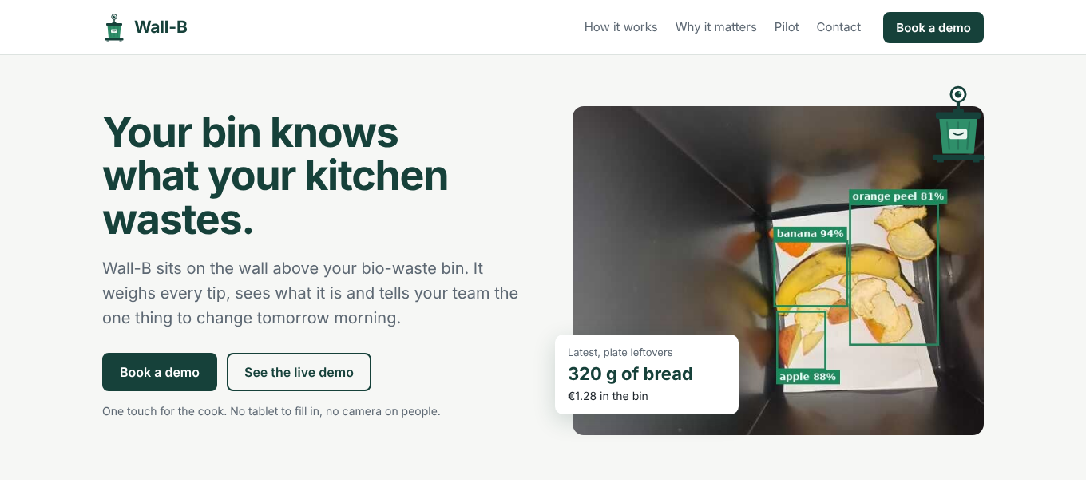
Live: the kitchen dashboard and the website
Wall-B
Every record appears instantly; managers book a demo on the website
Dashboard
Photo, weight and € cost per tip; Basic vs. Pro plan in one click
Insights
Suggestion for tomorrow, purchasing hints, repeat alerts
Website
Live pilot numbers, Book a demo, See the live demo
Notes:
0:55-1:40 LIVE DEMO (switch to localhost:8000). Throw broccoli, press 3: photo, grams and cost appear instantly. Throw a banana, press 2: purchasing hint. Click 'Add to tomorrow's briefing'. Switch Basic to Pro to show the plans. Then show localhost:8000/site: the website with live pilot numbers and 'Book a demo'. Backup: these screenshots.

Slide 4
What our demo run showed, honestly
Wall-B
Live run at the hackathon, 7 Nov 2026
4
60 g
65 %
278 g
tips logged
weighed tip by tip
plate leftovers
reference reads back exactly
What the kitchen learns
Decisions and risks
Biggest stream: plate leftovers, mostly broccoli
Tomorrow: serve 15 % smaller broccoli portions, free refills on request
Keeps coming back: guests left the noodles twice
Purchasing: spoiled items trigger 'order about X kg less per week'
Weigh each tip on an insert, not the whole bin (5 kg cell); product: platform scale
Type by one touch: a camera sees broccoli, not whether it came from a pot or a plate
Touching items merge: seen in our run; cooks throw on a free spot
Forgotten type: yellow prompt, otherwise flagged as a guess
Costs and CO₂e are estimates (CO₂e: Poore & Nemecek 2018 via Our World in Data).
Notes:
1:40-2:10 In our live demo run Wall-B logged every tip: plate leftovers were 65 percent, mostly broccoli, and the noodles came back twice. So Tom's measure for tomorrow isn't a guess: smaller broccoli portions with free refills. And honestly: the 278 g reference reads back exactly, every tip was named, touching items merge, so cooks throw on a free spot, and when Wall-B is unsure it says unknown instead of guessing.

Slide 5
From one bin to 1,000 kitchens
Basic €19 / bin / month
Pro €39 / bin / month
Scale
Weight, type, photo and € per tip
Daily totals and comparisons
One suggestion for tomorrow
Purchasing hints: order less of X
Repeat alerts with recipe ideas
Service periods, spoilage trend
Hardware about €160 per bin, clip-on
Set up from the menu in 10 minutes
Next: pot vs. plate detection, POS link
Wall-B. Every tip counts.
Team Wall-B: Sai, Sunil, Manyam, Sumanth, Sai. Live at localhost:8000/site
Prices are draft estimates. Corporate Innovation Challenge WS26 with WebMeister360.
Notes:
2:10-2:30 Wall-B clips onto any existing bin for about 160 euro in hardware, with a Basic and a Pro plan. A new restaurant is set up from its menu in ten minutes, and every correction makes every Wall-B smarter. Tom still carries out a bin every night. But now he knows exactly what's in it, and what to buy less of tomorrow. Wall-B. Every tip counts.

