Slide 1
Notes:
0:00-0:05 Hi, we are Team Wall-B. We built a bin that knows what a kitchen throws away.

Slide 2
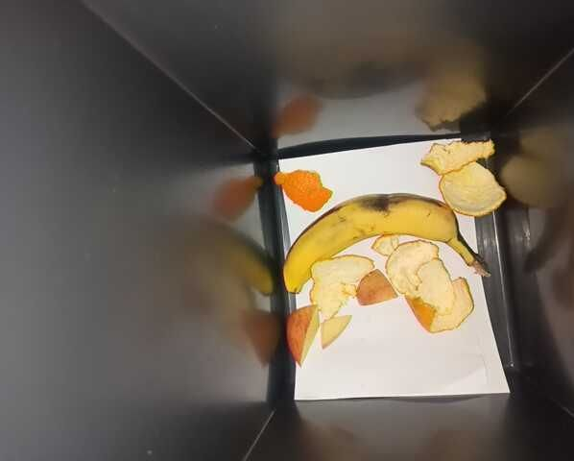
Every kitchen bin hides money nobody sees
290 million t
of food were wasted by restaurants, canteens and hotels worldwide in 2022
The bin is full at night. But which item, how much and why?
Wall-B answers that for every single tip, and tells the team what to change tomorrow.
Source: UNEP Food Waste Index Report 2024
Notes:
0:05-0:25 Every professional kitchen has a bio-waste bin. At the end of the day it is full, but nobody knows what is in it, how much of it, or why it was thrown away. Worldwide, food service wasted 290 million tonnes of food in 2022 (UNEP). You cannot reduce what you do not measure. That is what Wall-B does.

Slide 3
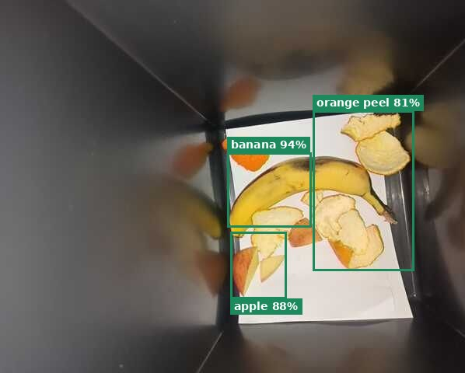
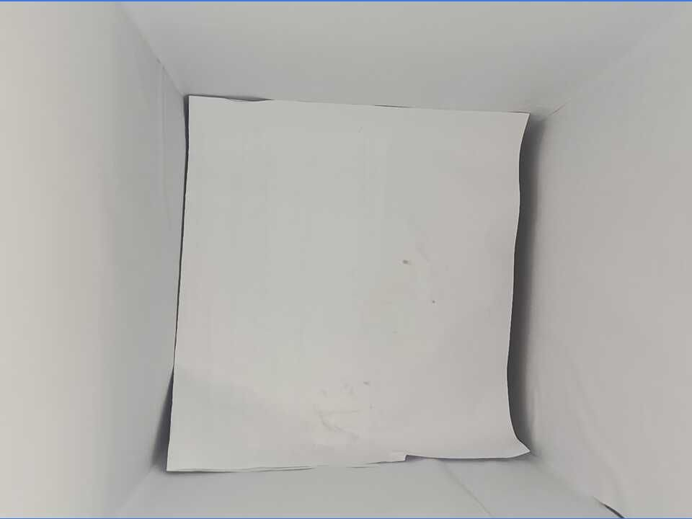
One tip, one touch, one record
1
2
3
4
5
Tip
Weigh
Recognise
Type
Record
Cook tips waste into the bin as usual
Load cell records the weight of this tip
Camera cuts out what was added and names it, on site
One touch: 1 preparation, 2 spoiled, 3 plate
Time, grams, type, food, photo
1 Preparation
2 Spoiled
3 Plate
Prototype: ESP32 + HX711 + 5 kg load cell, phone as camera, recognition on a laptop (CLIP model, runs offline).
Camera view: new items outlined (left), lined bin, no reflections (right)
Notes:
0:25-0:45 How it works. The cook tips food into the bin. A load cell weighs each tip on its own. A camera above the bin compares before and after and recognises what was added, locally, no cloud, no faces. The cook presses one of three buttons for the type: preparation, spoiled, plate. Wall-B writes one record: time, grams, type, food.

Slide 4
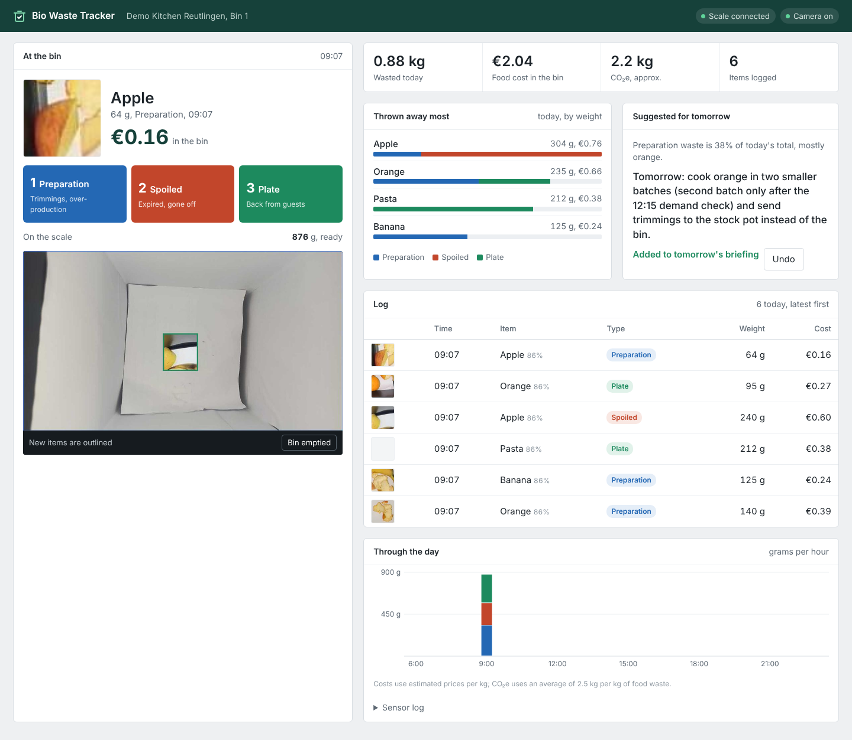
Live demo
Three disposals, straight onto the kitchen dashboard
1
Pasta, key 3
Plate leftovers: photo, 212 g, €0.38 appear at once
2
Banana, key 2
Spoiled stock: 'order about 2 kg less banana per week'
3
One click
Tomorrow's action goes into the kitchen briefing
Notes:
0:45-1:30 LIVE DEMO. Switch to the browser (localhost:8000). 1) Throw in pasta, press 3: record appears with photo, grams and cost. 2) Throw in a banana, press 2: purchasing panel says order less banana. 3) Point at 'Suggested for tomorrow' and click 'Add to tomorrow's briefing'. Backup if the demo fails: this screenshot.

Slide 5
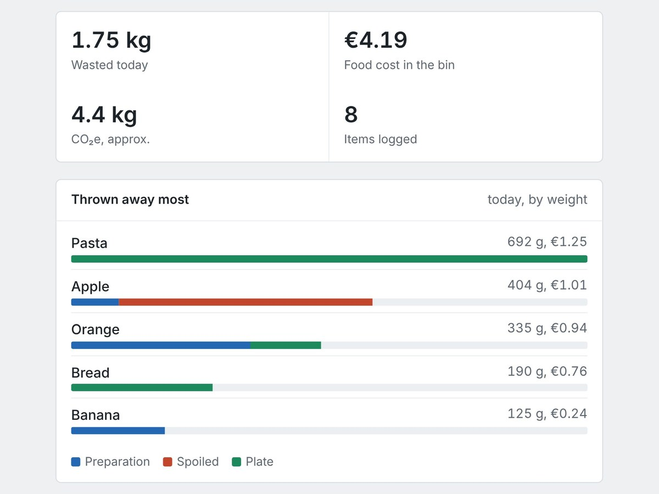
What one test run already tells a kitchen
[24]
[3.1 kg]
[€7.40]
disposals logged
wasted, weighed per tip
food cost, estimated
Biggest stream: [Plate leftovers, 54 %, mostly pasta]
Tomorrow: [serve 15 % smaller pasta portions, free refills on request]
Purchasing: [order about 2 kg less banana per week, €3.90]
Repeats: [guests left the pasta 3 times]
Orange values: replace with the real test run before submitting
Notes:
1:30-1:55 Our test run: [N] disposals over [time span]. Weight per tip, type and food for every one. The biggest stream was [plate leftovers, mostly pasta]. So the measure for tomorrow morning is [smaller pasta portions with free refills]. And for purchasing: [order less banana].

Slide 6
Our decisions, and how good it really is
1
Weigh each tip, not the whole bin
Measured in our test run
5 kg cell under a light insert; product version: 4-cell platform scale
[±3 g]
[8/10]
[1]
2
Type by one touch
weight error per tip
items named correctly
tips missed
A camera sees pasta, not whether it came from a pot or a plate
Top 3 risks and what we do
3
Recognise on site, per menu
Cook forgets the type
Yellow prompt; time-of-day guess, flagged as low confidence
No cloud, no faces; each restaurant's own item list, taught with photos
Pile shifts, items hidden
Before/after cut-out; the scale confirms one item was added
Unknown or non-food item
Logged as 'unknown' instead of a wrong guess; one-click teach
Notes:
1:55-2:15 Three decisions. A small weighing insert instead of the whole bin, because the kit has a 5 kg cell. One-touch type keys, because a camera sees pasta but not where it came from. Local recognition with a per-restaurant item list, because privacy and accuracy. Honest numbers: [weight error], [recognition rate], and the three biggest risks with what we do about them.

Slide 7
From one bin to 1,000 kitchens
Cost per bin
Install and run
10 → 1,000 kitchens
Prototype: about €25 in parts
Product: about €160 (4-cell scale, camera, edge computer, housing)
Plan: €39 per bin per month, hardware at cost
Clip-on unit above the existing bin, one socket, Wi-Fi
Onboarding from the menu in about 10 minutes
Remote updates; we swap faulty units
10: per-kitchen profiles, weekly report
100: shared photo library from every correction
1,000: purchasing and POS integration, group dashboards
Next on the roadmap
Camera reads the container in the throw (pot vs. plate) to set the type automatically
Order quantities from weeks of data plus the kitchen's purchase history
Prices are estimates for the draft; business model to be confirmed by the team.
Notes:
2:15-2:25 From one bin to a thousand kitchens. Hardware about [160 euro] per bin, installed above the existing bin. Subscription per bin. Onboarding from the menu in ten minutes, every correction improves a shared photo library. Next: detect pot versus plate from the throw to get the type automatically, and connect to purchasing.

Slide 8

The bin that tells your kitchen what to buy less of tomorrow
Weighed, typed, timed and named: every single tip
Makers of Wall-B: Sai, Sunil, Sai, Manyam, Sumanth, Philip
Live demo and website: localhost:8000/site
Notes:
2:25-2:30 Wall-B: the bin that tells your kitchen what to cook, serve and buy less of tomorrow. Thank you.

Slide 9
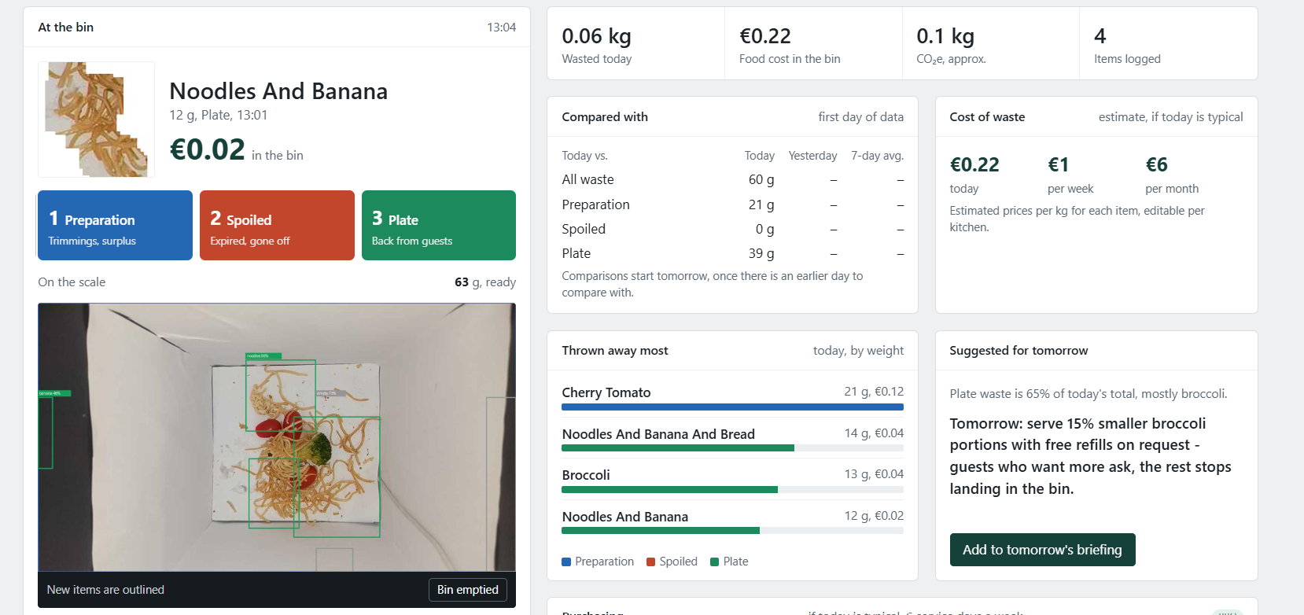

Slide 10
Appendix: one record per disposal
Log file station_events.csv, one line per tip, plus a raw sensor log with every failure
Field | Example | Meaning
timestamp | 2026-11-07T09:36:48 | laptop clock when the tip settled
weight_g | 212.0 | weight jump of this tip only
type | plate_leftovers | key 1/2/3 or hardware button; else time rule
station_id | bin-1 | which bin
confidence / source | high / key | low = type guessed from the time of day
food / food_conf | pasta / 0.86 | camera result for the cut-out
image_id | 20261107_093648_0.jpg | cut-out photo for checking and teaching
Notes:
Appendix, not presented: data format (D2).

Slide 11
Appendix: risks and mitigations
Risk | Effect | Mitigation
Type forgotten | Missing origin data | Yellow prompt on screen; time rule fallback marked low confidence; reported daily
Items hidden in the pile | Wrong or missing food name | Before/after cut-out per tip; empty bin regularly; weight confirms one tip
Liquids, wet waste | Weight drifts, camera blur | Insert with drip tray; drift tracking in firmware; liquids logged as 'unknown'
Lighting and reflections | False changes in the picture | White matte liner, locked exposure, area of interest
Power or Wi-Fi loss | Lost records | Calibration in flash; USB/serial logging works offline
Privacy | Staff on camera | Camera points only into the bin; processing on site; only cut-outs stored
Notes:
Appendix, not presented: full risk list (D6).

