Slide 1

Meet Tom.
A full bin. Every night. Nobody knows what's in it.
290 million ton
food wasted in food service, 2022 (UNEP)
Wall-B · WebMeister360 challenge · CIC WS26
Notes:
Meet Tom: head chef, 400 meals a day. Every night a full bin, every morning the same question: what did we throw away? Nobody knows. Food service wasted 290 million tonnes in 2022 (UNEP). So we built Tom a helper: Wall-B.

Slide 2
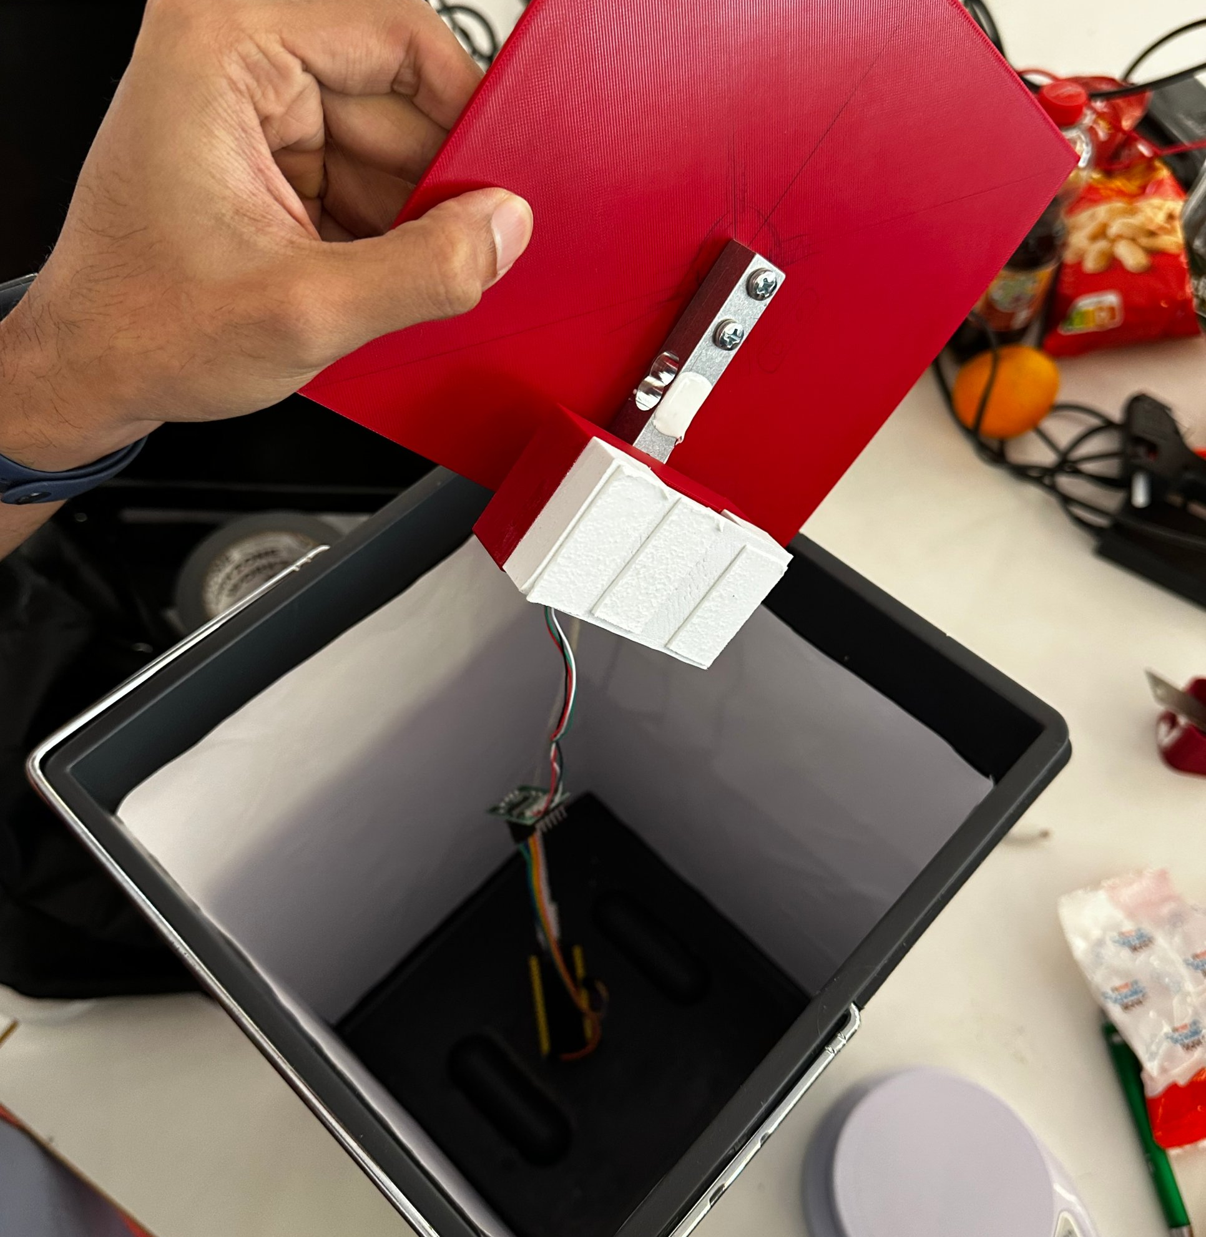
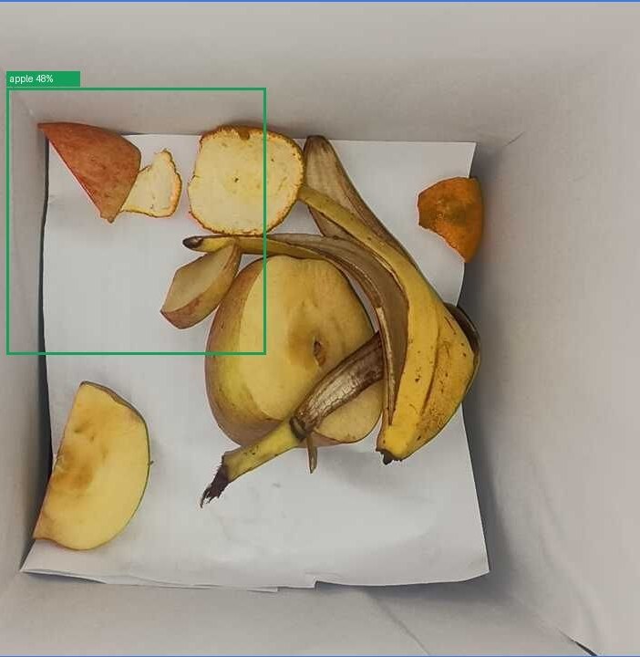
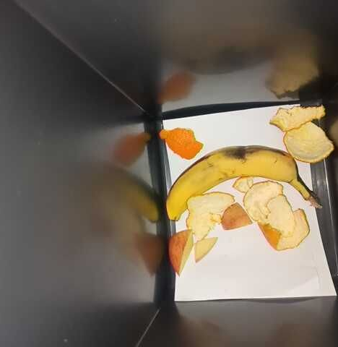
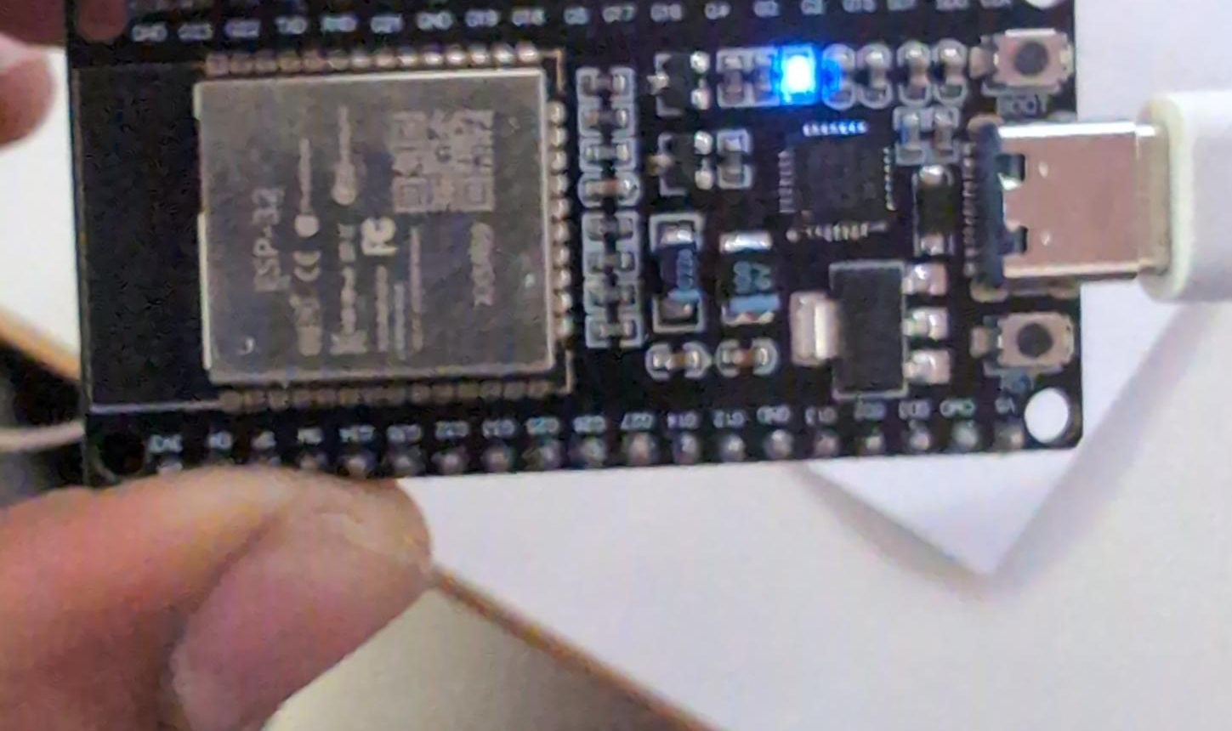
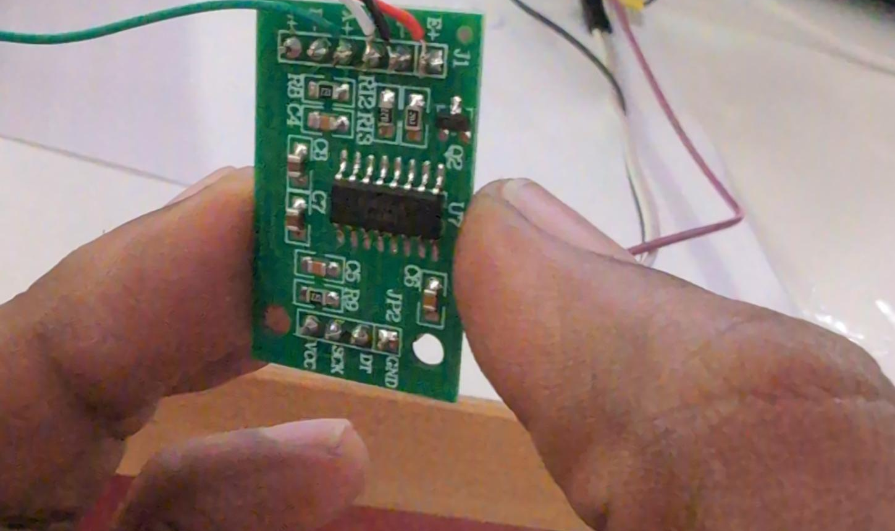
Weigh. See. Tap.
Wall-B
Weigh
load cell, to the gram
See
camera + AI, offline
Tap
1 prep · 2 spoiled · 3 plate
ESP32 + HX711 + 5 kg load cell + phone camera · under €30 hardware
Notes:
Wall-B does three things. Weigh: a load cell under the bin, ESP32 and HX711, catches every tip to the gram. See: a camera above recognises the food with an open-source vision model, offline. Tap: the cook presses one of three big buttons: preparation, spoiled or plate. Five seconds, no typing.

Slide 3
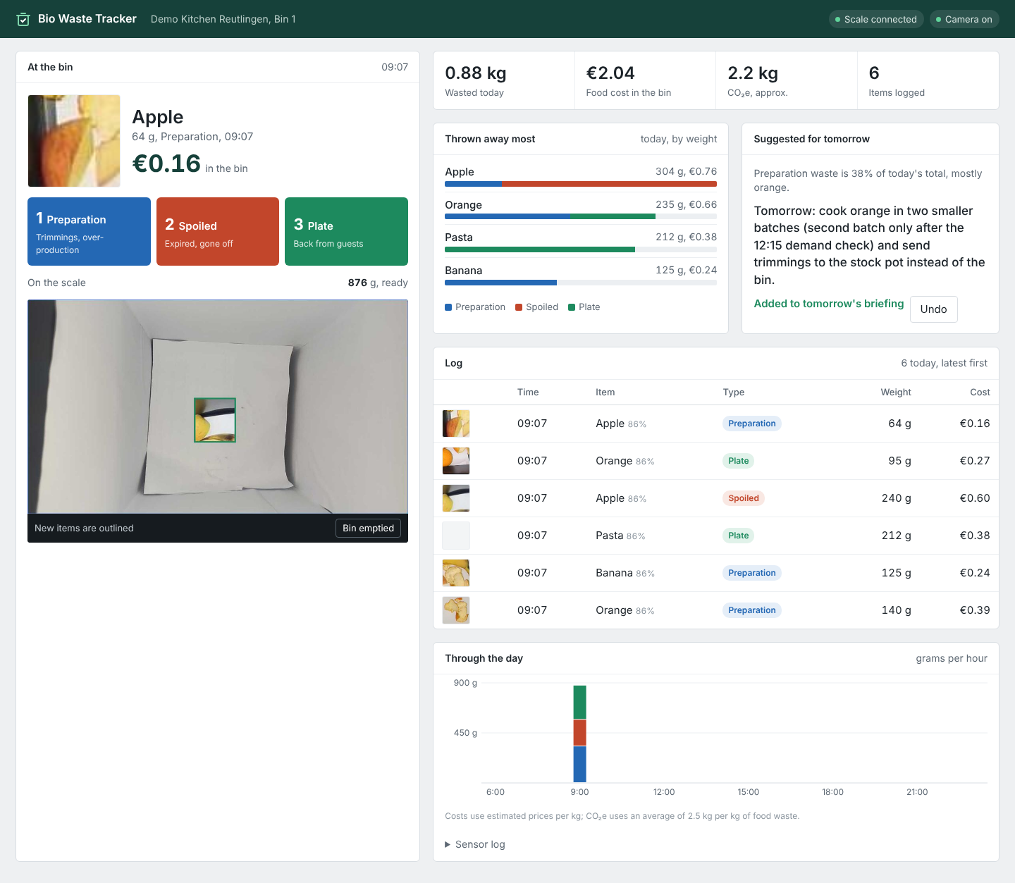
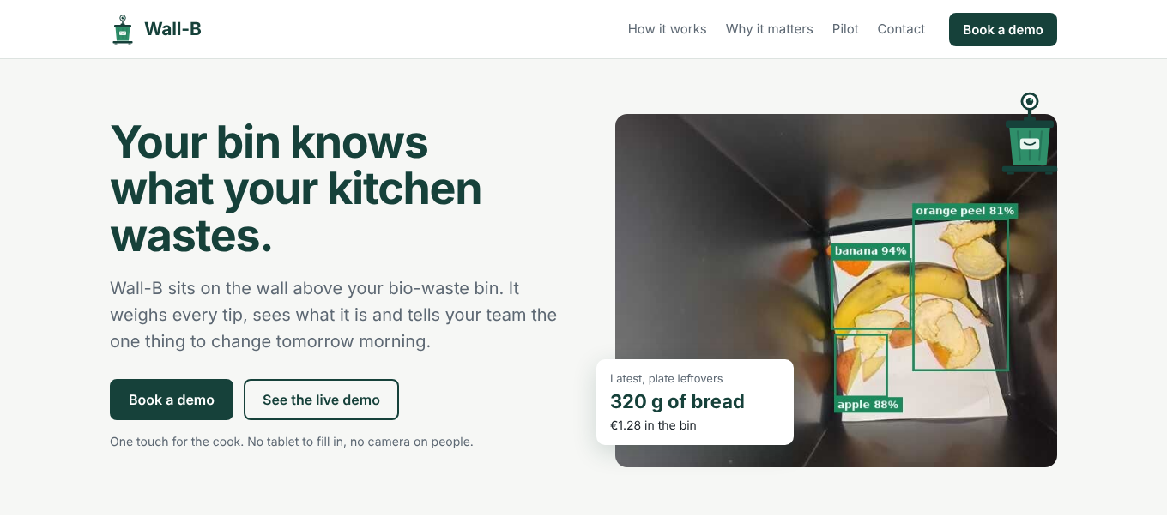
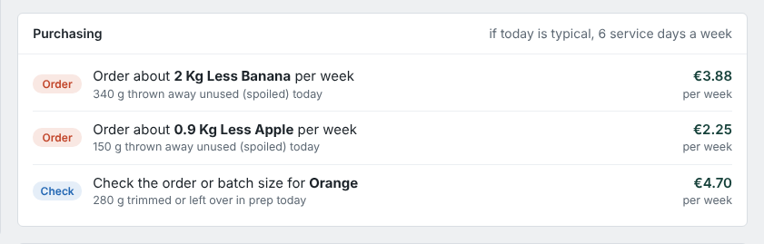
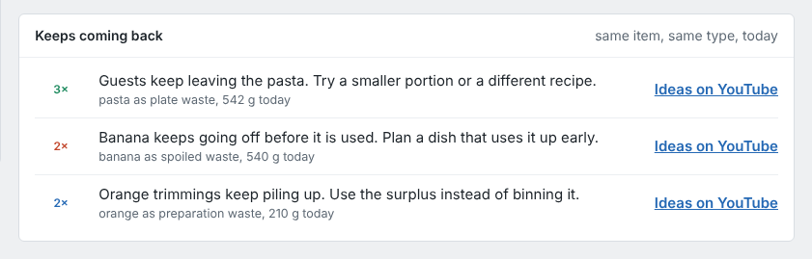
Tom's dashboard. Live.
Wall-B
PRO
Notes:
This is what Tom sees. The bin card shows what just went in. The dashboard adds it up: kilos, euros, CO2, what was thrown away most, and a suggestion for tomorrow. Pro adds purchasing hints and recipes for leftovers that keep coming back. Plus a website where kitchens book a demo. [Switch to live demo here if time allows.]

Slide 4
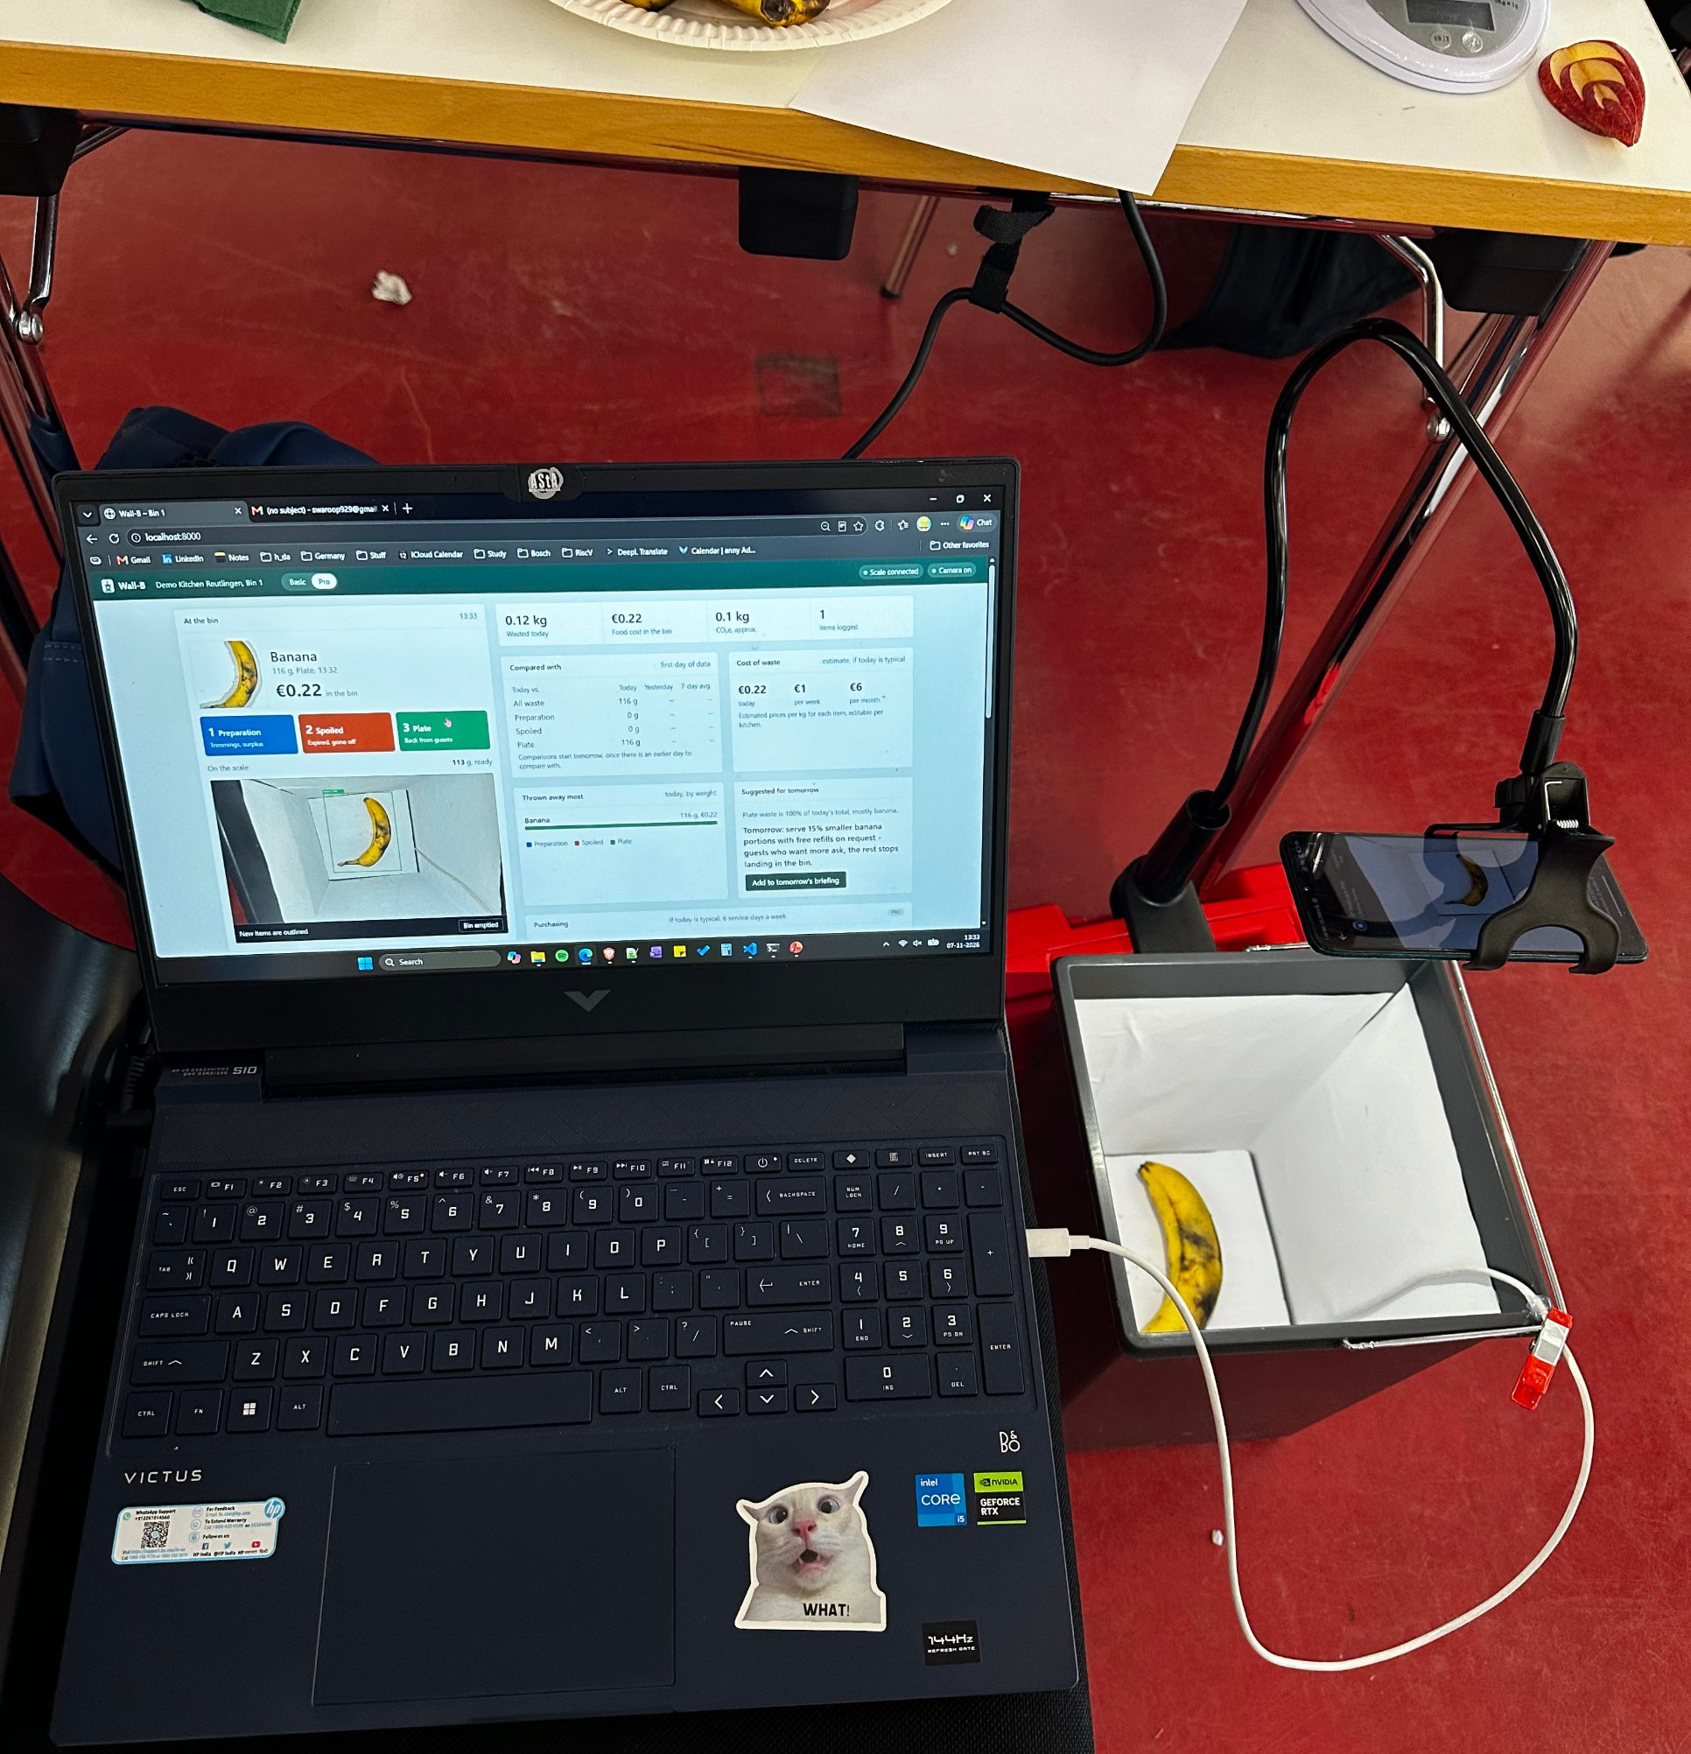
Tonight's pilot.
Wall-B
278 g
65 %
reference weight, read exactly
came back on plates
< 5 s
100 %
per tip for the cook
offline, no cloud
Tomorrow: smaller broccoli portions.
Notes:
We ran it tonight with real food. Every tip was weighed and classified at the bin. Most waste came back on plates, so the fix is portion size, not purchasing. Wall-B said: smaller broccoli portions tomorrow. The reference weight read exactly 278 g.

Slide 5
Basic
Pro
€19 /month
€39 /month
weigh · see · dashboard
+ purchasing · trends · recipes
Wall-B. Every tip counts.
Sai · Sunil · Phil
Notes:
Basic at 19 euros a month: weighing, recognition, daily dashboard. Pro at 39: purchasing, trends, leftover recipes. A kitchen that cuts waste by a fifth saves far more than that. We're Sai, Sunil and Phil. Wall-B. Every tip counts.

