Slide 1



BStack
UNDER GUIDENCE OF MRS.VAISHALI SONAWANE MAM.

Slide 2

INTRODUCTION
Browser Stack is a cloud testing platform that allows developers and testers to test websites and mobile applications across different browsers, operating systems, and real devices.

Slide 3

OVERVIEW
What is BStack?
Browser Stack is a cloud-based testing platform that enables developers and testers to test websites and mobile applications on real browsers and devices without maintaining physical infrastructure.
My project is a demo setup using Browser Stack.
It helps users understand how cross-browser and cross-device testing works.
Browser Stack provides instant access to thousands of browsers, operating systems, and mobile devices.
It supports both manual and automated testing, with integrations for Selenium, TestNG, JUnit, Appium, and CI/CD tools.

Slide 4
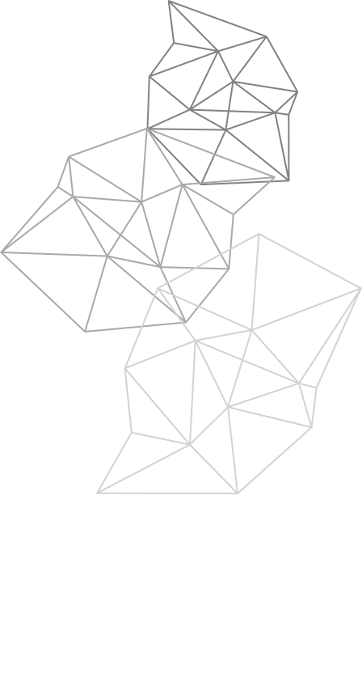
MODULES
MODULE 1 :
LOGIN
Checked the functionalities of username and password in the sign in page for login
MODULE 2 : ADD TO CART
Checked the functionality of add to cart button by adding an item to the cart.
MODULE 3 : DELETE
Checked the functionality of delete by deleting an item from the cart.

Slide 5
MODULES
MODULE 4 :
CHECKOUT
Checked the functionality of checkout by buying an item from the cart.
MODULE 5 : SEARCH MULTIPLE ITEMS
Checked the functionalities of search button by searching multiple items
MODULE 6 : SHOP BY BRANDS
Checked the functionalities of vendors button by selecting different company phones
MODULE 7 : ORDER BY
Checked the functionality of order by button by changing lower to higher and vice versa .

Slide 6
MODULES
MODULE 8 : FAVOURITES
Checked the functionality of favorites button by adding items to favorite .
MODULE 9 : OFFERS
Checked the functionality of offers button.
MODULE 10 : PRIVACY POLICY
Checked the functionality of privacy policy button
MODULE 11 : LOGOUT
Checked the functionality of logout button

Slide 7
DEFECTS
Search Engine is not working
Privacy Policy Read More is not navigating to policy page
Subscribe mail is not sending mails
Product images are not clickable

Slide 8

Defect identifier :- DEF_001
DEFECT SUMMARY : - Expected result is when we click on "Search" Product list shows iPhone or related products, but it is navigating to home page Search engine is not working
TEST ID :- TC_001,TC_002,TC_003,TC_004
TEST CASE NAME :- Search_Valid, Search_Invalid, BStack-Search-PartialMatch, Search_Blank
MODULE NAME :- Search
REPRODUCIBLE :- when we search iPhone in search Product list shows iPhone or related products
SEVERITY :- HIGH
PRIORITY :- HIGH
RAISED BY :- SWAROOP
ASSIGNED TO :- DEVELOPER
DATE OF ASSIGNMENT :-
STATUS :- PENDING
FIXED BY :- DEVELOPER
DATE OF FIXING :-

Slide 9
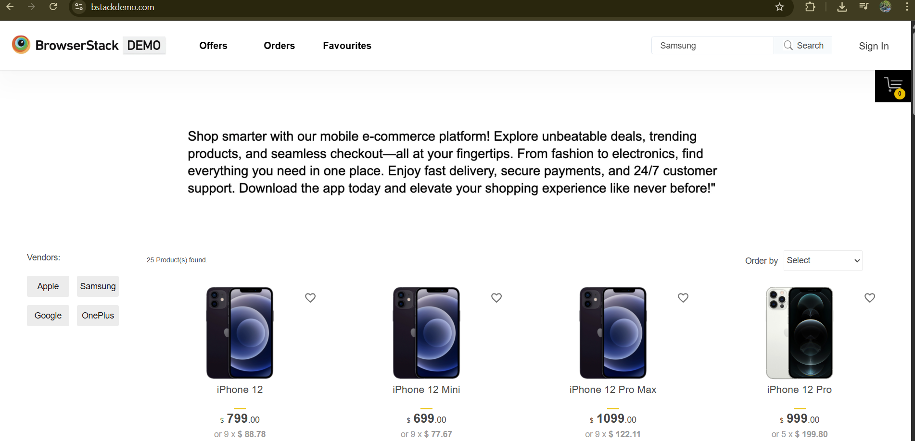
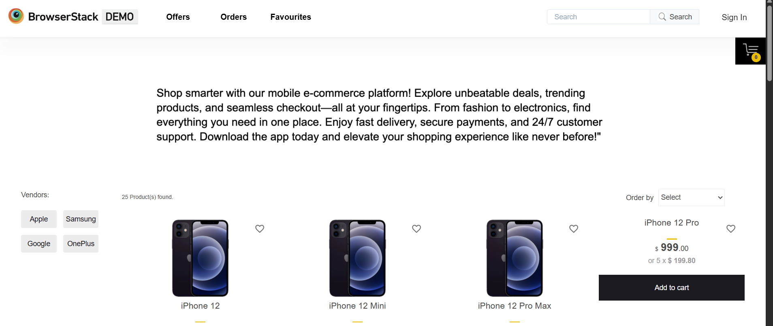
Navigating to home page

Slide 10
Defect identifier :- DEF_002
DEFECT SUMMARY : - Expected result is when we click on "Privacy Policy Read More" it need to navigate to the privacy policy page, but it is navigating to Homepage
TEST ID :- TC_001
TEST CASE NAME :- Privacy_Policy_Read_More
MODULE NAME :- offers , privacy policy & subscription
REPRODUCIBLE :- when we click on "Privacy Policy Read More" it need to navigate to the privacy policy page
SEVERITY :- HIGH
PRIORITY :- HIGH
RAISED BY :- SWAROOP
ASSIGNED TO :- DEVELOPER
DATE OF ASSIGNMENT :-
STATUS :- PENDING
FIXED BY :- DEVELOPER
DATE OF FIXING :-

Slide 11
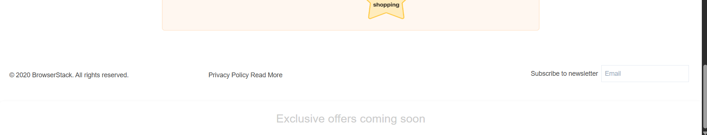
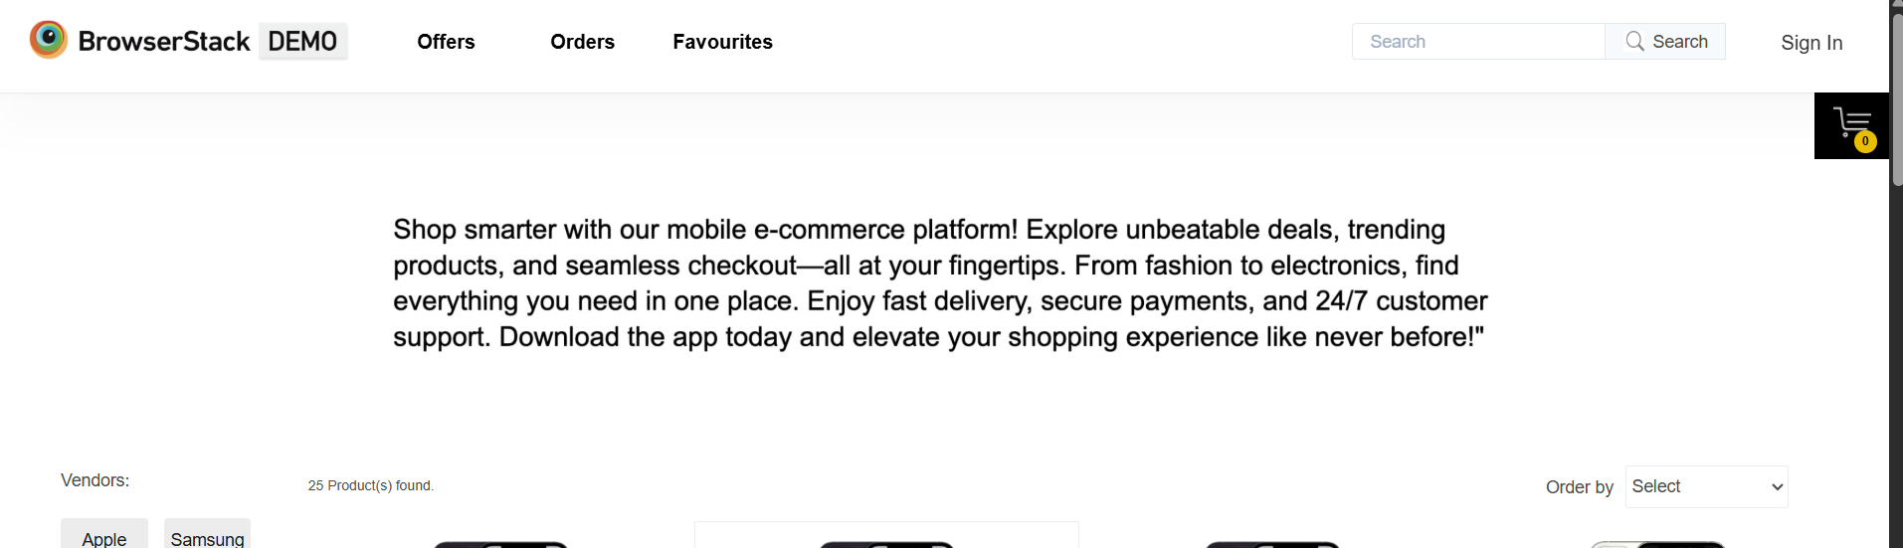
Navigating to home page

Slide 12
Defect identifier :- DEF_003
DEFECT SUMMARY : - Expected result is when we click on subscribe mail it need to send
subscription mail to mail but no mail is found
TEST ID :- TC_003
TEST CASE NAME :- Subscribe to newsletter
MODULE NAME :- offers , privacy policy & subscription
REPRODUCIBLE :- when we click on subscribe mail it need to send subscription mail to mail
SEVERITY :- HIGH
PRIORITY :- HIGH
RAISED BY :- SWAROOP
ASSIGNED TO :- DEVELOPER
DATE OF ASSIGNMENT :-
STATUS :- PENDING
FIXED BY :- DEVELOPER
DATE OF FIXING :-

Slide 13
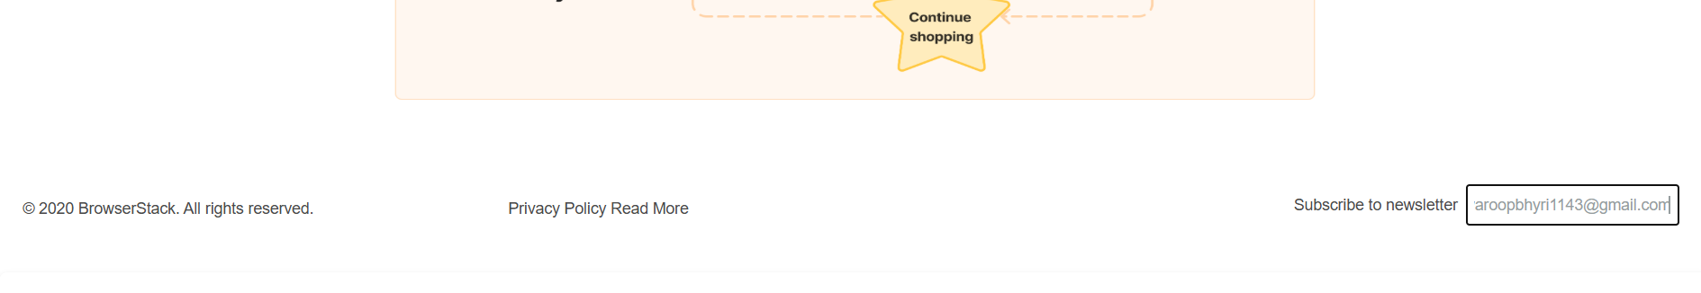
Navigating to home page

Slide 14
Defect identifier :- DEF_004
DEFECT SUMMARY : - Expected result is when we click on product image it need to redirect to
product details but it is not clickable
TEST ID :- TC_001
TEST CASE NAME :- addtocart_item
MODULE NAME :- add to cart
REPRODUCIBLE :- Expected result is when we click on product image it need to redirect to product details
SEVERITY :- MEDIUM
PRIORITY :- MEDIUM
RAISED BY :- SWAROOP
ASSIGNED TO :- DEVELOPER
DATE OF ASSIGNMENT :-
STATUS :- PENDING
FIXED BY :- DEVELOPER
DATE OF FIXING :-

Slide 15
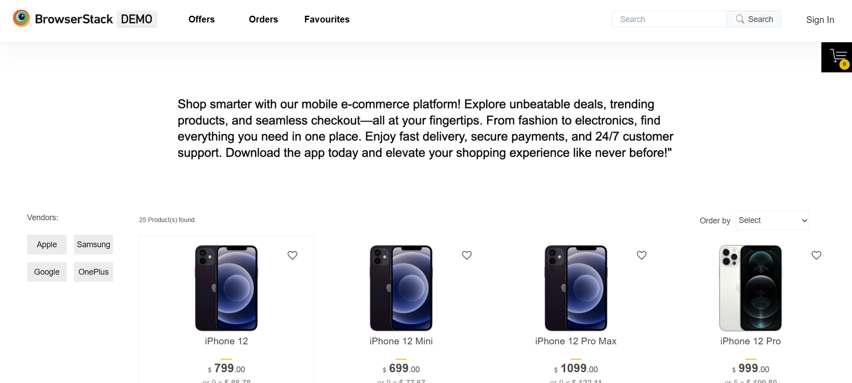
Product image is not clickable

Slide 16
CHALLENGES
Login module was bit difficult because of locators
SOMETIMES AUTOMATION FAILS BECAUSE OF UNSTABLE
OR SLOW INTERNET.

Slide 17
EXPERIENCE
GAINED HANDS-ON EXPERIENCE IN E-COMMERCE TESTING BY WORKING ON BStack DEMO SHOP.
LEARNED TO WRITE AND EXECUTE AUTOMATION TEST CASES FOR PRODUCT LISTING, SEARCH, CART, AND CHECKOUT FLOWS.
FACED REAL-WORLD CHALLENGES LIKE CAPTCHA/VERIFICATION, NETWORK ISSUES, AND ELEMENT SYNCHRONIZATION DURING AUTOMATION.

Slide 18
THANK YOU

