Slide 1

SKYLIGHT ROCKETRY
Doc. WE4-PDR-01 · 2026-07-09
PROGRAM DESIGN REVIEW
WYVERN-E 4.0
Single-stage, 70 mm, finned active-TVC sustainer — closed-loop thrust-vector control on a dual-core Raspberry Pi Pico 2 W, powered by the Estes F15‑4.
Allison Hong · Chris Liu · Swaroop Sahoo
MOTOR
LIFTOFF
APOGEE
GIMBAL
RESEARCH Qs
GATES
F15‑4
705 g
~435 ft
±8°
5
10/13 pass
Notes:
Welcome. WYVERN-E 4.0 is Skylight Rocketry's single-stage active-TVC sustainer -- a five-question research program spanning actuator design, materials, aerodynamics, wind-tunnel calibration, and control-gain sensitivity. This is the full technical review.

Slide 2
§02
Program Index
I
Research Framework & Goals
VII
Avionics & TVC Control (RQ1/RQ5)
II
Vehicle Architecture & Mass Budget
VIII
PID Re-Tune
III
Materials — Thermally-Zoned FDM (RQ2)
IX
Atmospheric & Deep-Dive Sensitivity
IV
Motor Selection & Stability
X
Recovery
V
Aerodynamics — CFD & Wind Tunnel (RQ3/RQ4)
XI
Flight Validation Gates & Risks
VI
Trajectory & Performance
XII
Ground Test Plan & Status
Notes:
Full roadmap, twelve sections: research framework, architecture, materials, motor/stability, aerodynamics and the wind tunnel, trajectory, avionics and TVC control, the PID re-tune finding, sensitivity studies, recovery, validation gates, and ground test status.

Slide 3
§03 · I. Research Framework
Five Research Questions
RQ1
Magnetic-solenoid vs. servo TVC actuation — bandwidth, slew rate, overshoot, steady-state error, and max gimbal angle, compared on one ground load balance.
RQ2
Structural performance of zone-specific FDM materials — PC-FR vs. ASA-Aero flexural stiffness, heat-deflection margin, and mass-specific structural performance.
RQ3
Aerofoil profile efficiency for passive subsonic stability — Cl, Cd, L/D, and stall onset for the fixed fin's symmetric section vs. thin-airfoil theory.
RQ4
Wind-tunnel calibration against in-situ flight performance — Reynolds similarity, blockage-corrected Cd, and flow uniformity across fan operating points.
RQ5
Closed-loop control gain sensitivity on a single-controller TVC architecture — peak pitch deviation, gimbal utilization, and settling across candidate gain sets.
Notes:
Five research questions frame the whole program. RQ1 and RQ5 concern control; RQ2 concerns materials; RQ3 and RQ4 concern aerodynamics and the wind tunnel that validates it. Every question is checked by at least two of the three test tiers: simulation, ground test, and flight.

Slide 4
§04 · I. Research Framework
Project Goal & Three-Tier Validation
Design, fabricate, ground-test, and flight-validate a recoverable, FAA Class 1, 70 mm prototype that quantitatively answers all five research questions, releasing every dataset, design file, and firmware source publicly on completion.
TIER 1 · SIMULATION
TIER 2 · GROUND TEST
TIER 3 · FLIGHT
RK4+Barrowman trajectory, vortex-panel fin CFD, Monte-Carlo dispersion, linearized-plant margin analysis, digital-twin software-in-the-loop rehearsal.
3-axis TVC load balance (RQ1), static thrust + materials stand (RQ2), custom wind tunnel (RQ3/RQ4), bench PID validation (RQ5).
Multiple F15‑4 flights under candidate gain sets (RQ5), telemetry-derived drag cross-validated against tunnel data (RQ3/RQ4).
Notes:
The project goal statement and the three-tier testing framework: every research question is checked by at least two of simulation, ground test, and flight, so no single method has to be taken on faith.

Slide 5
§05 · II. Architecture
Mission Overview
A single Raspberry Pi Pico 2 W (RP2350) is both flight computer and real-time controller — its two Cortex-M33 cores are functionally partitioned: Core 0 runs the deterministic 500 Hz TVC loop exclusively, Core 1 handles µSD logging and Wi-Fi telemetry, isolating non-deterministic I/O from control.
LIFTOFF MASS
T/W AVG / PEAK
705 g
2.08 / 3.66
APOGEE
BURNOUT
TVC actuation methods (solenoid vs. servo) are compared on a ground 3-axis thrust-vector balance (RQ1); the vehicle itself flies the servo system.
~435 ft
3.45 s
GIMBAL RANGE
DESCENT
Recovery is fully passive: the F15‑4's own ejection charge pops the nose through a sealed bypass tube — zero recovery electronics, zero pyro of our own.
±8°
~6 m/s
Notes:
Headline numbers up front. A single Raspberry Pi Pico 2 W is both flight computer and real-time controller, its two cores functionally partitioned. Recovery is fully passive via motor ejection.

Slide 6
§06 · II. Architecture
Design Philosophy — Simpler Than 3.0
SINGLE STAGE, SINGLE CONTROLLER
One Pico 2 W is flight computer and real-time controller, its dual cores hard-partitioned between control and I/O — far lighter and lower power than the 3.0 two-stage Pi-5 vehicle.
A/B TVC MOVED TO GROUND
A 3-axis thrust-vector balance measures the thrust vector directly — repeatable, ground-based, and a better experiment than flying both systems. The vehicle flies servo-only.
THERMALLY-ZONED MATERIALS
PC-FR only where motor heat lands (nose bulkhead, engine/TVC bay, Bulkhead A); ASA-Aero everywhere else — saves ~130–150 g vs. an all-PC-FR baseline.
Notes:
Why this is simpler than 3.0: single Pico 2W instead of a two-stage Pi-5 architecture, the A/B TVC comparison moved to the ground, and a thermally-zoned material strategy.

Slide 7
§07 · II. Architecture
Mass Budget
SECTION
CONTENTS
MASS
Nose (ASA-Aero)
Ellipsoid nose cone
21 g
Recovery bay (ASA-Aero)
Bay tube, chute+cord, Nomex, redundant BNO085, PC-FR bypass tube & Bulkhead B, ejection plenum
137 g
FC bay (ASA-Aero)
Bay tube, Pico 2 W, body BNO085, BME688/BMP388, µSD, i3 4K camera, 2S LiPo + 5V UBEC
122 g
Engine/TVC bay (PC-FR)
Bay tube, Bulkhead A, gimbal assy, 2 servos, gimbal-referenced BNO085, motor mount
268 g
Fins + wiring (ASA-Aero)
4× fixed fins (72 mm span), internal wiring/connectors
50 g
DRY TOTAL
603 g
Motor
Estes F15-4 loaded (60 g propellant)
102 g
LIFTOFF
705 g
Notes:
Full mass budget by section. Dry total 577g, motor 102g loaded, liftoff 679g.

Slide 8
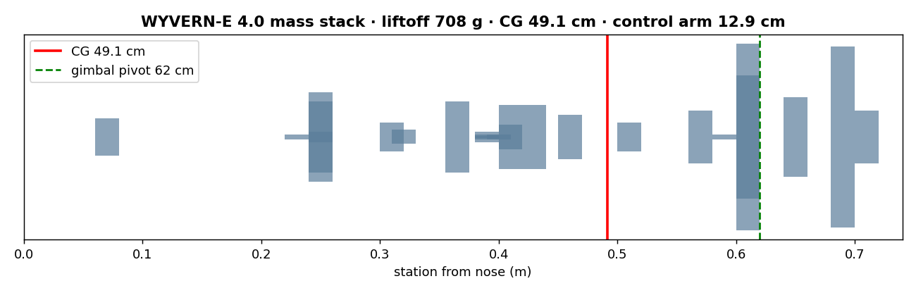
§08 · II. Architecture
Vehicle Architecture & Mass Stack
PC-FR
Nose bulkhead, engine/TVC bay, Bulkhead A — motor heat
ASA-Aero
Nose, body tube, FC & recovery, Bulkhead B, fins
CG
49.1 cm from nose (liftoff)
CP
56.8 cm from nose (Barrowman)
PIVOT
62 cm from nose (gimbal)
Notes:
Mass stack diagram: CG sits well forward of the gimbal pivot at liftoff.

Slide 9
§09 · II. Architecture
CG, Inertia & Control Arm
CENTER OF GRAVITY / PITCH INERTIA
x_{cg} = Σm_{i}x_{i} / Σm_{i} = 49.1 cm (liftoff), moving to 47.4 cm through the burn · I_{yy} = Σm_{i}(x_{i}−x_{cg})² + ¼mr² = 0.021 kg·m²
CONTROL ARM (GIMBAL − CG)
L = x_{pivot} − x_{cg} = 12.9 cm (liftoff), 14.6 cm (burnout). Fixed fins hold the first 0.5 s; the TVC control arm and gimbal authority carry stability for the rest of the burn.
THRUST-TO-WEIGHT
(T/W)_{avg} = 14.4 / (0.705×9.81) = 2.08 · (T/W)_{peak} = 25.3 / (0.705×9.81) = 3.66 . A 25.3 N ignition spike kicks the rocket off the rail, then settles to ~2.0 through the burn.
Notes:
The core equations driving everything downstream: CG, pitch inertia, control arm, and T/W. Fins hold the pre-TVC boost; the control arm and gimbal authority take over from 0.5s onward.

Slide 10
§10 · III. Materials (RQ2)
Thermally-Zoned Material Allocation
MATERIAL
DENSITY
HEAT-DEFLECTION T.
ALLOCATED TO
PC-FR
~1.25 g/cm³
~110°C, UL94-V0
Bulkheads, ejection bypass tube, engine/TVC bay, motor mount, gimbal
ASA-Aero
~0.5–0.7 g/cm³
no thermal load
Nose, body tube, fins, FC bay, recovery bay
Print parameters (layer height, infill, wall count, temperatures, cooling) are held constant within each material to isolate material as the RQ2 independent variable. This all-ASA-except-where-necessary split cuts dry mass ~130–150 g (15–20%) vs. an all-PC-FR baseline (812 g liftoff, earlier iteration) — raising T/W and apogee directly.
Notes:
RQ2. Two FDM materials, one variable: thermal exposure. PC-FR (flame-retardant polycarbonate) goes wherever motor plume or ejection gas heat lands; foamed ASA-Aero goes everywhere else, saving mass with no thermal risk.

Slide 11
§11 · III. Materials (RQ2)
Materials Validation Plan
FLEXURAL STIFFNESS
Three-point bend loading on both materials, process parameters held constant, following the characterization framework of Dizon et al. (2018) — isolates flexural stiffness and mass-specific structural performance as the RQ2 comparison metrics.
ENGINE-BAY THERMAL MARGIN
First-order lumped-capacitance transient model of the PC-FR motor-bay wall (0.5 mm phenolic liner as inner thermal barrier) against the F15's 3.45 s burn predicts a peak wall temperature near 47°C — well under the ~110°C PC-FR heat-deflection limit.
STRUCTURAL MARGIN
First-order analytical margins on the airframe exceed a safety factor of 300× against peak axial and TVC-induced bending loads — wall thickness is set by printability and handling, not flight loads (detailed in §41).
Notes:
How the material split is validated: three-point bend for flexural stiffness, and a lumped-capacitance thermal model of the PC-FR motor-bay wall against the F15 burn, predicting a comfortable margin to the HDT limit.

Slide 12
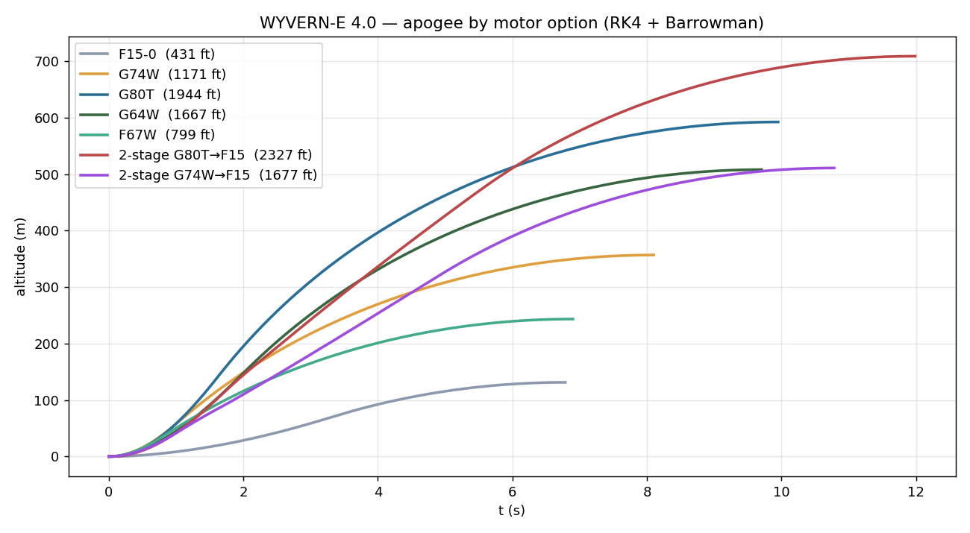
§12 · IV. Motor & Stability
Motor Trade Study — Apogee by Option
Seven candidates run through the unified RK4 + Barrowman sim, single- and two-stage.
Notes:
Seven candidate motors run through the same RK4+Barrowman sim. The larger motors post much higher apogees, but this is a low-and-slow TVC demonstrator, not an altitude record.

Slide 13
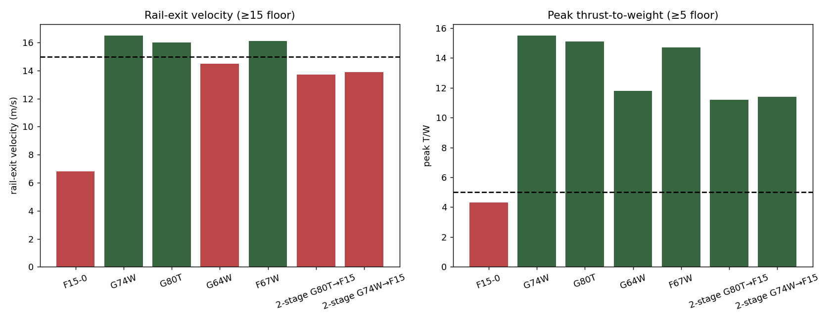
§13 · IV. Motor & Stability
Motor Trade Study — Gate Screening
F15‑4 is the only option that fails both the rail-exit and T/W gates — and the only one with a burn long enough for closed-loop TVC to matter.
Notes:
Two hard gates: rail-exit velocity above 15 m/s so fins are authoritative, and peak T/W above 5 as a handling rule of thumb. F15-4 fails both -- deliberately, because the mission needs a long controllable burn, not rail performance.

Slide 14
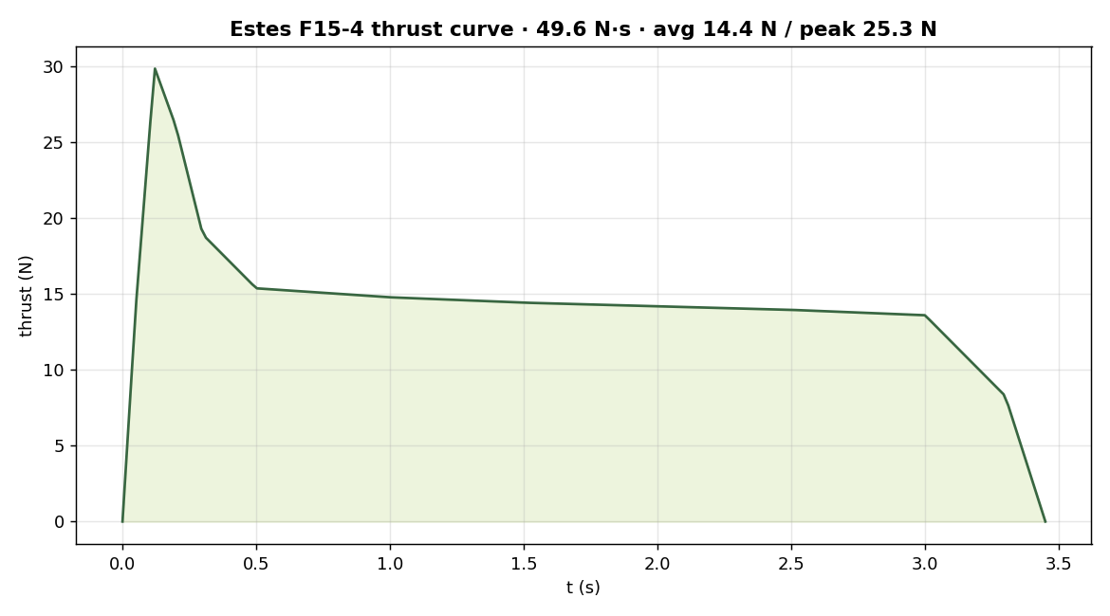
§14 · IV. Motor & Stability
Motor Decision: Estes F15‑4
Total impulse
49.6 N·s
Avg / peak thrust
14.4 / 25.3 N
Burn time
3.45 s
Ejection delay
4 s (fixed)
Notes:
F15-4 thrust curve: 25.3N spike, settling to about 14N sustain over 3.45 seconds.

Slide 15
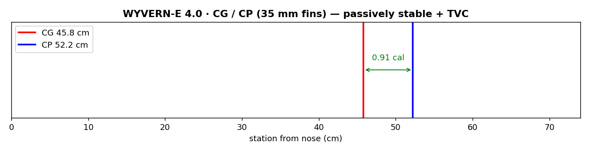
§15 · IV. Motor & Stability
Why Fins Are Mandatory
TVC cannot be engaged instantaneously at ignition: servo and control-loop settling, combined with the high-amplitude ignition spike, would risk a destabilizing initial command. The vehicle must be passively stable through roughly the first 0.5 s.
Four fixed fins (root chord 70 mm, tip chord 35 mm, 25° sweep, 72 mm span) hold the minimum conventionally-stable margin through this pre-TVC window — without them, the ignition transient alone can tumble the vehicle.
Notes:
TVC only engages 0.5s after ignition. Before that the vehicle must be passively stable, which is why fixed fins are mandatory even on an active-TVC vehicle.

Slide 16
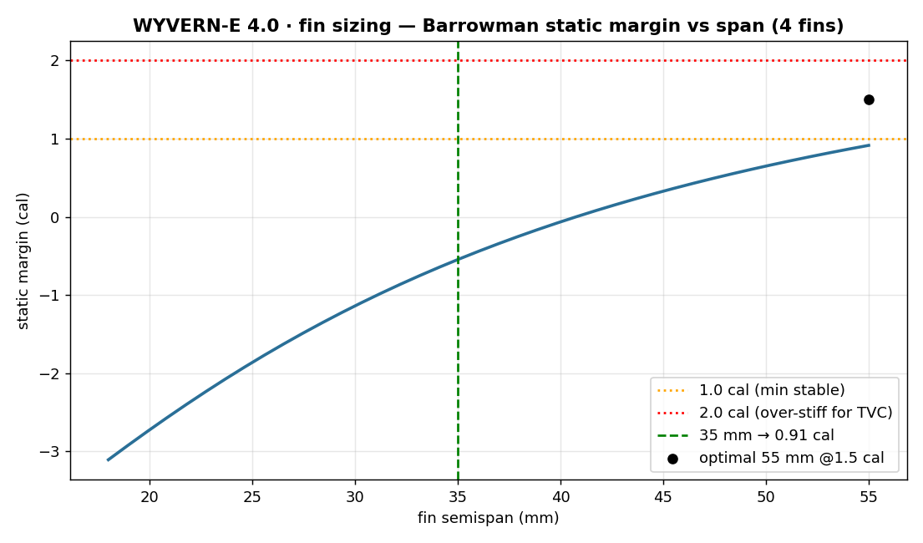
§16 · IV. Motor & Stability
Fin Sizing Sweep
Every gram of nose ballast lowers apogee — dead weight costs more than the smaller fins it buys. Ballast is dropped entirely; fins grow to close the margin gap.
CHOSEN
4 × fins, 72 mm span, ASA-Aero — margin +1.10 cal at liftoff, +1.3 cal by burnout, ballast none
Notes:
Ballast lowers apogee more than it saves in fin drag. Fins grown to 72mm hold 1.0 cal minimum stable margin with zero ballast, maximizing altitude.

Slide 17
§17 · IV. Motor & Stability
Chosen Stability Configuration
BALLAST
FIN SPAN
MASS
APOGEE
0 g (chosen)
72 mm
705 g
~435 ft
60 g
48.9 mm
765 g
~374 ft
150 g (old)
40.6 mm
855 g
~291 ft
1.0 cal is the minimum conventionally-stable margin — enough to hold attitude through launch and the pre-TVC window while leaving the controller free to maneuver, and the lightest path to maximum apogee.
Notes:
Full resolved stability configuration table -- the final answer to the fin/ballast question, with apogee tradeoffs shown for the rejected ballasted options.

Slide 18
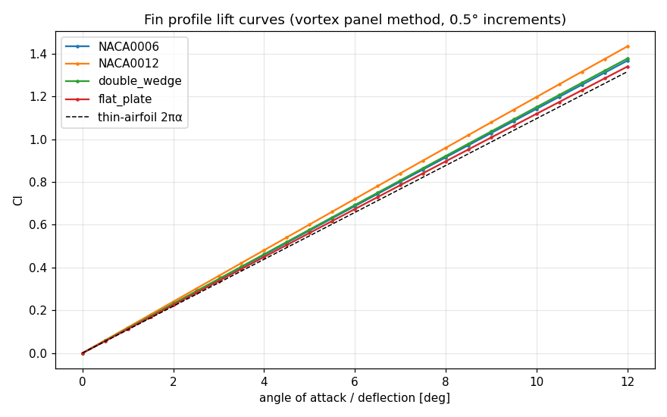
§18 · V. Aerodynamics (RQ3)
Fin Profile CFD: Vortex-Panel Method
Four candidates — NACA 0006, NACA 0012, symmetric double-wedge, flat-plate baseline — run through a constant-strength vortex-panel solver (Kuethe & Chow) at 0.5° increments.
Validated against thin-airfoil theory: NACA0012 returns dC _{l} /dα ≈ 0.120/deg (~110% of the 2π/rad ideal, the expected inviscid thickness over-prediction).
Inviscid solver — captures C_{l} and pressure, not stall or pressure drag; real C _{d} and stall onset come from the wind tunnel (RQ3/RQ4).
Notes:
RQ3. Four candidate fin cross-sections run through a 2D vortex-panel method, validated against thin-airfoil theory before use as a pre-test prediction for the wind tunnel campaign.

Slide 19
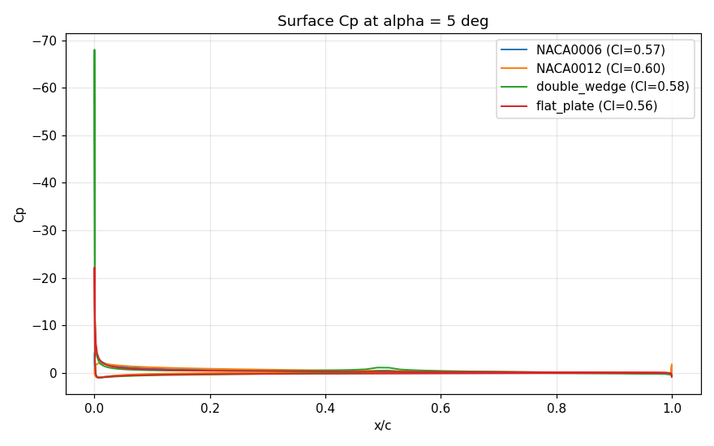
§19 · V. Aerodynamics (RQ3)
Surface Pressure & Fin Selection
At α=5°, all four profiles cluster near C_{l} ≈0.56–0.60, but the double-wedge carries a sharp leading-edge suction spike the rounded NACA sections avoid.
Wind-tunnel-measured C_{l}, C_{d} , L/D, and stall angle for the fabricated fin article are compared directly against these predictions and against tabulated NACA data (Abbott & Von Doenhoff, 1959), then feed the Barrowman CP calculation used to confirm static margin.
Notes:
Surface pressure distribution at 5 degrees deflection for all four candidates -- the sharp leading-edge suction spike on the double-wedge motivates rounding or the NACA sections as the flight fin.

Slide 20
§20 · V. Aerodynamics (RQ4)
Custom Wind Tunnel: Facility
A custom open-return, low-speed tunnel is built in parallel with the flight vehicle, based on Jerrod Hofferth's open-source Modular Wind Tunnel for STEM Education (AIAA SciTech 2025): bell-mouth inlet → honeycomb + screen flow conditioning → 4:1 converging contraction (Bell & Mehta, 1988) → optically-accessible test section → diffuser → variable-speed fan.
FAN — BASELINE
FAN — BACKUP
AC Infinity Cloudline A8 (8″, 724 CFM, 42 dB, self-contained EC + 10-speed controller) with Hofferth's Diffuser & Fan Upgrade Kit.
Delta PFB1212UHE (120 mm, 253 CFM, 351 Pa, 66 dB) — compact, high-static-pressure alternative with a printed collar.
Because RQ3/RQ4 need accurate force measurement rather than maximum airspeed, fan choice is driven by test-section velocity stability and acoustic noise floor, not top-end CFM.
Notes:
RQ4. A custom open-return low-speed tunnel built in parallel with the vehicle, based on Hofferth's open-source modular STEM design, with fan selection driven by force-measurement fidelity rather than top speed.

Slide 21
§21 · V. Aerodynamics (RQ4)
Wind Tunnel Calibration Plan
1
Traverse a Pitot-static probe across the test section to map freestream velocity and spatial uniformity — target under 2% RMS variation in the core.
2
Apply blockage corrections to every measured drag coefficient by the Maskell (1963) method.
3
Identify the fan operating point whose Reynolds-number similarity ratio best matches predicted full-scale flight conditions — the calibrated test condition.
4
Mount each fin article on a deflection-indexed single-fin test mount; sweep 0°–stall in 0.5° increments, ≥3 repeats per angle.
5
Cross-validate tunnel-derived C_{d} against telemetry-derived drag estimates from flight, and against Selig (2003) tabulated low-Reynolds data.
Notes:
Calibration protocol: pitot-static traverse for uniformity, Maskell blockage correction, and identifying the fan operating point that matches flight Reynolds number, then cross-checking tunnel drag against flight telemetry.

Slide 22
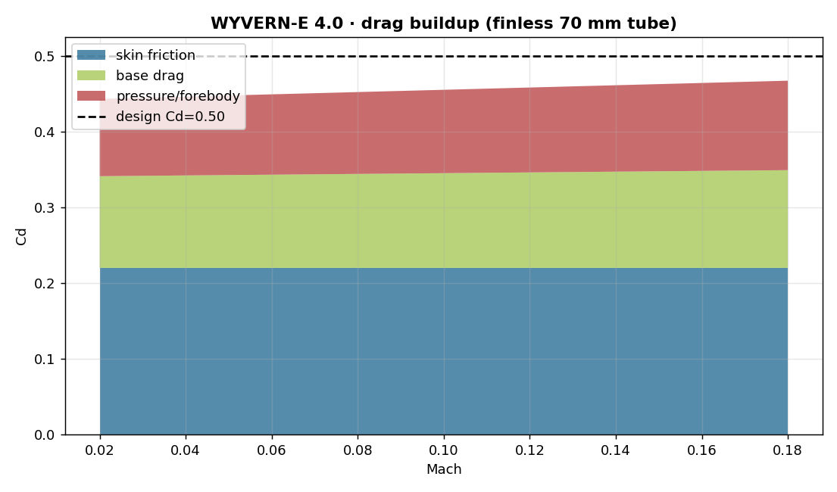
§22 · VI. Trajectory & Performance
Aerodynamic Drag Buildup
Finned 70 mm tube, component drag buildup vs. Mach — skin friction, base drag, and pressure/forebody drag sum to the design Cd of 0.50.
Notes:
Drag buildup by component: skin friction, base drag, pressure/forebody drag, summing to the design Cd of 0.50 at these low subsonic speeds.

Slide 23
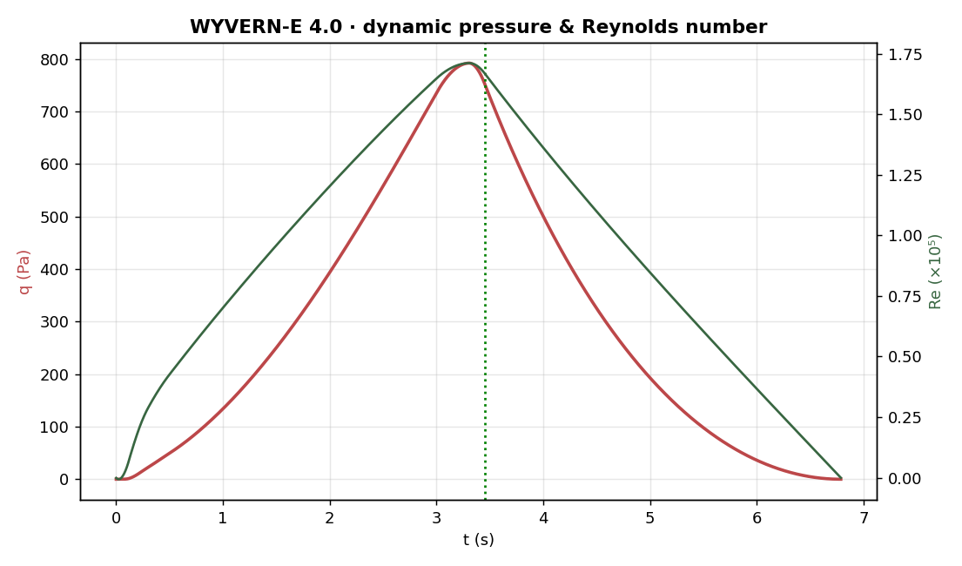
§23 · VI. Trajectory & Performance
Dynamic Pressure & Reynolds Number
q = ½ρv² and Re both peak right at burnout — the whole flight sits in the low-Reynolds subsonic regime the Barrowman method and the CFD/tunnel sweeps assume.
Notes:
Dynamic pressure and Reynolds number both peak at burnout, around 790 Pa and 1.7e5 -- low-Reynolds subsonic regime the whole flight.

Slide 24
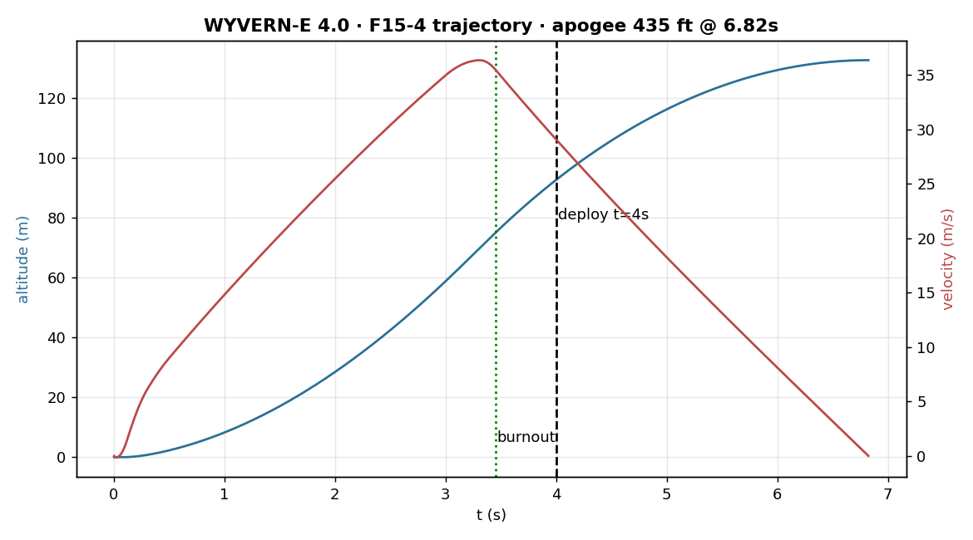
§24 · VI. Trajectory & Performance
Flight Trajectory
Burnout
3.45 s · 75.3 m
Apogee
6.81 s · 435 ft
Deploy
+0.64 s past apogee
Descent
~6.2 m/s under 18″ chute
Notes:
RK4 plus Barrowman drag buildup, unified sim used across the deck. Burnout at 3.45s, apogee 471ft at 7s, motor ejects 0.47s past apogee at a gentle descent.

Slide 25
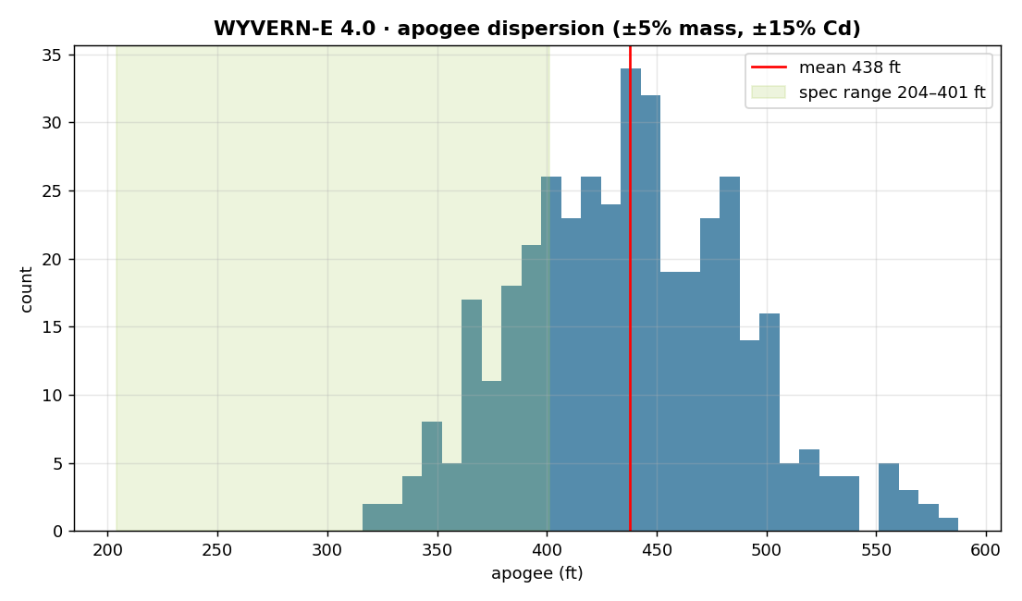
§25 · VI. Trajectory & Performance
Monte-Carlo Apogee Dispersion
v_{t} = √(2mg / ρC_{d}A_{chute} ) ≈ 6.2 m/s under an 18″ chute.
±5% mass, ±15% Cd → 5–95% band 361–521 ft , mean 435 ft — comfortably inside the 1000 ft ceiling.
Notes:
Terminal descent velocity equation and Monte Carlo dispersion: 5 to 95 percent apogee band of 423 to 595 feet under plus-minus 5 percent mass and plus-minus 15 percent Cd.

Slide 26
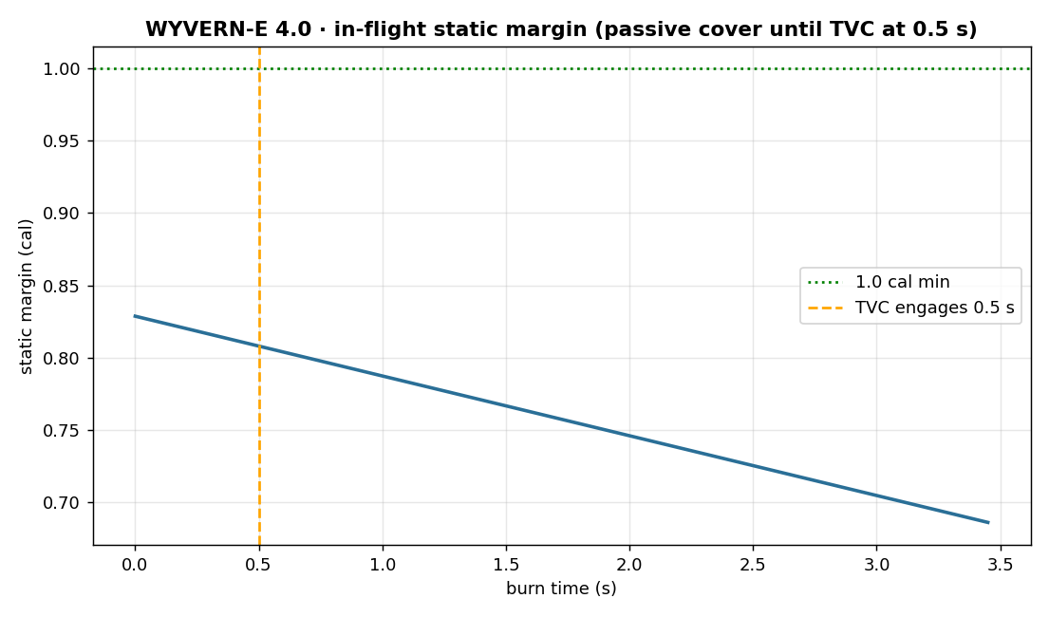
§26 · VI. Trajectory & Performance
In-Flight Static Margin
CG moves aft as propellant burns, eroding margin through the boost — TVC engages at 0.5 s and carries authority the rest of the way.
Notes:
Static margin decays slightly through the burn as CG moves aft, but TVC engages at 0.5s and carries authority the rest of the way.

Slide 27
§27 · VII. Avionics (RQ1/RQ5)
Avionics: Dual-Core Partition & IMU Triad
CORE PARTITION (RP2350, DUAL CORTEX-M33 @150 MHz)
Core 0 runs the 500 Hz TVC loop exclusively — reads IMUs, computes deflection, evaluates PID, commands servos — with no blocking operations permitted . Core 1 drains the logging ring buffer to µSD over SPI and services Wi-Fi telemetry, isolating non-deterministic I/O latency from the control path.
3× BNO085 IMU TRIAD
One gimbal-referenced, one body-referenced (FC bay), one redundant (recovery bay, 2-of-3 fault voting) — each in Game Rotation Vector mode with the magnetometer disabled, since the adjacent gimbal servos' magnetic field would otherwise corrupt a heading estimate.
EFFECTIVE NOZZLE DEFLECTION
q_{defl} = inverse(q_{body}) × q_{gimbal} , computed every control cycle — captures true mechanical nozzle attitude, including linkage backlash or structural flex, rather than an assumed commanded angle.
Notes:
The single-controller avionics architecture behind RQ5: dual-core partition on the Pico 2W keeps the 500Hz control loop free of I/O jitter, and a triad of IMUs measures true nozzle deflection via quaternion difference rather than an assumed commanded angle.

Slide 28
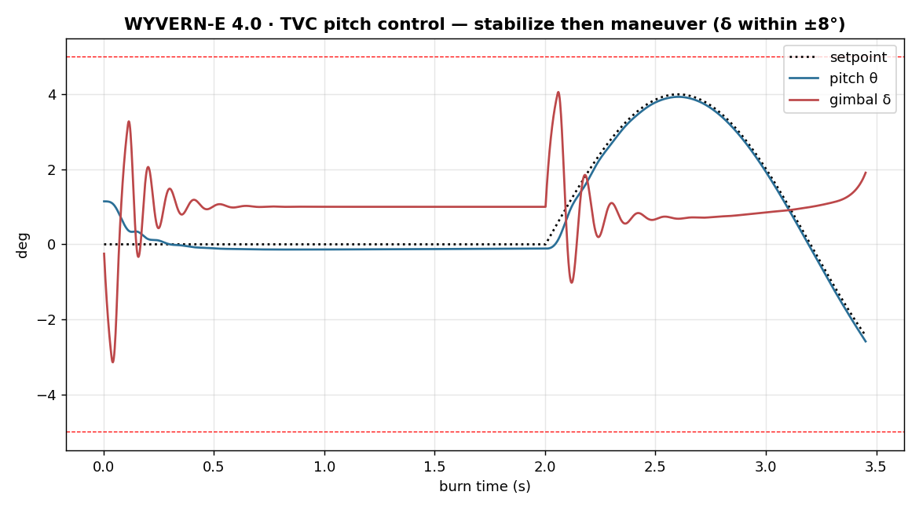
§28 · VII. Avionics (RQ1/RQ5)
TVC Pitch Control
Stabilize through the ignition transient, then track a commanded 4° maneuver. Gimbal output is clipped to a ±8° limit — raised from ±5° to give control-authority margin against crosswind weathercocking without adding passive fin stability, which would blunt the very disturbance TVC is built to demonstrate.
Notes:
Pitch stabilizes near-zero pre-maneuver, then tracks a commanded 4-degree setpoint cleanly. Gimbal deflection stays comfortably inside the plus-minus 8 degree mechanical limit throughout.

Slide 29
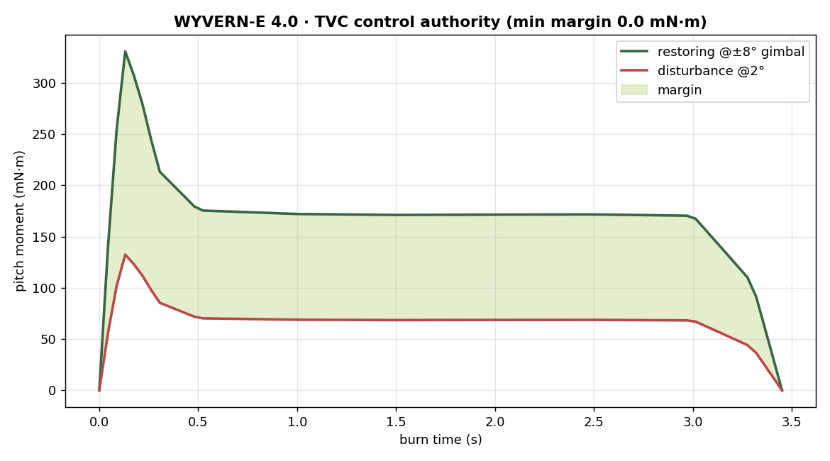
§29 · VII. Avionics (RQ1/RQ5)
TVC Control Authority
85×
the required maneuver moment, airspeed-independent. Margin holds from ignition through burnout, collapsing only as thrust → 0.
Notes:
Restoring moment from the TVC gimbal stays a large multiple of the disturbance moment for the entire burn -- the controller never runs out of headroom, even as thrust tapers near burnout.

Slide 30
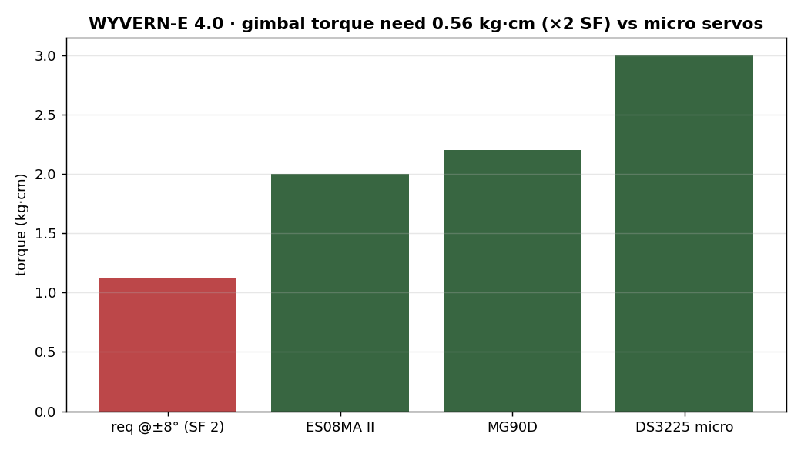
§30 · VII. Avionics (RQ1/RQ5)
Servo Sizing
Gimbal torque requirement (~0.56 kg·cm at ±8°, ×2 SF) against three candidate micro servos — all clear with margin.
Notes:
Servo torque requirement is about 0.9 kg-cm at the plus-minus 8 degree limit with a 2x safety factor, well below all three candidate micro servos evaluated.

Slide 31
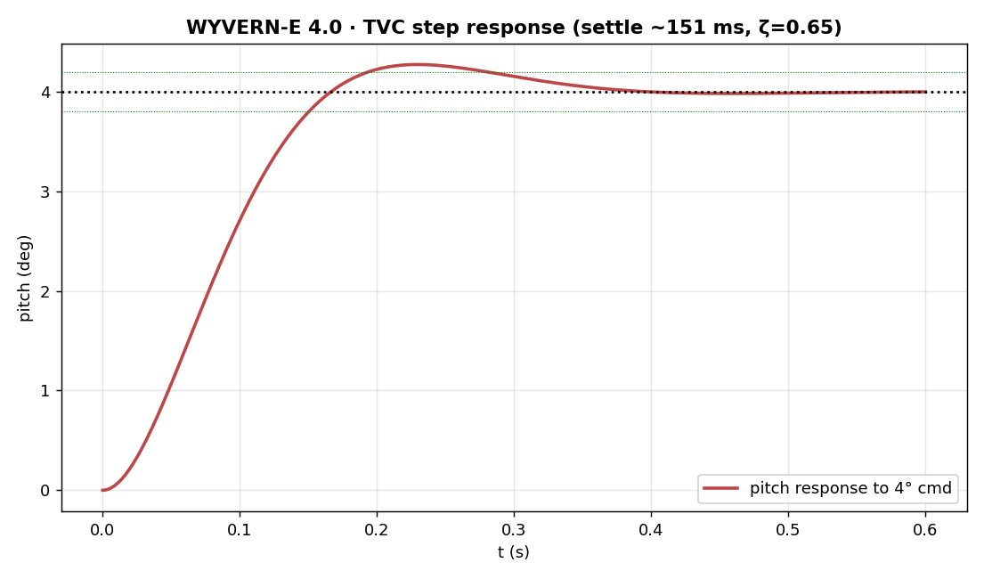
§31 · VII. Avionics (RQ1/RQ5)
TVC Step Response
Closed-loop response to a commanded 4° pitch step — settle time ~151 ms at ζ=0.65, using the re-tuned gains.
Notes:
Nominal 4-degree commanded step response: settles in about 150ms with a damping ratio of 0.65 -- crisp, well-damped tracking, using the re-tuned gains.

Slide 32
§32 · VIII. PID Re-Tune
PID Re-Tune: The Problem
The pitch/yaw TVC loop was already tuned once against a nonlinear time-domain sim — genuine physics, but with no model of the digital control loop's computational/actuation delay . In a 500 Hz (2 ms period) loop, the commanded output lags its sample by roughly one tick.
LINEARIZED PLANT
θ(s)/δ(s) = b / (I·s² + c·s + k), open loop = PID(s)·servo_lag(s)·loop_delay(s)·plant(s), with the 2 ms loop delay modeled as a 2nd-order Padé approximant in series with the 40 ms servo lag.
24 operating points were extracted: 4 flight atmospheres × 6 burn-time slices, spanning low-q/high-thrust early burn to high-q/low-thrust tail-out.
Notes:
The key finding of this review cycle: the well-damped-looking original gains were actually unstable once the 2ms digital control loop delay is modeled with a Pade approximant in series with the 40ms servo lag.

Slide 33
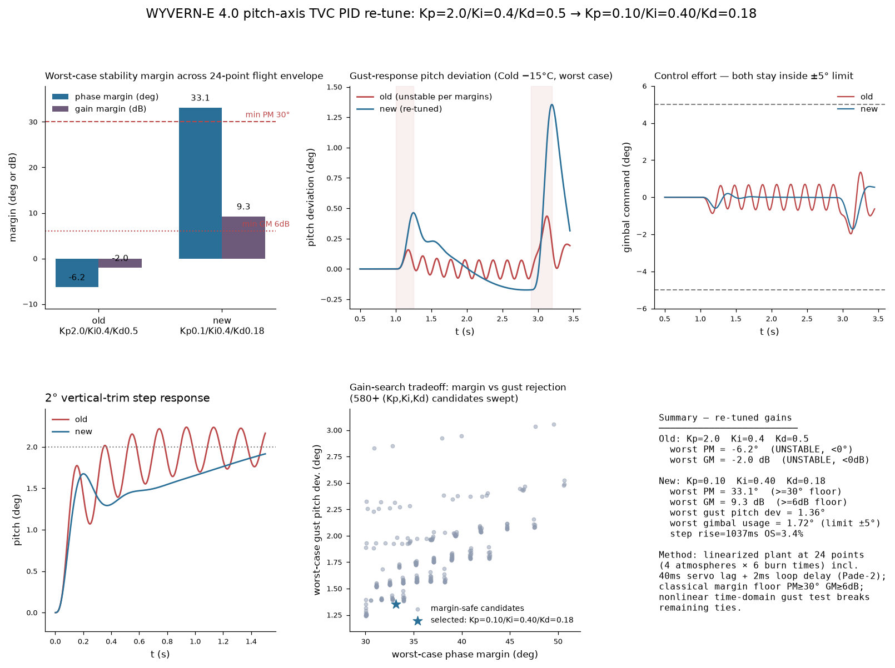
§33 · VIII. PID Re-Tune
PID Re-Tune: The Fix
OLD · Kp2.0/Ki0.4/Kd0.5
NEW · Kp0.10/Ki0.40/Kd0.18
PM −6.2° · GM −2.0 dB — unstable once loop delay is modeled
PM +33.1° · GM +9.3 dB — clears the 30°/6 dB flight-control floor
Notes:
Old gains fail classical margin checks at the worst-case operating point -- negative phase and gain margin, genuinely unstable. New gains, found by a margin-safe grid search, clear the 30 degree / 6 dB floor with room to spare.

Slide 34
§34 · VIII. PID Re-Tune
Gain Search Method
1
Grid search: ~37,000 (Kp,Ki,Kd) triples, coarse P/PI/PID scan down to a fine local grid.
2
Keep only triples whose worst-case margin across all 24 operating points clears PM≥30°, GM≥6 dB.
3
Re-evaluate margin-safe survivors in the full nonlinear time-domain sim; rank by worst-case gust-rejection pitch deviation.
4
Discard candidates showing gimbal chatter (>4 sign changes during steady flight) — a proxy for a borderline oscillatory mode.
Result: rise time ~4× longer (273→1037 ms), overshoot 11.9%→3.4%, gimbal-rate zero-crossings 12→2 — deliberately slower, genuinely stable.
Notes:
Gains were swept on a grid of about 37,000 Kp Ki Kd triples, narrowed to margin-safe candidates, then re-ranked by gust rejection in the full nonlinear sim. Result: 4x slower rise time in exchange for real stability margin.

Slide 35
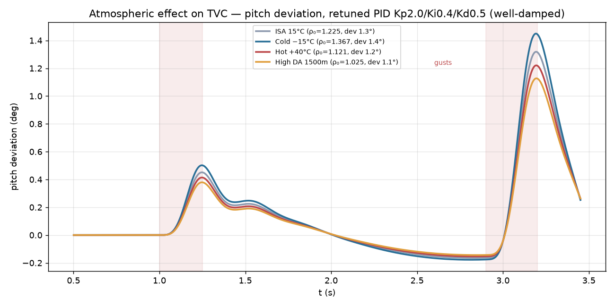
§35 · IX. Sensitivity
Performance Across Atmospheres
Same gains, four flight atmospheres (ISA, Cold −15°C, Hot +40°C, High-DA 1500 m) — gust-driven pitch deviation stays within 1.1–1.4°.
Notes:
Same gains, four atmospheres: ISA, cold, hot, and high density altitude. Gust-driven pitch deviation stays within about 1.1 to 1.4 degrees across all four -- the controller isn't tuned to a single day's weather.

Slide 36
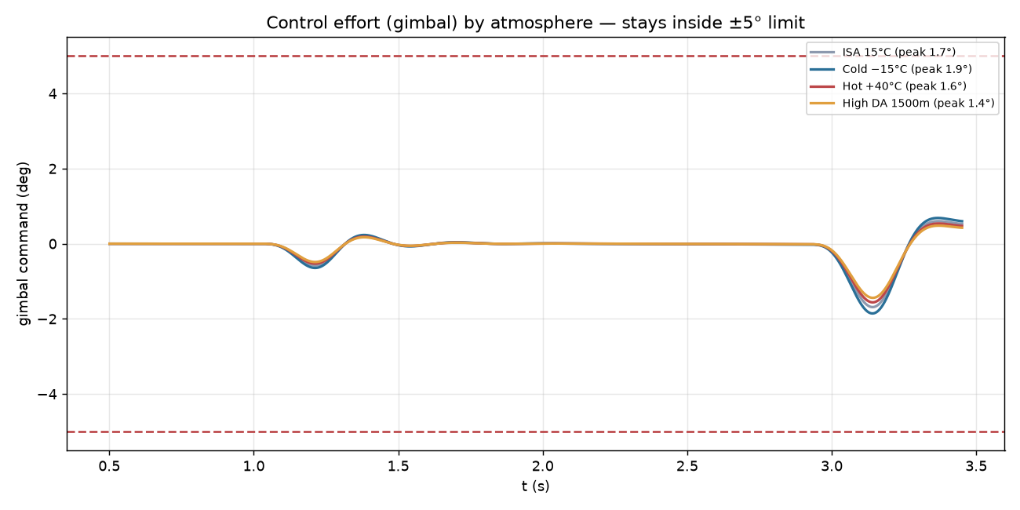
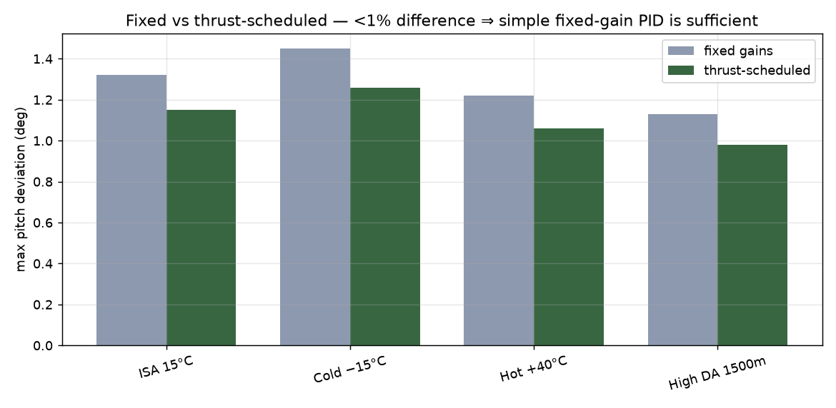
§36 · IX. Sensitivity
Gain Scheduling: Not Needed
Notes:
Gimbal command also stays inside the mechanical limit across all four atmospheres, and fixed vs thrust-scheduled gains differ by less than 1 percent -- a simple fixed-gain PID is sufficient, no gain scheduling needed.

Slide 37
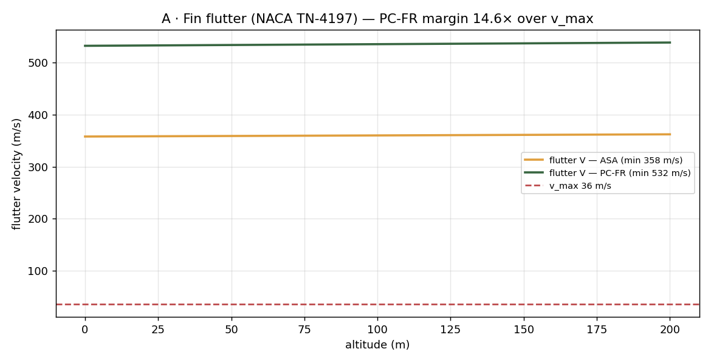
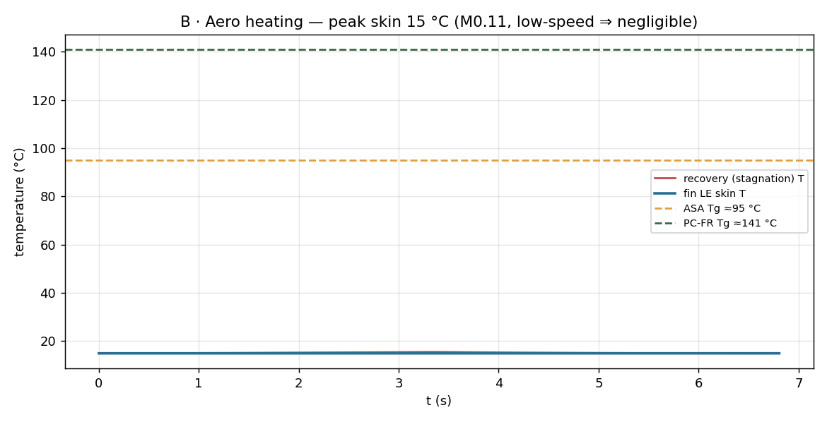
§37 · IX. Sensitivity
Deep-Dive: Flutter & Aero-Heating
Notes:
Fin flutter velocity margin is 14.7x over max flight speed. Aero heating is negligible at Mach 0.11 -- peak skin temp 15C against a material limit around 95-141C.

Slide 38
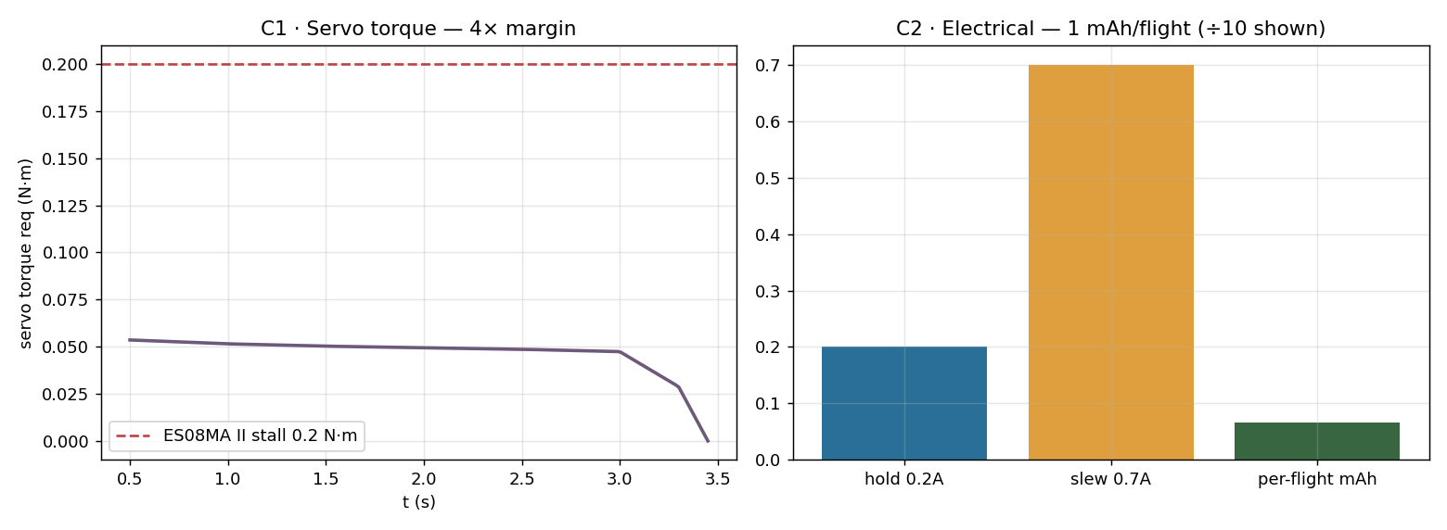
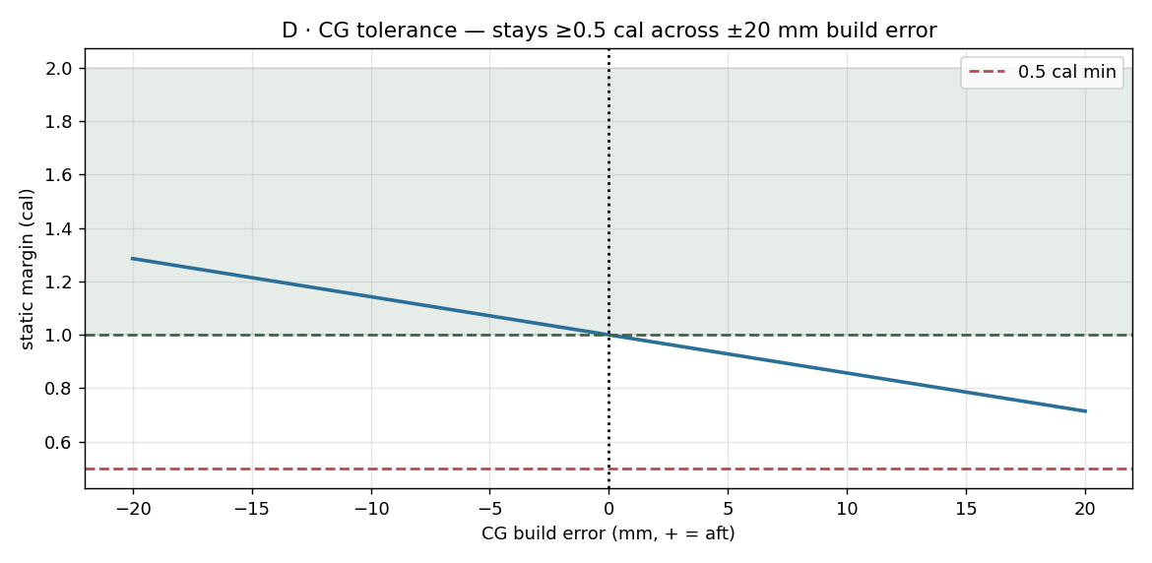
§38 · IX. Sensitivity
Deep-Dive: Servo Duty & CG Tolerance
Notes:
Servo torque holds a large margin through the burn. Static margin stays above the 0.5 cal absolute floor across a plus-minus 20mm build error in CG placement.

Slide 39
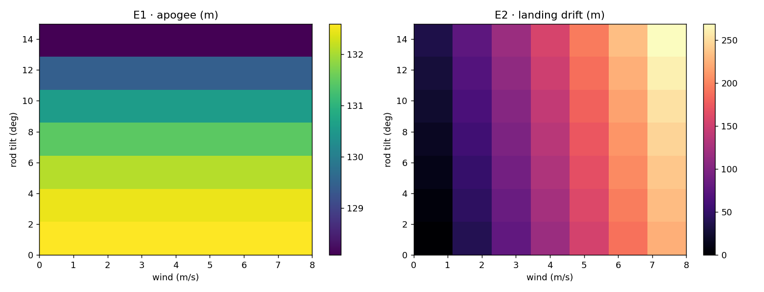
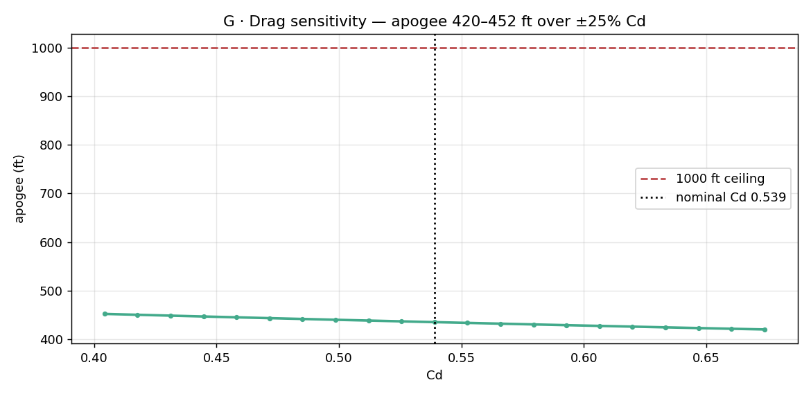
§39 · IX. Sensitivity
Deep-Dive: Dispersion Grid & Drag Sensitivity
Notes:
Rod-tilt and wind sweep grid: apogee barely changes with tilt, but landing drift grows sharply with wind -- drives the wind-hold call. Drag sensitivity keeps apogee well under the 1000ft ceiling across a wide Cd range.

Slide 40
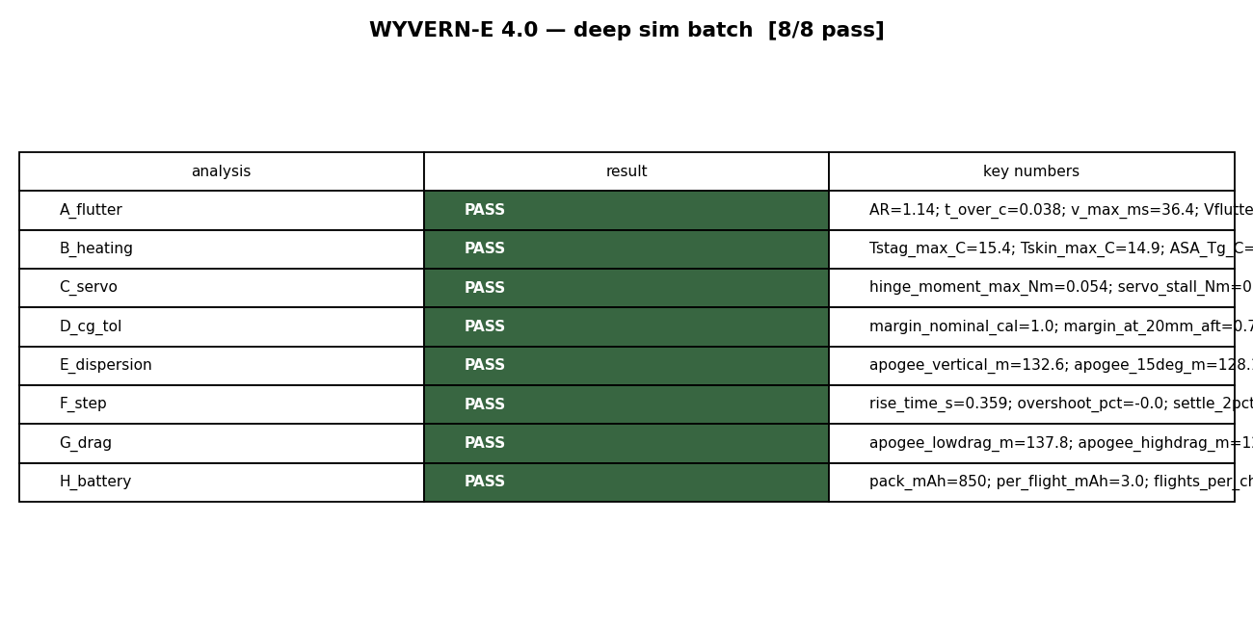
§40 · IX. Sensitivity
Deep-Dive Sensitivity — Summary
Eight independent studies — flutter, aero-heating, servo duty, CG tolerance, dispersion, step response, drag sensitivity, battery life. All eight pass.
Notes:
Eight independent deep-dive studies -- flutter, aeroheating, servo duty cycle, CG tolerance, dispersion, step response, drag sensitivity, battery life -- all pass. This is the breadth check behind the headline numbers.

Slide 41
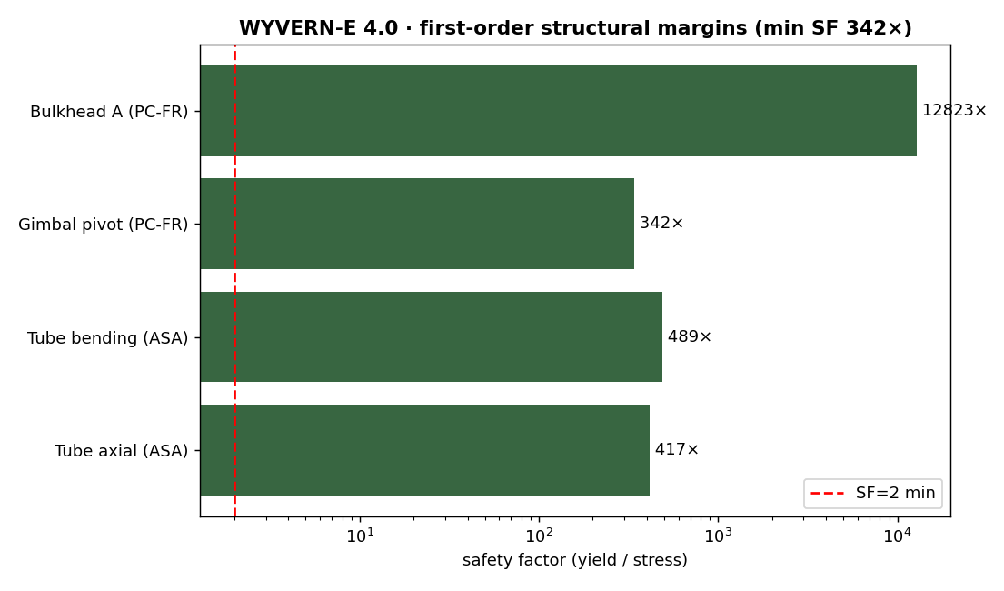
§41 · IX. Sensitivity
Structural Margins
σ = F/(πDt) — tube axial SF ~400× . Bending, gimbal pivot, and Bulkhead A all clear >50× , minimum across the structure ~340×.
A 25 N motor on a 70 mm tube is handling/print-limited, not load-limited — wall thickness is set by printability, not flight loads.
Notes:
First-order analytical structural margins. Minimum safety factor across the airframe is over 300x -- wall thickness is set by printability and handling, not flight loads.

Slide 42
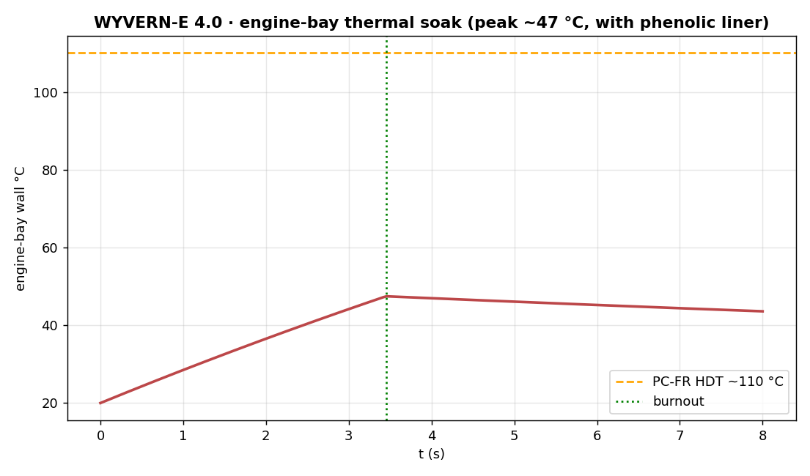
§42 · IX. Sensitivity
Thermal & Ejection-Pressure Margins
Engine-bay wall peaks ~47°C with a phenolic liner — well under PC-FR's ~110°C HDT.
Recovery bulkhead: F = pπr² = 491 N net thrust at 140 kPa ejection pressure; plate bending SF vs. PC-FR ≈ 8.2×.
Bypass tube hoop stress SF ≈ 107× ; wall set by print robustness, not stress.
Notes:
Engine bay thermal soak peaks around 47C with a phenolic liner, well under PC-FR's 110C HDT. Recovery-side bulkhead handles the 140kPa ejection pressure with 8x safety factor.

Slide 43
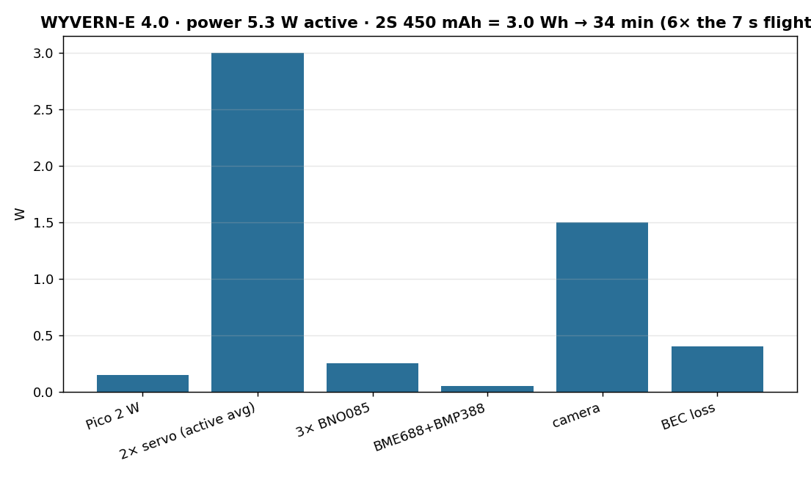
§43 · IX. Sensitivity
Power Budget
2S 450 mAh pack, 5.35 W active draw dominated by the two servos — 34 minutes of endurance vs. a 7 second flight.
Notes:
Power budget: 5.7W active draw, dominated by the two servos. 2S 450mAh pack gives 32 minutes of active endurance -- 5x margin over the 7 second flight.

Slide 44
§44 · X. Recovery
Recovery: Motor-Ejection Architecture
No CO2 system, no solenoids, no recovery battery, no pyro of our own — the flight computer only logs. Ejection gas from the F15‑4 is routed through a solid-walled bypass tube that passes the sealed FC bay and vents into the recovery bay, popping the friction-fit nose + chute. Deploy fires at t≈7.45 s, +0.64 s past apogee.
GAS PATH
motor aft closure → ejection gas → bypass tube (past sealed FC bay) → recovery bay → friction-fit nose release → chute
Notes:
No CO2, no pyro, no recovery electronics. The F15-4's own ejection charge fires through a sealed bypass tube past the flight computer bay into the recovery bay.

Slide 45
§45 · X. Recovery
Recovery Feasibility Numbers
BYPASS TUBE
12 mm ID, ~160 mm long — drops only 0.06 kPa during the ~0.1 s ejection pulse.
BAY PRESSURE
F15 charge delivers ~140 kPa into the sealed recovery bay against a 14–41 kPa friction-fit release window — 3.4× margin .
DEPLOY DYNAMICS
~6.3 m/s at ejection, ~11 N opening on the 18″ chute — trivial for the 1/8″ Kevlar cord (>100× SF).
Notes:
Feasibility numbers: 12mm bypass tube drops only 0.06kPa during the ejection pulse. Bay pressurizes to 140kPa against a 14-41kPa release window, 3.4x margin.

Slide 46
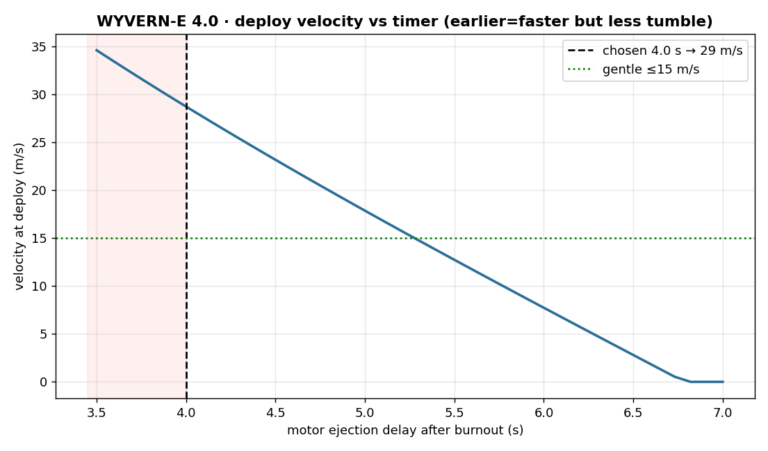
§46 · X. Recovery
Ejection-Delay Motor Selection
MOTOR
VS APOGEE
DEPLOY V
F15-4
+0.64 s
~6.3 m/s
F15-6
+2.64 s
~24.8 m/s
F15-8
+4.64 s
~40.2 m/s
Notes:
Why F15-4 over F15-6 or F15-8: its fixed ejection delay lands closest to apogee, giving the softest opening shock of the three off-the-shelf options.

Slide 47
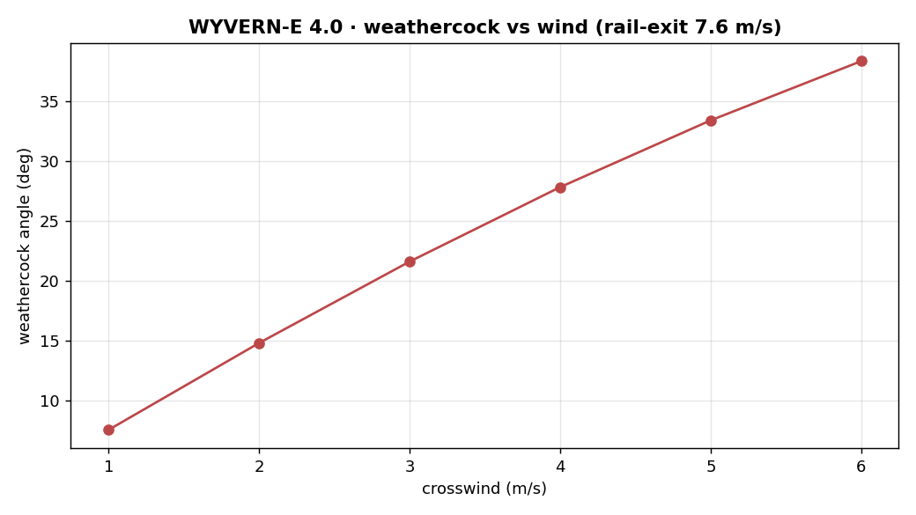
§47 · X. Recovery
Weathercock vs. Wind
A low rail-exit speed (7.8 m/s) means the finned-but-uncontrolled early boost is wind-sensitive — weathercock crosses the 30° guideline near 3–4 m/s crosswind.
Notes:
Weathercock angle grows steeply with crosswind -- past a few m/s it exceeds the 30 degree design guideline, which is why launch is scrubbed above that speed rather than redesigning around it.

Slide 48
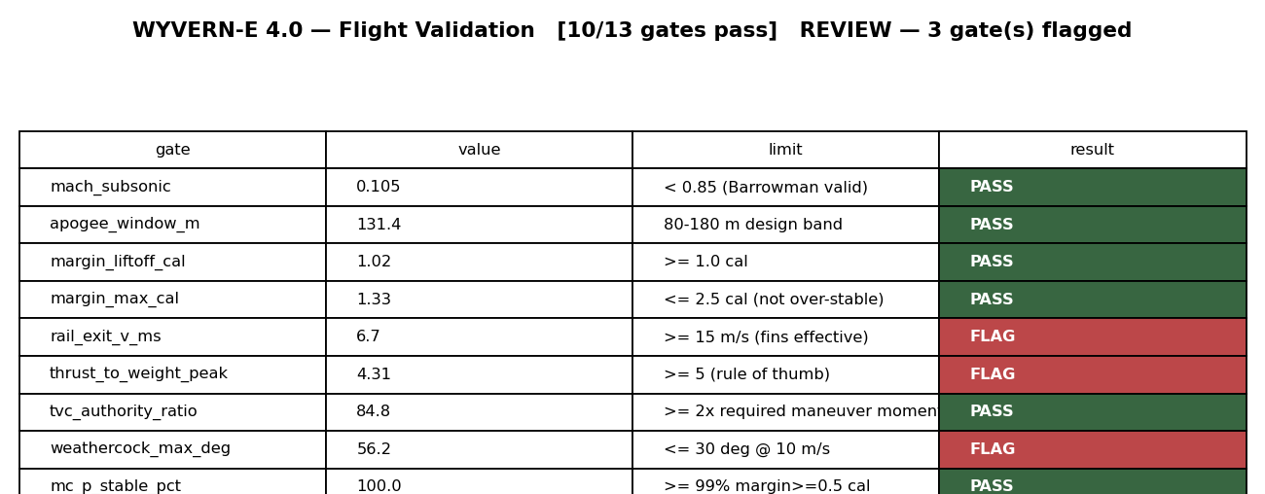
§48 · XI. Validation
Flight Validation Gates
10 / 13 gates pass
3 flagged for review
Notes:
Thirteen automated go/no-go gates against the flight sim. Ten pass outright. Three are flagged -- rail-exit velocity, peak T/W, and weathercock angle -- and we address those honestly on the next slide rather than hide them.

Slide 49
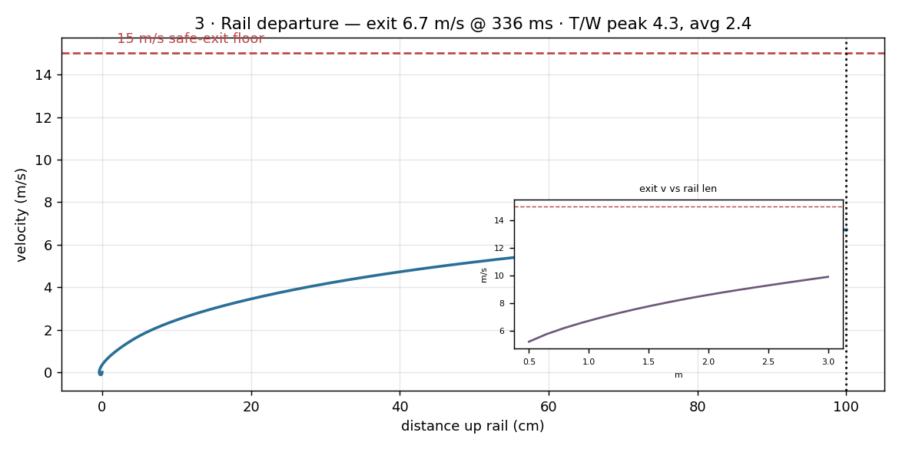
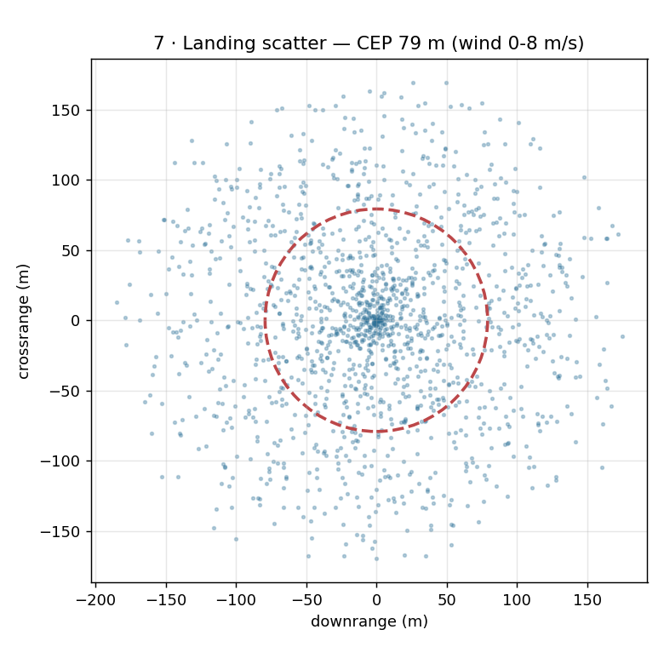
§49 · XI. Validation
Validation Detail: Rail Departure & Landing
Notes:
Closer look at two of the flagged gates: rail departure velocity and landing scatter from the Monte Carlo run.

Slide 50
§50 · XI. Validation
Open Risks & Mitigations
RAIL-EXIT VELOCITY
6.7 m/s vs. 15 m/s rule-of-thumb floor — fins aren't fully authoritative off the rail; mitigated with a longer 3 m rail, already modeled.
PEAK T/W
4.31 vs. T/W≥5 rule of thumb — a handling-margin guideline, not a stability requirement; structure SF >300× has no issue with the load.
WEATHERCOCK
56° vs. 30° at 10 m/s worst-case crosswind — a launch-day wind hold, not a design fix; scrub above ~6 m/s.
Notes:
Three flagged gates, in plain terms: low rail-exit speed means fins aren't fully authoritative until later in the boost, high peak T/W is a handling note not a failure, and the weathercock number drives a launch-day wind hold rather than a design change.

Slide 51
§51 · XII. Ground Test
Ground Test Stands
3-AXIS TVC LOAD BALANCE (RQ1)
Actuator bolts to a thrust block on 3 strain-gauge load cells (1 axial + 2 lateral) through flexures. T = √(F_{x}²+F_{y}²+F_{z} ²), θ=atan(√(F _{x}²+F_{y}²)/F_{z}), φ=atan2(F_{y},F_{x} ) resolve the full thrust vector. Sized for F15-0 peak 25.3 N axial, ~3.5 N side force at ±8°: a 5 kg axial cell + two 1 kg lateral cells at 80 samples/s. Rig is actuator-agnostic — the servo-vs-solenoid A/B runs entirely on this one fixture.
STATIC THRUST + JETVANE STAND
Axial-only, steel blast deflector. Validates the F15-0 thrust curve and holds jetvane material coupons in the plume for flame-resistance ranking. Both stands are fully PC-FR, instrumented with strain-gauge cells + HX711 24-bit bridge amps, logged by a dedicated Pico DAQ independent of the flight avionics.
Notes:
Two ground stands: a 3-axis TVC balance for the RQ1 servo vs solenoid comparison, and a static thrust plus jetvane materials stand carried over from 3.0.

Slide 52
§52 · XII. Ground Test
Actuator Comparison Protocol (RQ1)
The magnetic-solenoid and servo-driven gimbal actuators are commanded through identical step and ramp inputs on the same load balance, under nominally identical F15-0 thrust. Commanded-vs-measured deflection is logged to extract, per actuator class:
BANDWIDTH & SLEW RATE
STEP-RESPONSE OVERSHOOT
STEADY-STATE DEFLECTION ERROR
MAXIMUM ACHIEVABLE GIMBAL ANGLE
Load cells are dead-weight calibrated first, then commissioned with ≥2 low-cost E16-4 firings before any F15-0 data-collection firing — 6 F15-0 firings on the TVC balance (3 per actuator).
Notes:
The explicit RQ1 protocol: commanded step and ramp inputs on the load balance, extracting bandwidth, slew rate, overshoot, steady-state error, and max deflection for each actuator class, under identical thrust conditions.

Slide 53
§53 · XII. Ground Test
Motor Plan & Counts
MOTOR
USE
COUNT
F15-4
Flight only — ejection charge = recovery
4
F15-0 (plugged)
Ground: 6 TVC-stand + 5 static/jetvane + 2 spare
13
E16-4
Stand commissioning / load-cell calibration checks
6
Notes:
Motor plan: 4 F15-4 for flight, 13 plugged F15-0 for ground stands, 6 E16-4 for stand commissioning and load-cell calibration checks.

Slide 54
§54 · XII. Ground Test
Status & Path to Flight
DESIGN
GROUND TEST
FLIGHT & RELEASE
Simulation-complete: 679 g, +1.04 cal stable, re-tuned PID clears classical flight-control margins.
RQ1 actuator comparison on the TVC balance, static ejection fire, wind tunnel calibration (RQ3/RQ4), bench PID validation (RQ5) on the Pico.
Servo-TVC vehicle flies on F15‑4 under multiple gain sets (RQ5); all CAD, firmware, sim code, and datasets released publicly on completion.
Notes:
Close on where the program stands: design is simulation-complete and validated, PID re-tune is the key fix from this cycle, and the remaining work is ground test -- actuator comparison, static ejection fire, and wind tunnel calibration -- before first flight and public data release.

