Slide 1


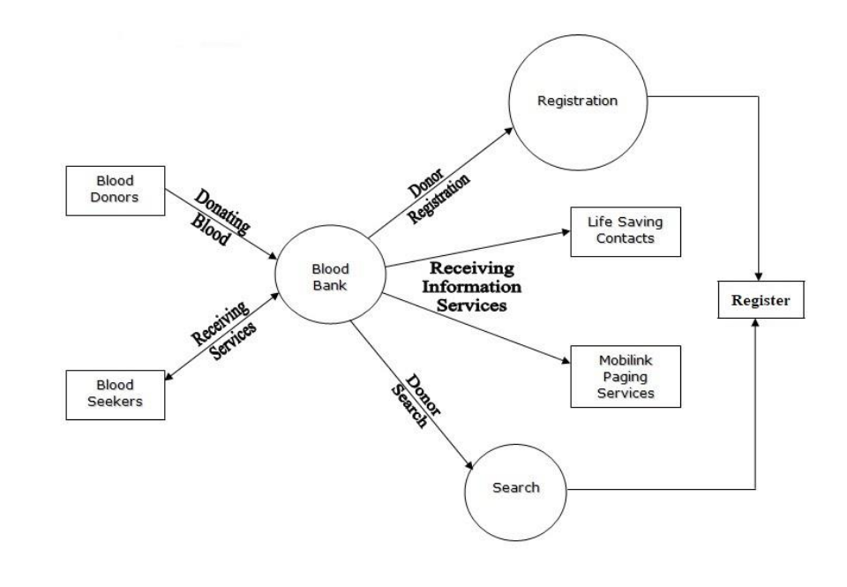
BLOOD BANK
Prepared by:
Raval Mihir (160503116009)
Pandya Swar(150500116016)
Surani Fenil (150500116046)
Sigma Institute of Engineering, Vadodara
Guided by:
Mr. Trilok Suthar
ASSISTANT PROFESSOR,
Sigma Institute of Engineering, Vadodara
ABSTRACT
PROPOSED SYSTEM
Blood bank is the new way to help needy & greedy people in their emergency period. It has digitalized the typical blood bank phenomenon & makes it much more easy & faster way to donate & take blood in the emergency time. It can be used by every needy people to get the blood faster from the nearby hospital or person. This project is aimed to developing an online Blood Donation Information. The entire project has been developed keeping in view of the distributed client server computing technology, in mind. The BloodDonation Agent is to create an information organization that are related to donating the blood. Through this application any person who is interested in donating the blood can register himself in the same way if any organization wants to register itself with this site that can also register.
The Joy of Saving Human Lives.
It manages the use of proper resources in time.
It manages donor & patient relation with each other & communication network.
The system saves time, efforts and cost of organization.
It is easy and flexible to use.
INTRODUCTION
SYSTEM DESIGN
The “Blood Bank“ , The Blood Donation Agent is to create an e- Information about the donor and Organization that are related to donating the blood. This project is aimed to developing an online Blood Donation Information. Online Blood Bank is aims serving for human welfare.
We have all the information, you will ever need. Many people are here for you, to
help you, willing to donate blood for you anytime. We have done the entire job, rest is yours. Search the blood group you need. You can help us by registering on Online Blood Bank if you are willing to donate your blood when needed.
OBJECTIVE
A blood bank is a cache or bank of blood or blood components, gathered as a result of blood donation or collection, stored and preserved for later use in blood transfusion.
The term "blood bank" typically refers to a division of a hospital where the storage of blood product occurs and where proper testing is performed (to reduce the risk of transfusion related adverse events).
WEAKNESS OF CURRENT SYSTEM
Blood Authenticity is the highest weakness in current management system.
Delay in blood transferring.
Location is not working properly.
Less accuracy in blood management.
Less awareness for blood donation.
Poor advertisement of blood donation events.
CONCLUSION
TOOLS & TECHNOLOGY
It has been a great pleasure for me to work on this exciting and challenging project. This project proved good for me as it provided practical knowledge of not only programming in ASP.NET web based application and no some extent Windows Application and SQL Server, but also about all handling procedure related with “Blood donation management system”. It also provides knowledge about the latest technology used in developing web enabled application and client server technology that will be great demand in future.
Operating system : Windows 10.
Coding Language : PHP
IDE : VS CODE
Database : MYSQL
REFERENCES
[1] https://www.w3schools.com
[2] https://www.tutorialspoint.com

