Slide 1


Let's build circuits!

Slide 2
Welcome
Today we will build some electronic circuits
Four different circuits
  Choose which you want based on experience
  Light an LED
  Control an LED using a switch
  Build a NOT logic gate (inverter)
  Flash an LED

Slide 3
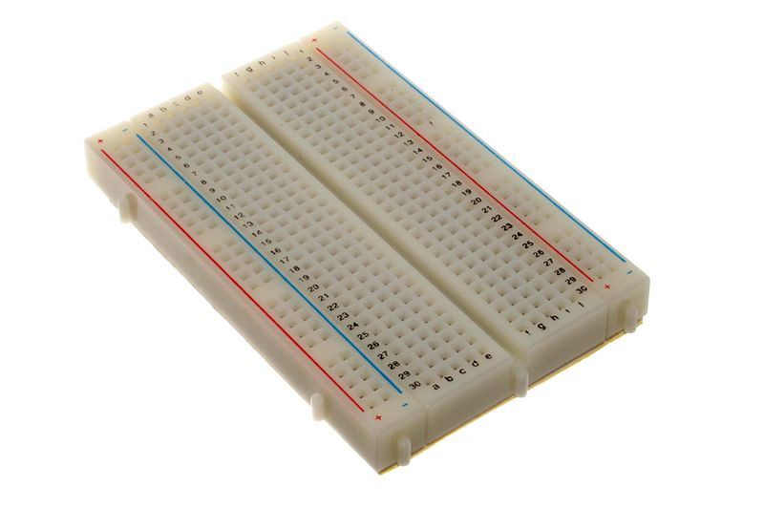
Breadboards
Used for quick circuit prototyping
Has holes to plug components' wires into
Internal wires connect the holes in a predefined pattern
Main circuit building area
Gutter for ICs
(not used today)
Power rails along edges
Main body is columns
of 5 connected holes
Two sides of gutter not connected

Slide 4
Placing components
Polarity
  Some components don't work backwards;
  follow instructions in handouts
Don't bend pins
  Gentle aiming OK, no need for permanent kinks
Carefully connect circuits as shown
  Or you may burn out a component
Don't connect power until circuit is complete

Slide 5
Transistor Packages
E-line package
Kit contains:
ZVP2110A (used in NOT gate)
TO-92 package
Kit contains:
BS170 (used in NOT gate)
BC547 (use in LED flasher; has pink dot)

Slide 6
Start Building
You will need:
Circuit handout(s)
Breadboard
Bag of components
Power supply (USB)
Power cable (modified USB)

