Slide 1
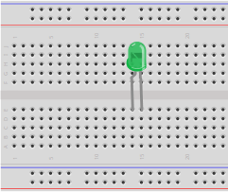
Light an LED – Step 1
LED:
Flat side, short lead
on right
Far back against
gutter

Slide 2
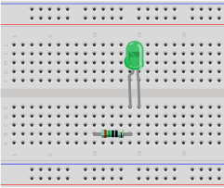
Light an LED – Step 2
Resistor 150Ω:
Brown green
black black
Right wire in same column as LED's left wire
Both legs in same horizontal row
3 empty holes underneath
Leave one row empty between it and power rails

Slide 3
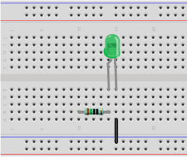
Light an LED – Step 3
Wire:
Top end aligns vertically with LED's right wire
Bottom end in the power rail that's farther away from you

Slide 4
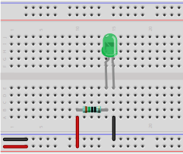
Light an LED – Step 4
Plug in power once circuit is complete
Pay attention to the colors of the two wires
Observe the LED light up
Wire:
Top end aligns vertically with resistors's left wire
Bottom end in the power rail that's nearer to you

