Slide 1
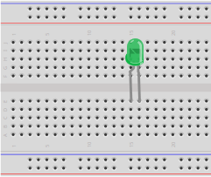
LED and Switch – Step 1
LED:
Flat side, short lead
on right
Far back against
gutter

Slide 2
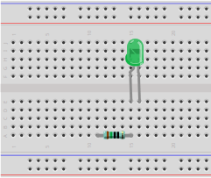
LED and Switch – Step 2
Resistor 150Ω:
Brown green
black black
Right wire in same column as LED's left wire
Both legs in same horizontal row
3 empty holes underneath
In nearest row

Slide 3
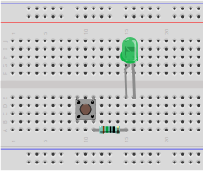
LED and Switch – Step 3
Push switch:
Wires stick out of top and bottom of switch, not left and right
Right wires in same column as resistor's left wire

Slide 4
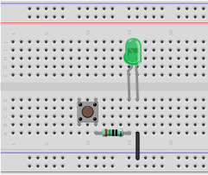
LED and Switch – Step 4
Wire:
Top end aligns vertically with LED's right wire
Bottom end in the power rail that's farther away from you

Slide 5
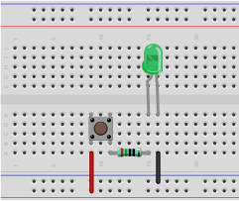
LED and Switch – Step 5
Wire:
Top end aligns vertically with push switch's left wire
Bottom end in the power rail that's nearer to you

Slide 6
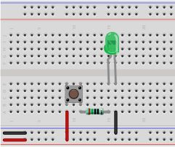
LED and Switch – Step 6
Plug in power once circuit is complete
Pay attention to the colors of the two wires
Observe the LED light up when the push switch is pressed

