Slide 1
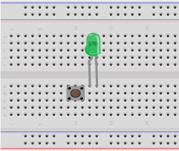
NOT gate – Step 1
Both components far back against gutter
Components are adjacent, not sharing columns
LED:
Flat side, short lead
on right
Switch:
Wires stick out of top and bottom of switch, not left and right

Slide 2
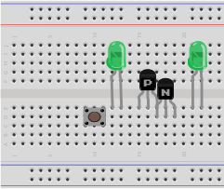
NOT gate – Step 2
LED:
Flat side, short lead
on right
Far back against gutter
One column gap between each LED and the transistors
P-channel transistor (flat back, no pink dot)
Larger flat side facing you
Overlaps N-channel transistor in one column only
N-channel transistor (round back, no pink dot)
Flat side facing you
Overlaps P-channel transistor in one column only

Slide 3
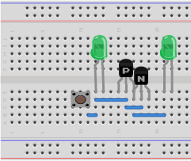
NOT gate – Step 3
Add four Wires
Pay careful attention to exactly match the picture

Slide 4
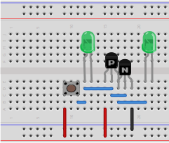
NOT gate – Step 4
Add three Wires
Pay careful attention to exactly match the picture

Slide 5
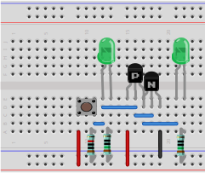
NOT gate – Step 5
Resistor 10KΩ:
Brown black black red
In the same column as the switch's right wires
Resistor 150Ω:
Brown green
black black
In the same column as each LED's right wire

Slide 6
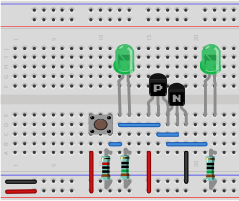
NOT gate – Step 6
Plug in power once circuit is complete
Pay attention to the colors of the two wires
Observe the two
LEDs' behavior
when the switch
is pressed and
released

Slide 7
NOT gate – Analysis
The left LED is the circuit's input
The right LED is the circuit's output
When the switch is not pressed, what state are the input and output? (Each is “on” or “off”)
When the switch is pressed, what state are the input and output now?
How does the output relate to the input? (unrelated, always on, always off, same, or opposite)

