Slide 1
Bus Protocols Explained
Parallel, '232, I2C SPI
Stephen Warren

Slide 2
Contents
Brief discussion of binary
Parallel bus
RS-232/EIA-232 (serial)
I2C
SPI

Slide 3
Binary

Slide 4
Binary vs. Decimal
What is binary?
  Simply another way to represent numbers
  Math works exactly the same
Decimal uses 10 values for digits; 0..9
  Numbers are represented as a sum of powers of 10
  905₁₀ (9 × 10²) + (0 × 10¹) + (5 × 10⁰)
Binary uses 2 values for digits, 0..1
  Numbers are represented as a sum of powers of 2
  101₂ (1 × 2²) + (0 × 2¹) + (1 × 2⁰)

Slide 5
Binary – Use In Circuits
Signals in (most) digital circuits have two states:
  On/off, high/low, 1/0
This maps perfectly to binary math:
  Binary allows only two values for any digit
  1 and 0
Circuits use a fixed number of digits per number
  BInary digiT == “bit”
  Each binary digit is a single wire/signal in the circuit
  Using 8 bits (1 byte) is common, e.g. files, ASCII, …

Slide 6
Binary Examples
00000000₂ = 0₁₀
00000001₂ = 1₁₀
00000010₂ = 2₁₀
10100110₂ = 166₁₀
11111111₂ = 255₁₀

Slide 7
Simple Parallel Port/Bus

Slide 8
Simple Parallel Port - Signals
Used by (older) printers
More complex variants are possible
  Address, read-vs-write, wait/busy, …
  Other uses: Memory bus, PCI, ...
Master
data
8 bits
Slave
strobe
(ground connection is implicit in all diagrams)

Slide 9
Simple Parallel Port - Waves
Data sent via 8 wires/signals (“d[7:0]” above)
  8 bits/wires/signals are sent at once “in parallel”
  Together they represent a single number/character
Strobe signal pulses once for each byte
  Receiver captures data on falling edge of strobe

Slide 10
RS-/EIA-232
a/k/a “serial port” or “UART”

Slide 11
RS-232/EIA-232 - Signals
Data is “serialized” onto a single signal
Asynchronous; no clock or strobe signal
  Start and Stop bits used for sync; see waves
Bi-directional
  Independent communication in each direction
txd
rxd
Device A
Device B
rxd
txd

Slide 12

RS-/EIA-232 – (TTL) Waves
Idle state is “1”
1 start bit
5, 6, 7, or 8 data bits sent serially LSB first
Optional odd/even/mark/space parity bit
1, 1.5, or 2 stop bits

Slide 13
RS/EIA-232 – Baud Rate
Each bit takes a fixed time to transmit
The transmitter and receiver must agree
on the time taken for each bit
The baud rate is the measurement of this time
  Counted in terms of bits per second, e.g. 115200
  Defines how many bits fit into each second,
  and hence the time taken by each bit

Slide 14
RS/EIA-232 – Voltage Levels
TTL and true RS-232 use different voltages,
but the same protocol
TTL: a 0 is 0V, a 1 is e.g. 1.8V, 3.3V, 5V
RS-232: Depending on what you read:
  0 is at least +3V, perhaps up to +25V
  1 is at least -3V, perhaps down to -25V
  Commonly quoted as ±12V

Slide 15
RS/EIA-232 – Receiver Sync
No clock; receiver must sync to incoming signal
RX typically samples using clock running at 16x baud rate to align to beginning of start bit
Start bit re-sampled 8 clocks later
Each bit sampled at 16 clocks later
Start, parity, stop bits validated before accepting character

Slide 16
I2C
Inter-IC Protocol – IIC – I²C
a/k/a TWI – Two Wire Interface
http://www.i2c-bus.org/

Slide 17
I2C - Signals
Multi-master, multi-device
One clock line (scl), driven by master
  Possibly extended by slave
One data line (sda), bi-directional
scl
Pull-ups
sda
Master
Master
Slave
Slave

Slide 18
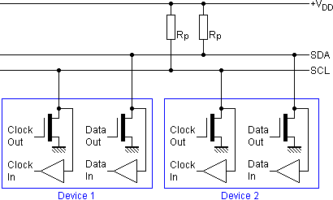
I2C - Signaling
Open-collector: Each device can either:
  Actively pull the line to logic 0
  Not drive the line;
  pull-up resistors pull the line to logic 1
No electrical conflicts with multiple drivers!

Slide 19

I2C - Waves
Start bit: Data falls while clock high
7 device address bits, 1 read/write bit, 1 ack bit
8 data bits, 1 ack bit
  Meaning of data bits is up to the device
  Can be repeated many times
Stop bit: Data rises while clock high

Slide 20
I2C – Protocol
I2C defines the pieces (start, stop, read, write)
Devices define their own protocol details
Common simple devices:
  Write: Start, device address, write data, stop
  Read: Start, device address, read data, stop
Common register-based devices:
  Write: Start, device address, write register address, write register data, stop
  Read: Start, device address, write register address, repeated start, read register data, stop

Slide 21
I2C – Clock Rate
I2C originally used 100KHz clock rate (max)
  Clock stretching can slow this
  But devices must be able to handle 100KHz clock,
  even if they stretch the clock when responding
Protocol revisions allow for devices
that can handle a 400KHz or 3.4MHz clock
  This allows faster data transfer
  Thus bus can ran only as fast as the clock rate supported by the slowest attached device

Slide 22
I2C – Advanced Topics

Slide 23
I2C – Clock Stretching http://www.i2c-bus.org/i2c-primer/clock-generation-stretching-arbitration/
Master pulses the clock to drive the transaction
When the clock is low, the device can “stretch” the clock by pulling it low too
The master will notice this,
and wait until the device releases the clock
This allows slow slaves to operate
at the clock speed they wish
Also could be used to delay a response until slave device can answer master's request

Slide 24
I2C – Multi-Master http://www.i2c-bus.org/i2c-primer/clock-generation-stretching-arbitration/
Any master can start a transaction
when the bus is idle
If no other master starts at the same time,
the transaction simply operates as expected
If multiple masters start at once,
some master sees the bus in a different state than it is transmitting
That master simply aborts its transaction and lets the other master keep going
  The transaction will be retried once the bus is idle

Slide 25


I2C – Repeated Start http://www.i2c-bus.org/repeated-start-condition/
Bus is idle between stop and start
Master can lose bus ownership (arbitration) when idle
Can be a problem for register reads
  This takes two separate I2C transactions
  Register address could be corrupted by another master
Generate a repeated start to solve this
  (Generate a start without a stop first; bus never idle)

Slide 26
I2C – 10-bit Addressing http://www.i2c-bus.org/addressing/10-bit-addressing/
7 bits of address isn't that much
Can have address collisions between devices
  Devices often can be configured to 1 of n addresses
  Doesn't solve all problems
Some devices can use 10 bits for the address
to help avoid collisions (split over 2 bytes)
Some of the 7-bit patterns indicate
an extra address byte follows
  No 7-bit device will respond to those patterns

Slide 27
SPI
Serial Peripheral Interface
a/k/a SSP – Synchronous Serial Port

Slide 28
SPI - Signals
Single-master, multi-slave (chip-/slave-selects)
Master drives clock
Read and write use separate wires
  Master In Slave Out / Master Out Slave In
clk
mosi
miso
Master
Slave
Slave
cs/ss

Slide 29
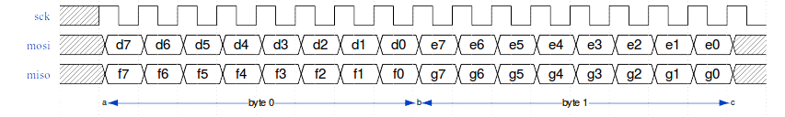
SPI - Waves
Rising clock: Both master and slave send data
Falling clock: Both receive a data bit too
Data typically framed into bytes
  By counting clocks/bits since start of transaction
100% of the meaning of data is defined by the slave device, not by SPI itself

Slide 30
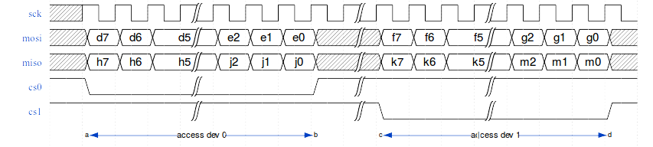
SPI with Chip Select - Waves
Addition of chip-/slave-select signals allows
multi-slave operation
Each slave receives MOSI and drives MISO only when its own chip select is active

Slide 31
SPI - Modes
Clock polarity can differ:
  Referred to as CPOL
  0: Clock is 0 at idle, rises and falls for each bit
  1: Clock is 1 at idle, falls and rises for each bit
Clock phase can differ:
  Referred to as CPHA
  0: First edge: send data, second edge: receive data
  1: First edge: receive data, second edge: send data
Together, these define the “mode”

Slide 32
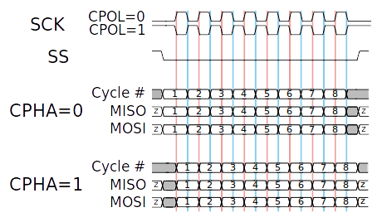
SPI - Modes
https://commons.wikimedia.org/wiki/File:SPI_timing_diagram2.svg

Slide 33
SPI - Modes
Mode | CPOL | CPHA
0 | 0 | 0
1 | 0 | 1
2 | 1 | 0
3 | 1 | 1
Not all vendors agree on the mapping of
mode to CPOL/CPHA values:-(

Slide 34
SPI – Clock Rates
Clock is driven by master; master sets rate
No clock stretching
Each slave can only withstand
a certain maximum clock rate
The chosen clock must satisfy each slave's requirements re: maximum rate

Slide 35
Final Thoughts

Slide 36
Voltage
Each device operates at some voltage
For I2C, SPI, the voltage is set by the device,
not the protocol definition
5V, 3.3V, even 1.8V are common
Make sure your devices and controller
are all compatible!
Level shifters can let you mix/match devices

Slide 37
Bit-Banging
Dedicated controllers make protocols easy
Some micro-controllers/CPUs/SoCs/...
don't have enough controllers
You might need to “bit-bang” the protocol
That is: write software to read/write
GPIO pins to emulate the protocol
Typically data rates are lower when bit-banging,
due to software overhead

Slide 38
Other Protocols
WS2812 RGB LEDs
OneWire, CAN, infra-red (remote control), ...
Custom protocols
Common themes across all protocols
Interrupts (out-of-band attention requests)

Slide 39
Questions

