Slide 1

Digital Logic
Build Your Own Logic Gate From Scratch

Slide 2
Overview
Digital Logic vs. Analog
Digital Data Representation
Logic Operations, Truth Tables
Transistors
NOT gates, NAND gates, …
Build a Logic Gate

Slide 3
Digital Logic vs Analog
All circuits have two (perhaps more) power inputs;
0v and e.g. 5v.
Signals in analog circuits vary arbitrarily between them
In digital circuits:
  Voltage represents data
  Only the two values 0v and e.g. 5v are used;
  values in between aren't used
  Boolean logic; true/false
  Binary math
  0/low/false (0v), 1/high/true (5v)

Slide 4
Logic Operations, Truth Tables
Logic operations (gates) take a set of inputs, transform them, and produce a set of outputs
Truth tables define output value(s)
for each combination of input(s)
Also: NOR/AND/OR/XOR/XNOR/...
NOT
NAND
A | X
0 | 1
1 | 0
A | B | X
0 | 0 | 1
0 | 1 | 1
1 | 0 | 1
1 | 1 | 0

Slide 5
Transistors
Many types; Bipolar, BJT, UJT, FET, ...
CMOS FETs (MOSFETs) used for most modern ICs
Think of MOSFETS as a simple switch;
they conduct between 2 terminals (source/drain)
or not, based on a control voltage (at the gate)
Two types of MOSFET:
  N-channel conducts if gate input is high
  P-channel conducts if gate input is low

Slide 6
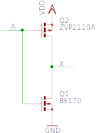
NOT schematic
NOT
A | X
0 | 1
1 | 0

Slide 7
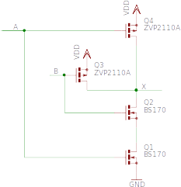
NAND schematic
NAND
A | B | X
0 | 0 | 1
0 | 1 | 1
1 | 0 | 1
1 | 1 | 0

Slide 8
Questions

Slide 9
Build A Logic Gate!
You will need:
Bag of components
Breadboard
USB power supply
Modified USB cable

Slide 10
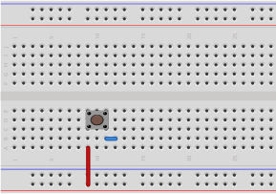
NOT gate - Step 1
Switch
Fit into 3x3 block
terminals at top/bottom
Wire
Wire

Slide 11
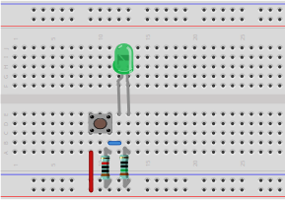
NOT gate - Step 2
LED
Flat side, short leg
to ground
10KΩ resistor
150Ω resistor

Slide 12
Transistor Packages
E-line package
Used by our P-channel device
(straight legs)
TO-92 package
Used by our N-channel device
(bent legs)

Slide 13
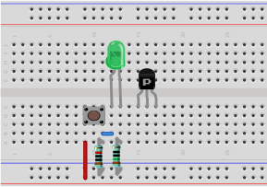
NOT gate - Step 3
P-channel FET
(E-line, straight legs)
Flat side facing you

Slide 14
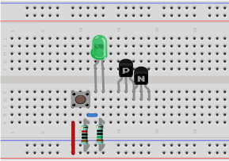
NOT gate - Step 4
N-channel FET
(TO-92 bent legs)
Flat side facing you

Slide 15
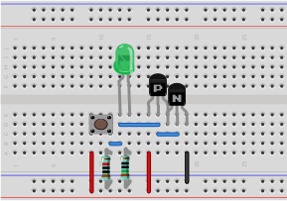
NOT gate - Step 5
Wire
Wire
Wire
Wire

Slide 16
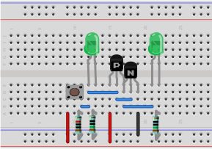
NOT gate - Step 6
LED
Flat side, short leg
to ground
Wire
150Ω resistor

Slide 17
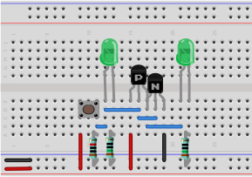
NOT gate - Power!
USB power cable
note heat-shrink colors!

Slide 18
NOT gate – Test
Press and release the button to test the NOT gate
Verify that the input and output match the truth table
NOT
A | X
0 | 1
1 | 0

Slide 19
Questions

Slide 20

NAND gate – Step 1
LED
Flat side, short leg
to ground
Switch
Fit into 3x3 block
terminals at top/bottom
Wire
150Ω resistor
10KΩ resistor
Wire

Slide 21
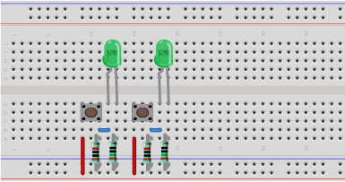
NAND gate – Step 2
LED
Flat side, short leg
to ground
Switch
Fit into 3x3 block
terminals at top/bottom
Wire
150Ω resistor
10KΩ resistor
Wire

Slide 22
Transistor Packages
E-line package
Used by our P-channel device
(straight legs)
TO-92 package
Used by our N-channel device
(bent legs)

Slide 23
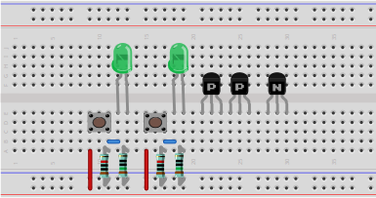
NAND gate – Step 3
P-channel FET
(E-line, straight legs)
Flat side facing you
N-channel FET
(TO-92 bent legs)
Flat side facing you

Slide 24
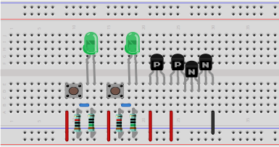
NAND gate – Step 4
N-channel FET
(TO-92 bent legs)
Flat side facing you
Wire

Slide 25
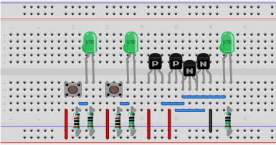
NAND gate – Step 5
LED
Flat side, short leg
to ground
150Ω resistor
Wire

Slide 26
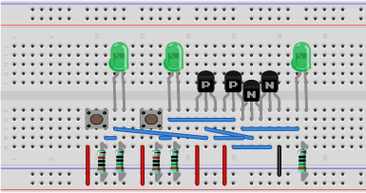
NAND gate – Step 6
Wire

Slide 27
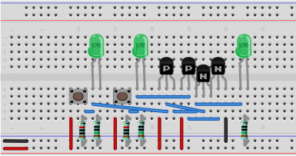
NAND gate – Power!
USB power cable
note heat-shrink colors!

Slide 28
NAND gate – Test
Press and release the buttons to test the NAND gate
Verify that the inputs and output match the truth table
NAND
A | B | X
0 | 0 | 1
0 | 1 | 1
1 | 0 | 1
1 | 1 | 0

Slide 29
Questions

