Slide 1

Introduction To Electronics
A practical introduction to common electronic components and circuits

Slide 2
Overview
Concepts – Circuit, Current, Voltage
Basic Components
Build simple circuits
Experiment with components

Slide 3
Level Of Detail
Brief description of theory
  Nothing too heavy
  Plenty of opportunity for follow-on presentations
  or hands-on coaching
Practical familiarity with components
  Pick them up and look at them a bit later
Practical experimentation
  Hopefully you'll get an intuitive feel
  for what the components do

Slide 4
What Is A Circuit?
A closed loop through which electrical current can flow
(What's current? Next page...)
The loop will contain various components
(We'll describe some examples later...)
Can be a complex network of loops,
not just one simple loop

Slide 5
Current - 1
A movement of charge carriers around a circuit
  Those charge carriers are typically electrons
  Similar to the flow of water in a pipe
Measured in Amperes/Amps (A)
  LEDs or micro-controllers use tens of mA
  Consumer electronics use (order of) ~1-2A
  Home appliances use (order of) 10-50A
  Just a few mA can kill you!
    Depending on voltage and other factors
    Don't worry – low voltages are safe

Slide 6
Voltage
“Electric potential energy per unit charge” (wikipedia)
  Sounds complicated!
  Potential: cf. gravitational potential energy
  due to height differences in a hydro-electric dam
Think of it as the force pushing current
  Similar to pressure in a water pipe,
Measured in Volts (V). Typical values:
  5V for electronics (safe to tinker with)
  12V for car batteries
  100-250V for household mains (don't play with this)
  Perhaps 2000kV for grid transmission lines (stay well away)

Slide 7
Current - 2
Current moves charge carriers from areas at one voltage to areas of another voltage
This is a change in the (electric) potential energy of the charge carriers
The gained or lost energy can be converted to/from other forms, e.g. light, heat, motion
  This is how electronics interfaces with the world

Slide 8
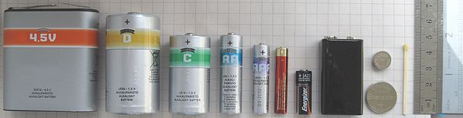
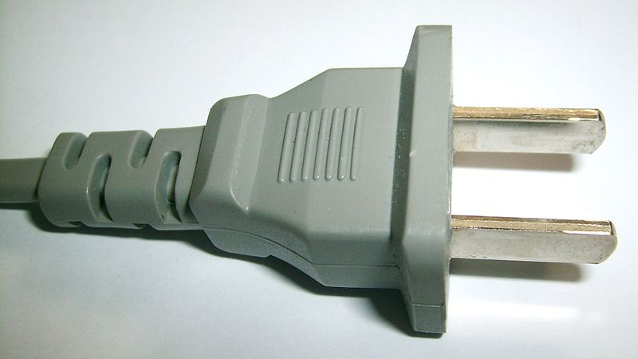
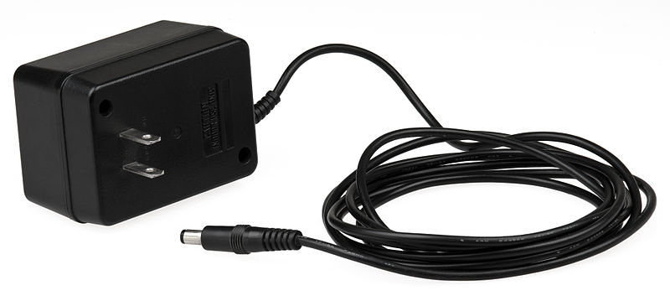
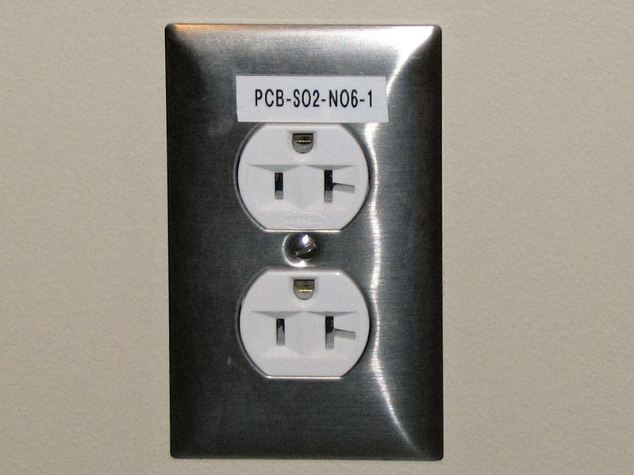
Voltage Sources
+
5V
GND
Mains electricity
Batteries
Wall Wart / Power Supply / Charger

Slide 9
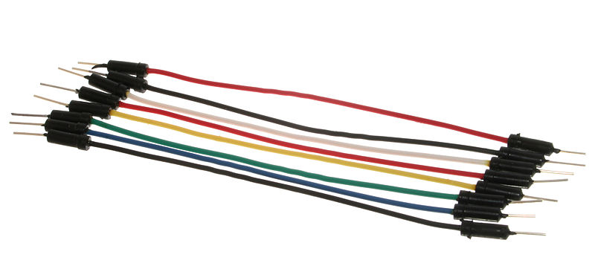
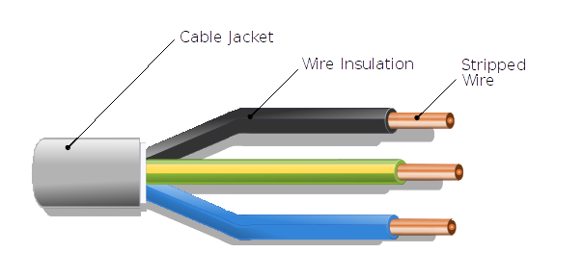
Wires
Contain lots of charge carriers (electrons)
Carry current
Connect components
Also, traces on PCB
Breadboard wires
have connectors on the end
Many different kinds of wire;
Single/multi-core, shielded/not, ...

Slide 10
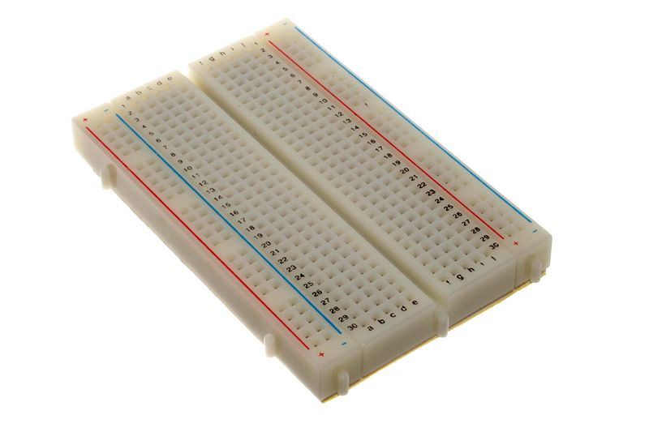
Breadboards
Used for quick circuit prototyping
Holes to plug components' wires into
Internal wires connect some of the holes
Columns are named
Rows are numbered
Gutter for ICs
Power rails along edges
Main body is rows
of 5 connected holes

Slide 11
Resistors - 1
Restrict the flow of current through a circuit
Non-polarized: 2 identical terminals (wires)
Value measured in Ohms (Ω)
  Typical values zero to millions of Ohms
Ohm's law:
  V = IR
  A voltage of 1V across a resistance of 1Ω causes 1A of current to flow through it
  Conversely, if a current of 1A flows through a resistor of 1Ω, there is a 1V voltage drop across the resistor

Slide 12
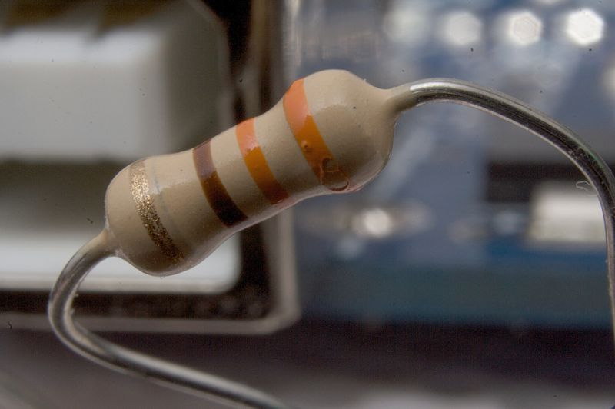
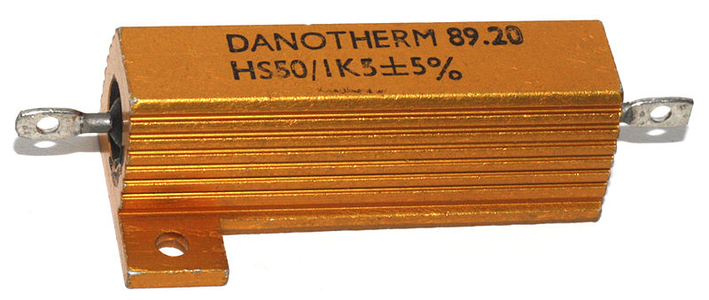

Resistors - 2
Common low-power resistor
Value represented by color bands
High power resistor
Value might be written as text, possibly coded
Multiple resistors in one package

Slide 13
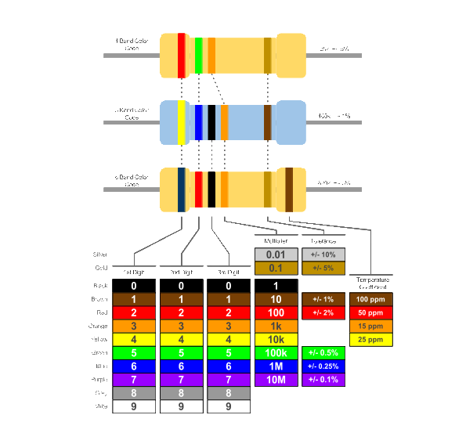
Resistors - 3

Slide 14
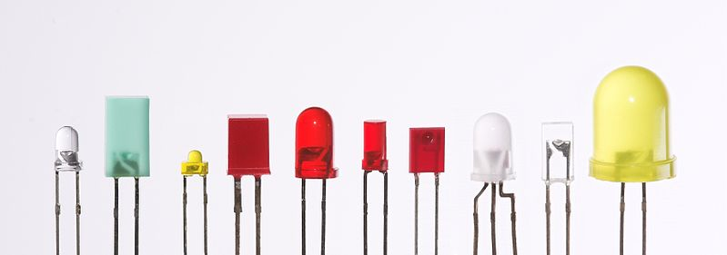
LEDs
Emit light when current flows through them
Polarized; two terminals are different
  Anode: Connect to more positive voltage
  Cathode: Connect to more negative voltage
Flat edge, short leg:
Cathode
Bi-color LED;
2 LEDS in 1 package
Anode

Slide 15

A Simple Circuit
Schematic
Resistor limits current
to protect LED
Power source (5V)
Power supply implicitly
connected to both 5V/GND
LED emits light
when current flows
Power source (0V/GND)

Slide 16
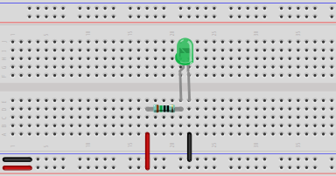
A Simple Circuit
Breadboard
150Ω resistor
Brown, green, black, black
LED: cathode on right
(flat side, short leg)
Count the holes, and match the picture!
It will be easier to make later circuits
USB power supply
Match the heat-shrink colors

Slide 17
Different Resistor Values
Breadboard
Does the LED light at all?
(look very closely, in darkness, to check)
Change to 10kΩ resistor
Brown, black, black, red

Slide 18
Diodes - 1
Allow current to flow in one direction
  Cause a slight voltage drop as the current flows
Block current flowing in the other direction
  If reverse voltage gets too high,
  break down and current still flows
Polarized; two terminals are different
  Anode & Cathode
  Current can flow from anode to cathode
  LED is a Light-Emitting Diode

Slide 19
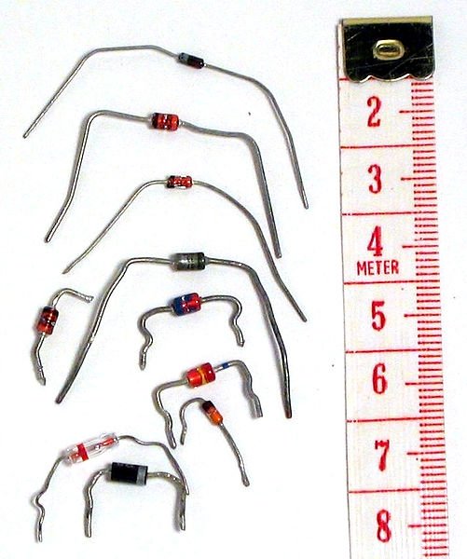
Diodes - 2
Stripe at cathode

Slide 20

Diodes
Schematic
New component:
Diode

Slide 21
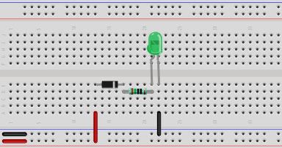
Diodes
Breadboard
Add diode
Which way around must the diode
be fitted for the LED to light?
Move wire
Change back to 150Ω resistor
Brown, green, black, black

Slide 22
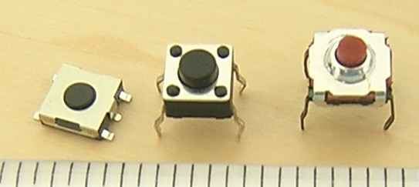
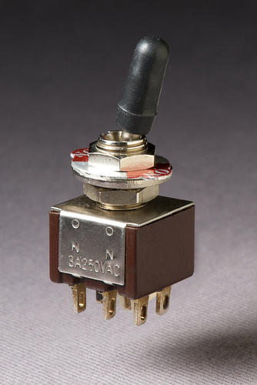
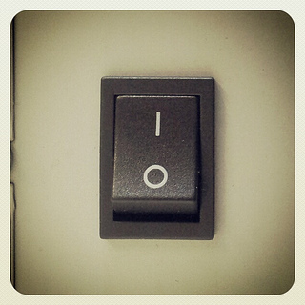
Switches
Connect (or not) their terminals based on physical position of part of the switch

Slide 23
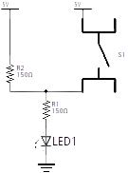
Resistors In Series
Schematic
New component:
Switch
Extra resistor
in series with R1
S1 optionally
bypasses R2

Slide 24
Resistors In Series
Schematic
Current flow with
S1 open:
Current flows through
R1 and R2

Slide 25
Resistors In Series
Schematic
Current flow with
S1 closed:
Current flows through
R1 only (not R2)

Slide 26
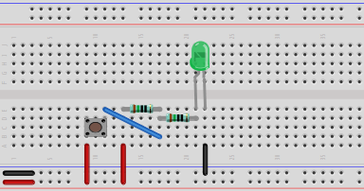
Resistors In Series
Breadboard
Replace diode with 150Ω resistor
Brown, green, black, black
Is the LED brighter or darker
with the button pressed?
New wires
Add switch
Legs are on top/bottom,
not left/right

Slide 27
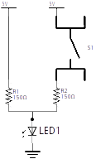
Resistors In Parallel
Schematic
S1 optionally adds
R2 to circuit
Extra resistor
in parallel with R1

Slide 28
Resistors In Parallel
Schematic
Current flow with
S1 open:
Current flows through
R1 only (not R2)

Slide 29
Resistors In Parallel
Schematic
Current flow with
S1 closed:
Current flow split
between R1 and R2

Slide 30
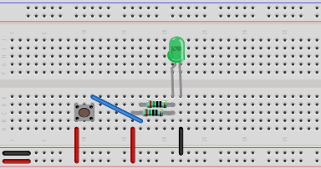
Resistors In Parallel
Breadboard
Is the LED brighter or darker
with the button pressed?
Move resistor
It straddles 4 holes,
not 3 like the other!
Move wire
It aligns with nearer resistor

Slide 31
Capacitors - 1
+
+
Can temporarily store electrical (potential) energy
Can release (or acquire) energy much more quickly, and at a higher current, than batteries
Some are polarized, some aren't
Value measured in Farads (F), but Farads are huge
  Typical values ~10pF through perhaps 10,000μF
If connected to a power source, will “charge up”
If power removed, will discharge, and can power a circuit
Time take to charge/discharge related to value
useful in timing circuits

Slide 32
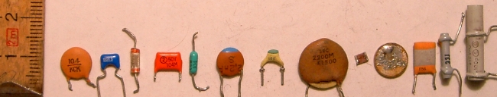
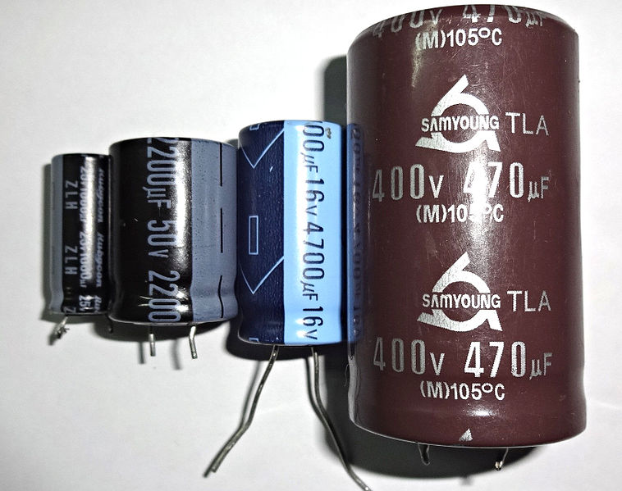
Capacitors - 2
Value written as coded text
Value written as text

Slide 33
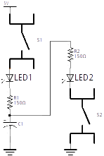
Capacitors
Schematic

Slide 34
Capacitors
Schematic
Current flow with
S1 closed:
Capacitor “charges”
through LED1, R1

Slide 35
Capacitors
Schematic
Current flow with
S2 closed:
Capacitor “discharges”
through R2, LED2

Slide 36
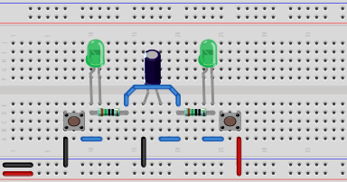
Capacitors
Breadboard
LED: cathode on right
(flat side, short leg)
3300μF capacitor
Stripe on left side
LED: cathode on right
(flat side, short leg)
Wire BEHIND
capacitor
Legs on top/bottom,
not left/right
150Ω resistor
Brown, green, black, black

Slide 37
Capacitors
Breadboard
How long does it take
to charge/discharge?
Press and hold
to “discharge” capacitor
Press and hold
to “charge” capacitor

Slide 38
Different Capacitor Values
Breadboard
Replace with 1000μF capacitor
Stripe on left side
Is the charge/discharge
slower or faster?

Slide 39
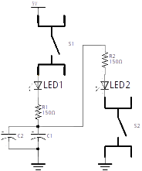
Capacitors In Parallel
Schematic
Extra capacitor
in parallel with C1

Slide 40
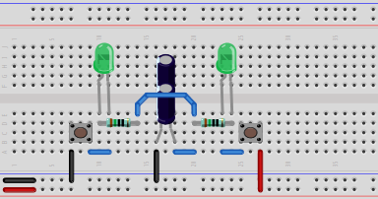
Capacitors In Parallel
Breadboard
Is the charge/discharge
slower or faster?
Add 3300μF capacitor
Straddle the same rows
Stripe on left side

Slide 41
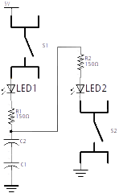
Capacitors In Series
Schematic
Extra capacitor
in series with C1

Slide 42
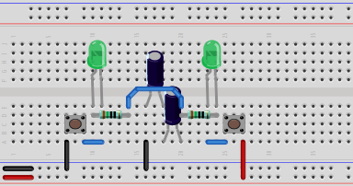
Capacitors In Series
Breadboard
Is the charge/discharge
slower or faster?
Remove wire
Move 3300μF capacitor

Slide 43
Questions

Slide 44
Image Licenses - 1
http://en.wikipedia.org/wiki/File:Batteries_comparison_4,5_D_C_AA_AAA_AAAA_A23_9V_CR2032_LR44_matchstick-vertical.jpegCC BY SA 3.0 unported
http://creativecommons.org/licenses/by-sa/3.0/deed.en
http://en.wikipedia.org/wiki/File:Wall-Wart-AC-Adapter.jpg
Public domain
http://en.wikipedia.org/wiki/File:A_plug.jpg
CC BY SA 3.0 unported
http://creativecommons.org/licenses/by-sa/3.0/deed.en
http://en.wikipedia.org/wiki/File:Electrical_outlet_with_label.jpg
CC BY SA 3.0 unported
http://creativecommons.org/licenses/by-sa/3.0/deed.en
http://en.wikipedia.org/wiki/File:A_few_Jumper_Wires.jpg
CC BY SA 2.0 generic
http://creativecommons.org/licenses/by-sa/2.0/deed.en
http://commons.wikimedia.org/wiki/File:Cable_Cross_Section.svg
CC BY SA 3.0
http://creativecommons.org/licenses/by-sa/3.0/deed.en
http://en.wikipedia.org/wiki/File:400_points_breadboard.jpg
CC BY SA 2.0 generic
http://creativecommons.org/licenses/by-sa/2.0/deed.en

Slide 45
Image Licenses - 2
http://en.wikipedia.org/wiki/File:Resistor.jpg
CC BY SA 3.0
http://en.wikipedia.org/wiki/File:Resistor.jpg
http://en.wikipedia.org/wiki/File:Danotherm_HS50_power_resistor.jpg
Public domain
http://en.wikipedia.org/wiki/File:Sil_resistor.png
Public domain
http://bit.ly/my-templates
https://drive.google.com/previewtemplate?id=1lWeBgAR_CIHPSBInJ29pKoF0bN0YCUG2NX6V9EKPN4o&mode=public
CC BY SA 3.0
http://creativecommons.org/licenses/by-sa/3.0/
http://en.wikipedia.org/wiki/File:Verschiedene_LEDs.jpg
CC BY SA 2.0 generic
http://creativecommons.org/licenses/by-sa/2.0/deed.en
http://en.wikipedia.org/wiki/File:Diodes.jpg
CC BY SA 3.0 unported
http://creativecommons.org/licenses/by-sa/3.0/deed.en

Slide 46
Image Licenses - 3
http://en.wikipedia.org/wiki/File:Ceramic_capacitors.jpg
CC BY SA 3.0 unported
http://creativecommons.org/licenses/by-sa/3.0/deed.en
http://en.wikipedia.org/wiki/File:Electrolytic_capacitor.jpg
CC BY 3.0
http://creativecommons.org/licenses/by/3.0/
http://en.wikipedia.org/wiki/File:Tactile_switches.jpg
CC BY SA 3.0 unported
http://creativecommons.org/licenses/by-sa/3.0/deed.en
http://www.flickr.com/photos/g4ll4is/7125837749/sizes/n/
CC BY SA 2.0
http://creativecommons.org/licenses/by-sa/2.0/
http://www.flickr.com/photos/arionfoto/4186043024/sizes/m/
CC BY ND 2.0
http://creativecommons.org/licenses/by-nd/2.0/

