Slide 1


Building Oscillating Circuits
(multivibrators)
Using Transistors

Slide 2
Introduction
What is a multivibrator?
Different types (bistable, monostable, bistable)
Walk through of the circuits
Build the circuits

Slide 3
What's a multivibrator?
Circuit that has two states, and changes (vibrates, oscillates) between them
Bistable – Stable in both states (Bi: 2)
  Moves between states only when forced externally
Monostable – Stable in just one state (Mono: 1)
  Moves from state A to B by external force
  Moves from state B to A after a time delay
Astable – Stable in neither state (A: Not)
  Autonomously oscillates between the states

Slide 4

LED Circuit
Resistor limits current
to protect LED
Power source (5V)
Power supply implicitly
connected to both 5V/GND
Power source (0V/GND)
LED emits light
when current flows

Slide 5
(Bipolar) Transistors
A transistor can be a switch,
or electronically controlled variable resistor
Transistors generally have 3 pins
For Bipolar transistors, these are named:
  Collector
  Base
  Emitter
Base voltage controls whether (how much) the
Collector and Emitter are connected

Slide 6

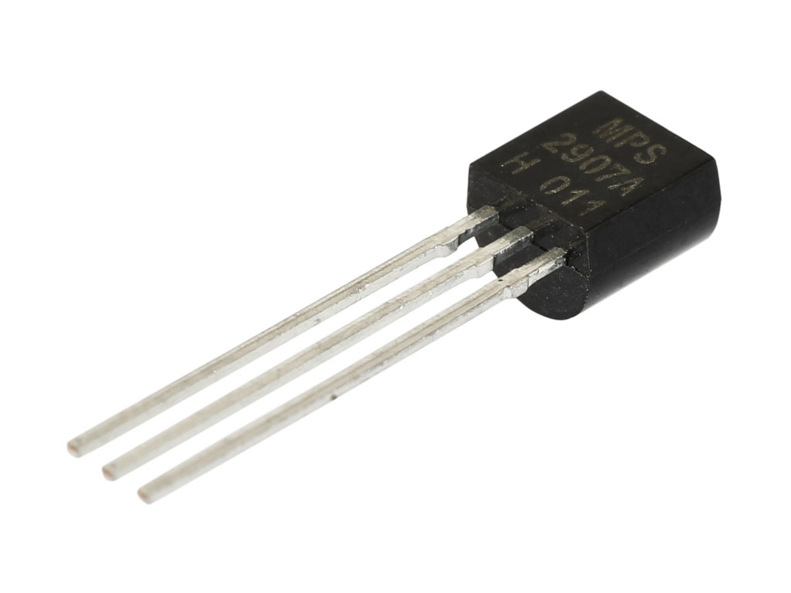

Transistor – Pictures and Symbols
PNP
(Pointing iN Proudly)
NPN
(Not Pointing iN)

Slide 7
Transistors - Operation
Base-Emitter current determines
Collector-Emitter current
Transistors often characterized as amplifying current:
The more Base current flows,
the more Collector-Emitter current can flow.
A Base voltage is required
to cause a Base current to flow
NPN: Turns on when Base is high (cf. Emitter)
PNP: Turns on when Base is low (cf. Emitter)

Slide 8

Transistor Circuit
If transistor is ON,
LED connected to GND
so lights up
If transistor is OFF,
LED not connected to GND,
so does not light
If Base is HIGH,
transistor is ON
If Base is LOW,
transistor is OFF

Slide 9
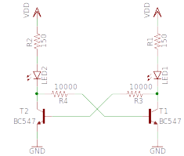
Bistable Circuit

Slide 10
Bistable Circuit
Circuit from before
Circuit from before

Slide 11
Bistable Circuit
Voltage here ...
… controls voltage here ...
… controls whether this
transistor is on or off

Slide 12
Bistable Circuit
Voltage here ...
… controls voltage here ...
… controls whether this
transistor is on or off

Slide 13
Bistable Circuit
Resistors to limit current
flow into transistors' Bases

Slide 14
Bistable Circuit
… this voltage is LOW ...
… this voltage is HIGH ...
IF this transistor is ON ...
… this transistor is OFF ...
… and so this transistor
stays ON

Slide 15
Bistable Circuit
… this voltage is HIGH ...
… this voltage is LOW ...
IF this transistor is OFF ...
… this transistor is ON ...
… and so this transistor
stays OFF

Slide 16
Bistable Circuit
Force high here
to turn on T1, LED1
Force high here
to turn on T2, LED2

Slide 17
Bistable Animation
http://www.falstad.com/circuit/e-multivib-bi.html

Slide 18
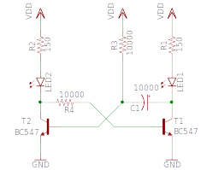
Monostable Circuit

Slide 19
Monostable Circuit
Different

Slide 20
Monostable Circuit – Stable State
IF T2 is ON ...
… T1 is OFF ...
… so ignore this!

Slide 21
Monostable Circuit – Unstable State
IF T2 is OFF ...
… so voltage is LOW
on BOTH sides of C1
(C1 is not charged)
so T2 stays off ...
… T1 is ON ...

Slide 22
Monostable Circuit – Unstable State
… C1 charges,
voltage across C1
increases, so voltage
becomes high here
So T2 turns ON
and T1 turns OFF
(circuit flips state by
itself)

Slide 23
Monostable Circuit – Unstable State
Force high here
to turn on T1, LED1
(for a while)

Slide 24
Monostable Animation
http://www.falstad.com/circuit/e-multivib-mono.html

Slide 25
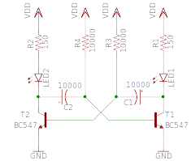
Astable Circuit

Slide 26
Astable Circuit
Different

Slide 27
Astable Circuit – Unstable state 1
C2 charges ...
and eventually
T1 turns ON,
T2 turns OFF
IF T2 is ON ...
… T1 is OFF ...

Slide 28
Astable Circuit – Unstable state 2
C1 charges ...
and eventually
T2 turns ON,
T1 turns OFF
IF T2 is OFF ...
… T1 is ON ...

Slide 29
Astable Animation
http://www.falstad.com/circuit/e-multivib-a.html

Slide 30
Let's Build Circuits!

Slide 31
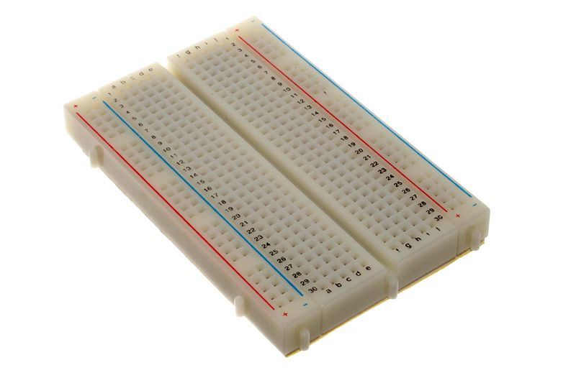
Breadboards
Used for quick circuit prototyping
Holes to plug components' wires into
Internal wires connect some of the holes
Rows are named
Columns are numbered
Gutter for ICs
Power rails along edges
Main body is columns
of 5 connected holes
Two sides of gutter not connected

Slide 32
Placing components
Polarity
  Some components don't work backwards
Don't bend pins
  Slight angling OK, no need for kinks
Don't burn out LEDs
  By connecting to power with no resistor
Don't connect power until circuit is complete

Slide 33
Transistor Packages
E-line package
Kit contains:
ZVP2110A (we won't use this)
TO-92 package
Kit contains:
BC547 (use this; has pink dot on back)
BS170 (we won't use this)

Slide 34
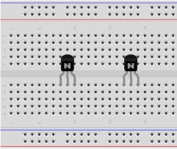
Bistable – Step 1
6 hole gap
horizontally
At least 3 hole gap
horizontally to edge
BC547 (pink dot)
Flat side towards you
Red line nearest you

Slide 35
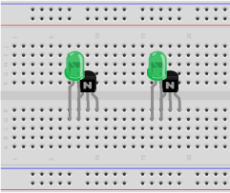
Bistable – Step 2
LED: cathode on right
(flat side, short leg)

Slide 36
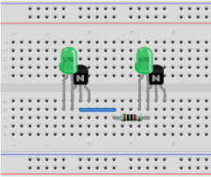
Bistable – Step 3
Wire
10kΩ resistor
Brown, black, black, red

Slide 37
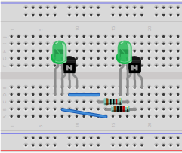
Bistable – Step 4
Wire
10kΩ resistor
Brown, black, black, red

Slide 38
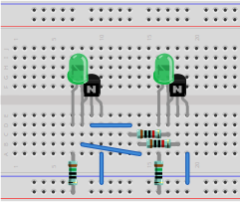
Bistable – Final
Wire
150Ω resistor
Brown, green, black, black

Slide 39
Bistable – Test
Apply power
Match heat-shrink colors
Touch wire from POWER … to either LED's right pin
One pin at a time

Slide 40
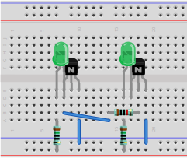
Monostable – Step 1
Remove power
Delete rear wire, resistor

Slide 41
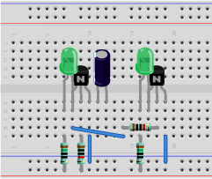
Monostable – Step 2
10kΩ resistor
Brown, black, black, red
10μF capacitor
Negative pin (stripe) on left

Slide 42
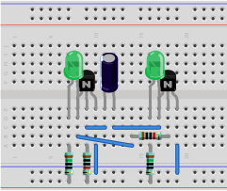
Monostable – Final
Wire

Slide 43
Monostable – Test
Apply power
Match heat-shrink colors
Touch wire from POWER … to left LED's right pin
Wait for LEDs to change automatically

Slide 44
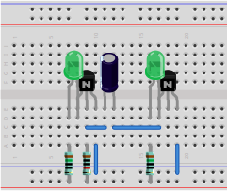
Astable – Step 1
Remove power
Delete front wire, resistor

Slide 45
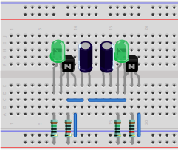
Astable – Step 2
10μF capacitor
Negative pin (stripe) on right
10kΩ resistor
Brown, black, black, red

Slide 46
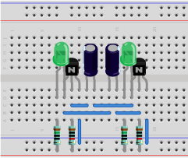
Astable – Final
Wire

Slide 47
Astable – Test
Apply power
Match heat-shrink colors
Observe circuit switching back and forth
between two states automatically

Slide 48
Questions
(and congratulations for
getting throughnearly 50 slides!)

