Slide 1
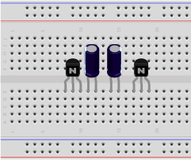
LED Flasher – Step 1
One hole horizontal gap to right of each capacitor
All components in farthest row
220μF capacitors
White stripe:
- on the left of the left capacitor
- on the right of the right capacitor
BC547 transistors
(pink dot on back)
Flat side facing you

Slide 2
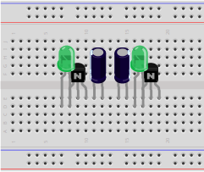
LED Flasher – Step 2
LEDs:
Flat side, short lead
on right
In row just in front on transistors
Right wire overlaps with transistor

Slide 3
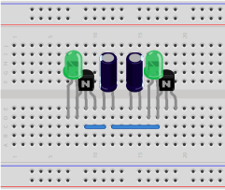
LED Flasher – Step 3
Add two Wires
In row in front of LEDs
Pay careful attention to exactly match the picture

Slide 4
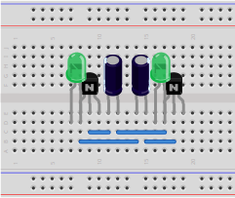
LED Flasher – Step 4
Add two Wires
In row in front of LEDS
Pay careful attention to exactly match the picture

Slide 5
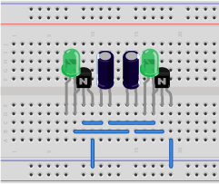
LED Flasher – Step 5
Add two Wires
Pay careful attention to exactly match the picture

Slide 6
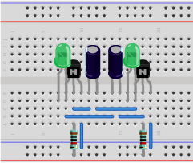
LED Flasher – Step 6
Resistor 10KΩ:
Brown black black red
In the same column as the transistors' middle wire

Slide 7

LED Flasher – Step 7
Resistor 150Ω:
Brown green black black
In the same column as the LEDs'
left wire

Slide 8
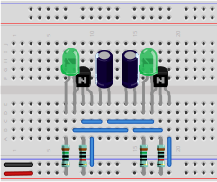
LED Flasher – Step 8
Plug in power once circuit is complete
Pay attention to the colors of the two wires
Observe the two
LEDs' behavior
Which component do you think is responsible for the dynamic behavior of the circuit?
What do you think controls how fast the LEDs flash?

Slide 9
NOT gate – Analysis
The left LED is the circuit's input
The right LED is the circuit's output
When the switch is not pressed, what state are the input and output? (Each is “on” or “off”)
When the switch is pressed, what state are the input and output now?
How does the output relate to the input? (unrelated, always on, always off, same, or opposite)

