Slide 1




Long read genome assembly course
2-day workshop
20/21 April 2023

Slide 2
Aim of the workshop
Learn the basics of genome assemblies
We will go through the entire process
Read quality
Genome assembly
Comparison & validation
Gain hands-on experience
Discuss and evaluate our findings

Slide 3
General information
Christina Papastolopoulou
MSc, currently doing her PhD in bioinformatics (plant pangenomics)
Sven Warris
PhD in bioinformatics, researcher Applied Bioinformatics
Netherlands Plant Eco-phenotyping Center
20th of April: room B3015 of the Orion building.
21st of April: room B0656 of the Forum building

Slide 4
General information
Google docs link in the course materials
Post your results, questions, observations, etc
Be respectful
Coffee, Tea & lunch are provided

Slide 5
Data & tools
Kiwifruit region of ~2.5Mb
diploid
Mapped PacBio Hifi & Nanopore data & extracted reads
assembly-stats, quast, seqtk, Tablet
Minimap2, mummer 4
Flye assembler
Hifiasm assembler

Slide 6
PacBio Sequel IIe / Revio
Long reads > 50kb
High throughput
Error rate < 10-15%
Proven technology
De novo assembly (but compute intensive)
Structural variant detection (re-sequencing)
Full-length RNA (IsoSeq sequencing)
Amplicon sequencing

Slide 7
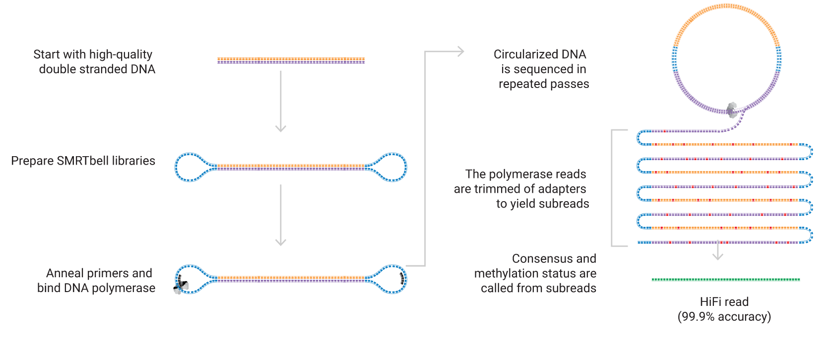
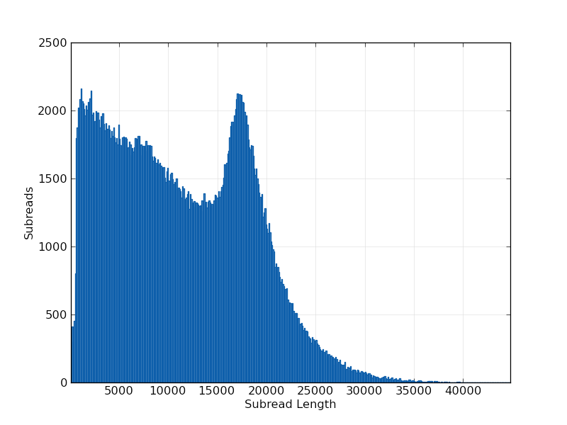
PacBio HiFi

Slide 8
Oxford Nanopore Technologies sequencing
Extremely long reads > 200kb
High throughput
Error rate 5-10%
Low DNA input requirements
Direct sequencing
De novo assembly (but very compute intensive)
Structural variant detection
Unstable in data production

Slide 9
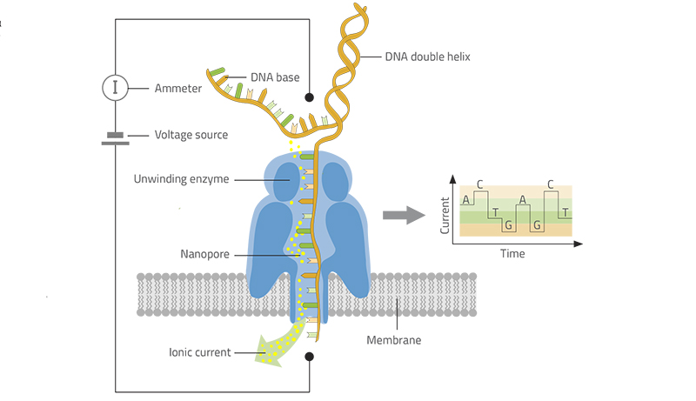
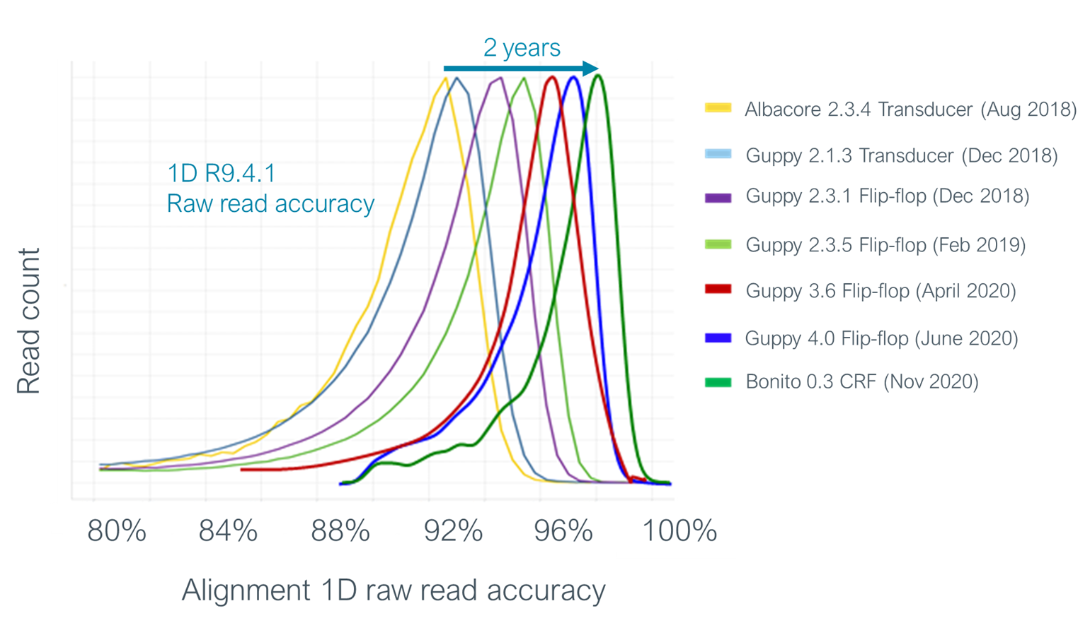
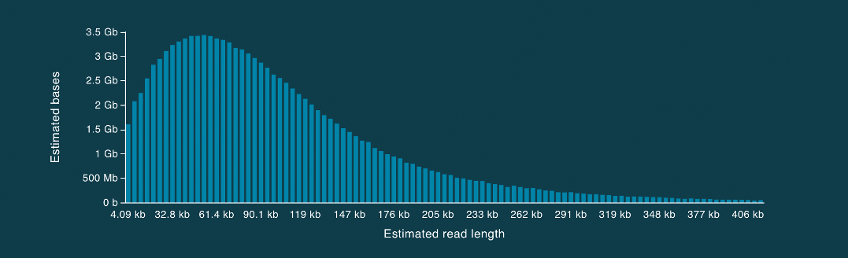
Oxford Nanopore Technologies sequencing

Slide 10
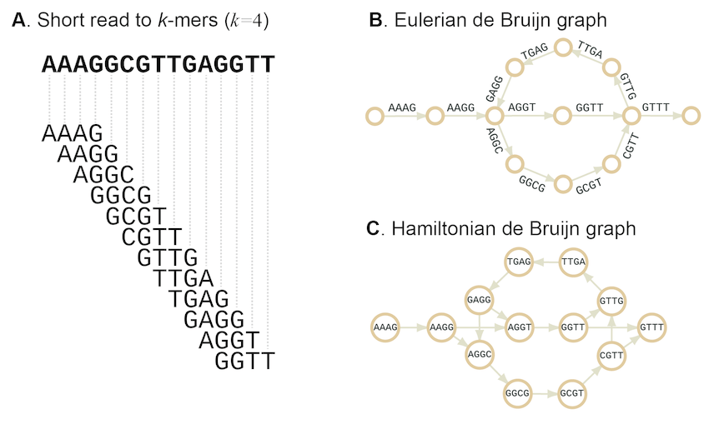
Genome assembly process: de Bruijn graph

Slide 11
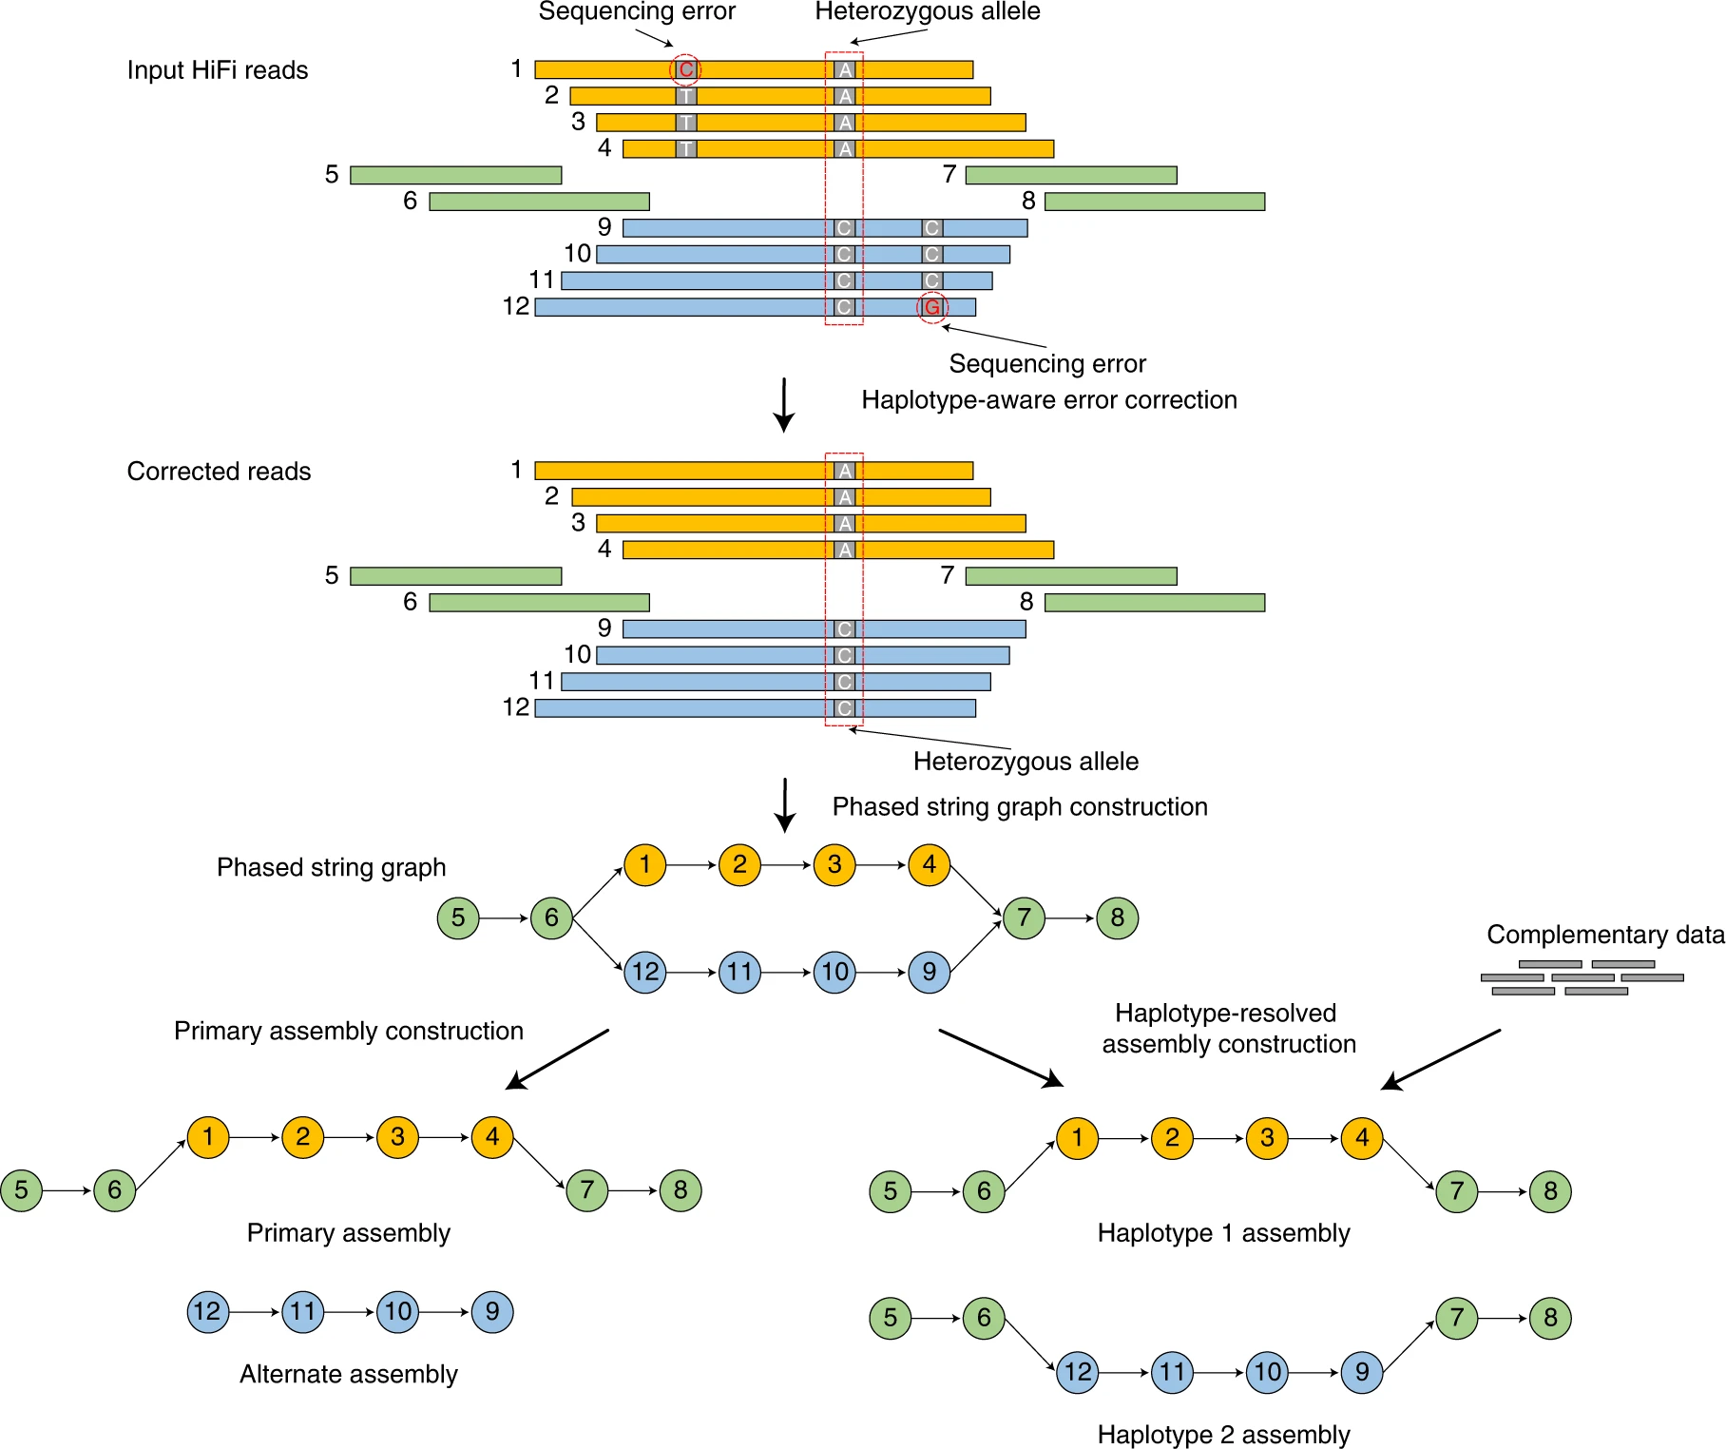
Hifiasm

Slide 12

Let’s start

