Slide 1
Long Read Sequencing Genomics Workshop
De novo assembly based on long read technology

Slide 2
Introduction
Teachers:
Henri van de Geest, Genetwister
Sven Warris, Wageningen UR, Bioinformatics
Helper:
Andrzej Czech, Genetwister
Introduction round
Two-day hands-on workshop
Learning by doing
Sticky notes for discussion points
Ubuntu VM in VirtualBox environment
Google doc for sharing

Slide 3
Technologies
Pacific Bioscience long reads (PacBio)
Oxford Nanopore Technologies long reads (Nanopore)
Illumina HiSeq short reads, paired-end (Illumina)
Java 8
Assembly-stats
Minimap2
Canu
Platanus
Mummer 4
Samtools & BCF tools
Tablet
Integrative Genomics Viewer (optional)

Slide 4
Overview of the workshop
Read Quality assessment using bioinformatics tools
De novo assembly based on PacBio, Nanopore and Illumina.
Assembly comparison of the three assemblies.
Assembly base Quality check using mRNA sequence and NGS data. We will study the effects these assembly errors have on downstream analyzes.
Raw
Quality checks
Assembly
Canu / Platanus
Comparison
Mummerplots
Validation
mRNA / DNA reads

Slide 5
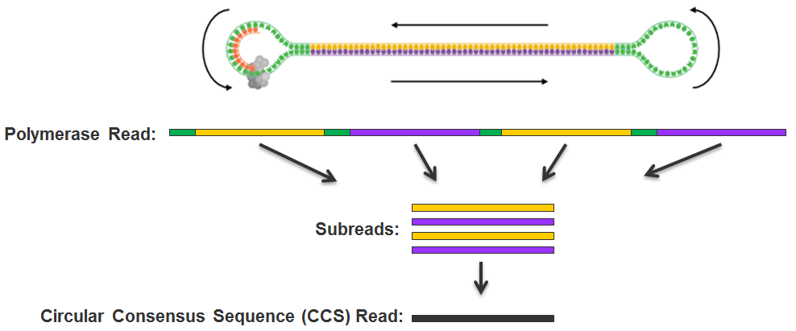
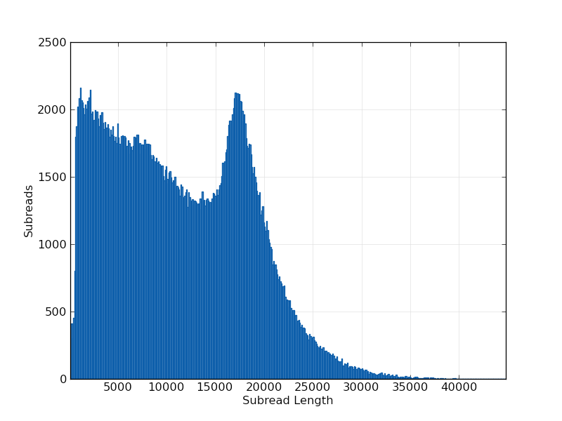
Pacific Bioscience platform

Slide 6
Pacific Bioscience platform
Long reads > 30kb
High throughput > 7GB / SMRTcell
High error rate < 10-15%
Proven technology
De novo assembly (but compute intensive)
Structural variant detection (re-sequencing)
Full-length RNA (IsoSeq sequencing)
Amplicon sequencing

Slide 7
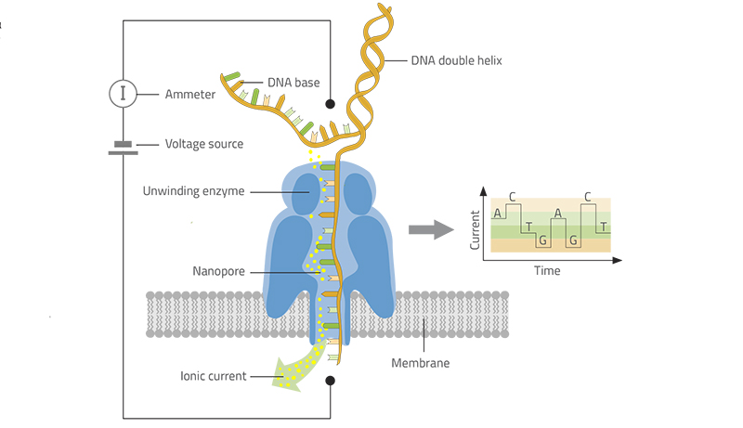
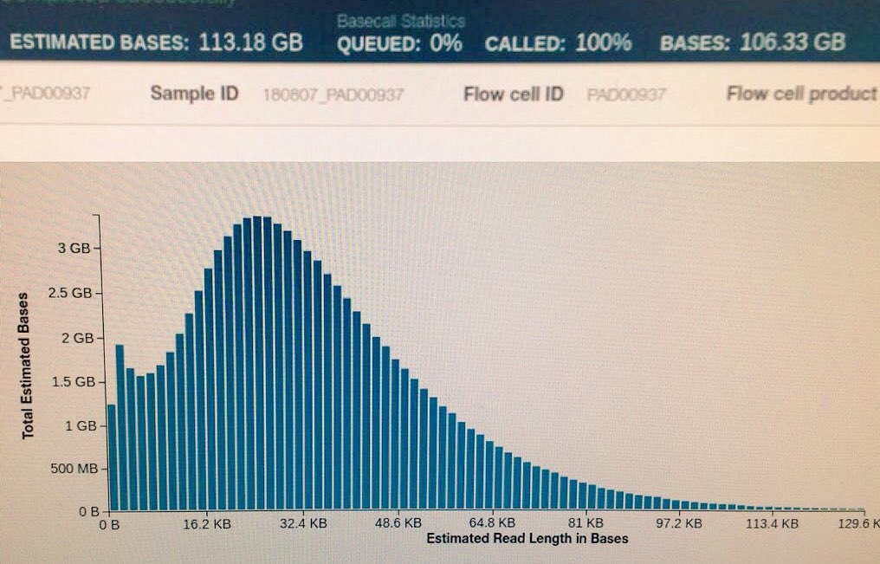
Oxford Nanopore Technologies sequencing

Slide 8
Nanopore sequencing
Extremely long reads > 60kb
High throughput >10GB
High error rate 5-15%
Low DNA input requirements
Direct sequencing
De novo assembly (but very compute intensive)
Structural variant detection
Unstable in data production

Slide 9
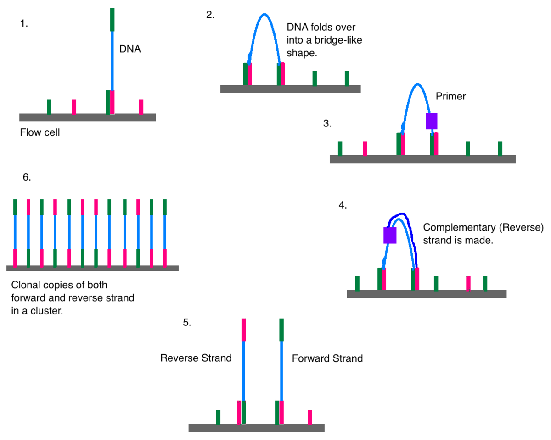
Illumina HiSeq

Slide 10
Illumina HiSeq, paired-end
Short reads <=2x125
Paired-end (or mate-pair)
Extremely high throughput ~1TB
Resequencing (SNP calling)
RNASeq
Hybrid assembly with long reads
Platform for linked-read technology (10x)

Slide 11
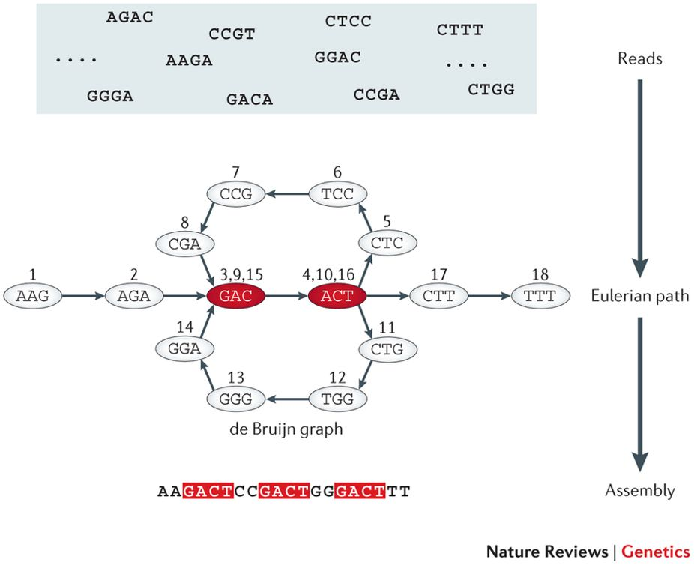
de bruijn graph genome assembly

Slide 12
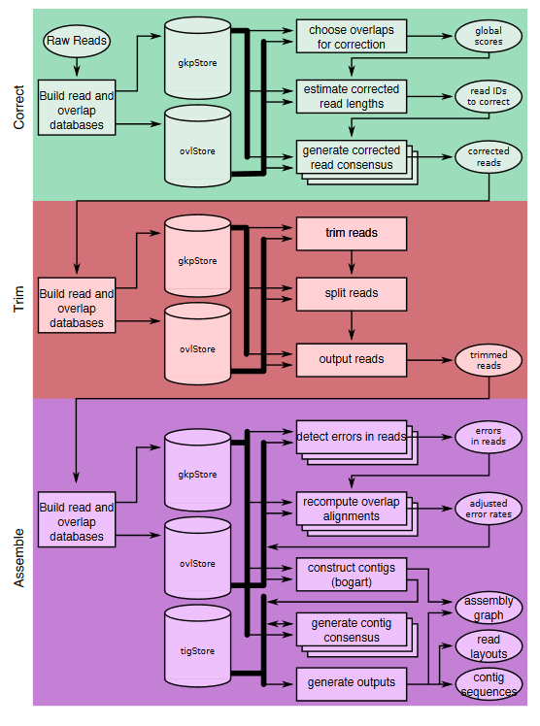
De novo assembly Canu

Slide 13

Let’s start!

