Slide 1

Build A Protocol
making a simple protocol over a serial connection between two devices

Slide 2
Checklist
What Should you have?
2 Raspberry Pi Model Bs
6 Blue LED Lights
2 Yellow LED Lights
6 220 Ω Resistors
2 2K Ω Resistors
6 M-F Breadboard Jumper wires
3 M-M Breadboard Jumper wires
2 Breadboards

Slide 3
Transmission Types Recap
Simplex
Half Duplex
Full Duplex

Slide 4
Switching
Circuit Switching
Packet Switching

Slide 5
Connecting via serial
For the purposes of the first few tasks, you will be maintaining a constant uninterrupted connection between the two Pis.
We’ll be connecting one GPIO pin, set to output to another that is linked to input, via a protective 2K Ω Resistor

Slide 6
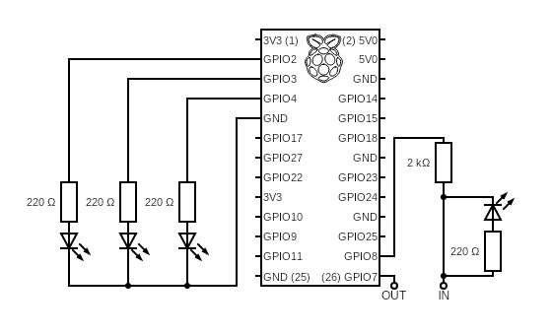
Circuit Diagram

