Slide 1
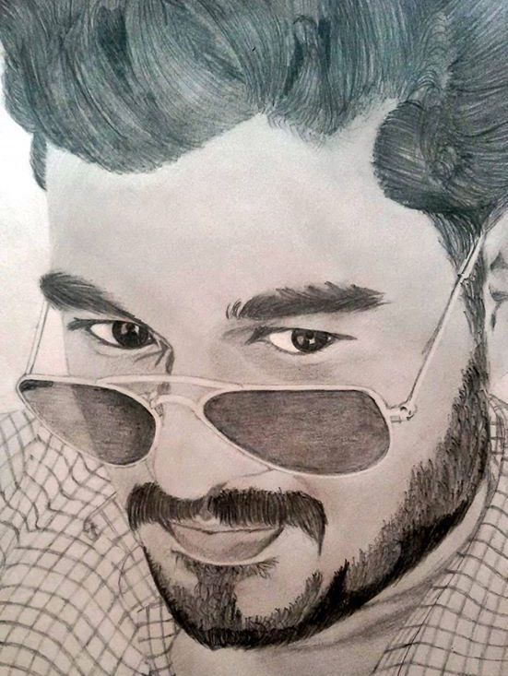
SWARUP R. BEHERA
DATA SCIENTIST
ABOUT ME
I am interested in the research work related to machine learning, data mining and application of these techniques. In particular, short text mining and sports analytics.
EDUCATION BACKGROUND
CONTACT ME
Address
2015 - present
PHD(cont.), CSE
F1, Hostel Brahmaputra
IIT Guwahati, India
IIT Guwahati, India
Email
Learning individual players strengths and weaknesses, in sports domain, is a non-trivial and an unexplored machine learning problem that has significant commercial value. Central idea is to mine strength and weakness rules using short text commentary data.
b.swarup@iitg.ac.in
swaruprj.vssut@gmail.com
Phone
9439872747
2013 - 2015
M. TECH., CSE
Website
IIT Guwahati, India
swarup-rj.github.io
Spectral clustering using convex and constrained settings. Central idea is to add pairwise constraints in to semidefinite spectral clustering and extend it from passive to active and self taught learning settings.
MY SKILLS
Python
2008 - 2012
B. TECH., CSE
C
VSSUT Burla, India
R
Ontology based entity relationship model.
MATLAB
MySQL
GRANTS AND FELLOWSHIPS
Web Dev
2015 - present
MHRD, INDIA
Data Mining
Fellowship for PhD
Machine Learning
2013 - 2015
Deep Learning
2013 - 2015
MHRD
MHRD, INDIA
Fellowship for MTech
Fellowship for MTech
REFERENCES
EXPERIENCE
Dr. V. Vijaya Saradhi
2013 - present
TEACHING ASSISTANT
Associate Professor
CSE Dept., IIT Guwahati
IIT Guwahati
Data Communication, Probability and Linear Algebra, Discrete Mathematics, Computer Vision using Machine Learning, Design and Analysis of Algorithms, Software Engineering, Data Structures Lab, Database Lab, Computing Lab.
saradhi@iitg.ac.in
Dr. Amit Awekar
Assistant Professor
IIT Guwahati
amit.awekar@gmail.com

