Slide 1
Registration Form
User Registration Details Overview

Slide 2

Introduction
This presentation covers the creation of a registration page with essential fields for a union app. It will explain the required data to be collected and the form submission process to ensure a smooth user experience. Emphasis will be on data completeness and accuracy for successful registration.

Slide 3
01
Registration Page Design

Slide 4
Required Fields Overview
The registration form includes fields such as Name, Passport Photo, Office ID Photo, Current Office Name, Address, Talu, District, Date of Birth, Service Join Date, Education, Mobile Number, Email, Joining Letter, Expert Field, Hobbies, Username, and Password. These fields are crucial for complete user profiling.

Slide 5

Form Submission Process
Users enter their data and submit the form to register. The system must validate each input for accuracy and completeness before acceptance. Successful submission leads to user account creation, allowing access to other app features seamlessly and securely.

Slide 6
Data Validation and Security
Data validation ensures all form inputs are accurate and complete before submission. The system checks for correct formats, mandatory fields, and file uploads like photos. Security measures protect sensitive data such as passwords and personal details using encryption and secure storage protocols to maintain user privacy and prevent unauthorized access.

Slide 7
02
User Login and Navigation

Slide 8
Successful Login Confirmation
After submitting valid credentials, users receive immediate confirmation of successful login. This screen confirms access and directs users to the app’s main dashboard, ensuring a smooth transition and clear feedback that they have entered the system securely.

Slide 9
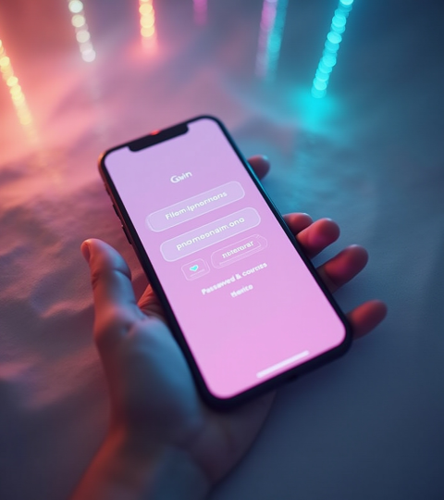
Login Window Features
The login window presents fields for username and password. It includes options for password recovery and a clear call-to-action button. The interface is designed for simplicity and quick access, supporting error messages for invalid attempts.

Slide 10
Payment Link Integration
Upon login, a Pay Now link is displayed to users who need to make payments. This link directs to a secure payment gateway, streamlining transactions within the app. It ensures easy access to payment options without navigating away from the main interface.

Slide 11

Conclusions
The union app’s registration and login design focuses on user-friendly interfaces and secure data handling. Proper validation and clear navigation enhance user confidence. Integrating payment options within the login area simplifies processes, making the app efficient and functional for all users.

Slide 12
Thank you
Do you have any questions?
youremail@freepik.com
+00 000 000 000
yourwebsite.com
Please keep this slide for attribution

