Slide 1
AWS DEPLOYMENT GUIDE
Deploying a Web App
on Amazon Linux (EC2)
A step-by-step walkthrough: launching an EC2 instance, connecting over SSH,
installing a web server, and going live with your application.

Slide 2
What We'll Cover
1
Connecting Securely
2
Launch an Instance
Why SSH is required to reach a remote server, and how to confirm it's enabled.
Create and configure an Amazon Linux EC2 instance, key pair, and security group.
3
Connect via PuTTY
4
Install & Configure
Configure and open an SSH session into the instance.
Update the system, install httpd, and prepare the web server.
5
Deploy the App
6
Go Live
Clone the repository and copy the site files into the web root.
Open the correct inbound port and verify the app in a browser.
AWS EC2 Web App Deployment
2

Slide 3
BEFORE YOU BEGIN
Why SSH?
To connect to any remote server, we follow a standard protocol: SSH (Secure Shell), which runs on port 22.
Whenever you launch an EC2 instance, check whether port 22 is enabled for SSH.
If it isn't enabled, the instance cannot be reached — from the console or from tools like PuTTY.
With SSH enabled, the connection is also protected from unauthorized access.
SSH · Port 22
Your Computer
EC2 Instance
PuTTY / Console
Amazon Linux
AWS EC2 Web App Deployment
3

Slide 4
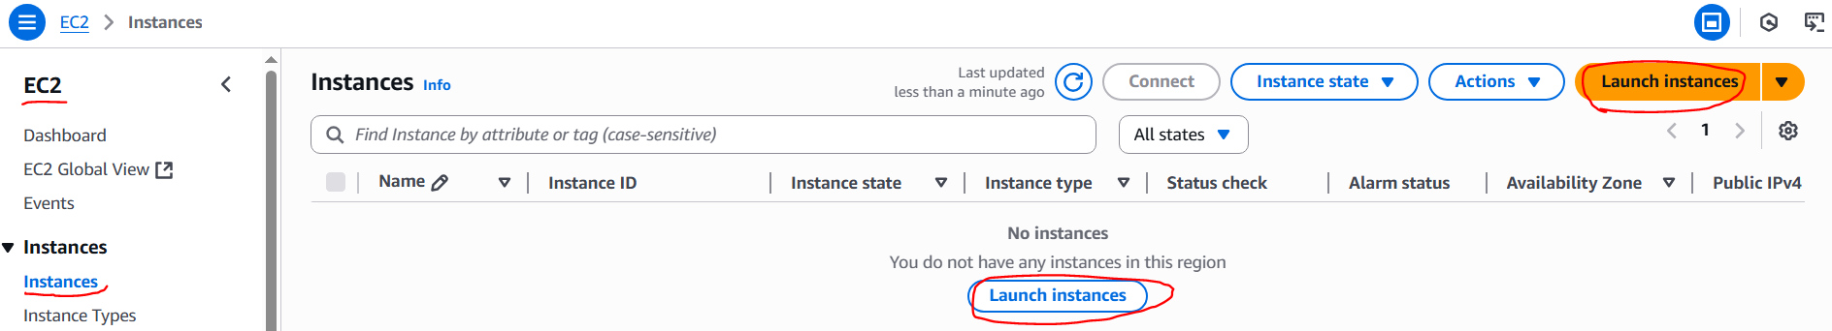
1
STEP 1
Launch an EC2 Instance
Sign in to your AWS account.
Navigate to EC2 → Instances → Launch Instance.
AWS EC2 Web App Deployment
4

Slide 5
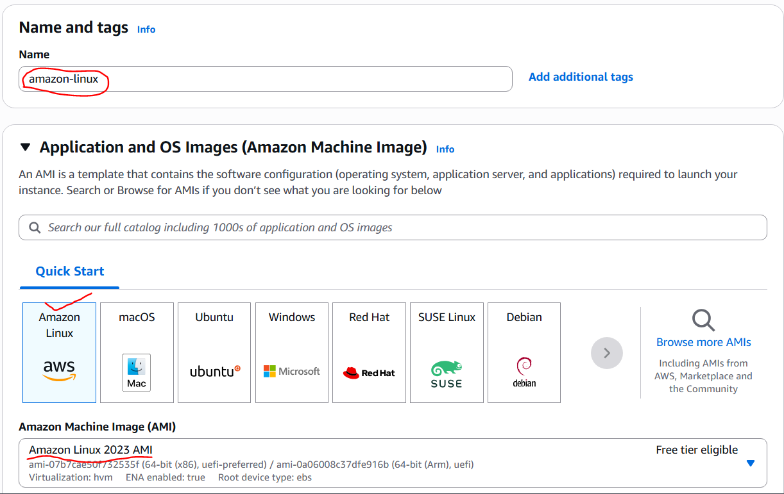
2
STEP 2
Configure the Instance
Create the EC2 instance using Amazon Linux, as shown below.
AWS EC2 Web App Deployment
5

Slide 6
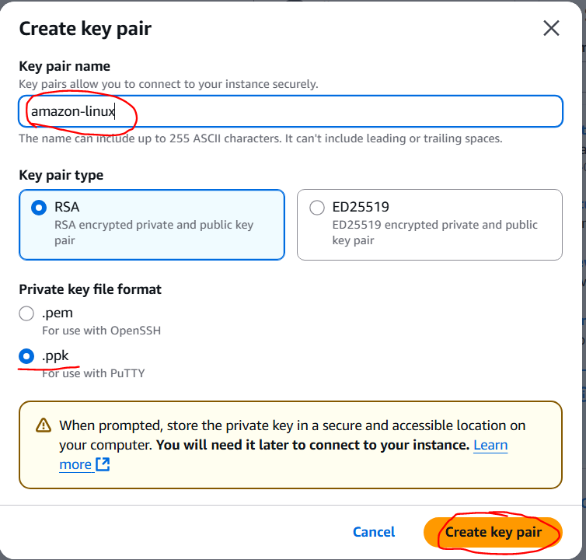
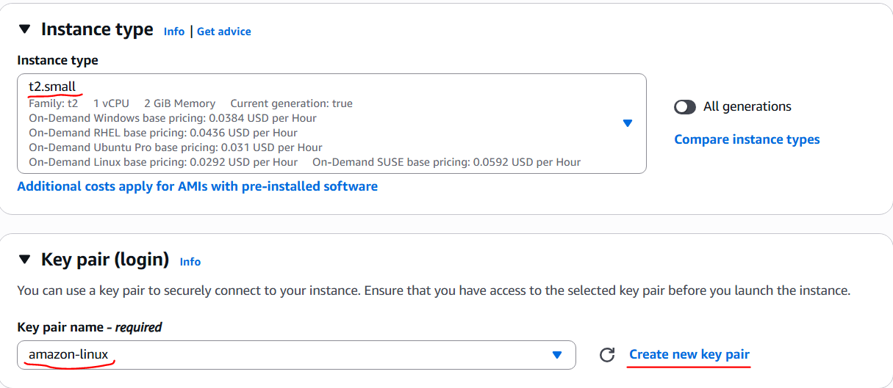
2
STEP 2
Instance Type & Key Pair
Choose a small instance type — only one instance is needed here.
Create a key pair using the “Create key pair” option; it secures your SSH login.
AWS EC2 Web App Deployment
6

Slide 7
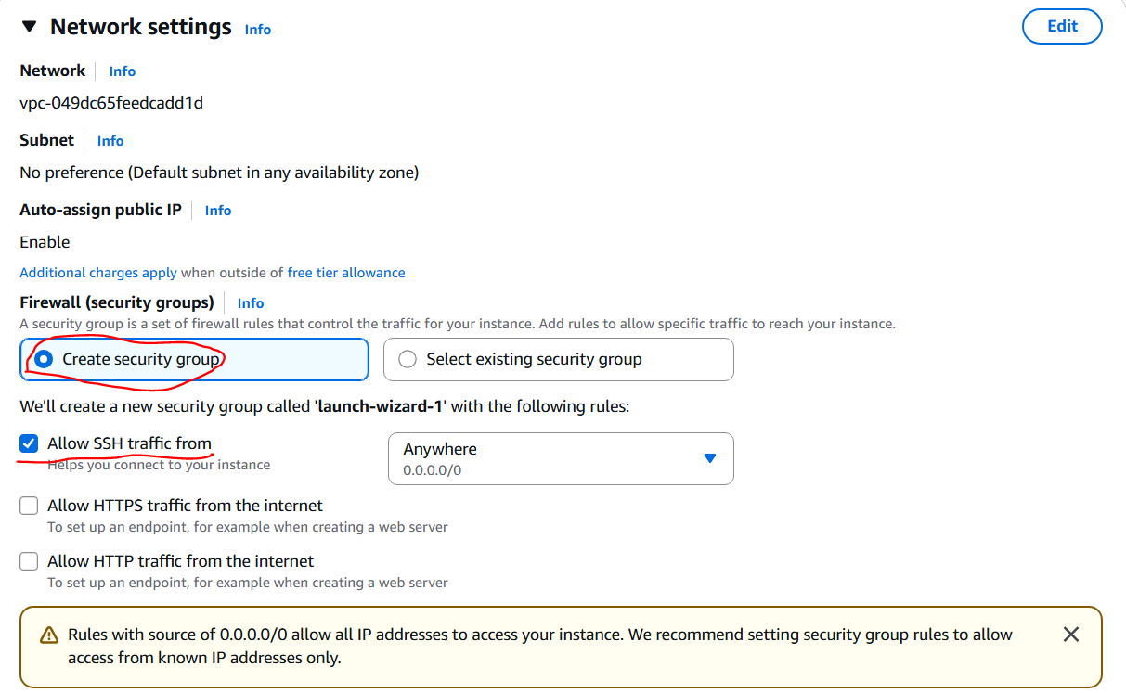
2
STEP 2
Configure the Security Group
Create a new security group and make sure the SSH check box is selected.
AWS EC2 Web App Deployment
7

Slide 8
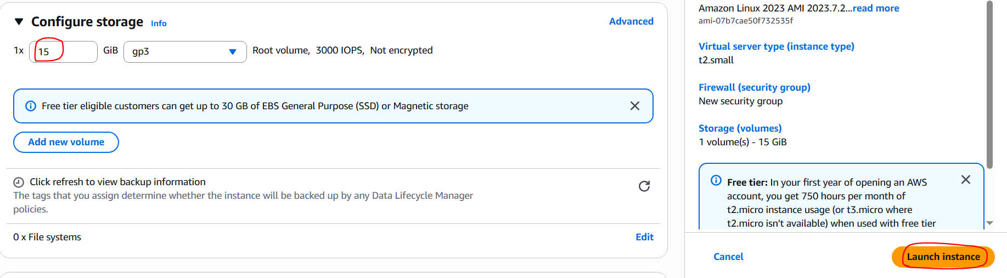
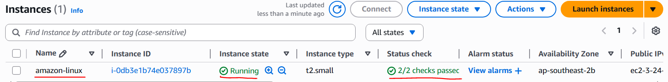
2
STEP 2
Storage & Launch
Set storage configuration to 15 GB, then click “Launch instance.”
The new instance appears in your instance list, ready to use.
AWS EC2 Web App Deployment
8

Slide 9
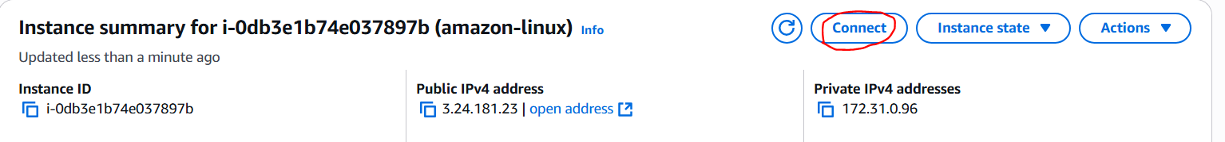
3
STEP 3
Connect to the Instance
Select the instance and click “Connect.” The connection page opens as shown below.
AWS EC2 Web App Deployment
9

Slide 10
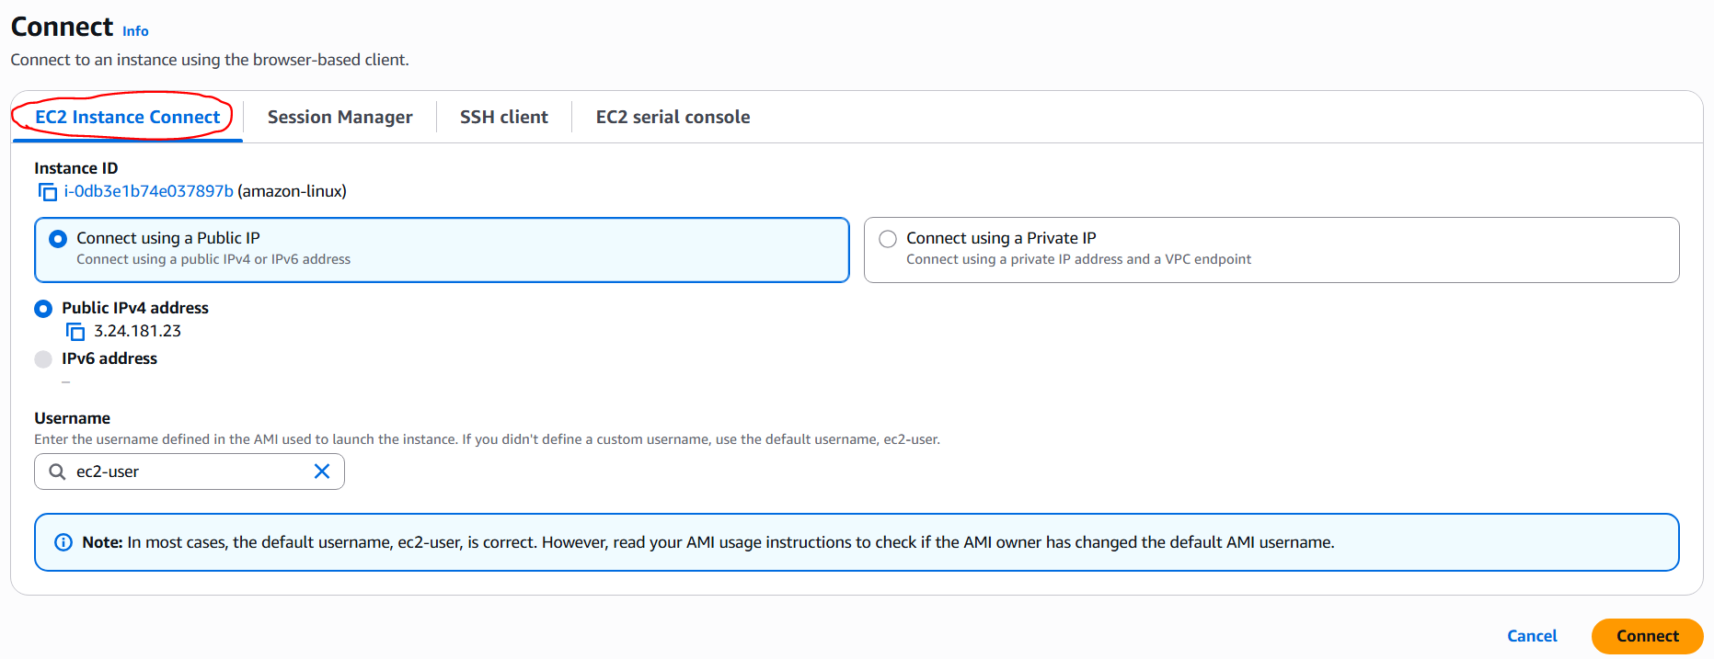
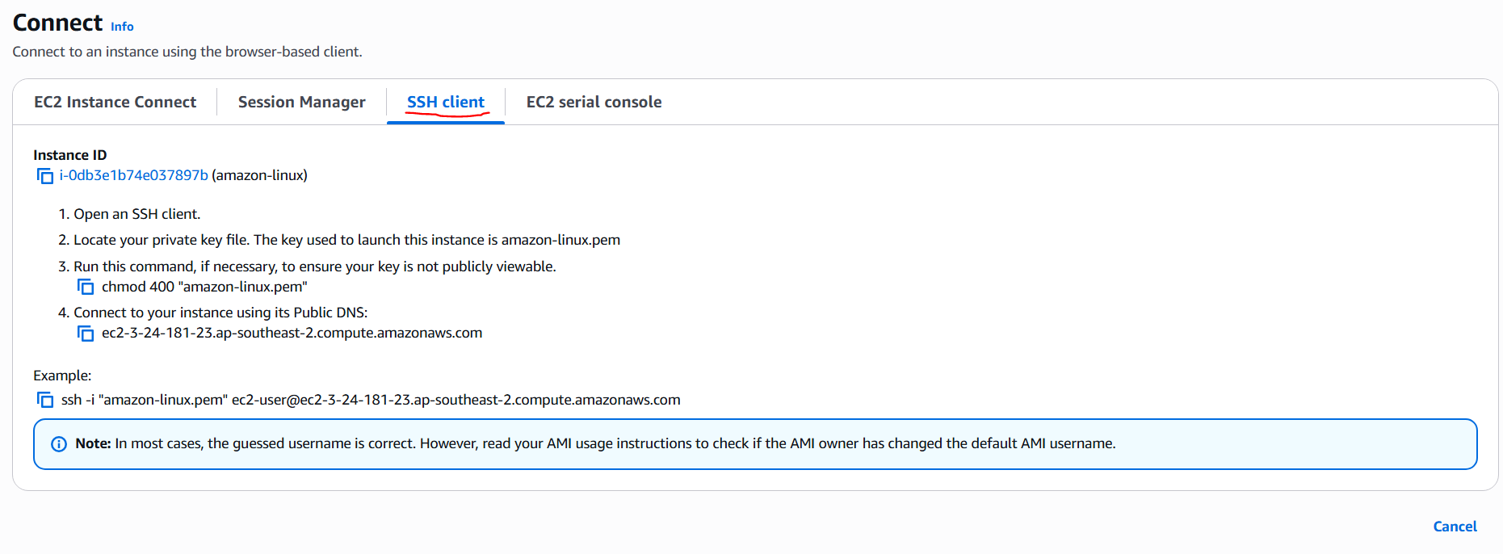
3
STEP 3
Two Ways to Connect
1. In-console: connect directly in the browser when PuTTY or MobaXterm isn't available.
2. On-premises: connect using an SSH client such as PuTTY or MobaXterm.
AWS EC2 Web App Deployment
10

Slide 11
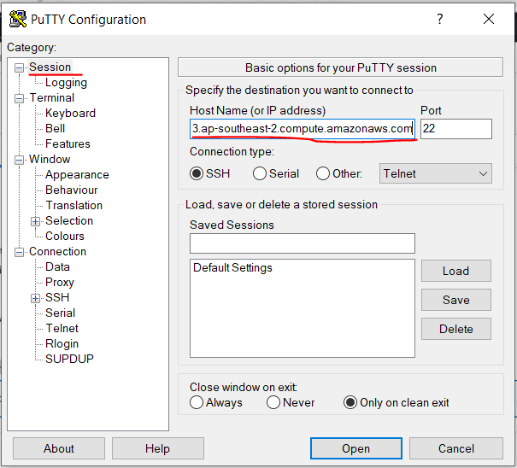
4
STEP 4
PuTTY: Enter the Host Address
Open PuTTY, then paste the instance's public IP address (or public DNS) as the host name.
AWS EC2 Web App Deployment
11

Slide 12
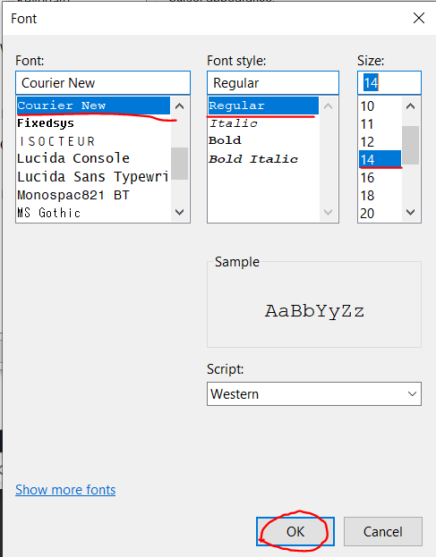
4
STEP 4
PuTTY: Appearance & Font
Go to Appearance → Font → Change to adjust the terminal font.
AWS EC2 Web App Deployment
12

Slide 13
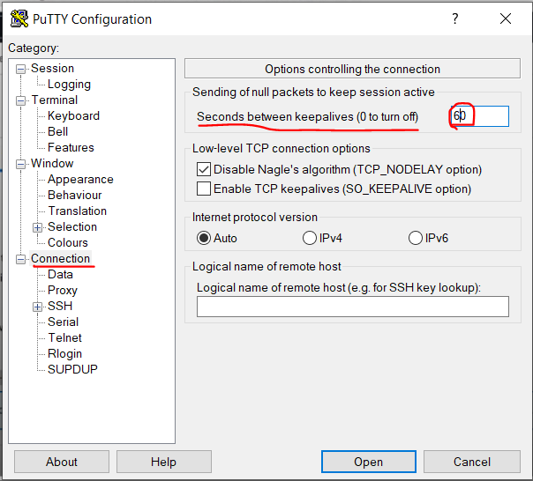
4
STEP 4
PuTTY: Connection Keepalive
Set Connection → Seconds between keepalives to 60, to keep the session from timing out.
AWS EC2 Web App Deployment
13

Slide 14
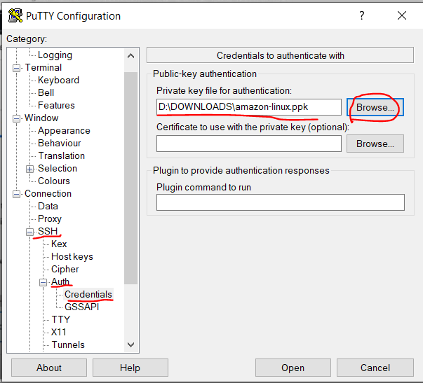
4
STEP 4
PuTTY: Authenticate with Your Key
Go to SSH → Auth → Credentials → Private key file, select the key pair (.ppk) file, then click Open.
AWS EC2 Web App Deployment
14

Slide 15
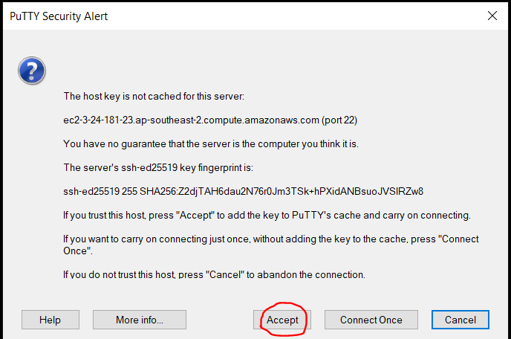
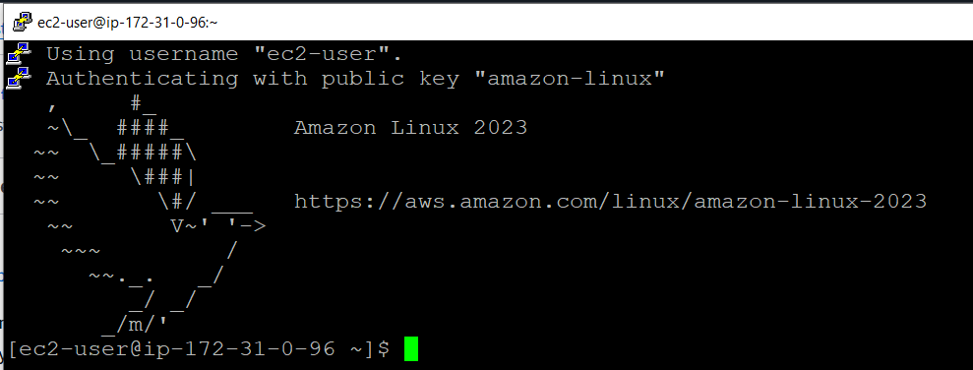
4
STEP 4
Logging In
The console prompts for permission, and the PuTTY terminal opens as shown below.
AWS EC2 Web App Deployment
15

Slide 16
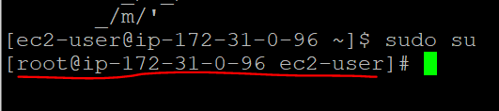
5
STEP 5
Switch to the Root User
Run sudo su to switch to the root user before continuing.
AWS EC2 Web App Deployment
16

Slide 17
6
STEP 6
Update the System
Amazon Linux uses YUM (Yellowdog Update Modifier) — also used by RedHat, CentOS, and SUSE. Ubuntu uses APT instead.
Update the system with: yum update -y
AWS EC2 Web App Deployment
17

Slide 18
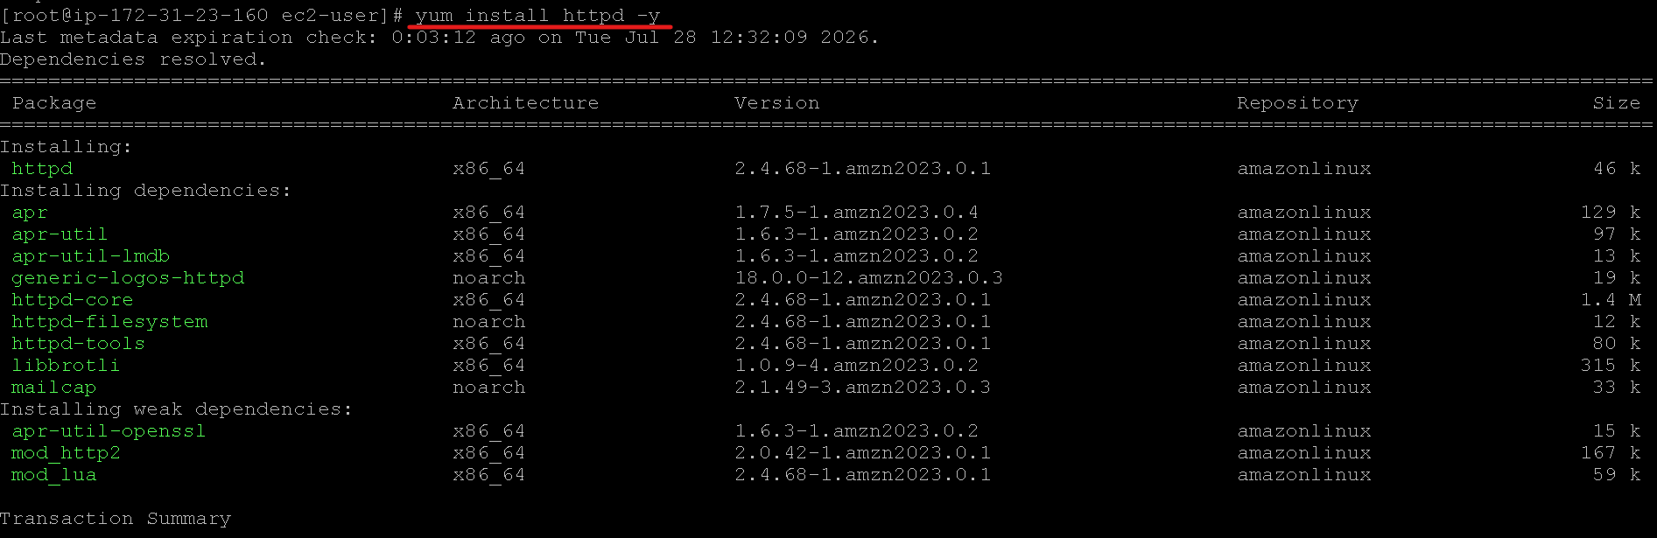
7
STEP 7
Install the Web Server
On Amazon Linux, the web server is httpd (HyperText Transfer Protocol Daemon).
AWS EC2 Web App Deployment
18

Slide 19
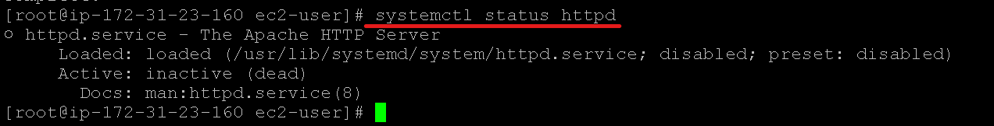
8
STEP 8
Check the httpd Service Status
Run: systemctl status httpd → for checking the status of httpd.
AWS EC2 Web App Deployment
19

Slide 20
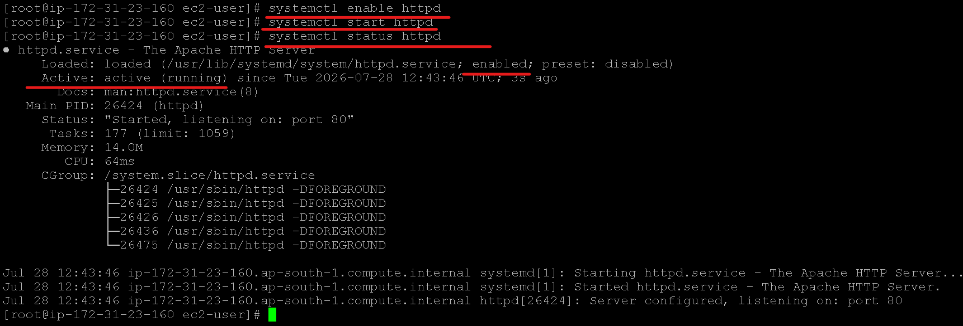
9
STEP 9
Start & Enable httpd
The service is inactive, so start and enable it:
systemctl start httpd — starts the service • systemctl enable httpd — enables it on boot
AWS EC2 Web App Deployment
20

Slide 21
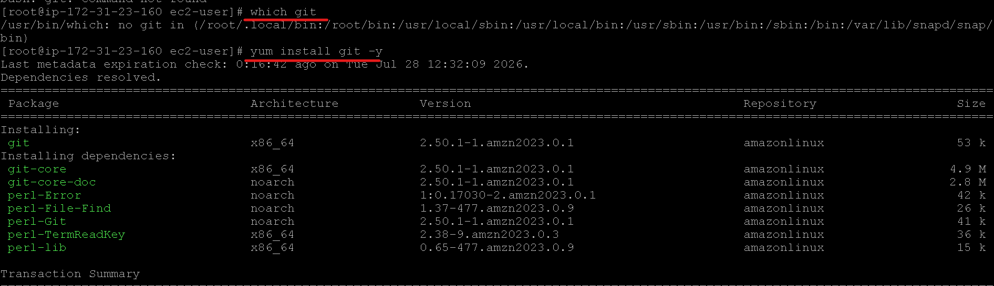
10
STEP 10
Verify / Install Git
Run which git → check whether Git is already installed.
If it isn't present, install it with: yum install git -y
AWS EC2 Web App Deployment
21

Slide 22
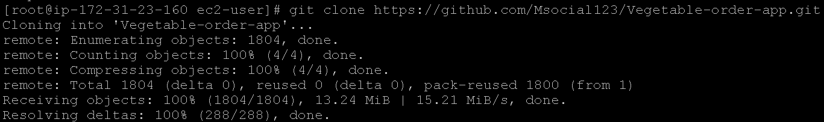
11
STEP 11
Clone the Repository
Clone the project using: git clone https://github.com/Msocial123/Vegetable-order-app.git
AWS EC2 Web App Deployment
22

Slide 23
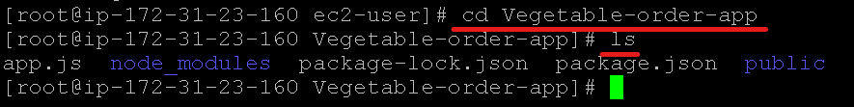
12
STEP 12
Navigate the Repository Folder
cd Vegetable-order-app — moves into the repo folder.
ls — lists the files and folders it contains.
AWS EC2 Web App Deployment
23

Slide 24
13
STEP 13
Locate the HTML Files
cd public — the site's HTML, CSS, and JS files live in the public folder.
AWS EC2 Web App Deployment
24

Slide 25
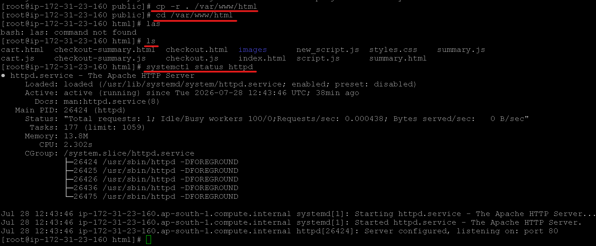
14
STEP 14
Copy Files to the Web Root
Destination path: /var/www/html
Command: cp -r . /var/www/html (cp = copy, . = current folder)
AWS EC2 Web App Deployment
25

Slide 26
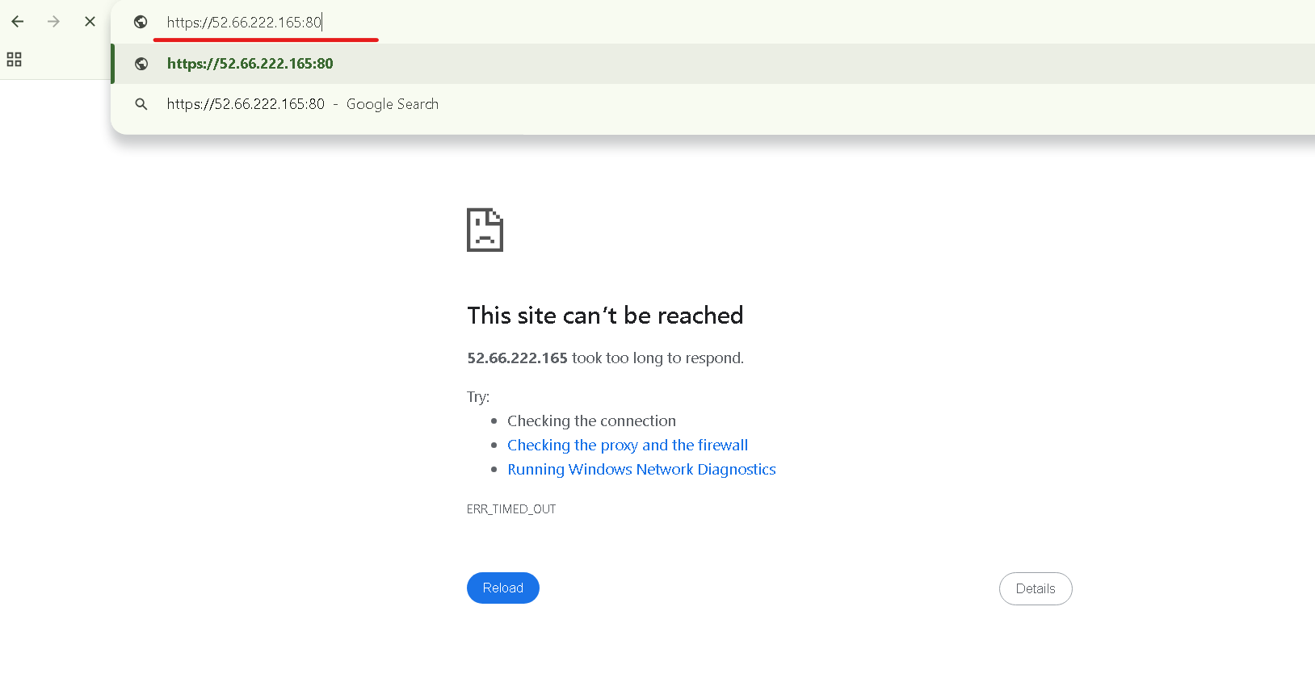
15
CHECK-IN
Verify the App in a Browser
Copy the instance's public IP address into the browser to check whether the application loads.
Tip: remove the “s” in https — this app doesn't have an SSL certificate configured.
AWS EC2 Web App Deployment
26

Slide 27
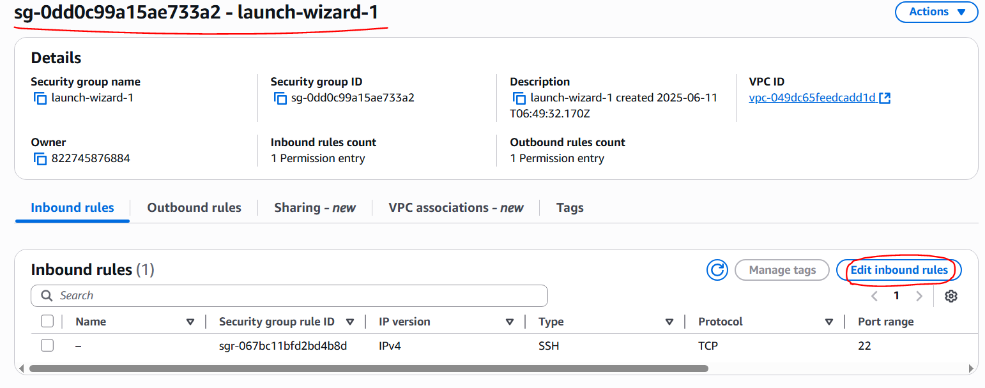
16
TROUBLESHOOTING
Open the Inbound Port
The app didn't load because port 80 wasn't opened in the instance's network settings.
Go to the EC2 instance → Network settings → Inbound rules → Edit inbound rules.
Inbound rules allow incoming traffic; outbound rules govern traffic leaving the instance.
AWS EC2 Web App Deployment
27

Slide 28
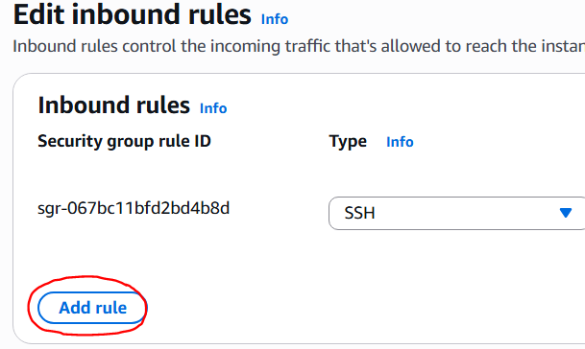
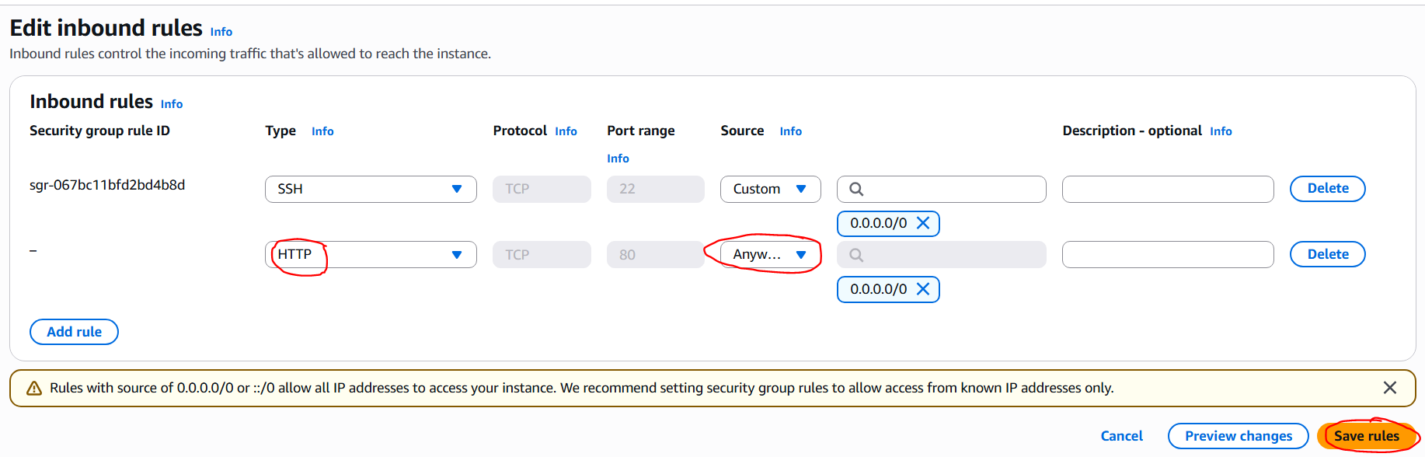
16
TROUBLESHOOTING
Add an HTTP Rule
Click “Add rule,” choose HTTP, then click “Save rules.”
AWS EC2 Web App Deployment
28

Slide 29
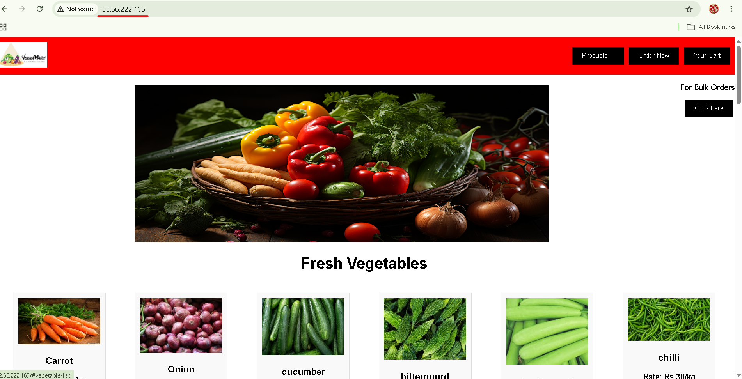
17
RESULT
The Application Is Live!
Return to the browser tab with the public IP address and refresh — the app now loads successfully.
AWS EC2 Web App Deployment
29

Slide 30
Key Takeaways
SSH (port 22) must be enabled to reach any EC2 instance securely.
1
Amazon Linux uses YUM for package management; httpd serves as the web server.
2
PuTTY connects over SSH using the instance's public IP/DNS and the private key (.ppk) file.
3
Application files are copied into /var/www/html, the default web root for httpd.
4
Port 80 (HTTP) must be opened in the security group's inbound rules for the app to be reachable.
5
AWS EC2 Web App Deployment
30

Slide 31
Thank You
Deploy Web App – Amazon Linux (EC2)

