Slide 1
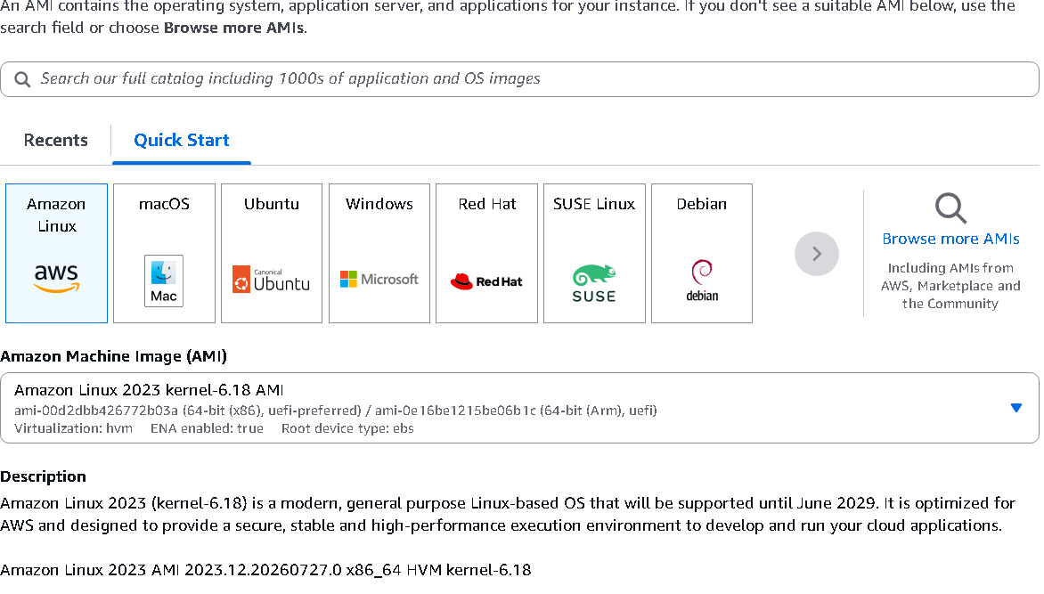
Amazon Linux vs Ubuntu

Slide 2
Learning Objectives
• Understand what an Operating System is. • Know what Amazon Linux and Ubuntu are. • Learn the differences. • Decide which OS to choose for an EC2 instance.

Slide 3
What is an Operating System?
An Operating System (OS) is software that manages the computer's hardware and allows applications to run. Examples: • Windows • Linux • macOS Think of an OS like a teacher managing a classroom.

Slide 4
What is Linux?
Linux is an open-source operating system. Popular Linux distributions: • Ubuntu • Amazon Linux • Red Hat • CentOS • Debian All are Linux operating systems with different features.

Slide 5
What is Amazon Linux?
Amazon Linux is developed by AWS. Features: • Optimized for AWS • Lightweight • Secure • Fast • Easy to maintain Best for running applications on AWS.

Slide 6
What is Ubuntu?
Ubuntu is developed by Canonical. Features: • Beginner-friendly • Easy to learn • Large community • Lots of tutorials Best for learning and development.

Slide 7
Amazon Linux vs Ubuntu
Amazon Linux • Developed by AWS • Optimized for AWS • Uses dnf/yum • Lightweight Ubuntu • Developed by Canonical • General-purpose Linux • Uses apt • Easy for beginners

Slide 8
When to Choose Amazon Linux
• Running applications on AWS • Creating production EC2 instances • Better performance on AWS • AWS-optimized operating system

Slide 9
When to Choose Ubuntu
• Learning Linux • Practicing commands • College projects • Following online tutorials

Slide 10
Package Managers
Ubuntu sudo apt update sudo apt install nginx Amazon Linux 2023 sudo dnf update sudo dnf install nginx Amazon Linux 2 sudo yum update

Slide 11
Real-Life Examples
Example 1: Company website on AWS EC2 → Amazon Linux Example 2: Student learning Linux → Ubuntu

Slide 12
Summary
• Amazon Linux is developed by AWS. • Ubuntu is developed by Canonical. • Amazon Linux is best for AWS workloads. • Ubuntu is best for learning and development. • Both are Linux operating systems.

