Slide 1
AWS & CLOUD COMPUTING
From Cloud Concepts to Launching Your First AWS Web Server
EC2 • Cloud Fundamentals • Apache Web Server Deployment

Slide 2
DEFINITION
Introduction to Cloud Computing
Cloud computing is the delivery of computing services over the internet (“the cloud”), including:
Servers
Storage
Databases
Networking
Software
Analytics
AI / ML Tools
To offer faster innovation, flexible resources & the economics of scale. You typically pay only for cloud services you use, helping lower operating costs, run infrastructure more efficiently & scale as your business needs change.

Slide 3
PART 1 OF 2
Need of Cloud Computing
1
Cost-Efficiency
2
Scalability
No need to buy expensive hardware
Pay-as-you-go model
Instantly scale resources up/down based on demand
Useful for startups and enterprises alike
3
Accessibility
4
Disaster Recovery & Backup
Access from anywhere via the internet
Enables remote work and global collaboration
Automatic backups
Redundant servers ensure high availability

Slide 4
PART 2 OF 2
Need of Cloud Computing
5
Software as a Service (SaaS)
6
Development & Testing
Use apps like Gmail, Dropbox, Microsoft 365 directly from the cloud
Quickly set up development environments
Deploy apps in minutes
7
Big Data & Analytics
8
Artificial Intelligence & Machine Learning
Store and process large datasets
Use cloud tools for real-time analytics
Access powerful AI/ML tools without needing local GPUs or complex setups

Slide 5
How Does Cloud Computing Work
Cloud computing works by using a network of remote servers hosted on the internet to store, manage, and process data. Here's how it typically works:
Cloud providers own massive data centers around the world
Users access these resources on-demand through a web browser or API
Cloud providers handle: Hardware maintenance, Security, Software updates
Users are charged based on usage (e.g., storage, computing time, bandwidth)

Slide 6
PART 1 OF 2
Situations Where We Use Cloud Computing
1. On-Demand Resource Scaling
Situation: A company launches a product and expects traffic spikes. Use: Cloud allows auto-scaling to handle high traffic without crashing.
2. Software Development & Testing
Situation: Developers need to quickly create test environments. Use: Easily spin up development and test servers in the cloud.
3. Data Backup & Disaster Recovery
Situation: A business wants to protect data from loss due to system failure or cyberattacks. Use: Cloud offers automated backup and fast recovery options.

Slide 7
PART 2 OF 2
Situations Where We Use Cloud Computing
4. Remote Work & Collaboration
Situation: A company has remote teams or employees in different locations. Use: Tools like Google Drive, Microsoft Teams, and Zoom run on cloud to support real-time collaboration.
5. Media Streaming
Situation: A company like Netflix or YouTube needs to stream videos to millions. Use: Cloud delivers content globally using Content Delivery Networks (CDNs).
6. AI, Machine Learning, and Big Data
Situation: An organization wants to train an AI model or analyze large datasets. Use: Cloud platforms (like AWS SageMaker or Google BigQuery) provide powerful processing power and ready-made tools.

Slide 8
Introduction to EC2 (Elastic Compute Cloud)
In cloud, we mostly use AWS (Amazon Web Services), Azure, GCP (Google Cloud Platform)
We create EC2 in AWS — before that we need to create an AWS account with credit / debit card details
EC2
AWS
Elastic Compute Cloud
Amazon Web Services

Slide 9
STEPS 1–3
Creating AWS Account
1
Go to Chrome & search for aws.amazon.com & click “Create AWS account”.
2
Select root user & enter mail ID, password (for logging into AWS account), AWS account name & click Continue.
3
Select account type as Personal (we are using it just for learning) & fill name, address, phone number & click Continue.

Slide 10
STEPS 4–6
Creating AWS Account
1
It asks for credit / debit card details like card number, CVV, name. AWS may place a temporary $1 charge to verify the given card.
2
Choose your country & phone number. Then receive an OTP through call or SMS and enter it.
3
Choose a support plan — Basic, Developer, or Business. Basic is recommended as it is free — click Complete Sign Up.

Slide 11
KEY CONCEPTS
Creating EC2 Instance
REGION
AVAILABILITY ZONE
A geographic area where AWS has a group of data centers. Each region is isolated and independent from others to provide the highest possible fault tolerance and stability.
It is an isolated location within that particular region.
34 launched regions in AWS
108 availability zones in AWS
EC2 → Elastic Compute Cloud AWS → Amazon Web Services

Slide 12
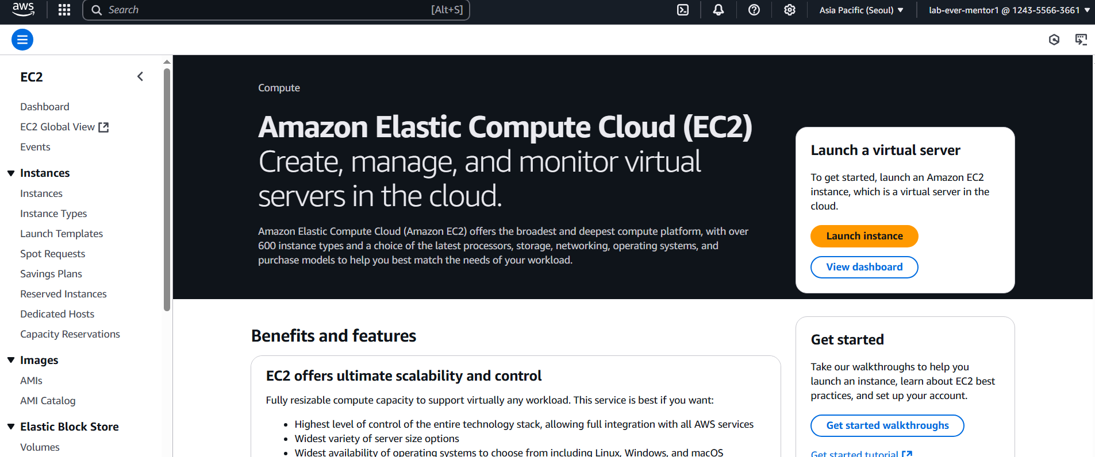
STEP 1 — LAUNCH INSTANCE
Creating EC2 Instance
Go to AWS console homepage. Click the EC2 option — this is the home page of EC2. Now click on “Launch instance” on the right side. Note: top-right shows the region name (e.g. Asia Pacific (Seoul)).

Slide 13
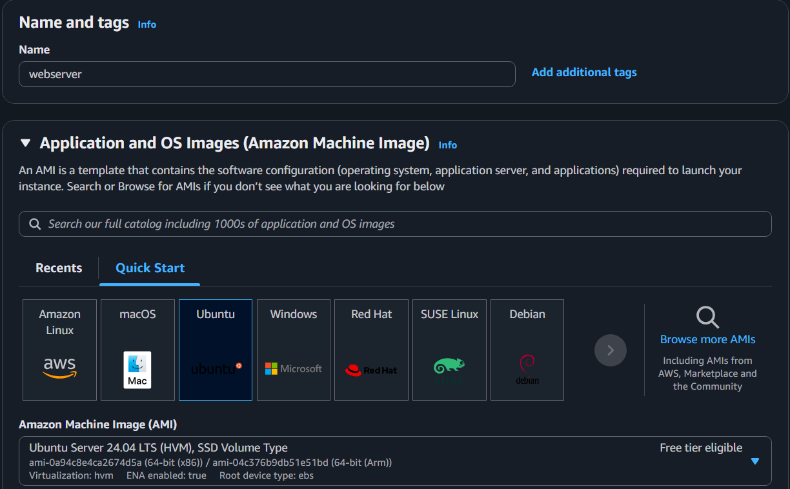
STEP 2 — NAME & AMI
Creating EC2 Instance
Click the “Launch instance” option. Give a name & select Ubuntu as AMI and Ubuntu server SSD volume type.

Slide 14
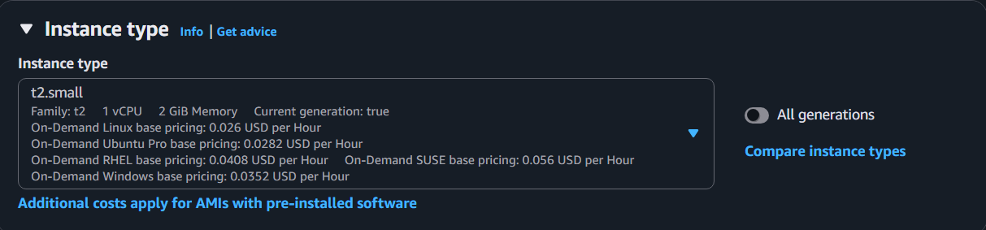
STEP 3 — INSTANCE TYPE
Creating EC2 Instance
Select the instance type as shown below.

Slide 15
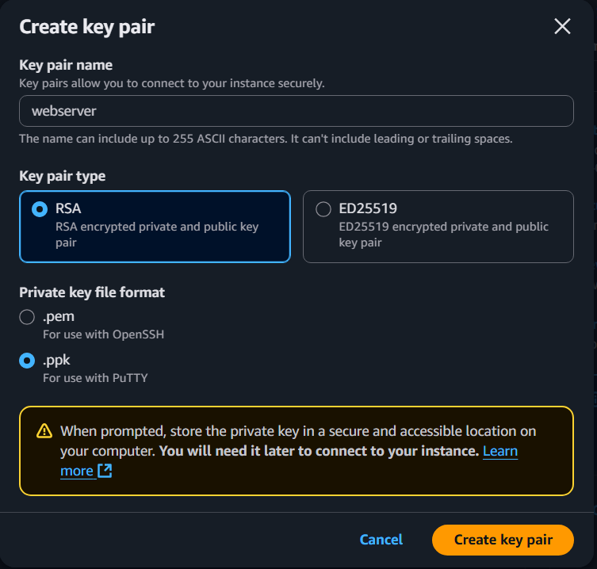
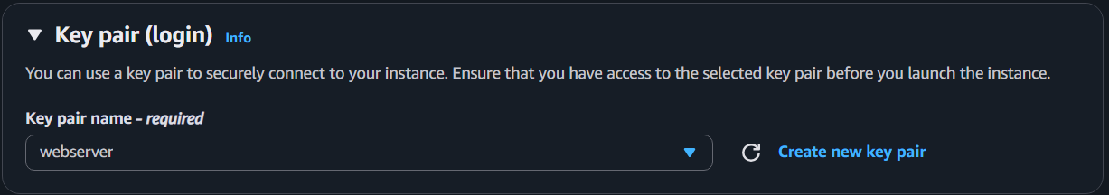
STEP 4 — KEY PAIR
Creating EC2 Instance
Create a keypair for one of the instances & use that same keypair for the other one too.

Slide 16
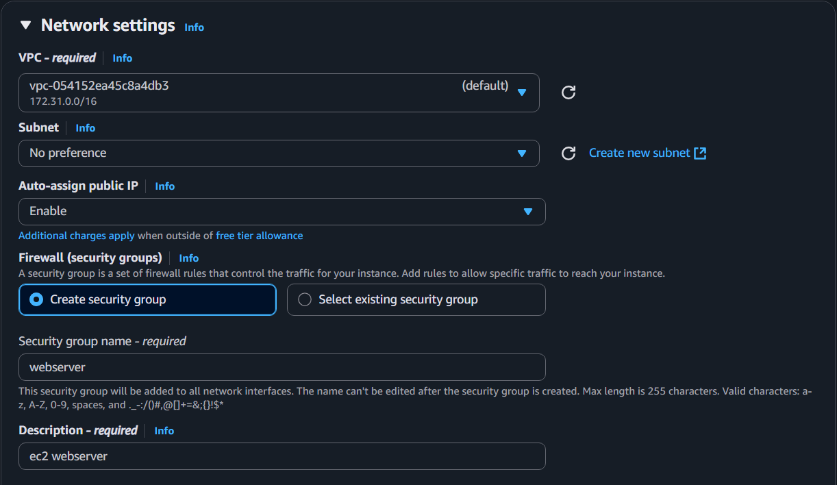
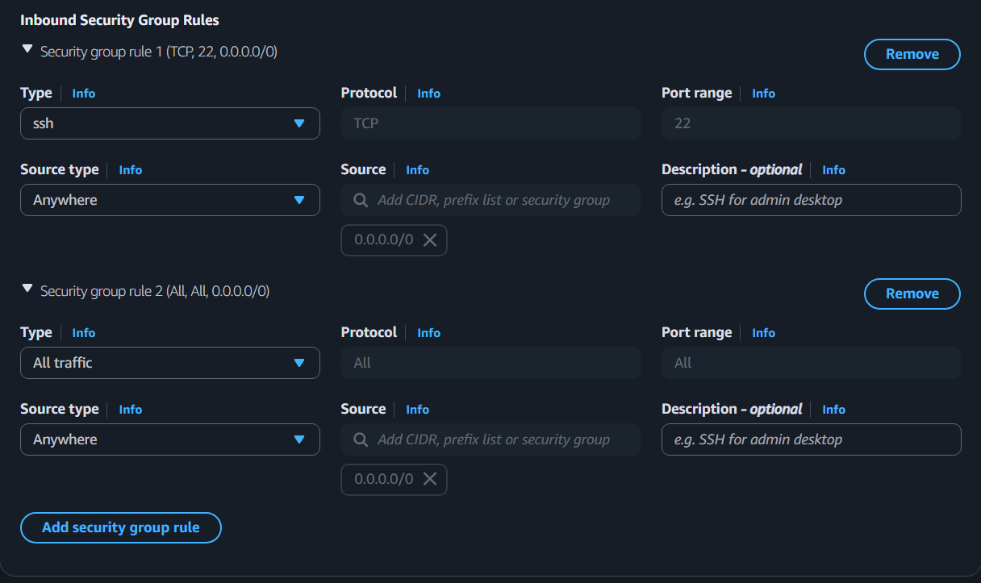
STEP 5 — NETWORK SETTINGS
Creating EC2 Instance
Under network settings, change the description.
SSH → Secure Shell protocol. The Secure Shell protocol is a network communication method that allows two computers to securely communicate & share data, even over an unsecured network.

Slide 17
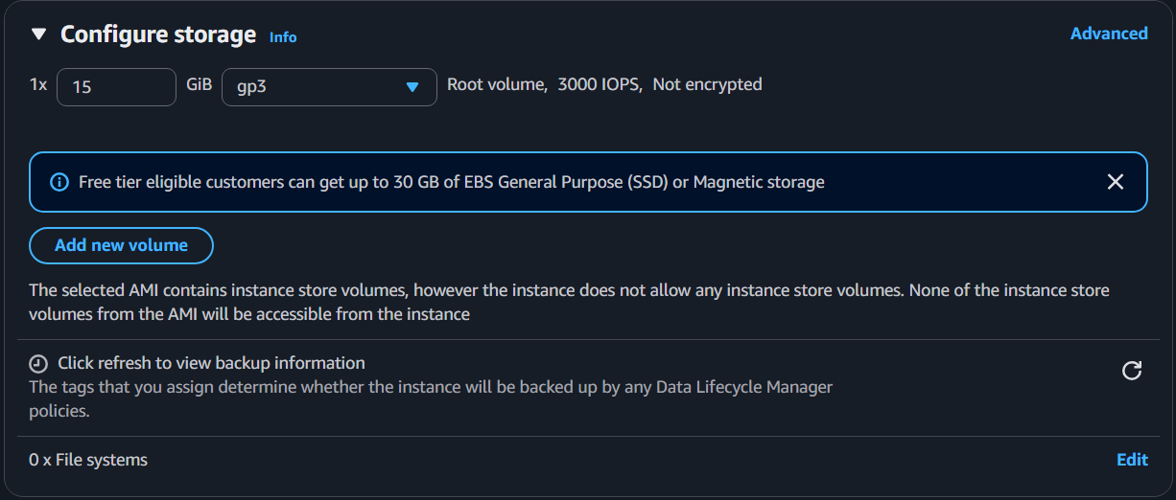
STEP 6 — CONFIGURE STORAGE
Creating EC2 Instance
Select the configuration storage between 15–20 GiB.
In AWS, there are 2 types of storage:
1. Elastic Block Storage
2. Object Based Storage → like Google Drive
There are 4 volume types:
• General Purpose SSD (gp3)
• General Purpose SSD (gp2)
• Provisioned IOPS SSD (io2)
• Provisioned IOPS SSD (io3)

Slide 18
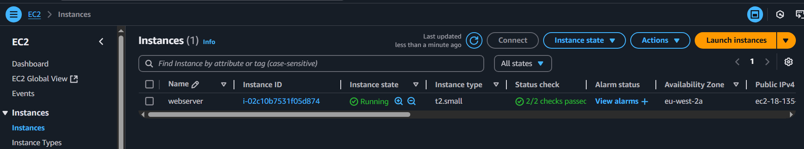
STEP 7 — LAUNCH
Creating EC2 Instance
Click launch instance. Now the instance can be shown like this.

Slide 19
OVERVIEW
Creating EC2 Instance with Webserver
We can connect the instance using MobaXterm, PuTTY.
There are many ways to connect & we can connect using whatever tool we want.

Slide 20
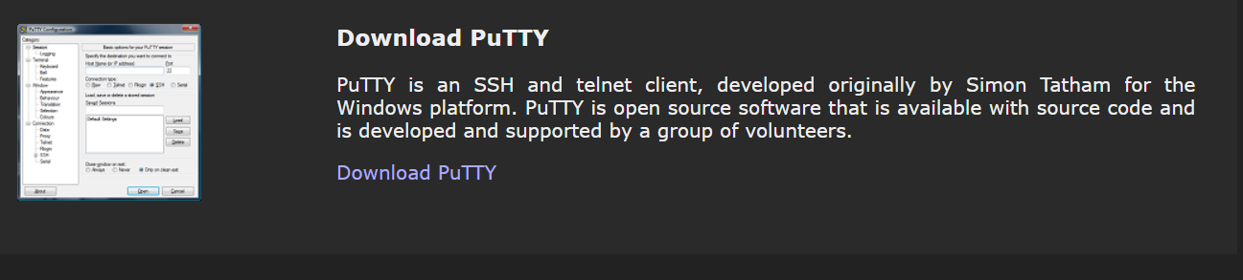
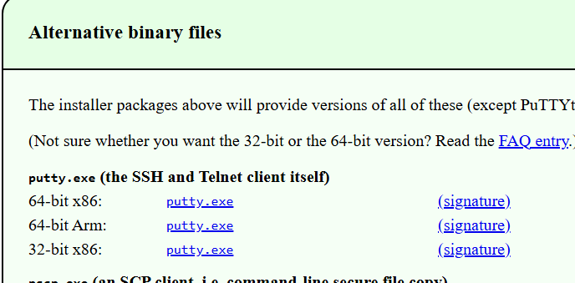
STEP 1–2 — PUTTY SETUP
Creating EC2 Instance with Webserver
Step 1:
Download PuTTY (putty.org page → Alternative binary files → putty.exe → 64-bit)
Step 2:
If the keypair is downloaded in .ppk then ignore this step. If not, open PuTTY → Load → select .pem file & click “Save private key”. The file is converted into .ppk.

Slide 21
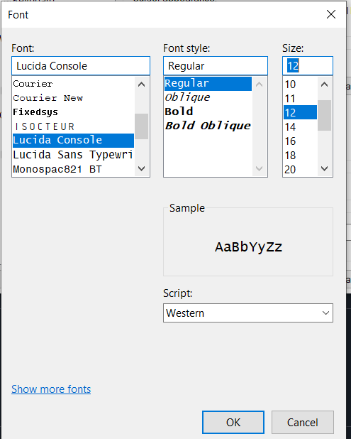
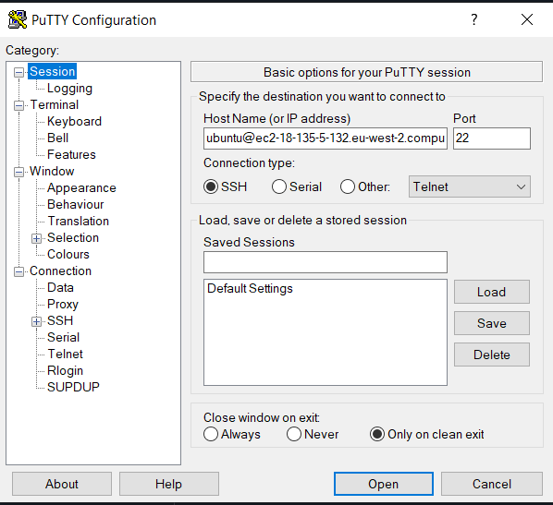
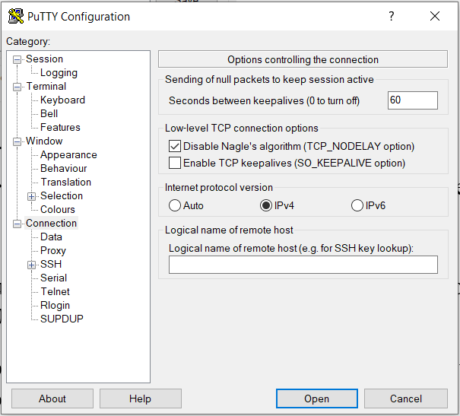
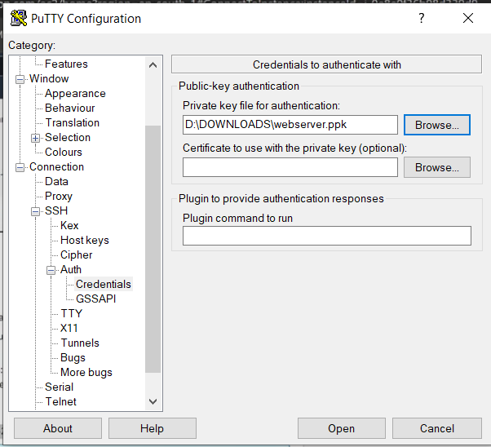
STEP 3–4 — CONNECT VIA SSH
Creating EC2 Instance with Webserver
Step 3:
Open PuTTY. In host name, enter ubuntu@<your-ec2-public-ip>.
Step 4:
Go to Connection → SSH → Auth, browse and select the .ppk file. Click Open.

Slide 22
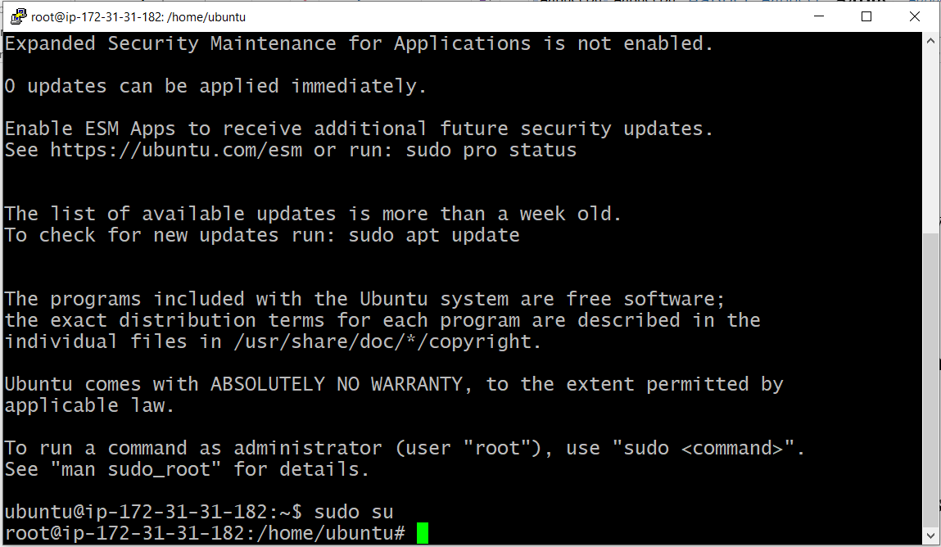
STEP 5 — SWITCH TO ROOT USER
Creating EC2 Instance with Webserver
After logging in, the Ubuntu prompt opens. Now, to use the root user, we use the command sudo su.
Sudo means “Super User DO”. Su means “Switch User”.

Slide 23
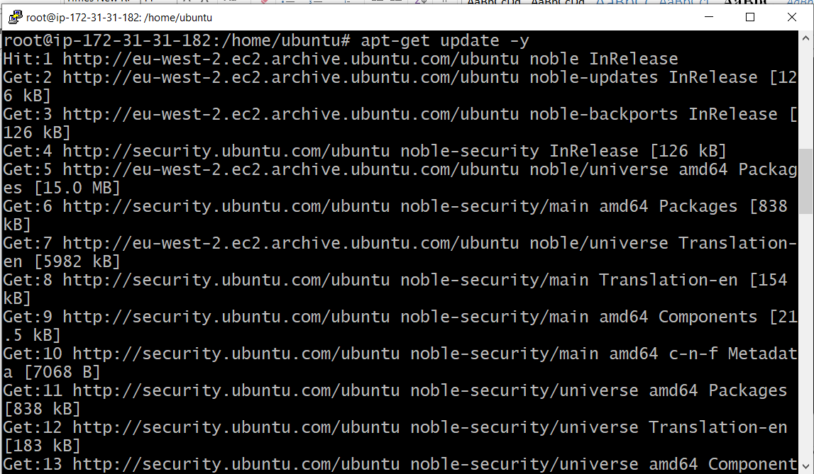
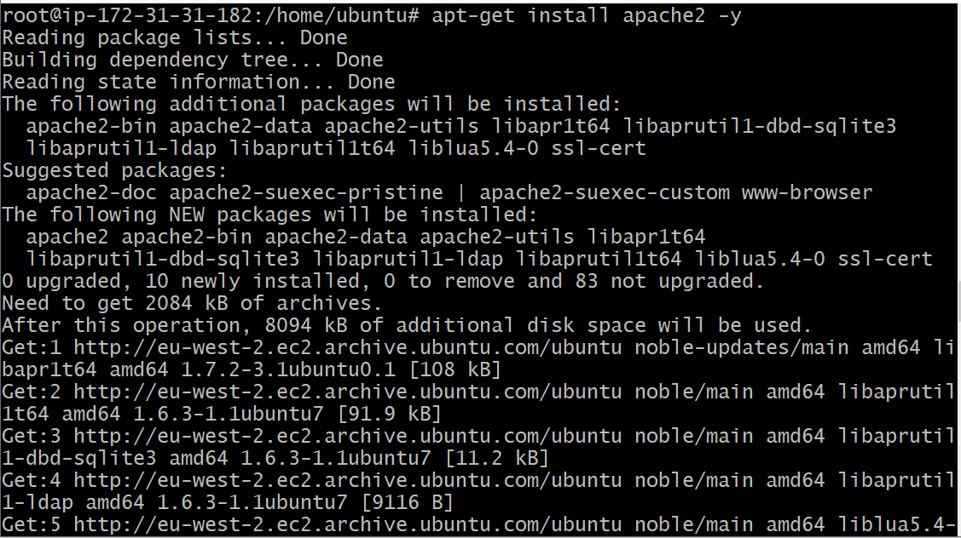
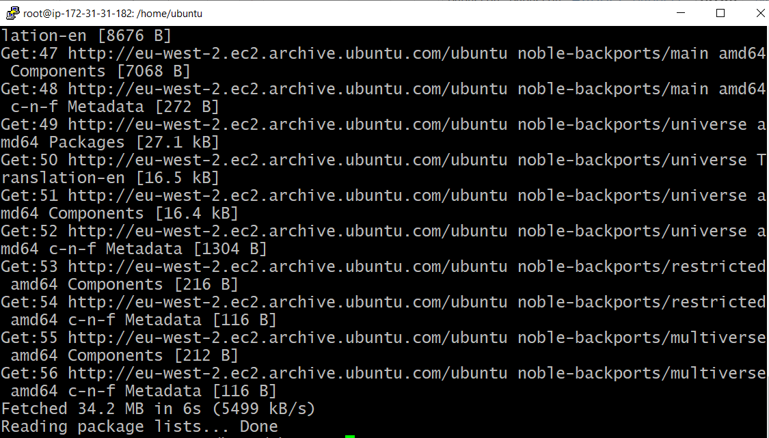
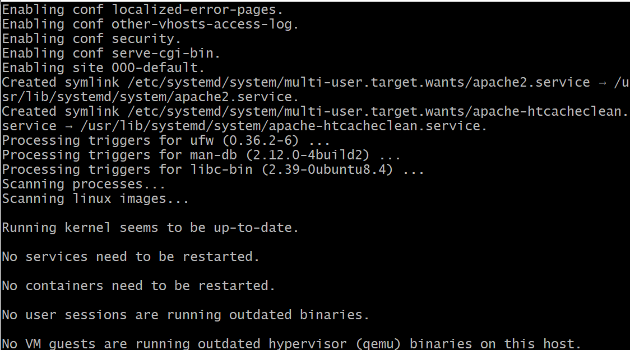
STEP 6 — INSTALL APACHE2
Creating EC2 Instance with Webserver
For installing the Apache2 application, first update Ubuntu using apt-get update –y & apt-get install apache2 –y. Here apache2 is the package name.
Update packages
Install apache2

Slide 24
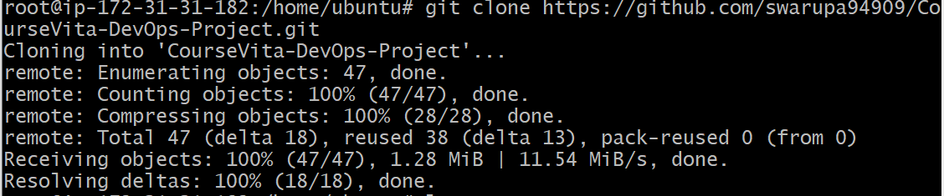
STEP 7–9 — CLONE THE REPOSITORY
Creating EC2 Instance with Webserver
Step 7:
Give which git — this tells the path of the git command.
Step 8:
Now clone the repo into the local machine using: git clone https://github.com/Msocial123/CourseVita-Devops-Project.git
Step 9:
cd CourseVita-Devops-Project — here cd is changing directory.

Slide 25
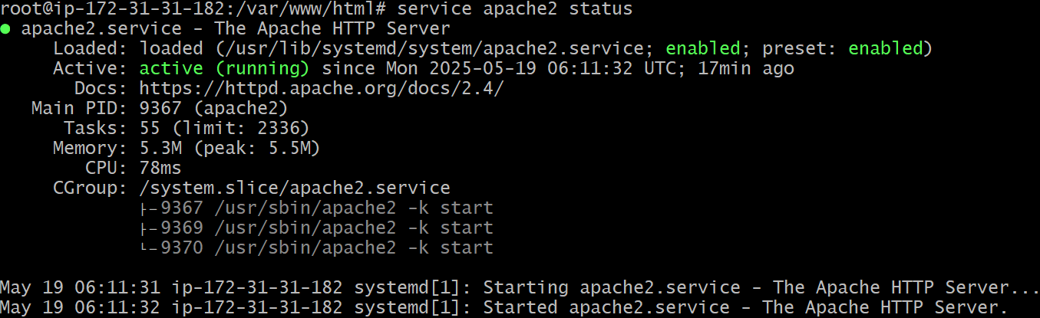
STEP 10–11 — DEPLOY & VERIFY
Creating EC2 Instance with Webserver
Step 10:
cp -r . /var/www/html — here cp is the copy command, -r means recursive (changing location), ‘.’ means from current directory to /var/www/html.
Step 11:
For checking the status of Apache2, use command: service apache2 status

Slide 26
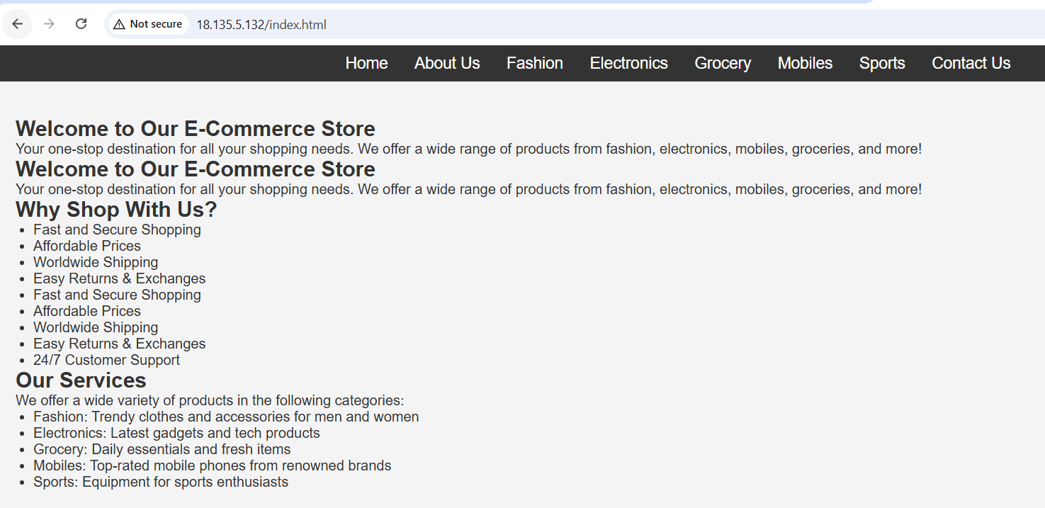
STEP 12 — VIEW THE WEBSERVER
Creating EC2 Instance with Webserver
Now copy the public IP address & paste it in Chrome, adding “:80” to the public IP address — then we can see the webserver.

