Slide 1


Relate !t

Slide 2
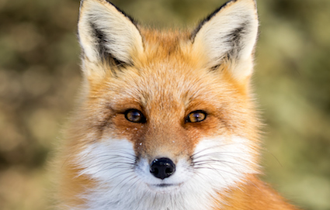
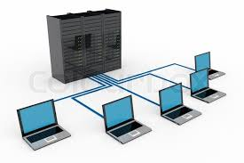

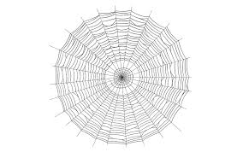
Example:
Answer: Mozilla Firefox and browsing

Slide 3
Question 1

Slide 4
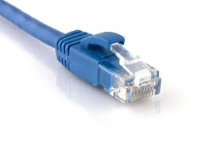
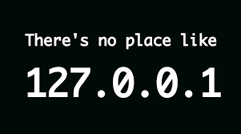
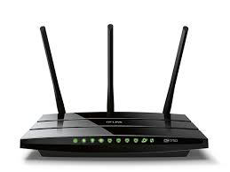

IEEE 802.11x

Slide 5
Question 2

Slide 6
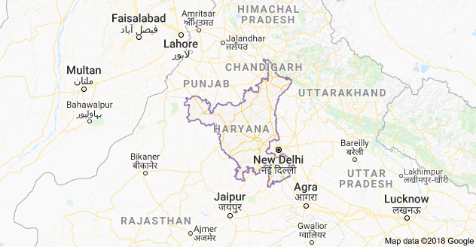
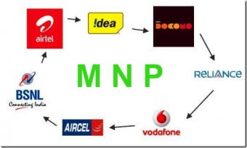
20 Jan, 2011
₹19

Slide 7
Question 3

Slide 8


Jann Horn
Project Zero

Slide 9
Question 4

Slide 10
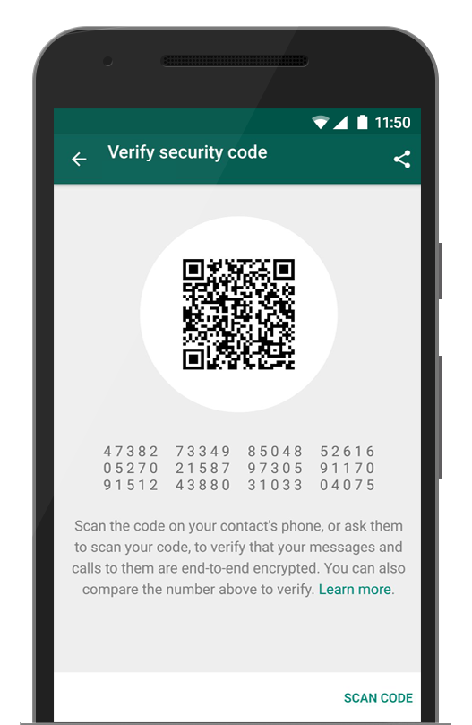
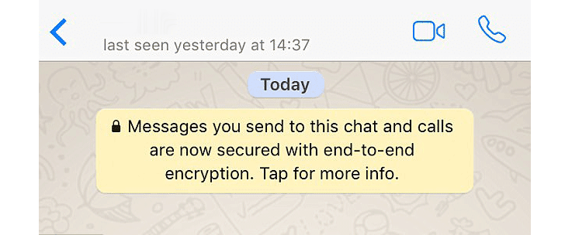
Nov, 2014
Open Whisper Systems
Jan, 2015

Slide 11
Question 5

Slide 12
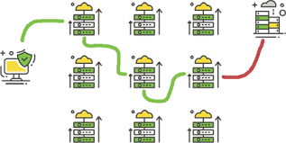


.onion

Slide 13
Question 6

Slide 14
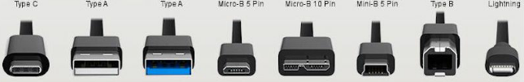

Nov, 1995

