Slide 1









SWARUP LAB · UC IRVINE
A simple desktop tool
that runs your biology
analyses for you.
Operon
Operon puts an AI lab assistant on your laptop. Tell it what you want to do in plain English and it helps clean data, run analyses, and make figures for you. No prior coding experience required.
Your AI research partner
for biology.
Chat to analyze
Works on your HPC
Ready-made recipes
Ask for plots, tables,
or QC checks in words.
Use your lab laptop
or a remote server.
Protocols for scRNA-seq,
imaging, and more.
swaruplab.bio.uci.edu/operon
Built by biologists, for biologists.

Slide 2


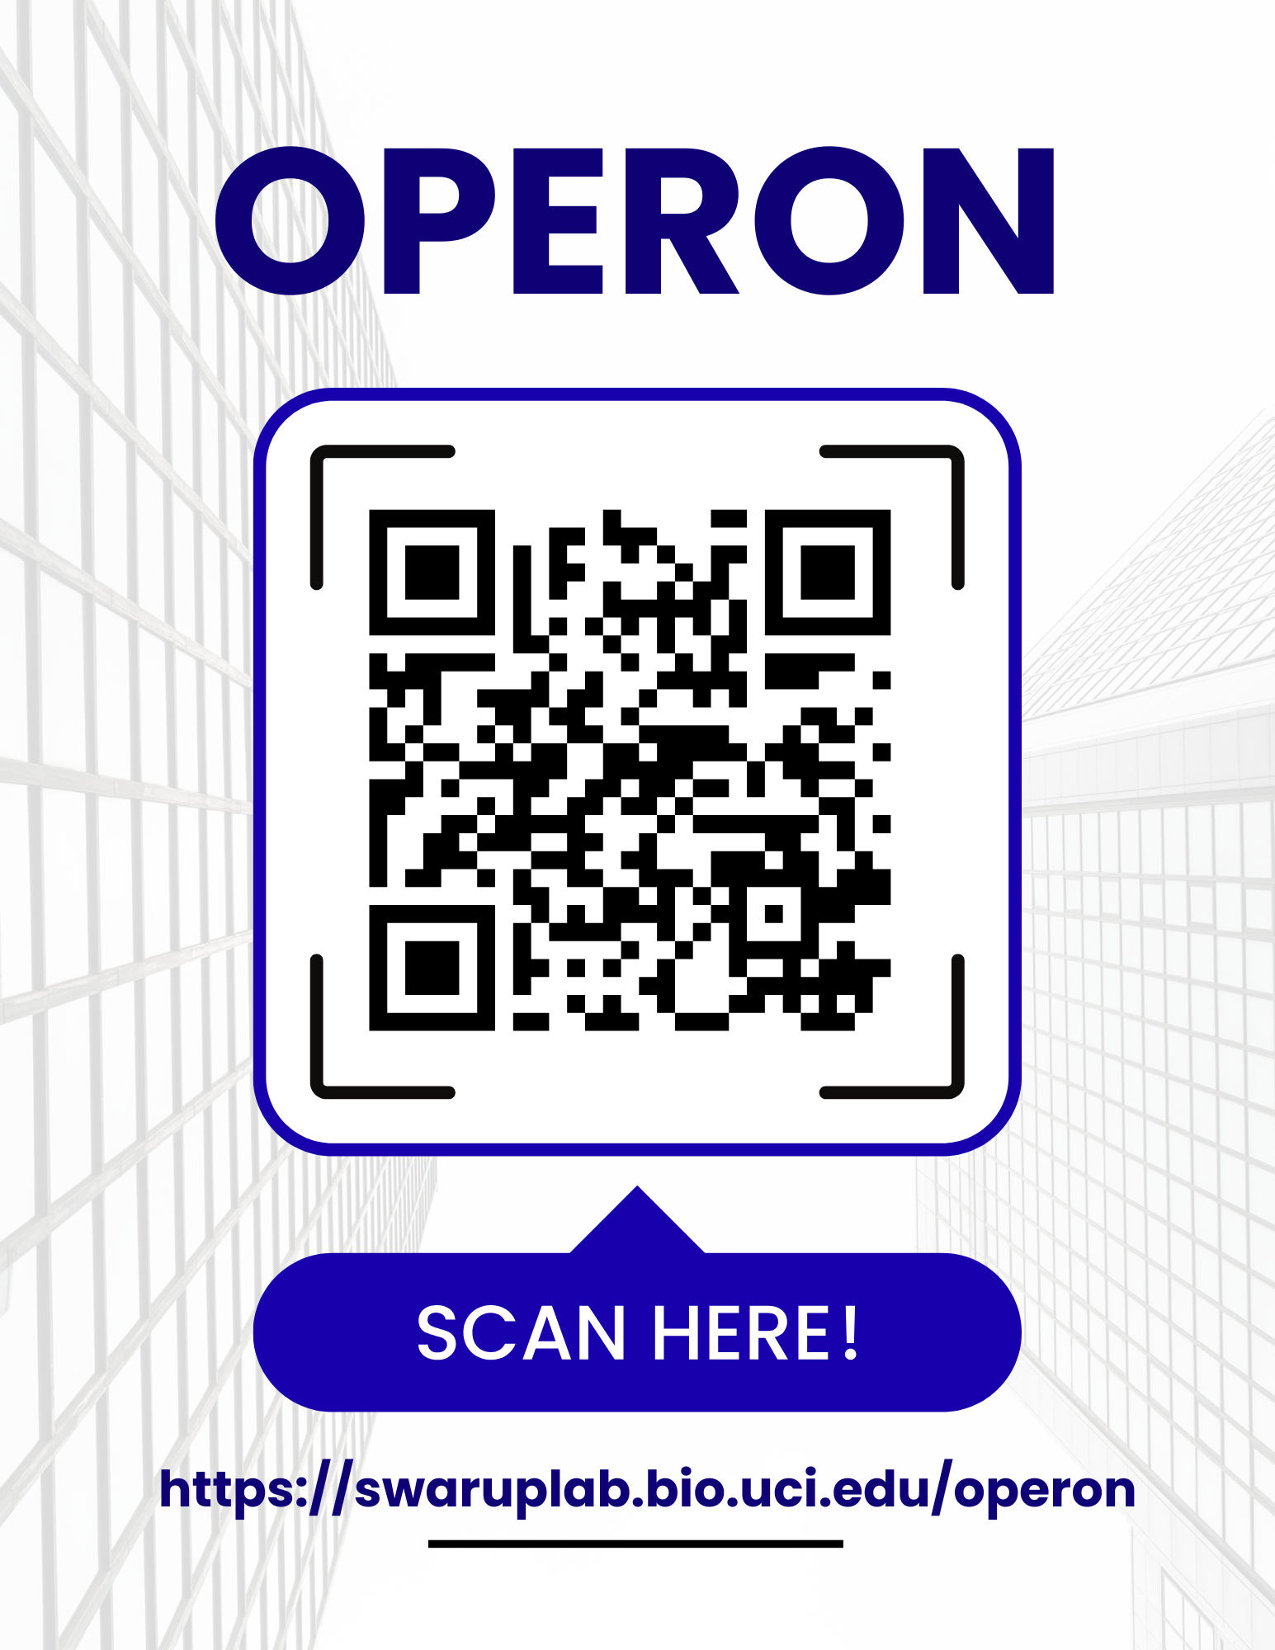




What can you do with Operon?
A tour in one page
Analyze single-cell data
Analyze spatial data.
SCAN TO GET OPERON
Scanpy walkthroughs for scRNA-seq,
clustering, and cell-type labels.
Spatial Transcriptomics Data Analysis
Free for researchers
Ask plain-language questions
Reuse lab protocols
“Plot UMAP by treatment.”
Operon writes and runs the code.
Save your group’s best practices
and share them with new students.
swaruplab.bio.uci.edu/operon
Start in 3 steps:
1
Download
2
Log in with Claude*
3
Ask your first question
Swarup Lab · University of California, Irvine
*subscription needed

