Slide 1



Load Balancing in Cloud Computing: A Simulation-Based Evaluation
Team Members:
Bhakti Lahane - 16010122093
Kshitij Pandey - 16010122129
Swarup Pingale - 16010122145
Cloud Computing IA2
K J Somaiya School Of Engineering
Guide: Prof. Zaheed Shaikh

Slide 2
Introduction
Cloud computing delivers computing resources over the internet on demand.
It provides scalability, cost-efficiency, and high availability.
One major challenge in cloud computing is load balancing – ensuring optimal distribution of workloads across servers.
Load balancing improves resource utilization, response time, and overall system reliability.

Slide 3
Research Objectives
To evaluate and compare three load balancing algorithms:
Round Robin
Equally Spread
Location-Aware
To Simulate Algorithms using CloudAnalyst
To assess their performance based on:
Balancing Efficiency
Complexity
Suitability
Fault Tolerance

Slide 4
Load Balancing Algorithms
Round Robin Algorithm:
Simple and widely used method.
Distributes requests sequentially across VMs.
Ignores server load or capabilities.
Equally Spread Current Execution
Assigns jobs to the VM with the least current load.
Offers better distribution than Round Robin.
May struggle with fault tolerance.
Location-Aware Algorithm:
Considers the physical/geographic location of servers.
Reduces latency by assigning jobs to the nearest or least-latent VM.
Performs VM migrations if imbalance is detected.

Slide 5
Round Robin Algorithm
The Round Robin Algorithm is a simple and commonly used load balancing method. It assigns virtual machines (VMs) to physical machines (PMs) in a sequential, circular order. Each server gets an equal number of VMs without considering the current load.
Best suited for small-scale systems with uniform workloads.
Offers low complexity and high fault tolerance, but may lead to uneven performance in dynamic environments.

Slide 6
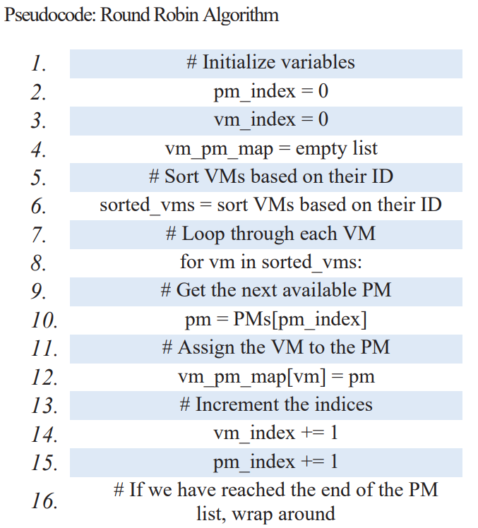
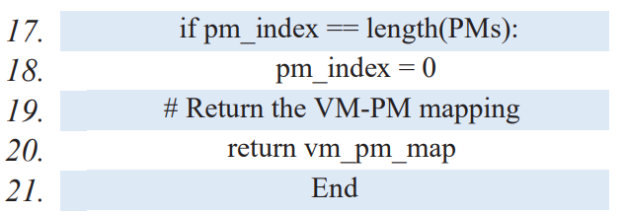
Round Robin Algorithm Pseudocode

Slide 7
Equally Spread Algorithm
The Equally Spread Current Execution Algorithm dynamically distributes incoming jobs to the VM with the least current load. It ensures that no VM is overburdened while others remain underutilized.
Suitable for small-scale systems with varying workloads.
Provides high balancing efficiency, but lacks in fault recovery.

Slide 8
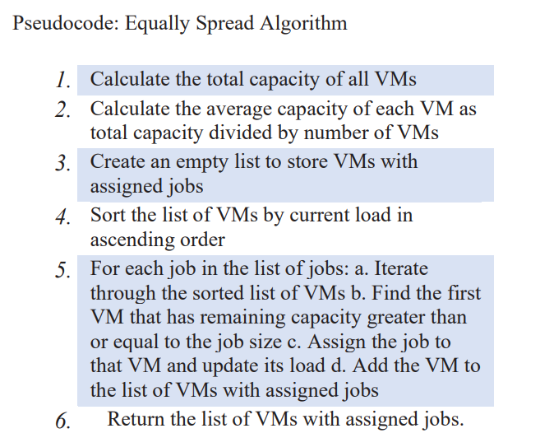
Equally Spread Algorithm Pseudocode

Slide 9
Location-Aware Algorithm
The Location-Aware Algorithm considers the geographical proximity of VMs and data centers to reduce network latency and balance workloads more effectively.
Highly suitable for large-scale, geo-distributed systems
Performs VM migrations based on distance and load to ensure even distribution and fault tolerance.

Slide 10
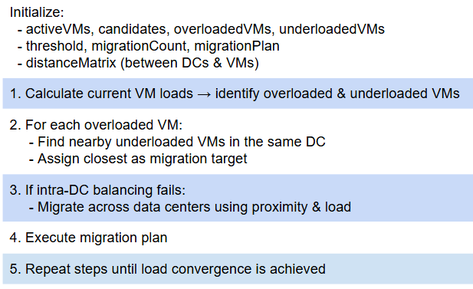
Location-Aware Algorithm Pseudocode

Slide 11
CloudAnalyst Simulation Tool
CloudAnalyst is an extension of CloudSim, built specifically for simulating and analyzing cloud computing environments visually. It allows configuring:
User Bases: representing users from different regions.
Data Centers: including VMs, hosts, network latency, and costs.
Policies: such as scheduling, load balancing, and brokering.
CloudAnalyst is ideal for academic and research purposes because it simplifies complex cloud behaviors into a GUI-based simulation platform.

Slide 12
Experimental Setup
To closely replicate real-world scenarios, the simulation setup in the paper includes:
5 User Bases (UB1–UB5) spread across global regions.
2 Data Centers configured with the same resources to eliminate bias.
20 Virtual Machines per Data Center, each with 512 MB RAM and 250 MIPS.
Workload Distribution using traffic patterns to simulate realistic user behavior.
Simulation Time: 60 minutes to capture performance trends across time.

Slide 13
Algorithm Comparison
Algorithm | Balancing Efficiency | Complexity | Suitability | Fault Tolerance
Round Robin | Moderate | Low | Small-scale systems | High
Equally Spread | High | Low | Small-scale systems | Low
Location-Aware | High | Moderate | Large, geo-distributed systems | High
Efficiency measures load distribution.
Complexity reflects ease of deployment and computation.
Suitability is the recommended cloud environment.
Fault Tolerance covers resilience during failure scenarios.

Slide 14
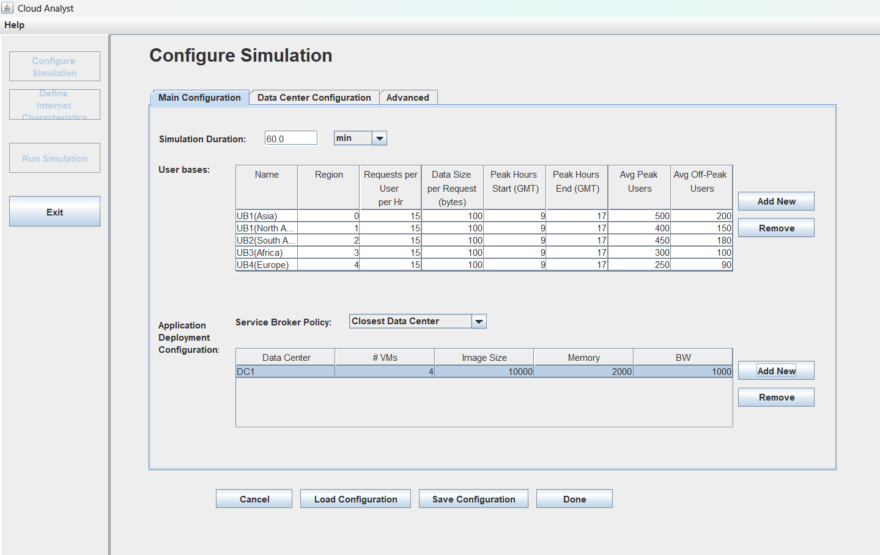
Simulation Setup: User and Datacenter Configuration

Slide 15
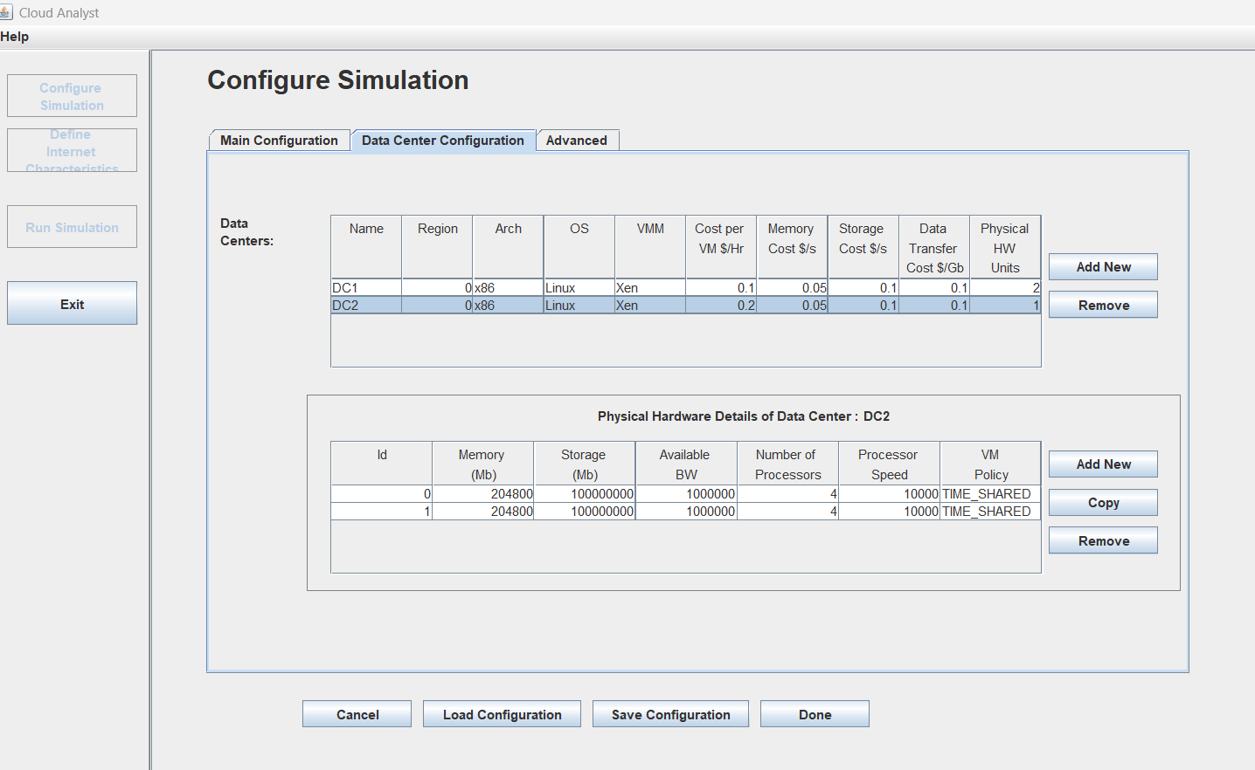
Virtual Machine Configuration

Slide 16
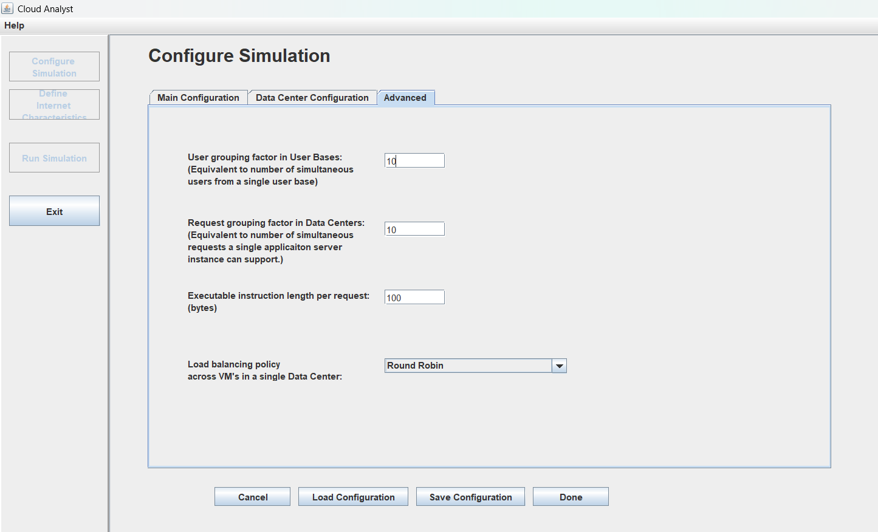
Application Deployment Configuration

Slide 17
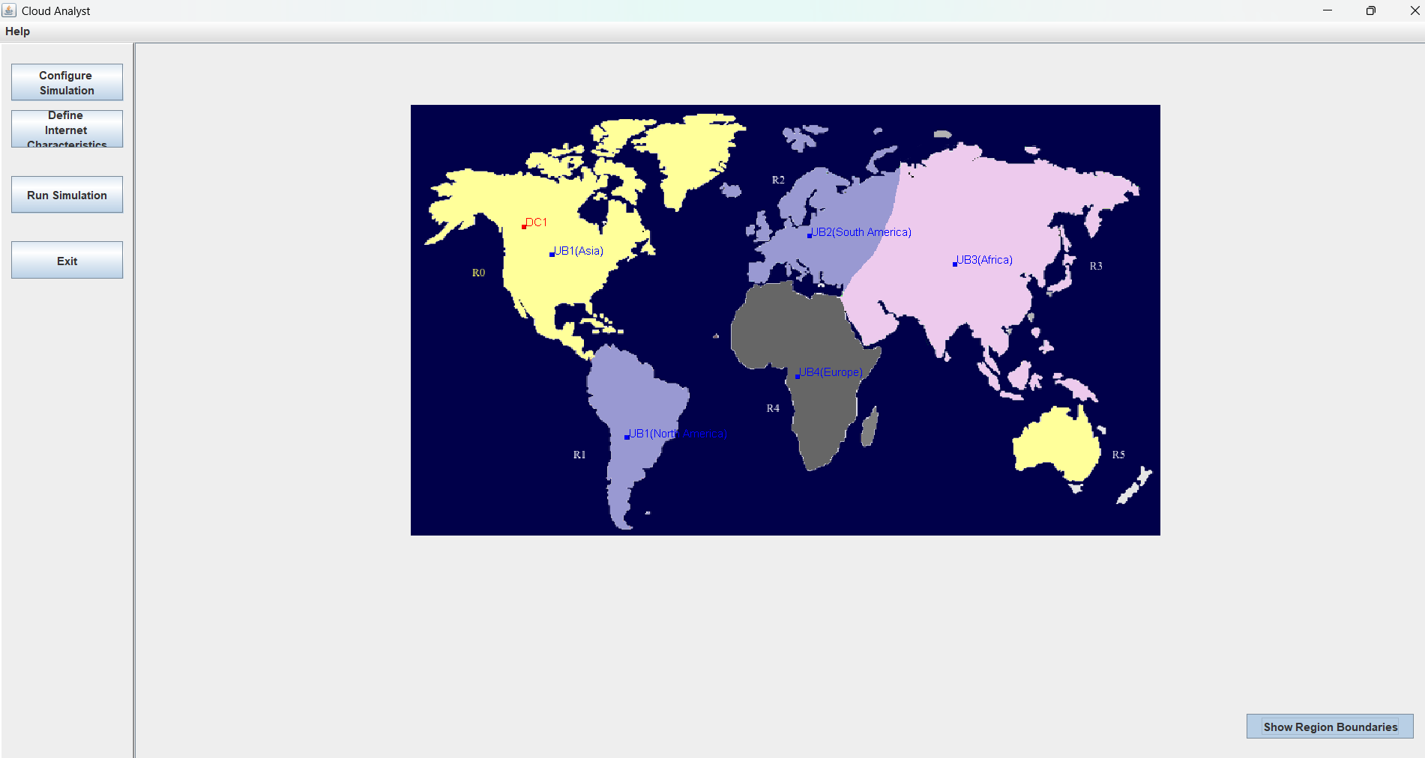
User Base and Data Center Setup on World Map – Location-Aware Routing Enabled

Slide 18
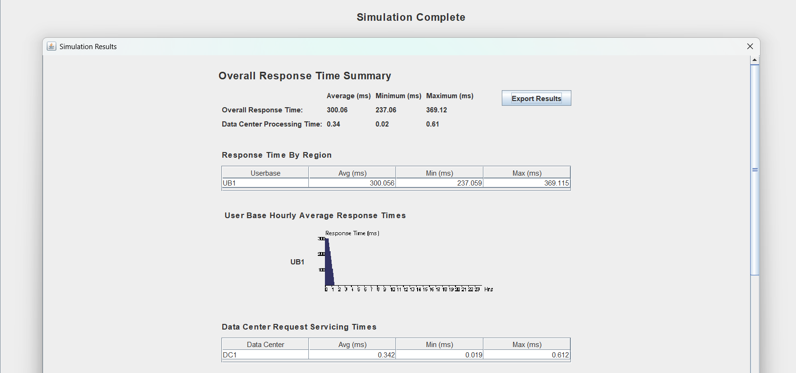
Graphical Results – Response Time Analysis (Location-Aware Impact)

Slide 19
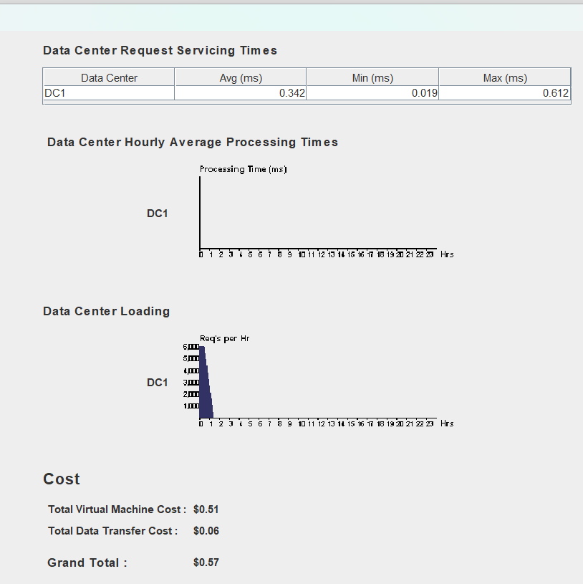
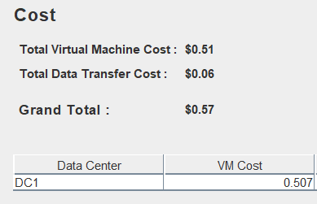

Detailed Response Times and Data Center Request Summary – Comparing Algorithm Efficiency

Slide 20
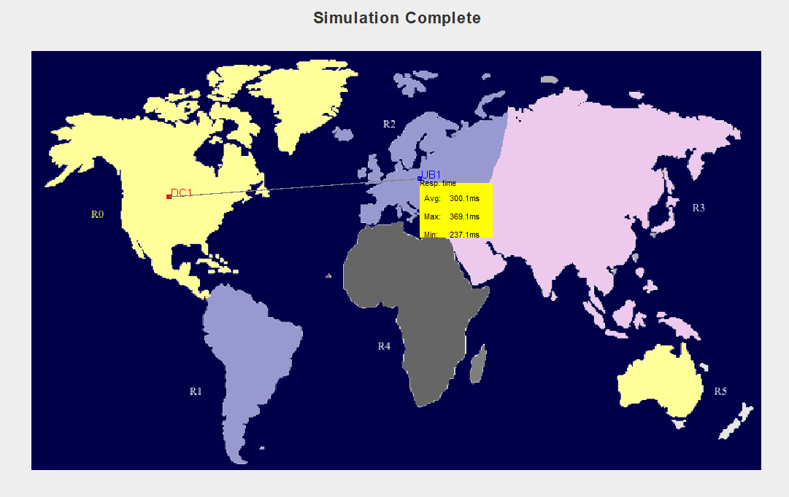
Simulation Insights: Processing Time and Cost Analysis

Slide 21
Key Observations
Round Robin is efficient in smaller, uniform load settings.
Equally Spread works well with static workloads and provides balance but fails during traffic spikes.
Location-Aware adapts dynamically, reduces latency, and handles geographical load variations best.
Load balancing is not one-size-fits-all, the algorithm should match the cloud environment.

Slide 22
Conclusion
The simulation confirmed that Location-Aware is the most suitable algorithm for modern, large-scale, distributed cloud systems, offering a balance of performance, resilience, and scalability.
However:
In resource-constrained or smaller environments, Round Robin or Equally Spread may suffice.
CloudAnalyst proved valuable for testing such scenarios in a controlled, visual environment.
Future scope includes:
Implementing AI/ML-based dynamic load balancers.
Testing under energy efficiency, cost, and latency optimization goals.

Slide 23
THANK YOU

