Slide 1
OLIST MARKETPLACE ANALYSIS
What Really Drives Customer Satisfaction on Brazil's Largest Marketplace Integrator
Data Analytics Hackathon - Gradient Learnings | September 2026
Team GenWin: Swati Dubey (Leader) & Nitanshu Tak

Slide 2
OLIST MARKETPLACE ANALYTICS
Executive Summary: Core Findings Across 96,478 Orders
96,478
Delivered Orders Analyzed
4.07 / 5.0
Platform Average Review
6.8%
Orders Delivered Late
1.69 / 5.0
Review Score at 7+ Days Late
THE DELIVERY CLIFF EFFECT
Review scores do not degrade smoothly. A single day past estimate drops reviews from 4.28 to 2.70; at 7+ days late, average ratings collapse to 1.69.
MULTI-SELLER COORDINATION DEFICIT
Orders split across multiple sellers suffer a 6.47x higher odds ratio of bad reviews (46% vs 9%), driven by partial tracking confusion rather than transit speed.
STRUCTURAL GEOGRAPHIC MISMATCH
60% of sellers are concentrated in Sao Paulo, while customers are dispersed nationwide. Cross-state orders double transit time and increase freight by 75%.
PAYMENT BEHAVIOR IS A NON-DRIVER
Installments and payment methods have negligible statistical impact on reviews (OR 1.02x). Focus resources on logistics, not checkout payments.

Slide 3
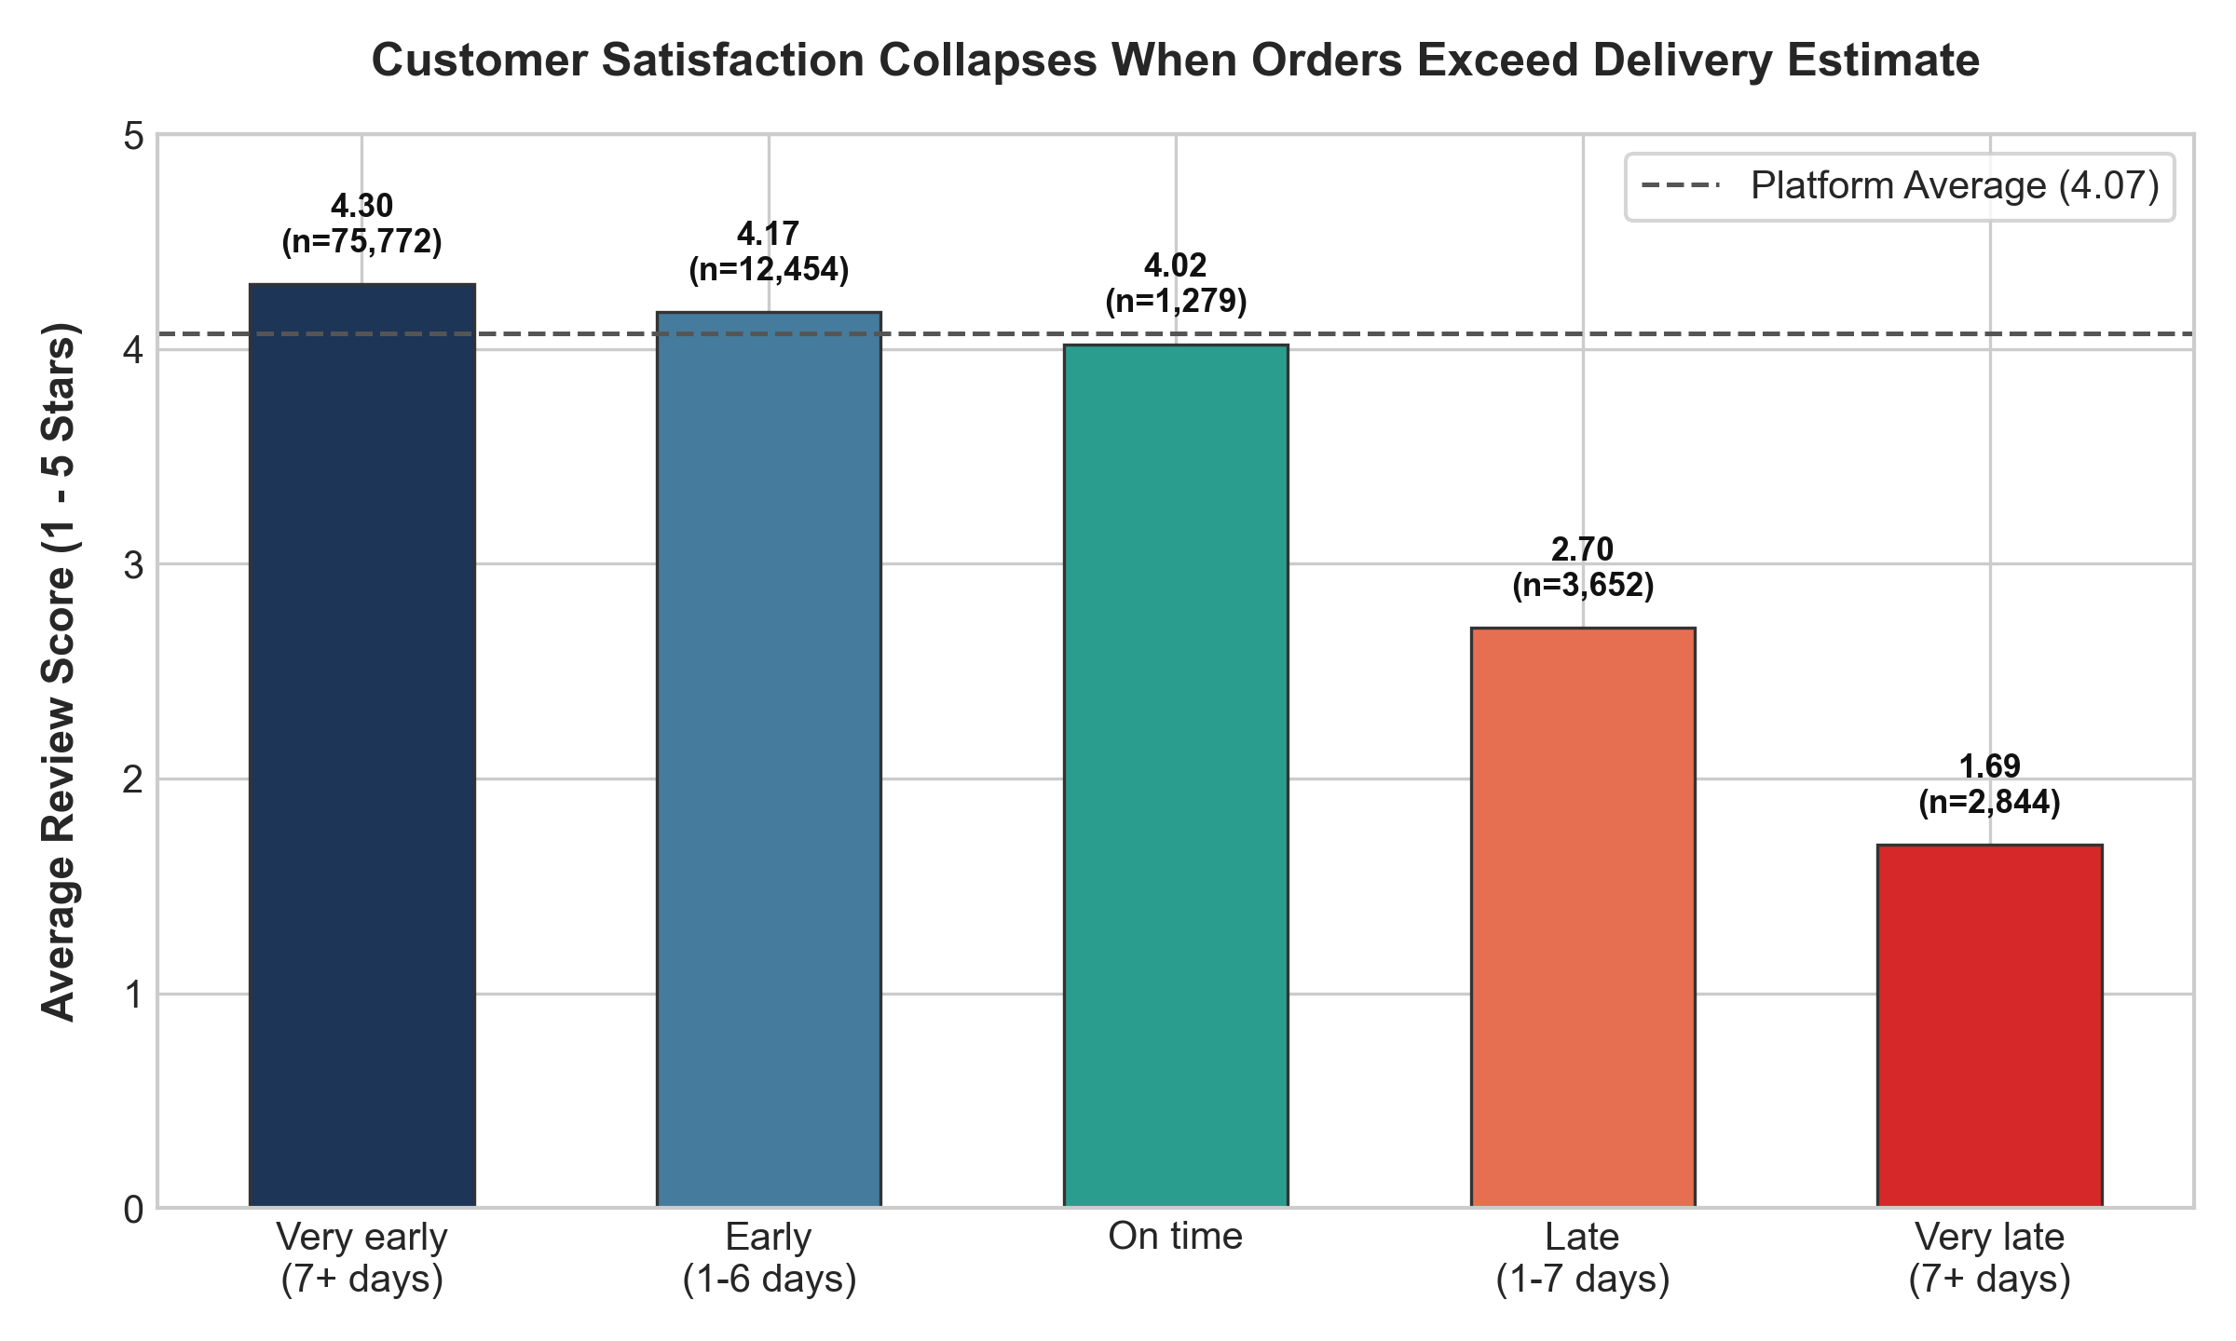
OLIST MARKETPLACE ANALYTICS
Delivery Timing & Customer Satisfaction: The Threshold Effect
ANALYTICAL TAKEAWAYS
- Non-Linear Cliff Effect: Being early earns negligible extra rating (4.17 - 4.30), but missing the estimated date drops ratings into immediate dissatisfaction (< 2.70).
- Pearson Correlation: r = -0.27 across delay days, confirming that customers penalize delays asymmetrically.
- Strategic Takeaway: Speeding up shipments that are already on time produces diminishing returns. Priority must be eliminating late tail-risk.

Slide 4
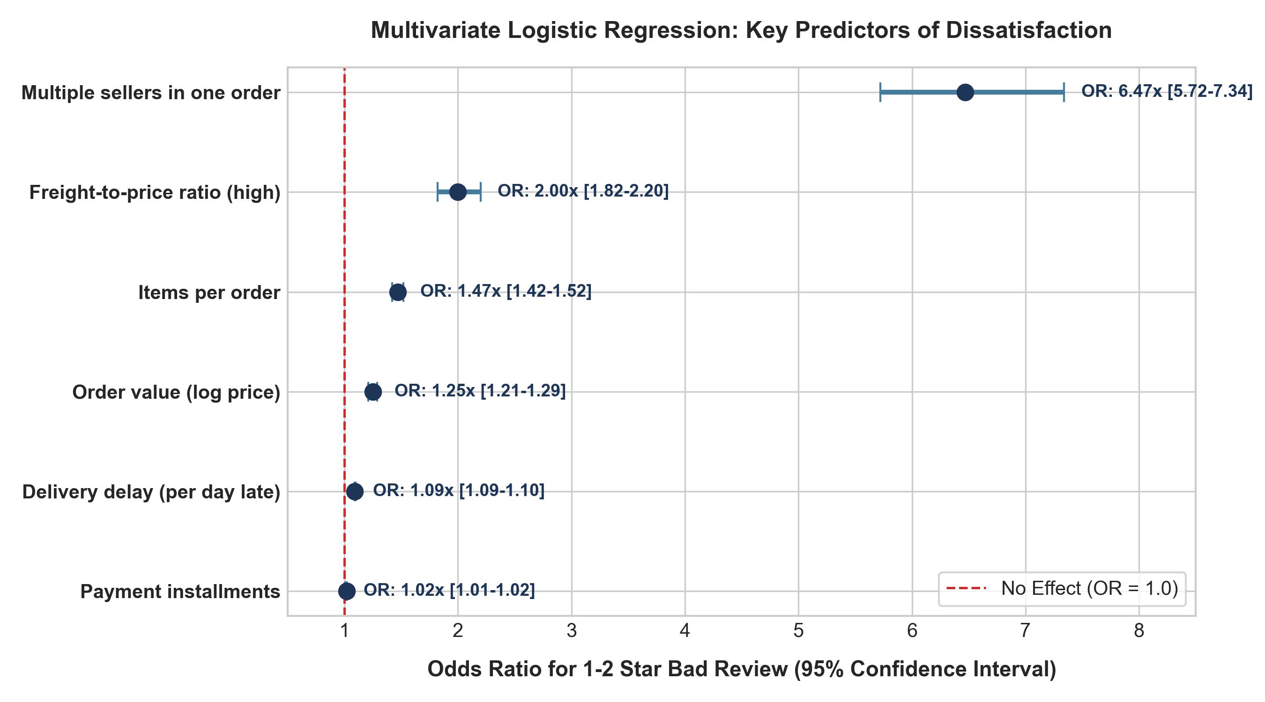
OLIST MARKETPLACE ANALYTICS
Multivariate Logistic Regression: Isolating Root Drivers
MODEL SPECIFICATION
- Model: sm.Logit predicting Low Review (1-2 Stars) across 96,000 orders (Pseudo R2 = 0.127).
- Primary Drivers: Multi-seller orders (OR = 6.47x) and Delay days (OR = 1.09x/day).
- Secondary Factors: Freight ratio (OR = 2.00x) and Items count (OR = 1.47x).
- Robustness Validations: All VIFs < 2.50. Out-of-sample AUC = 0.702 on 75/25 split. Confound test proved 46% vs 9% dissatisfaction even on small, on-time orders!

Slide 5
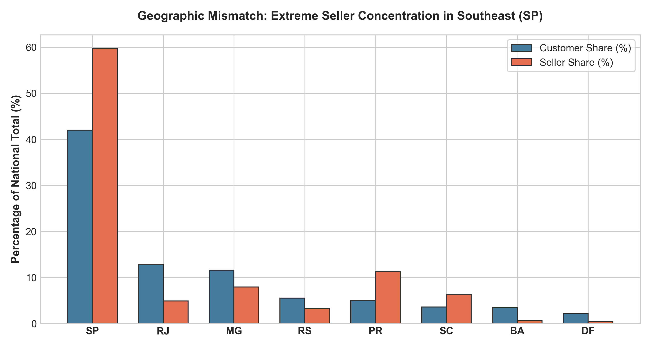
OLIST MARKETPLACE ANALYTICS
Geographic Disparity: Southeast Concentration vs Regional Delays
LOGISTICS BOTTLENECK
- 59.7% of all sellers reside in Sao Paulo (SP), whereas SP represents only 42.0% of customer demand.
- Cross-state shipments take an average of 14.7 days to arrive vs 7.5 days for intra-state delivery.
- Freight charges on cross-state shipments are 75% higher (R$ 26.96 vs R$ 15.46).
- Worst-affected states are in North/Northeast: Alagoas (21% late), Maranhao (18% late), and Sergipe (15% late).

Slide 6
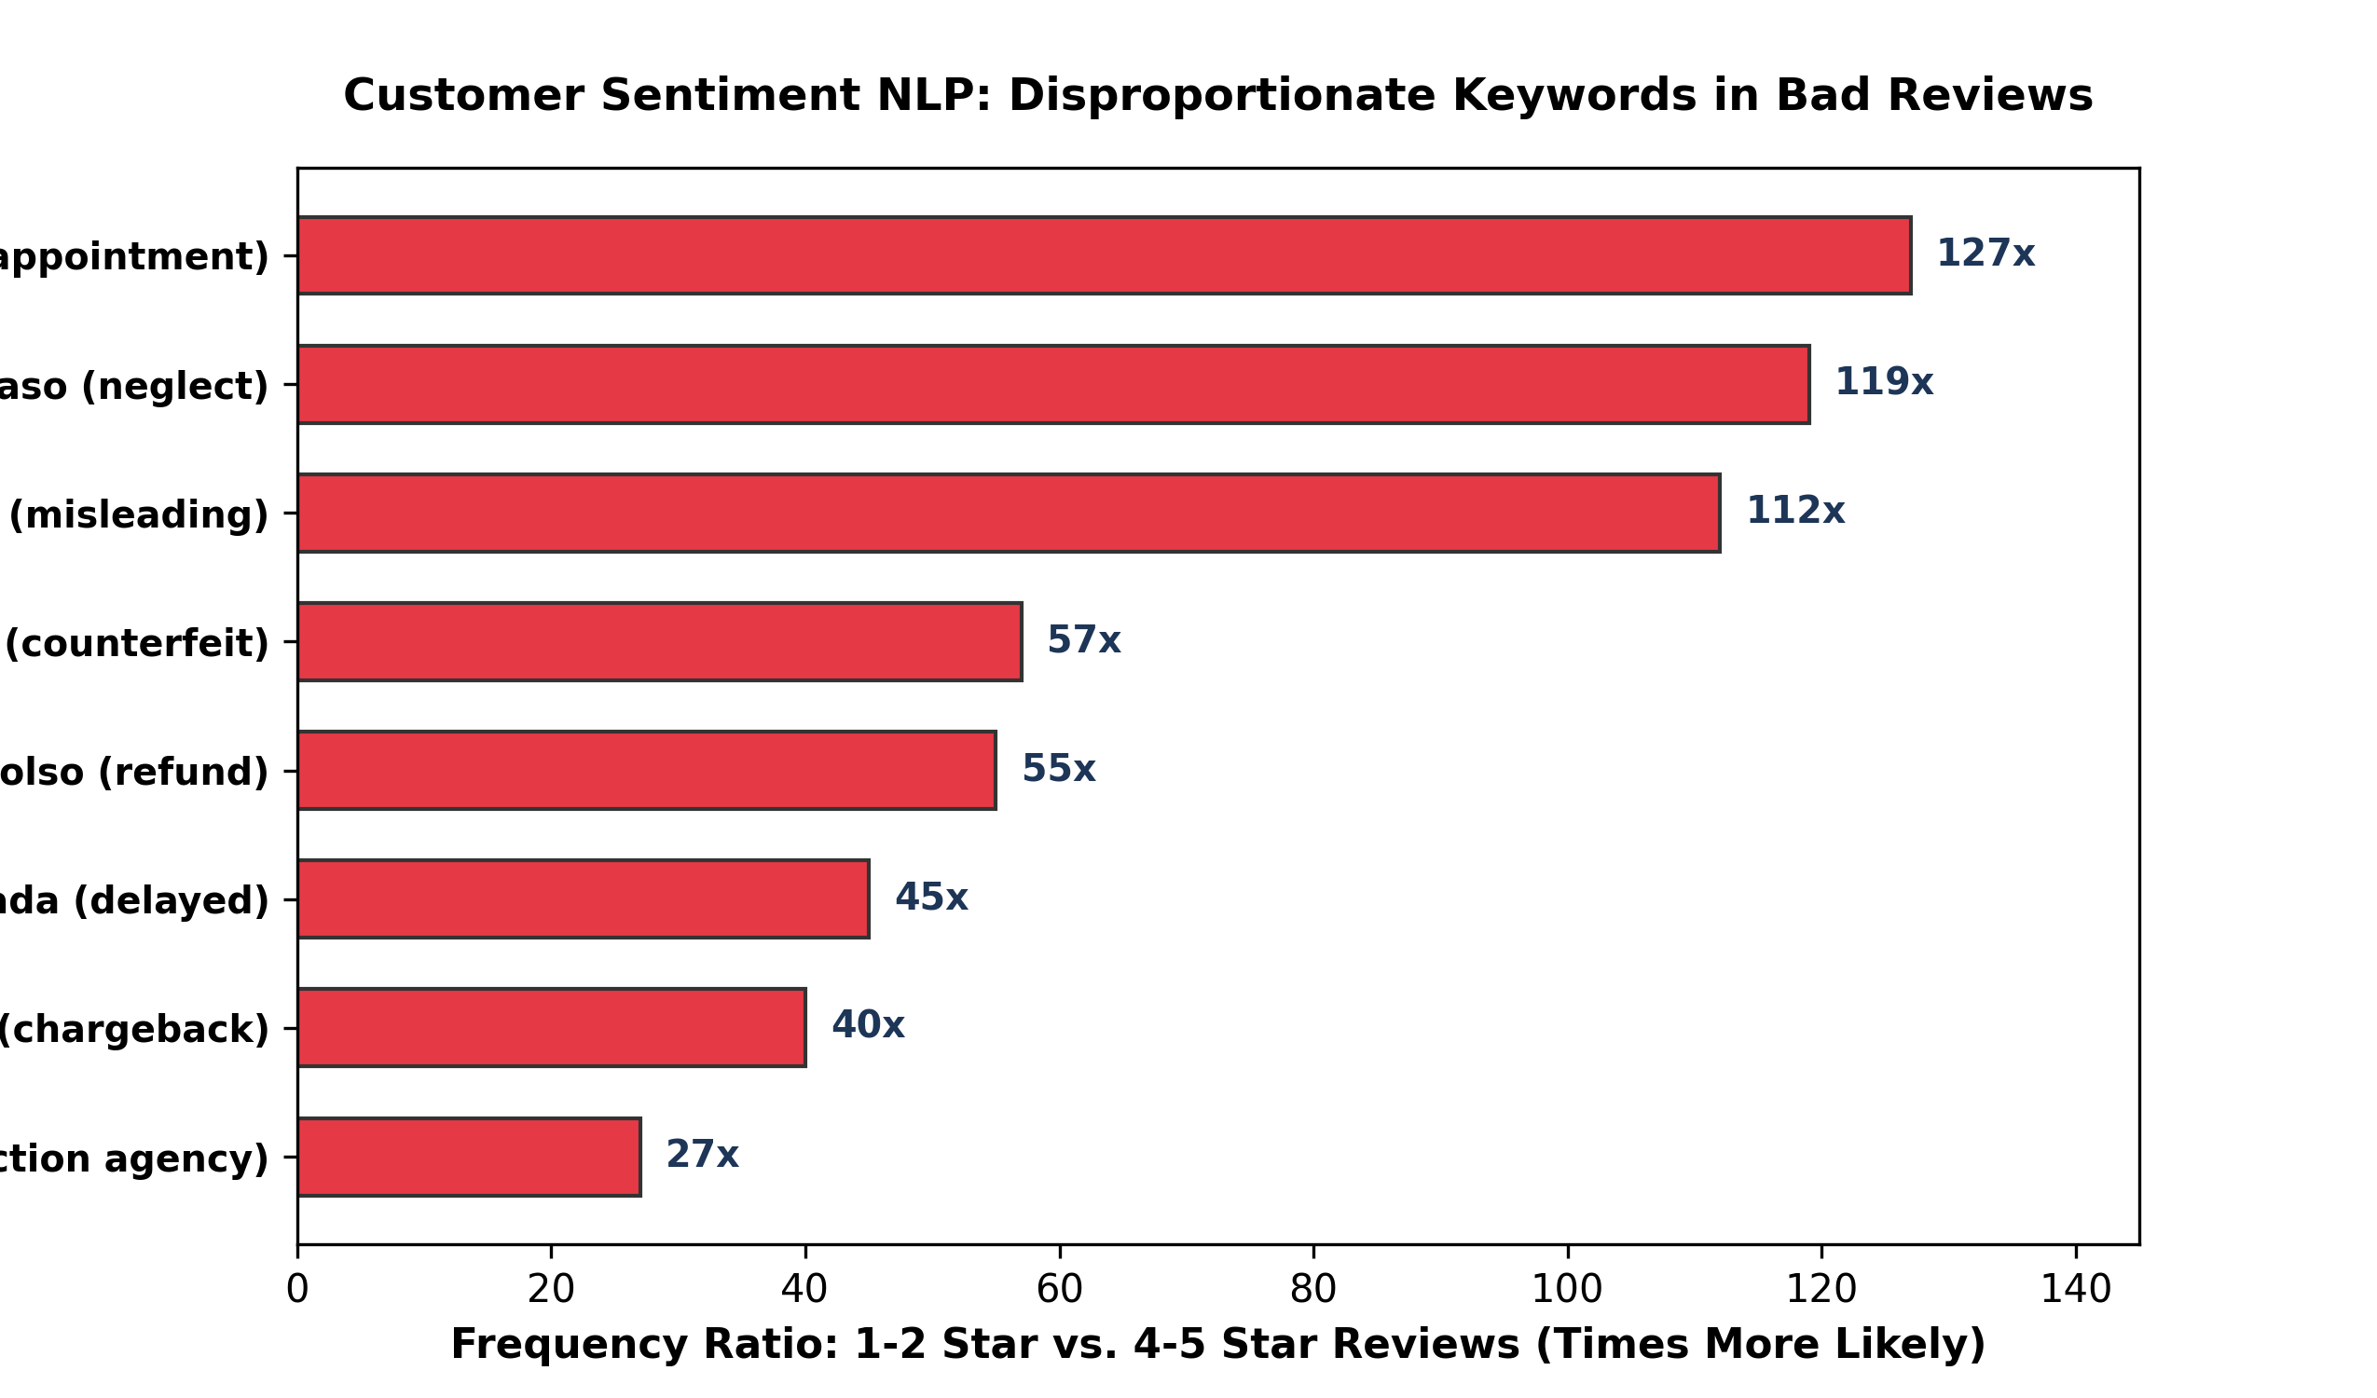
OLIST MARKETPLACE ANALYTICS
Qualitative Review Intelligence: The Voice of Dissatisfaction
UNSTRUCTURED TEXT FINDINGS
- 41,753 reviews contained customer text comments. Disproportionate keyword ratios identify root causes.
- Disappointment & Neglect: decepcao (127x higher in bad reviews) and descaso (119x higher).
- Counterfeit & Misleading: enganosa (112x) and falsificado (57x), indicating product integrity issues.
- Regulatory Threat: Mentions of procon (Brazil consumer agency, 27x) signal legal and reputational risk.

Slide 7
OLIST MARKETPLACE ANALYTICS
Strategic Recommendations: Prioritized Roadmap for Execution
Priority 1: EDT Dynamic Recalibration & Regional Hubs
Recalibrate delivery estimation algorithm specifically for cross-state routes to halt systematic over-promising. Establish regional 3PL fulfillment partnerships in Recife and Salvador.
Priority 2: Multi-Seller Order Coordination & Tracking
Overhaul post-checkout notifications for split-seller baskets. Provide unified dispatch timelines and single-dashboard tracking to eliminate customer anxiety.
Priority 3: Category-Specific Handling & Packaging SLAs
Enforce heavy-goods packaging audits and dedicated freight carrier assignment for bulky furniture items (Office Furniture: 3.51 avg review).
Resource Savings: Rule Out Payment System Overhauls
Installment count and payment type have negligible statistical relationship to customer reviews. Avoid diverting developer bandwidth to checkout payments.

