Slide 1
ARDUINO
RAIN DETECTION
SYSTEM
A step-by-step build presentation
Rain sensor • LED alert • Buzzer • 10-second auto-off
PROJECT PRESENTATION
Prepared for an academic electronics project
01

Slide 2
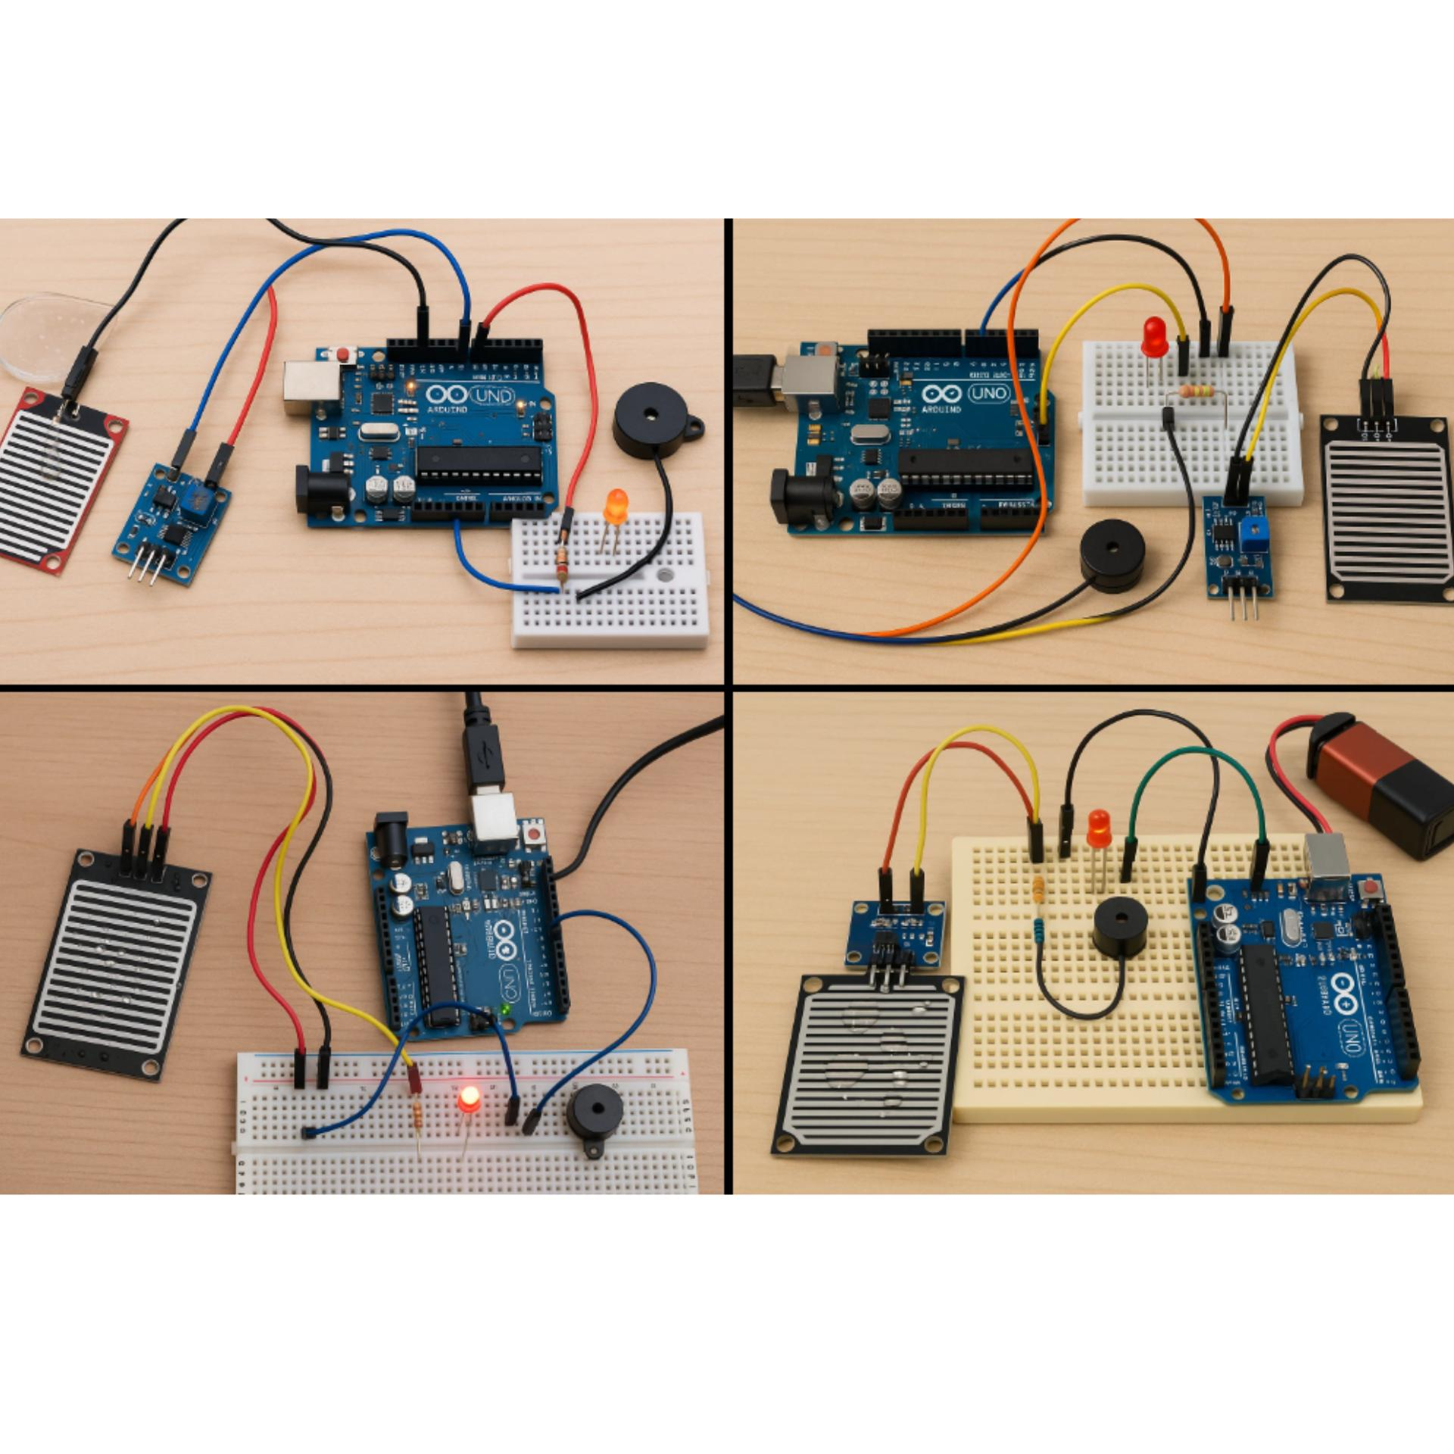
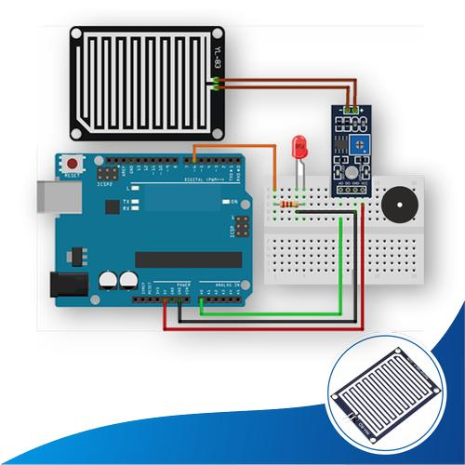
RAIN DETECTION SYSTEM
ARDUINO RAIN DETECTION SYSTEM
01

Slide 3
Project overview
01 • INTRODUCTION
A small embedded system that senses water and gives a short visual + audible alert.
01 SENSE
02 ALERT
03 AUTO-OFF
Rain sensor detects moisture on its sensing plate.
Arduino reads the analogue value at A0.
If the reading crosses the chosen threshold:
• LED turns ON
• Buzzer sounds
Alarm turns OFF after 10 seconds.
System waits for the sensor to become dry before it can trigger again.
PROJECT GOAL
Build a low-cost, beginner-friendly rain alert and learn sensor input, output control, timing, and circuit wiring.
ARDUINO RAIN DETECTION SYSTEM
02

Slide 4
Components required
02 • PREPARE
Arduino Uno
Rain sensor module
Active buzzer
Main controller; reads the sensor and controls outputs.
Sensing plate + module; use AO for analogue readings.
Provides audible alert. Code below assumes an active buzzer.
Small LED + 220Ω
Breadboard + jumpers
USB cable / power
Visual alert; resistor limits current through the LED.
Temporary connections without soldering.
Upload code and power the Arduino during testing.
Optional: a high-power white torch LED is different from a small indicator LED and needs a suitable driver and power supply.
ARDUINO RAIN DETECTION SYSTEM
03

Slide 5
How the system is connected
03 • SYSTEM DESIGN
LED
Visual alert
D8 through resistor
RAIN SENSOR
ARDUINO UNO
Water / moisture
Analogue signal
Reads A0
Runs decision + timer
BUZZER
Sound alert
D3
Power and GND are shared appropriately; all modules must share a common GND.
SIGNAL FLOW
Sensor reading → threshold check → outputs ON → 10-second timer → outputs OFF
ARDUINO RAIN DETECTION SYSTEM
04

Slide 6
Wiring: make each connection
04 • BUILD
COMPONENT / PIN | CONNECT TO | PURPOSE
Rain sensor VCC | Arduino 5V | Power for sensor module
Rain sensor GND | Arduino GND | Common ground
Rain sensor AO | Arduino A0 | Analogue sensor reading
Buzzer + | Arduino D3 | Active buzzer control
Buzzer − | Arduino GND | Return path
Arduino D8 | 220Ω resistor → LED long leg (+) | LED current limited by resistor
LED short leg (−) | Arduino GND | Ground connection
LED rule: long leg = positive; short leg = GND. Do not omit the resistor.
ARDUINO RAIN DETECTION SYSTEM
05

Slide 7
Breadboard and safe wiring tips
04 • BUILD
Use the ground rail
Protect the hardware
Connect one Arduino GND pin to the breadboard’s negative (−) rail.
Connect the sensor, buzzer, LED and other GND wires to that rail.
Check that separate rails are linked if needed.
Power off before changing wiring.
Use a 220Ω resistor in series with the small LED.
Never connect a battery directly to the 5V pin unless it is a regulated 5V supply.
About a white torch LED
About the buzzer
A high-power torch LED must not be driven directly from D8. It may need a suitable transistor/MOSFET driver, current limiting, and an appropriate external supply.
This example assumes an active buzzer that sounds when driven HIGH. A passive buzzer may need tone() / noTone(). Avoid drawing excessive current from an Arduino pin.
ARDUINO RAIN DETECTION SYSTEM
06

Slide 8
Program logic: from water to alarm
05 • LOGIC
START / SETUP
READ SENSOR
CHECK THRESHOLD
START ALARM
Set D3, D8 as outputs
Read analogue A0
Is value < 1000?
If not already started
REPEAT LOOP
SENSOR DRY?
10 SECONDS ELAPSED?
Read again after 100 ms
Reset for next detection
Turn LED + buzzer OFF
Important behavior: after the alarm times out, it stays OFF while the sensor remains wet. It rearms only after the reading returns to the dry range.
ARDUINO RAIN DETECTION SYSTEM
07

Slide 9
Arduino code (1/2): setup and trigger
06 • CODE
#define BUZZER_PIN 3
#define LED_PIN 8
bool alarmStarted = false;
unsigned long alarmStartTime = 0;
void setup()
{
pinMode(BUZZER_PIN, OUTPUT);
pinMode(LED_PIN, OUTPUT);
Serial.begin(9600);
}
void loop()
{
int sensorValue = analogRead(A0);
Serial.println(sensorValue);
// Start only once when wet is first detected
if (sensorValue < 1000 && alarmStarted == false)
{
alarmStarted = true;
alarmStartTime = millis();
digitalWrite(LED_PIN, HIGH);
digitalWrite(BUZZER_PIN, HIGH);
}
ARDUINO RAIN DETECTION SYSTEM
08

Slide 10
Arduino code (2/2): timeout and reset
06 • CODE
// Turn outputs OFF after 10 seconds
if (alarmStarted == true &&
millis() - alarmStartTime >= 10000)
{
digitalWrite(LED_PIN, LOW);
digitalWrite(BUZZER_PIN, LOW);
}
// Reset only after the sensor becomes dry
if (sensorValue >= 1000)
{
alarmStarted = false;
digitalWrite(LED_PIN, LOW);
digitalWrite(BUZZER_PIN, LOW);
}
delay(100);
}
10,000 milliseconds = 10 seconds
Why use a state flag?
millis() measures elapsed time without blocking the sensor loop.
alarmStarted prevents the timer from restarting continuously while the sensor stays wet.
ARDUINO RAIN DETECTION SYSTEM
09

Slide 11
Calibrate and test the sensor
07 • TEST
1 DRY TEST
2 WET TEST
3 SET THRESHOLD
Upload the code. Open Serial Monitor and set baud rate to 9600. Record the dry readings.
Add a few drops of water to the sensing plate. Record the wet readings.
Choose a value between the observed dry and wet readings. Example: 500 only if readings support it.
Illustrative readings only — your sensor may differ
Condition | Example reading | If threshold is 500
Dry | 900 | No alarm
Wet | 300 | Alarm starts
If dry readings are also below 500, the alarm may trigger unexpectedly; adjust the threshold after testing.
ARDUINO RAIN DETECTION SYSTEM
10

Slide 12
Expected result and verification
07 • TEST
DRY
LED OFF • Buzzer OFF
WATER DETECTED
LED ON • Buzzer ON
AFTER 10 SECONDS
LED OFF • Buzzer OFF
STILL WET
Alarm remains OFF
SENSOR DRIES
System rearms for next event
ARDUINO RAIN DETECTION SYSTEM
11

Slide 13
Troubleshooting checklist
08 • DEBUG
LED never lights
Check LED polarity, resistor, D8, and GND.
Buzzer stays silent
Confirm active buzzer type, polarity, D3 and GND; test buzzer separately.
Alarm triggers while dry
Read Serial Monitor and raise/lower threshold based on measured values.
Alarm never triggers
Check sensor AO → A0, sensor VCC/GND, and wet readings.
Switch not used
This version intentionally has no switch; it auto-silences after 10 seconds.
ARDUINO RAIN DETECTION SYSTEM
12

Slide 14
PROJECT SUMMARY
Sense. Decide. Alert. Reset.
The Arduino reads the rain sensor, activates a light and buzzer when the measured value crosses a calibrated threshold, and automatically silences the alarm after 10 seconds.
INPUT
PROCESS
OUTPUT
Rain sensor on A0
Threshold + timer
LED on D8 + buzzer D3
ARDUINO RAIN DETECTION SYSTEM
14

Slide 15
Thank you
PROCESS
OUTPUT
ARDUINO RAIN DETECTION SYSTEM
14

