Slide 1

SOP - Customer Inquiry Handling
Presented by: VEERESH 1NH23MC167
Date: 28-09-2024

Slide 2
abstract
This mini-project, "SOP-Customer Enquiry Handling," is designed to streamline and optimize the process of managing customer inquiries using Java technologies. The project focuses on developing a robust system that handles customer queries efficiently, ensuring a seamless experience for both the customer service team and the clients.
Implemented using Java, JDBC-MySQL, and Java Swing, the system facilitates smooth data management and user interaction. The application leverages JDBC for database connectivity to a MySQL backend, allowing for efficient storage and retrieval of customer data and inquiries. The graphical user interface, built with Java Swing, offers an intuitive and user-friendly platform for customer service representatives to manage inquiries, assign them to appropriate departments, and track their status.
This system enhances communication and reduces response times by providing a structured approach to handling inquiries. Furthermore, the project emphasizes data integrity and security, ensuring that customer information is handled with the utmost care. By integrating SOP (Standard Operating Procedures) into the inquiry handling process, the project aims to maintain consistency and quality in customer service operations.

Slide 3
Introduction
The SOP-Customer Inquiry Handling project was initiated to address the inefficiencies and delays caused by manual processes in managing customer inquiries. In traditional setups, inquiries are often handled through emails or spreadsheets, leading to scattered information, slow response times, and difficulty in tracking the status of each inquiry.
Problem:
Manual handling of customer inquiries results in slow response times.
Difficulty in tracking and assigning inquiries to appropriate departments.
Lack of a centralized system for storing and retrieving customer information.
Opportunity: The project aims to streamline this process by developing an automated system using Java Swing for the interface and MySQL for data management. This system provides a more efficient, centralized way to manage inquiries, improving response times and ensuring proper tracking of inquiry statuses.

Slide 4
Goals/Objectives:
Automate the handling and tracking of customer inquiries.
Provide a user-friendly interface for both customers and administrators.
Centralize the data storage using MySQL for easy access and management.
Improve the efficiency of assigning inquiries to appropriate departments.
Enhance overall customer satisfaction by reducing response time.

Slide 5
Agenda
- Introduction
- Project Overview
- Methodology/Process
- Key Findings/Results
- Challenges
- Solutions/Innovations
- Conclusion

Slide 6
Project Overview
Project Purpose:
The project was initiated to reduce inefficiencies in manual customer inquiry handling by implementing an automated system with centralized management.
Scope:
- Included: Customer registration, inquiry submission, department assignment, and status tracking.
- Excluded: Web-based solutions, AI-powered responses.

Slide 7
Methodology/Process
Tools: Java Swing for the user interface, MySQL for database management.
Frameworks: JDBC for database connectivity.
Development Process:
- Requirements analysis
- System design (UI and database schema)
- Development and integration
- Testing and deployment

Slide 8
Phases/Stages
Research:
Identified customer needs and key features for the system.
Planning:
Designed the UI and database schema.
Execution:
Developed the system using Java Swing & MySQL.
Testing & Deployment:
Validated functionality and trained users.

Slide 9
Key Findings/Results
- Streamlined inquiry management.
- Centralized customer data in MySQL for easy access and management.
- Clear role-based access control for admins and department staff.
- Positive feedback from users regarding ease of use and efficiency.

Slide 10
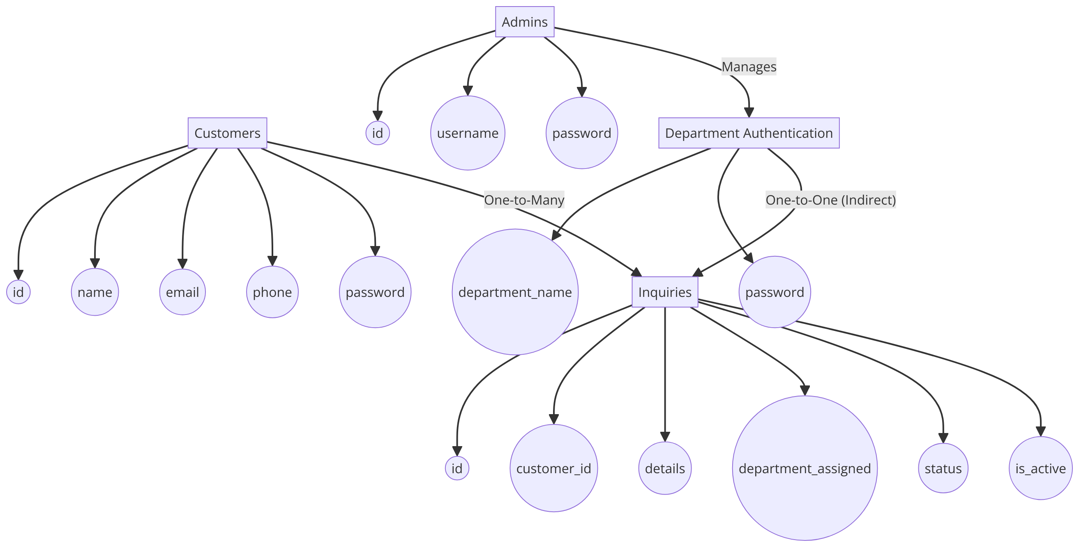
System design
Entity Relationship diagram

Slide 11

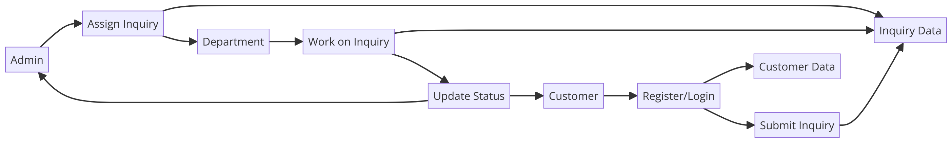
0-level and 1-Level Data Flow Diagram

Slide 12
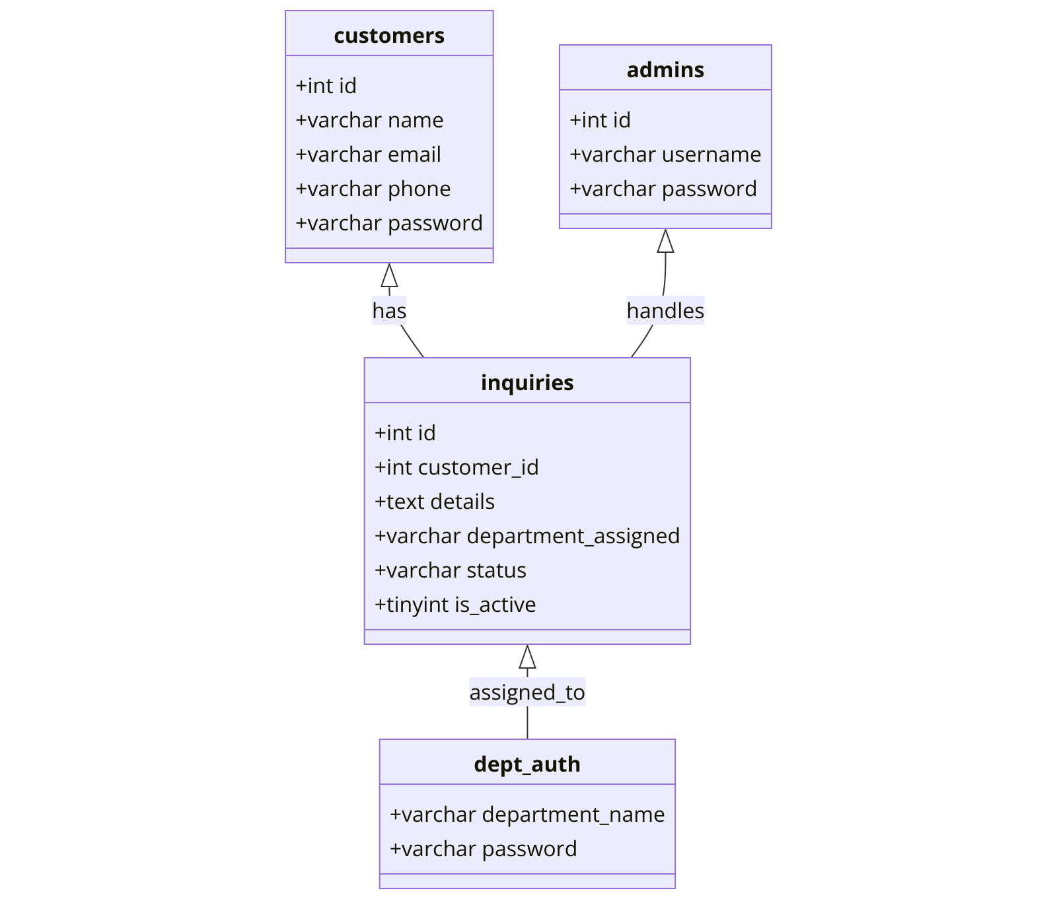
Database diagram

Slide 13
Challenges
- The system is desktop-based, limiting accessibility compared to web-based solutions.
- Network latency occasionally impacted performance.
- No automated escalation for overdue inquiries.

Slide 14
Solutions/Innovations
- Scalable design to handle future enhancements such as server migration.
- Intuitive Java Swing interface for user-friendly operations.
- Future plans to include automated inquiry escalation and server migration.

Slide 15
Conclusion
- The project successfully met its goals of improving customer inquiry handling efficiency.
- Future enhancements, including AI and cloud deployment, will increase system capability. And converting banner SOP.
- The system has proven to be effective and received positive user feedback.

