Slide 1
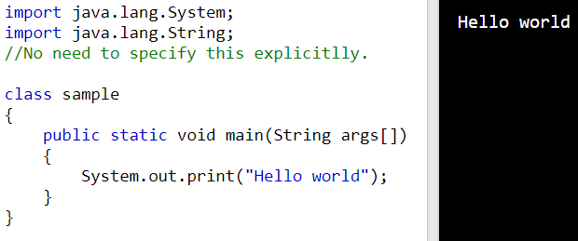
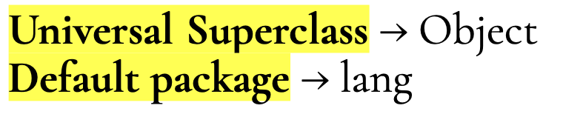
Basic structure of Java program Cormorant Garamond
class is a keyword, and the ClassName should be in pascal case for example: Main, MyClass, AdminUserInfo.
Why public ?
main() is the method written by us since we have to make it available to the JVM by declaring it as public, So that JVM can invoke it from outside the class/package. If we don’t declare the main() method as public, then it does not make itself available to JVM and JVM cannot execute it.
Why static ?
Since Java is purely an Object-Oriented Programming language, without creating an object to a class it is not possible to access members of a class. Since program execution starts from the main method, we need to call the main method without creating an object. Static methods are the methods, which can be called and executed without creating objects. Since we want to call the main() method without using an object, we should declare the main() method as static. JVM calls the main() method using its ClassName.main(). We can call a static method by using the ClassName.methodName. This way we can tell method belongs to the class not to an Object, so no need to create an object to access the method.

Slide 2
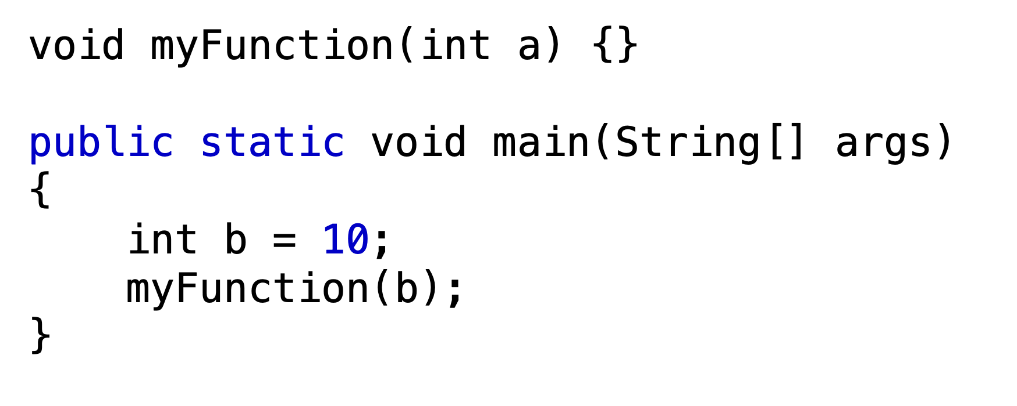
void → return type of function, indicating that the method does not return any value.
Why the parameter String args[] ?
JVM always looks for the main() method with a String type array as a parameter otherwise JVM can’t recognize the main() method, so we must provide a String type array as a parameter to the main() method.
Parameters vs Arguments
Parameters → They act as placeholders for the values the method expects to receive when it is called.
Arguments → They are the actual values or expressions passed to a method when it is called.
here,
void → return type
a, args → parameters
b → argument

Slide 3
Valid access modifiers for Outer class?
public: The class is accessible from anywhere in the application.
default (aka Package-Private): The class is accessible only within the same package.
final: A final class cannot be subclassed (i.e., no other class can extend it).
abstract: An abstract class cannot be instantiated directly. It is meant to be a base class that other classes can extend.
strictfp: Ensures that floating-point calculations in the class adhere to the IEEE 754 standard.
Why using final and abstract together for outer class Is Invalid?
A final class cannot be extended or subclassed. The purpose of marking a class as final is to prevent inheritance and ensure the class’s behavior cannot be modified by overriding methods in subclasses.
An abstract class is meant to be a blueprint for other classes. It cannot be instantiated on its own and typically contains abstract methods (methods without implementations). The purpose of marking a class as abstract is to allow other classes to extend it and provide implementations for its abstract methods.
So, Combining both would result in a class that cannot be extended (final) but is also expected to be extended (abstract), which is logically inconsistent. If the class is also abstract final, no subclass can be created, so the abstract methods would remain unimplemented, violating Java's rules.

Slide 4
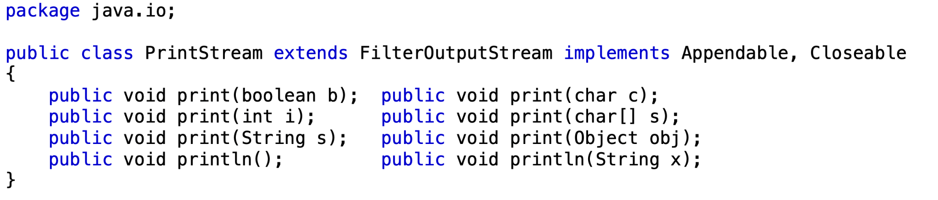
Why System.out.println() ?
System is a final class (we can’t extend the final class) available in java.lang package. lang is the default package. So we write import java.lang.System;. We don’t need to specify this explicitly. The out is a static member of the System class. The System class has a static block that initializes its static fields, including System.out, System.err, and System.in.
When the System class is loaded, the JVM runs its static initializer block(normally used to assign static fields). This block calls the native method initializeSystemClass() to set up System.out variable. Inside initializeSystemClass(), a new PrintStream object is created with a FileOutputStream that is tied to the platform’s standard output stream (FileDescriptor.out). Hence The setOut method assigns this PrintStream object to the System.out field.
Hence when we write System.out we will get value of out variable that got assigned inside the static block i.e an Object of PrintStream class.
So now we have an object of PrintStream class i.e System.out, we can call non static methods like print() & println() of PrintStream class using objectname.methodname() → System.out.println(), so this is the background.

Slide 5
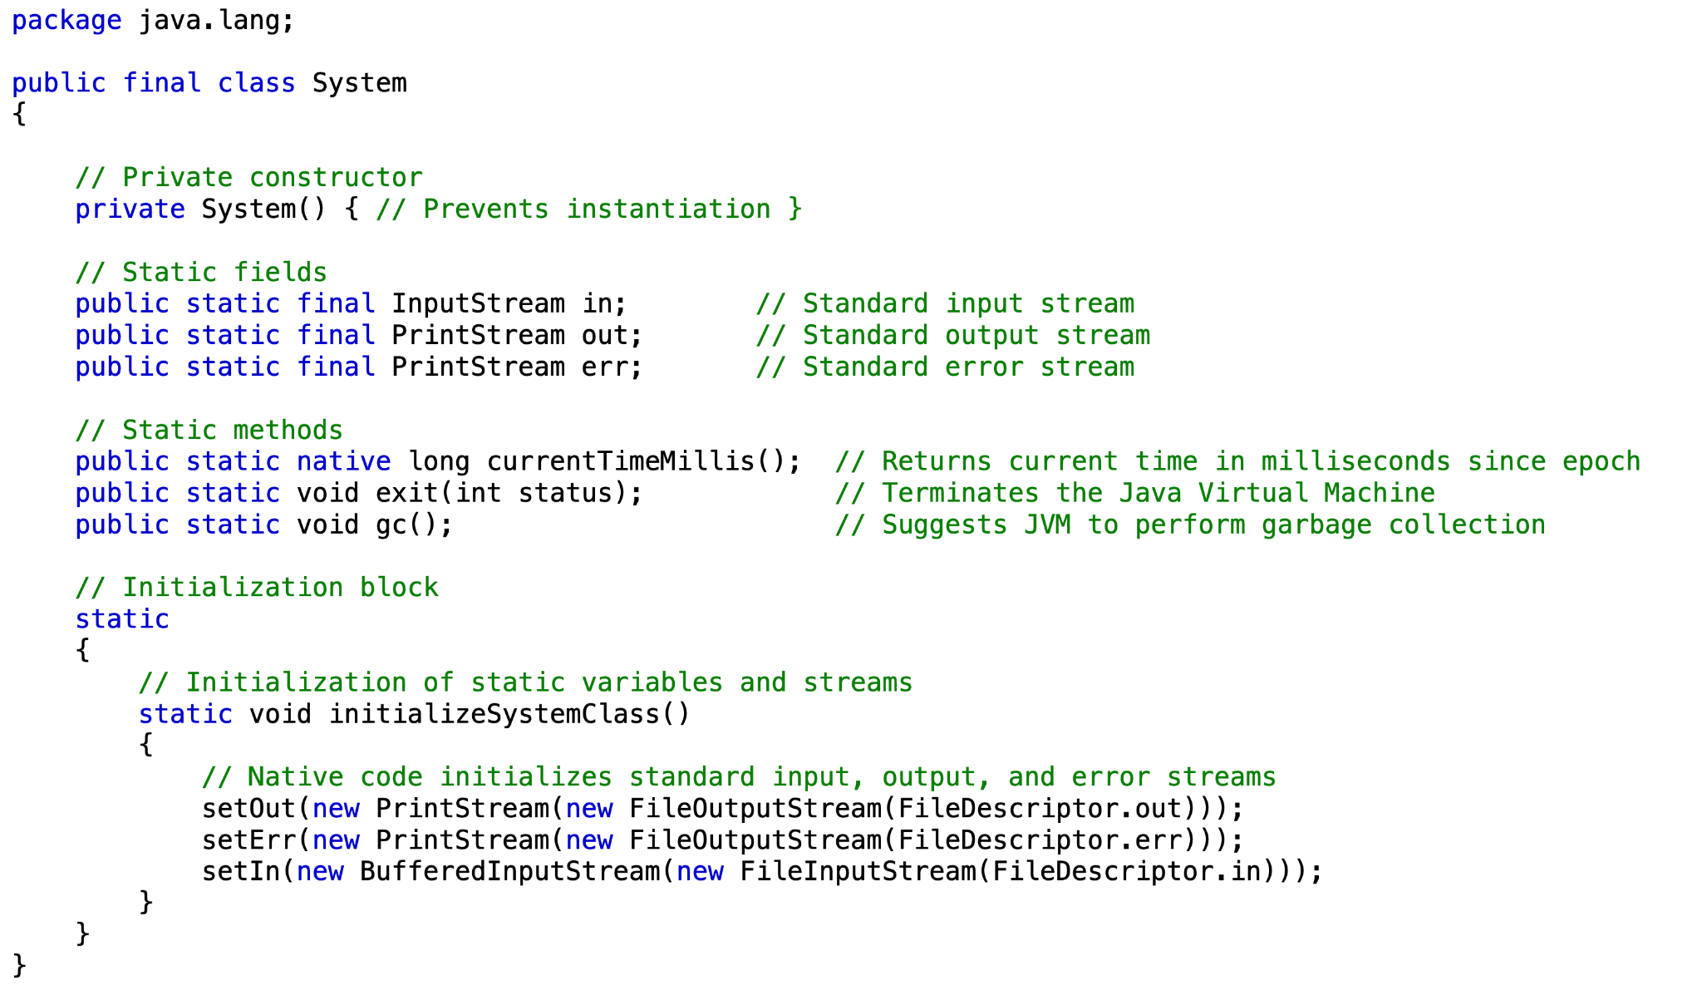
System class Doc

Slide 6
Java Documentation Comment or Doc Comment
Documentation comments in Java are a special type of comment used to generate API documentation. These comments are written using the /** ... */ syntax and are processed by the Javadoc tool, which creates HTML documentation for your code. HTML tags can be used inside documentation comment. When documenting code, it is generally considered best practice to only document public and protected classes as these are the ones accessible to other parts of the codebase.
Documentation comments are typically used to describe:
Classes
Interfaces
Methods
Constructors
Fields
Structure of a Documentation Comment
A documentation comment typically consists of:
Description: A general description of the element.
Tags: Special annotations to provide additional information.

Slide 7
Tags :
@author | Specifies the author(s) of the class or method.
@version | This tag provides version information for a class or method. It is often used to indicate the version of the code, the date of the version, and the author or developer responsible for that version. @version 1.1, 2023-01-01, Swasthik indicates that the version is 1.1, it was released on 2023-01-01, and "Swasthik" was the author or developer responsible for this version.
@since | Indicates the version since which the class or method has been available.
@code | Formats text as inline code, useful for method or variable names. This is helpful when you want to highlight code snippets, such as method names, variables, or expressions, in the generated Javadoc HTML output. When used, the @code tag formats the text in a monospace font and distinguishes it as code.
{@literal} | Displays text without interpreting special characters (like <, >, or &). which means it will be displayed exactly as written, including special characters.
@see | Provides a reference to another method, class, or field for further reading
@link | Inserts a hyperlink to another method, class, or field in the documentation. @link tag. The @link tag is meant to link to other documentation pages within the same project, not to external URLs.

Slide 8
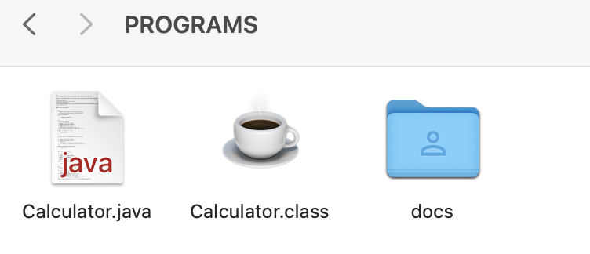
Tags :
How to generate docs when we have a java file ?
If we want to generate all html doc files for Calculator.java in current directory → javadoc Calculator.java
If we want to generate all html doc files for myFile.java in docs folder under current directory (if folder docs does not exists then it will be created automatically ) → javadoc -d docs Calculator.java
@param | Describes a parameter of a method or constructor.
@return | Describes the return value of a method.
@throws / @exception | Describes the exceptions that a method might throw.
@deprecated | Marks a method or class as deprecated, meaning it should not be used in new code.

Slide 9
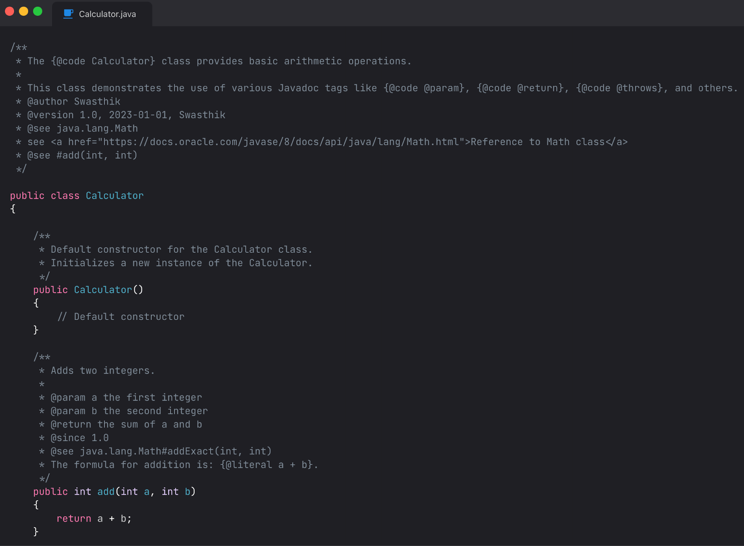

Slide 10
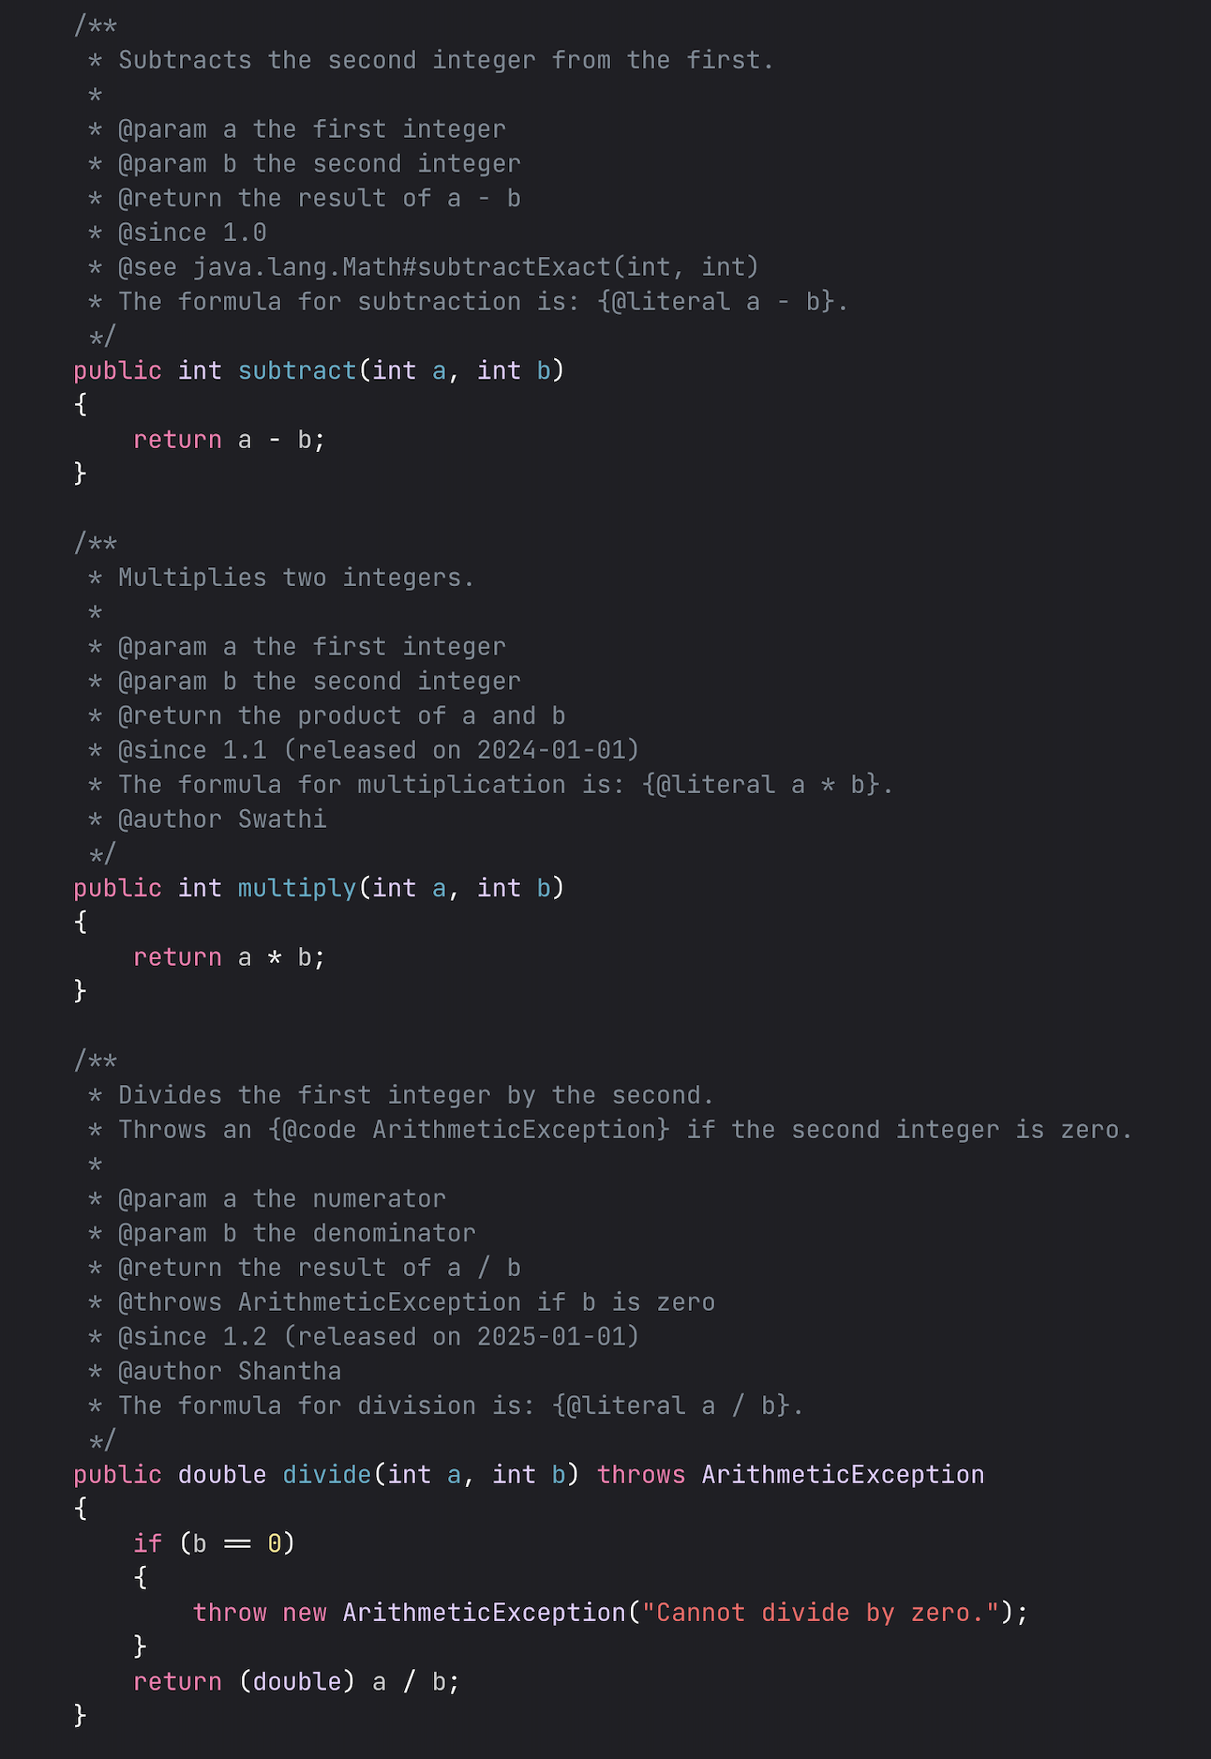
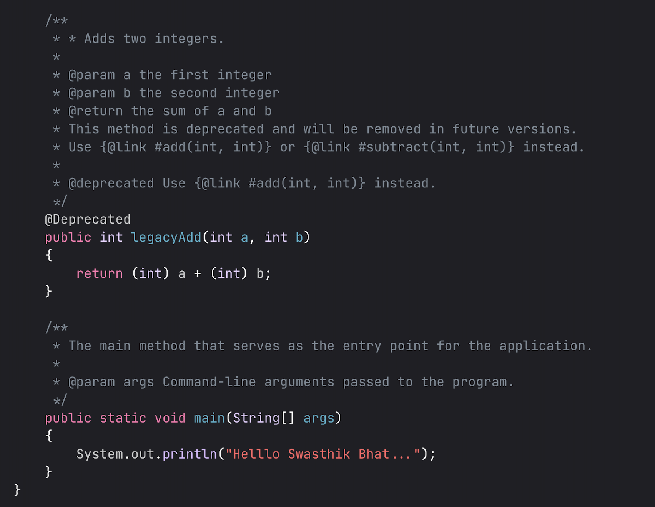

Slide 11
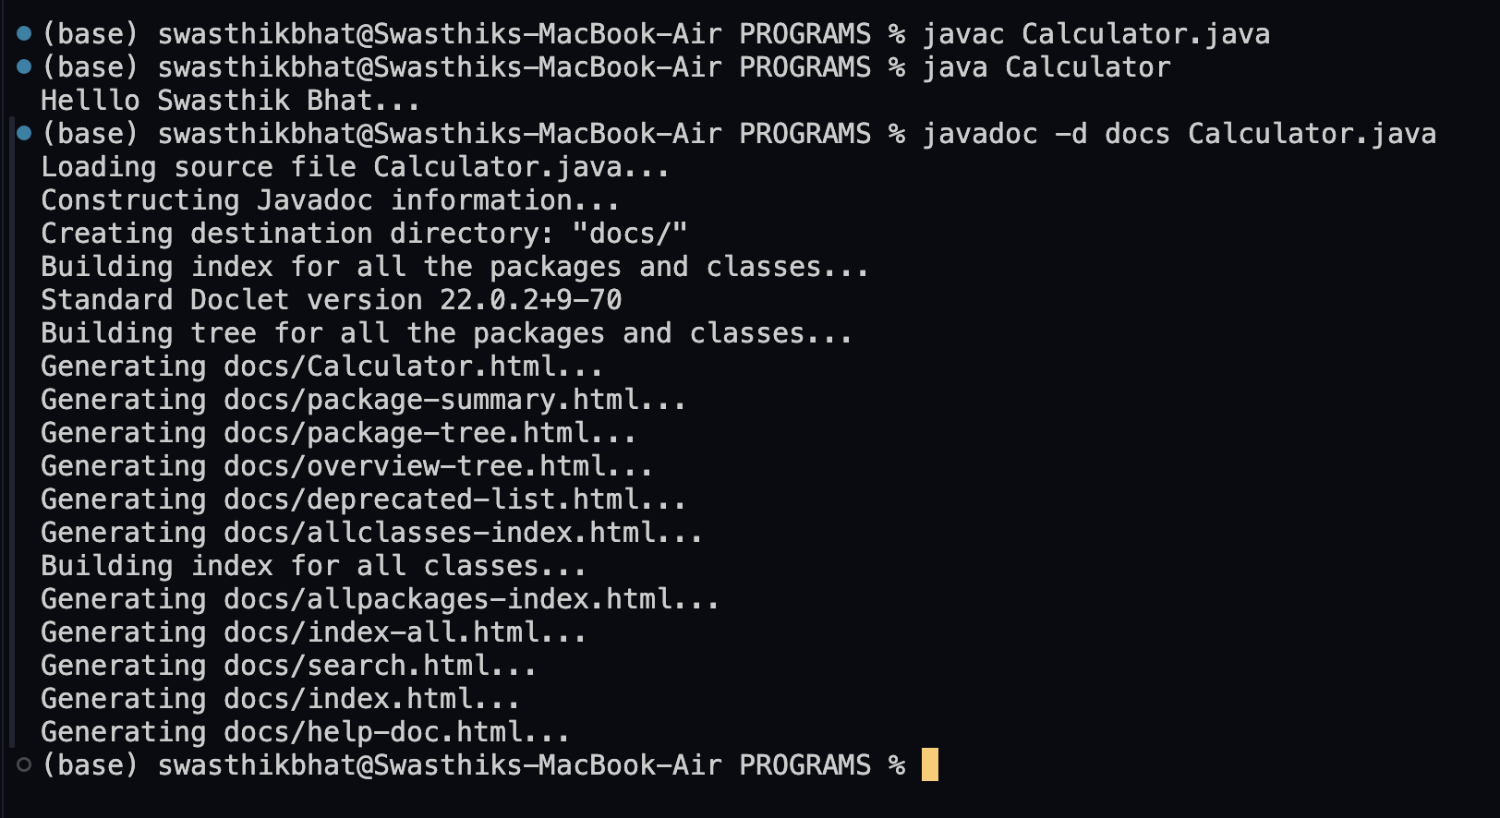
Generating javadocs for Calculator.java using Terminal :

Slide 12
Hi

Slide 13
Hi

Slide 14
Hi

Slide 15
Hi

Slide 16
Hi

Slide 17
Hi

Slide 18
Hi

Slide 19
Hi

Slide 20
Hi

Slide 21
Hi

