Slide 1


Tech ABC Corp - HR Database
[SWASTIK – JAN 20, 2022]

Slide 2
Business Scenario
Business requirement
Tech ABC Corp saw explosive growth with a sudden appearance onto the gaming scene with their new AI-powered video game console. As a result, they have gone from a small 10 person operation to 200 employees and 5 locations in under a year. HR is having trouble keeping up with the growth, since they are still maintaining employee information in a spreadsheet. While that worked for ten employees, it has becoming increasingly cumbersome to manage as the company expands.
As such, the HR department has tasked you, as the new data architect, to design and build a database capable of managing their employee information.
Dataset
The HR dataset you will be working with is an Excel workbook which consists of 206 records, with eleven columns. The data is in human readable format, and has not been normalized at all. The data lists the names of employees at Tech ABC Corp as well as information such as job title, department, manager's name, hire date, start date, end date, work location, and salary.
IT Department Best Practices
The IT Department has certain Best Practices policies for databases you should follow, as detailed in the Best Practices document.

Slide 3
Step 1
Data Architecture Foundations

Slide 4
Step 1: Data Architecture Foundations
Hi,
Welcome to Tech ABC Corp. We are excited to have some new talent onboard. As you may already know, Tech ABC Corp has recently experienced a lot of growth. Our AI powered video game console WOPR has been hugely successful and as a result, our company has grown from 10 employees to 200 in only 6 months (and we are projecting a 20% growth a year for the next 5 years). We have also grown from our Dallas, Texas office, to 4 other locations nationwide: New York City, NY, San Francisco, CA, Minneapolis, MN, and Nashville, TN.
While this growth is great, it is really starting to put a strain on our record keeping in HR. We currently maintain all employee information on a shared spreadsheet. When HR consisted of only myself, managing everyone on an Excel spreadsheet was simple, but now that it is a shared document I am having serious reservations about data integrity and data security. If the wrong person got their hands on the HR file, they would see the salaries of every employee in the company, all the way up to the president.
After speaking with Jacob Lauber, the manager of IT, he suggested I put in a request to have my HR Excel file converted into a database. He suggested I reach out to you as I am told you have experience in designing and building databases. When you are building this, please keep in mind that I want any employee with a domain login to be have read only access the database. I just don't want them having access to salary information. That needs to be restricted to HR and management level employees only. Management and HR employees should also be the only ones with write access. By our current estimates, 90% of users will be read only.
I also want to make sure you know that am looking to turn my spreadsheet into a live database, one I can input and edit information into. I am not really concerned with reporting capabilities at the moment. Since we are working with employee data we are required by federal regulations to maintain this data for at least 7 years; additionally, since this is considered business critical data, we need to make sure it gets backed up properly.
As a final consideration. We would like to be able to connect with the payroll department's system in the future. They maintain employee attendance and paid time off information. It would be nice if the two systems could interface in the future
I am looking forward to working with you and seeing what kind of database you design for us.
Thanks,
Sarah Collins
Head of HR

Slide 5
Data Architect Business Requirement
Purpose of the new database:
The new database must address concerns about data integrity and data security that arise in current mode of record keeping in shared spreadsheet. The new data base must give targeted read and write permissions. The new data base must meet federal regulations and have proper backups. Additionally, it should be able to interface with the payroll department’s system in the future.
Describe current data management solution:
Currently they maintain all employee information in a shared excel spreadsheet.
Describe current data available:
Current data is an Excel workbook consisting of 205 records, with fifteen columns: employee id, employee name, email, hire date, job title, salary, department, manager, start date, end date, location, address, city, state and education level.
Additional data requests:
Any employee with a domain login will have read only access to the database (except the salary information). Only HR and management level employees will have access to salary information and write access to the database. The database needs to be a live database into which the head of HR can input and edit information. The data needs to be maintained for at least 7 years and backed up properly. It would be
Who will own/manage data
What department will own / manage the data in the database
Who will have access to database
List user types that will have access; also list any restrictions to access.

Slide 6
Data Architect Business Requirement
Additional data requests:
preferrable to have the database interface with the payroll department’s system in the future.
Who will own/manage data
Management and HR employees will own/manage data.
Who will have access to database
Any employee with a domain login will have read only access to the database (except the salary information). Only HR and management level employees will have access to salary information and write access to the database.
Estimated size of database
The database will have 206 rows and 15 columns.
Estimated annual growth
The projected growth is 20% a year for the next 5 years.

Slide 7
Data Architect Business Requirement
Is any of the data sensitive/restricted
Only HR and management level employees will have access to salary information and write access to the database.

Slide 8
Data Architect Technical Requirement
Justification for the new database
The new database will address concerns about data integrity and data security that arise in current mode of record keeping in shared spreadsheet.
Database objects
List the database objects (tables, views, special procedures) that will be created for the database.
Following tables will be created per the star schema: Fact_employment_details, Dim_employee, Dim_education, Dim_salary, Dim_department, Dim_location and Dim_job.
Data ingestion
ETL

Slide 9
Data Architect Technical Requirement
Data governance (Ownership and User access)
Ownership: Management and HR employees will own data.
User Access: Any employee with a domain login will have read only access to the database (except the salary information). Only HR and management level employees will have access to salary information and write access to the database
Scalability
The head of HR is looking for a live database into which she can input and edit information. Given the requirement and considering the (a) size of the database and its expected growth and (b) cons of sharding with regards to complexity of administration and increased infrastructure costs, replication would be our choice for scaling.
Flexibility
A direct feed would be used to connect the database with the payroll department’s system in the future.

Slide 10
Data Architect Technical Requirement
Storage & retention
Storage (disk or in-memory): Disk
Retention: 7 years
Backup
There will be full back-up weekly, with daily interval backups

Slide 11
Step 2
Relational Database Design

Slide 12
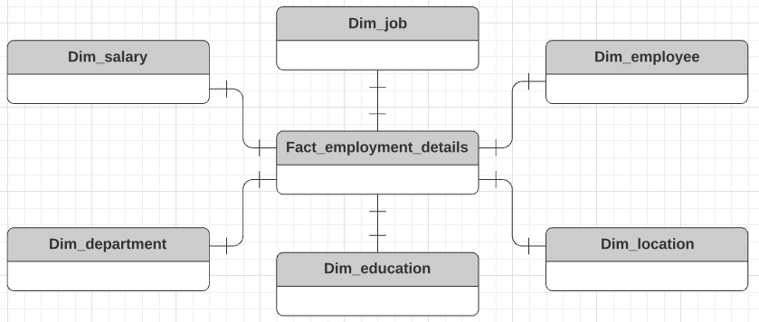
ERD
Conceptual

Slide 13
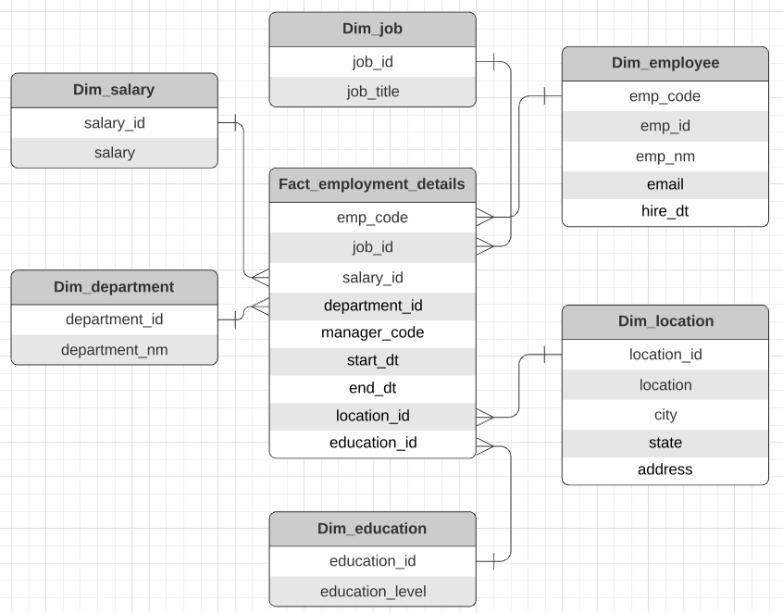
ERD
Logical

Slide 14
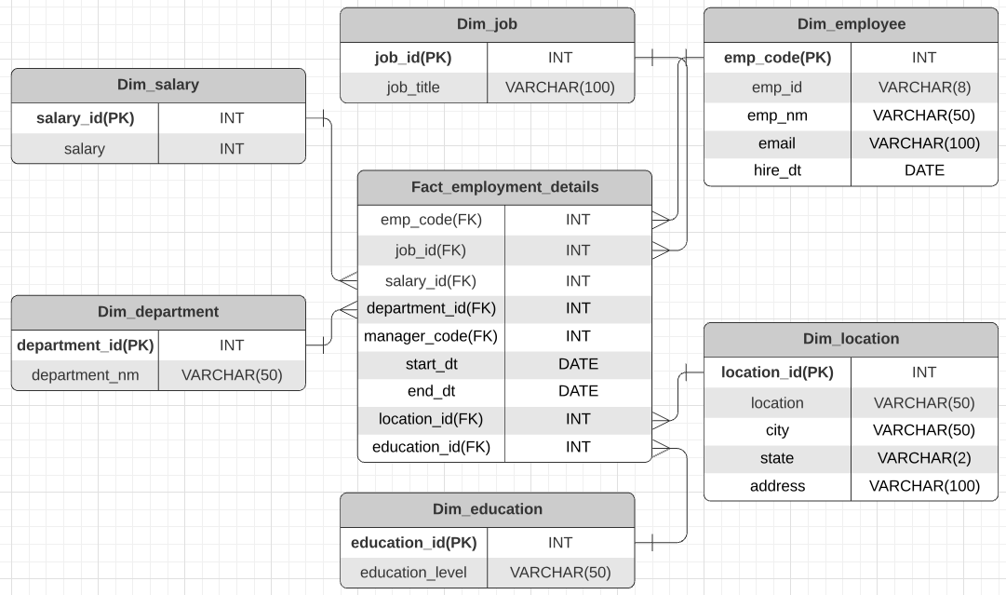
ERD
Physical

Slide 15
Step 3
Create A Physical Database

Slide 16
Step 3: Create A Physical Database
In this step, you will be turning your database model into a physical database.
You will:
Create the database using SQL DDL commands
Load the data into your database, utilizing flat file ETL
Answer a series of questions using CRUD SQL commands to demonstrate your database was created and populated correctly
Submission
For this step, you will need to submit SQL files containing all DDL SQL scripts used to create the database.
You will also have to submit screenshots showing CRUD commands, along with results for each of the questions found in the starter template.
Hints
Your DDL script will be graded by running the code you submit. Please ensure your SQL code runs properly!
Foreign keys cannot be created on tables that do not exist yet, so it may be easier to create all tables in the database, then to go back and run modify statements on the tables to create foreign key constraints.
After running CRUD commands like update, insert, or delete, run a SELECT* command on the affected table, so the reviewer can see the results of the command.

Slide 17
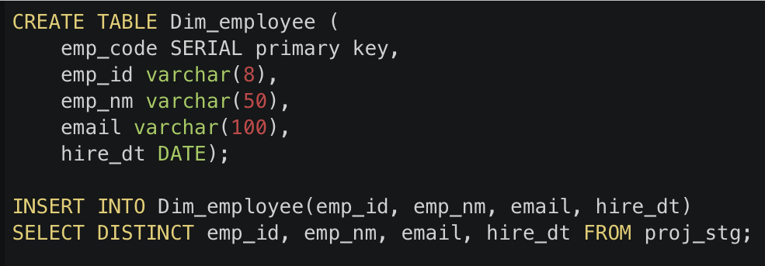
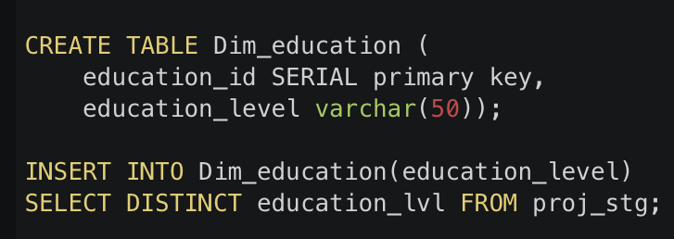
DDL
Create a DDL SQL script capable of building the database you designed in Step 2

Slide 18
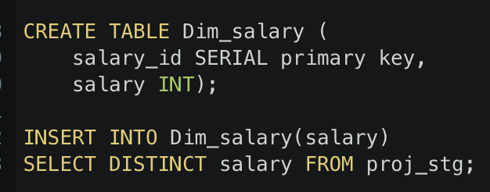
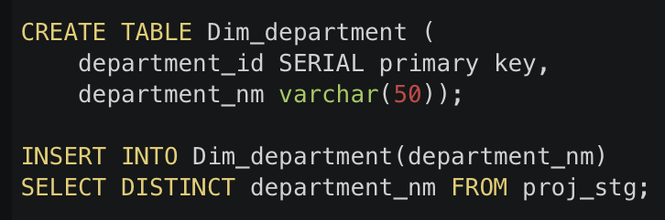
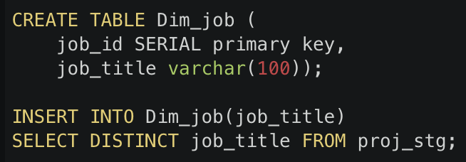
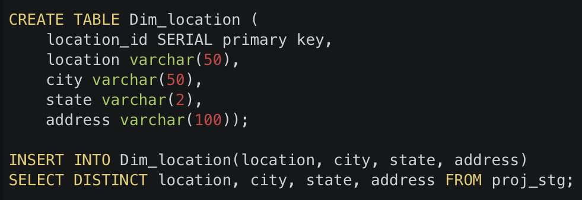
DDL
Create a DDL SQL script capable of building the database you designed in Step 2

Slide 19
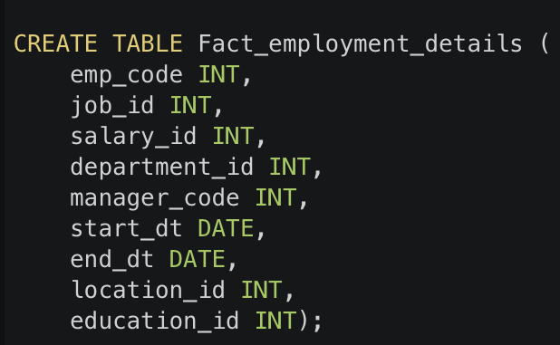
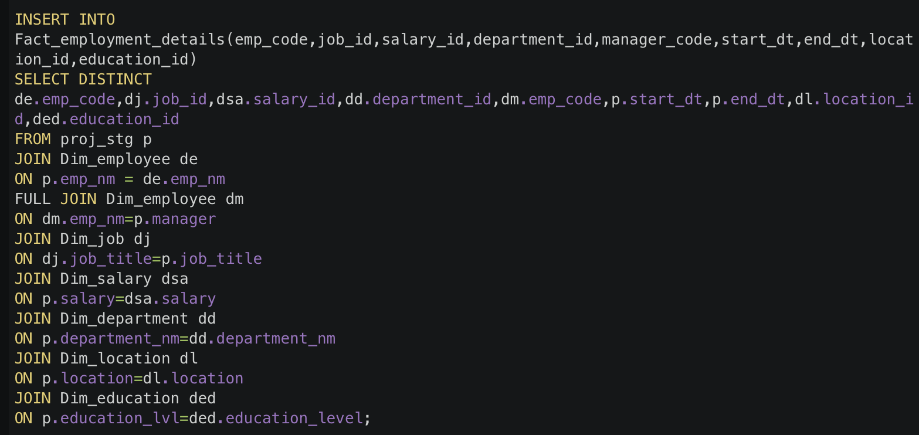
DDL
Create a DDL SQL script capable of building the database you designed in Step 2

Slide 20
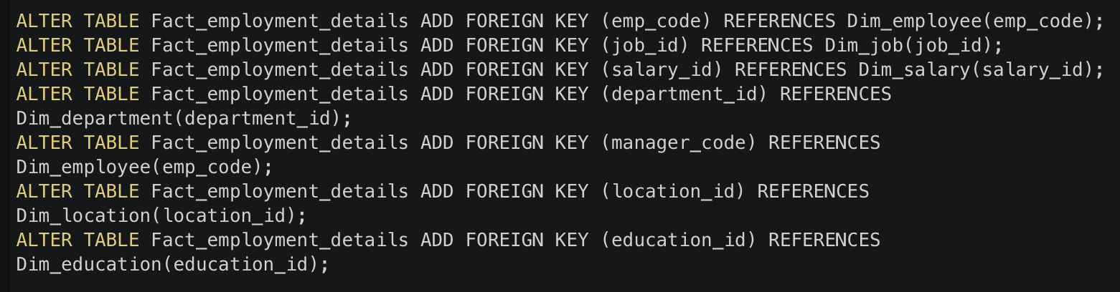
DDL
Create a DDL SQL script capable of building the database you designed in Step 2

Slide 21
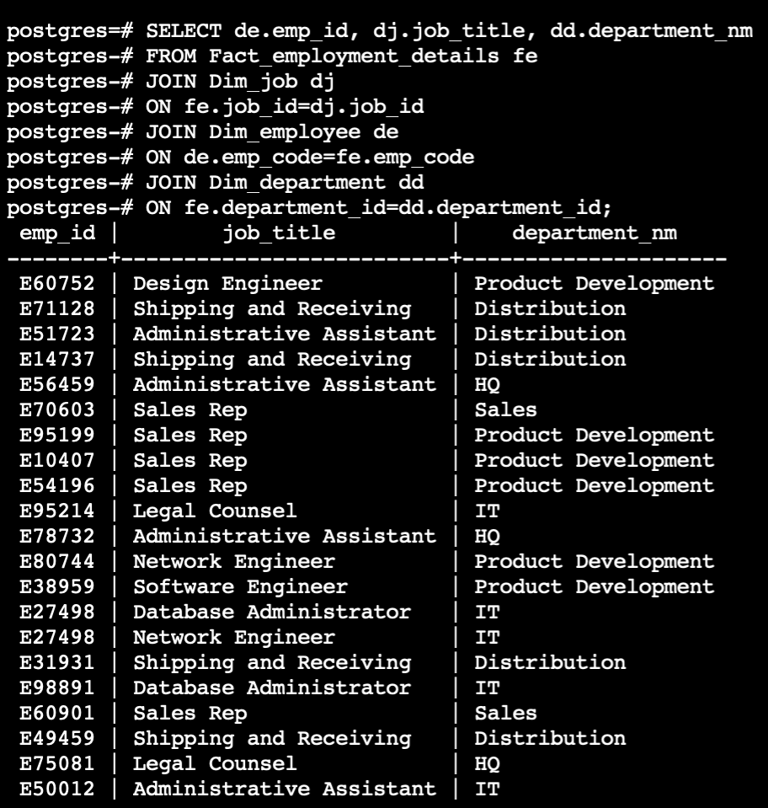
CRUD
Question 1: Return a list of employees with Job Titles and Department Names

Slide 22
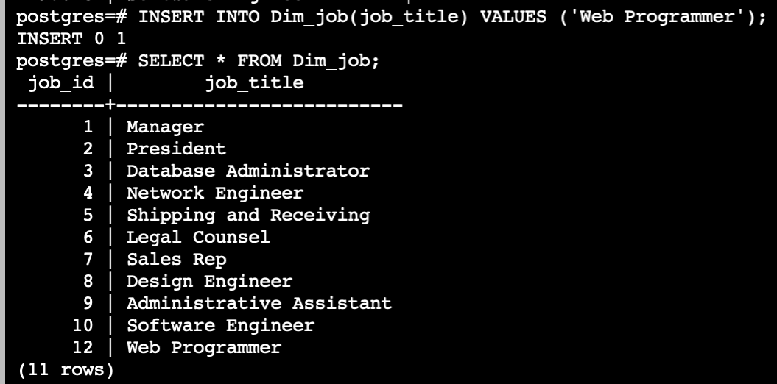
CRUD
Question 2: Insert Web Programmer as a new job title

Slide 23
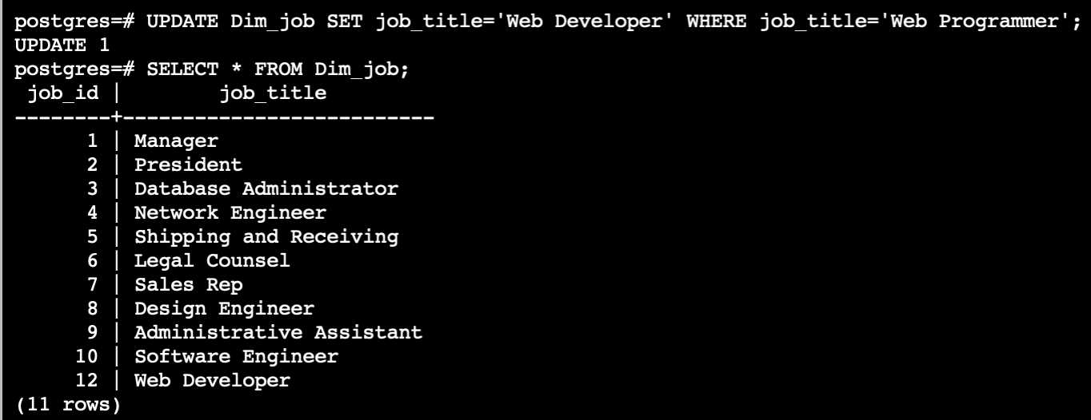
CRUD
Question 3: Correct the job title from web programmer to web developer

Slide 24
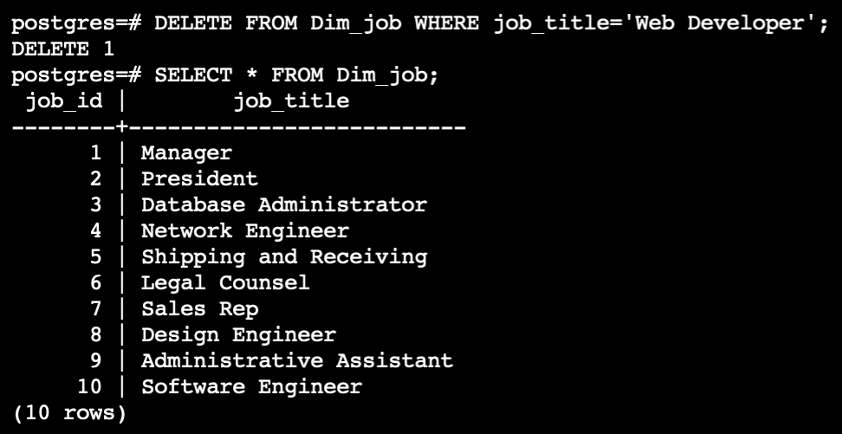
CRUD
Question 4: Delete the job title Web Developer from the database

Slide 25
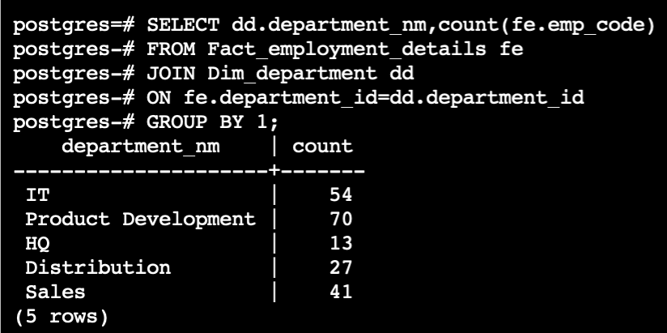
CRUD
Question 5: How many employees are in each department?

Slide 26
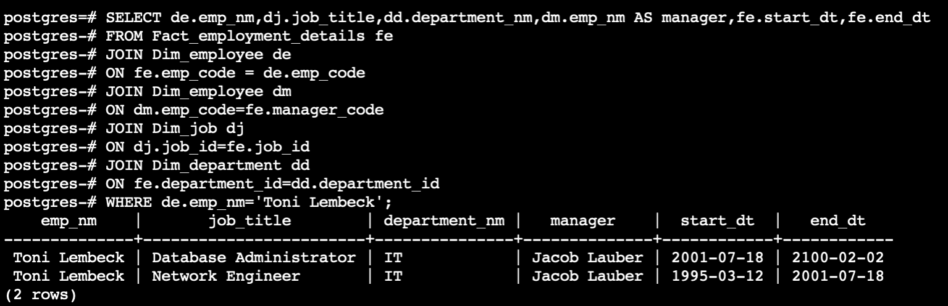
CRUD
Question 6: Write a query that returns current and past jobs (include employee name, job title, department, manager name, start and end date for position) for employee Toni Lembeck.

Slide 27
CRUD
Question 7: Describe how you would apply table security to restrict access to employee salaries using an SQL server.
I will use row-level security to enable access of Dim_salary table to only HR and management level employees.

