Slide 1
ALGORITHMS TO THE PROBLEMS
Both the problems were solved by using python code on Spyder.
By- Swastik Mishra

Slide 2
PROBLEM 1: TRIP ADVISOR
First in the data preprocessing phase the necessary libraries were imported and the dataset was divide into variables X and y. Then using label encoding and one hot encoding the categorical data was segmented. Steps were also taking to avoid dummy variable trap.
X and y were then split into training set and test set. Feature scaling was not required since we are using XGBoost which is a gradient boosting model with regression trees and hence doesn’t use Eucledian distance as its parameter.
Then Linear Discriminant Analysis(LDA) was used for dimensionality reduction to improve the accuracy of XGBoost Classifier.
XGBoost Classifier was trained on the training set and then it was used to predict the accuracy of the test set.
Initially an accuracy of 51.48% was achieved but on tuning the hyperparameter n_estimator we got the efficiency of 52.47%.
The confusion matrix was then plotted in the form of heatmap by using the seaborn library.

Slide 3
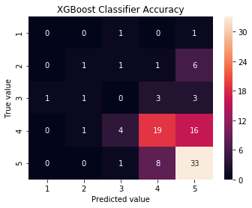
PROBLEM 1: TRIP ADVISOR
To identify the important features in the dataset the method of feature selection was used. This was done by using the ExtraTreesClassifier from the sklearn.ensemble library. Using this classifier an array was obtained which contained the importance score of each attribute and larger the importance score more important the attribute.
Using this we found the following relevant features in the dataset: ‘Member Years’, ‘Nr. Rooms’, ‘Hotel stars’ , ‘Helpful votes’ , ‘Nr. hotel reviews’, ‘Nr. reviews’, ‘Period of stay’, ‘Traveller type’, ‘Review month’, ‘Review weekday’.
Accuracy of the confusion matrix is taken as the metric to consider the efficiency of the model.

Slide 4
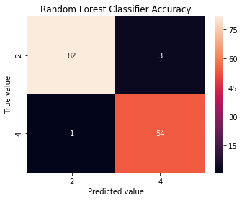
PROBLEM 2: BREAST CANCER DETECTION
In the data preprocessing phase the input was processed by replacing the missing values and then split into training set and test set.
Random Forest Classifier was trained on the training set and then used to predict the accuracy of the test set. The reason this classifier was used because it provides a high accuracy because it uses gradient boosting with decision trees. Hence it will generate a low amount of false positives and negatives.
Initially the accuracy was 97.142% on the test set and it generated 3 false positive and 1 false negative. This is shown in the following confusion matrix.

Slide 5

PROBLEM 2: BREAST CANCER CELL DETECTION
To reduce the number of false positives and negatives, tuning of hyperparameters of RandomForestClassifier was done using GridSearchCV.
From this we got the optimum hyperparameters which increased the efficiency of the classifier to 97.67% on the test set and generated 2 false positive and 1 false negative.
Although we increased the efficiency the computation time increased by about 30s.
The following confusion matrix shows the result after hyperparameter tuning. Accuracy of confusion matrix is taken as the metric to consider efficiency of the model.

