Slide 1
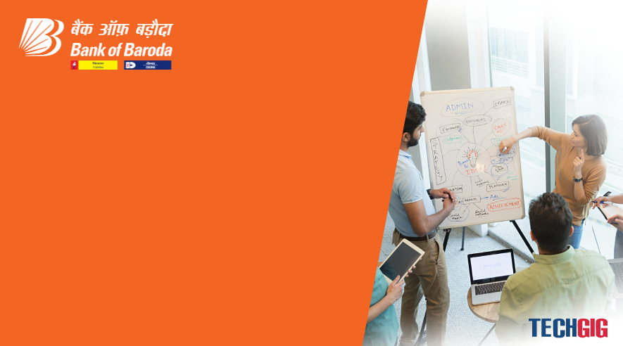

Bank of Baroda Hackathon - 2022
Technology Partner
Team Name : Algomizers
Team bio : A group of students working together to solve real time problems utilising innovative technologies.
Date : 17/09/2022

Slide 2
Problem Statement?
Nowadays almost everyplace is covered by cctv cameras, thus producing a lot of video data every second which leads to the need of video analytics as it assists in reviewing the rising hours of video surveillance footage that an operator struggles to observe. It enables you to locate and record critical surveillance material in real time. Furthermore, it improves video surveillance efficiency by lowering the strain on security management personnel. Video analytics enables you to record the most valuable video footage by making CCTV cameras smarter in their operation. Video analytics attempts to provide relevant insights into data such as the number of consumers visiting, customer attitudes, and visitation statistics of known facilitators.

Slide 3
User Segment
Video analytics can be used in a variety of sectors such as banks, nuclear sites, government buildings such as post offices, passport offices, museums, shopping malls, and a variety of other places that require crowd monitoring such as number of people, sentiments, object detection, and etc.

Slide 4
Pre-Requisites
Alternative products :
Senstar : A product which can perform video analysis tasks such as crowd detection, face recognition, crowd activities however its use cases are limited to places that generally are not visited by high number of people.
Breifcam : The BriefCam® complete Video Content Analytics platform drives exponential value from surveillance system investments by making video searchable, actionable and quantifiable.
Maxicus : A product that can perform tasks such as crowd detection, object detection, loitering in area after time, object missing or removed detection.

Slide 5
Azure tools or resources
Azure tools or resources which are likely to be used by you for the prototype, if your idea gets selected
Ubuntu instance with GPU on Azure or Google Colab pro
Grafana server
Real-time Dataset to work on

Slide 6
Any Supporting Functional Documents
Methodology
YOLO- V3 : You Only Look Once, Version 3 is a real-time object detection algorithm that identifies specific objects in videos, live feeds, or images. We are going to use it in the sentiment analysis of customers, activity that needs attention, and counting number of people visiting the bank.
Audio/Video analysis : If given the audio and video we can use it for the customer sentiment analysis using spectrogram analysis. In a case when only video is present we can classify facial expressions into negative, neutral,positive for the purpose of analysis.
Motion Influence map : The key feature of the proposed motion influence map is that it effectively reflects the motion characteristics of the movement speed, movement direction, and size of the objects or subjects and their interactions within a frame sequence. Use case for this is activity that needs attention. (Click for Reference)

Slide 7
4. Python Face Recognition Library: Face recognition is a step further to face detection. In face detection, we only detect the location of the human face in an image but in face recognition, we make a system that can identify humans. Use case : Identification of known facilitators : The people identified by the 1st layer model - yolo-v3 will be cropped to extract faces. These will will be given as input to the face
recognition methods to compare faces. All unknown faces will be marked the same.
5. Grafana : Grafana is a multi-platform open source analytics and interactive visualization web application. It provides charts, graphs, and alerts for the web when connected to supported data sources. Use case : Analysis of count of people, Time spent on activities in a bank, etc by clubbing number of people from frames per minute and generating a time series database either locally(.csv) or on cloud then retrieve the time series database on Grafana and plot various visualizations (histogram, line chart, etc) to analyse peak crowd hours in the bank everyday.

Slide 8
Architecture :
Sentiments of customers
We will use audio-video analysis for tracking the sentiments of customers. In case when we have the video as well as the audio data of the customer we can use weighted average of facial expressions(determine mouth is open or not) and spectrogram analysis when mouth is open. And in case when only video data is available we can use a model with Sequential CNN layers with ReLU activation function along with Batch Normalization.

Slide 9
Key Differentiators
Most of the available products in the market are giving solution for the places that are not very crowded and number of people visiting such places is not very large.
Instead of just generating data we are able to visualize it for better analysis using advanced tools like grafana.
Adoption Plan
Develop models for each use case expected
Merge the models into a single working prototype
Deploy it on the various bank facilities according to the analytics required by the branch.

Slide 10
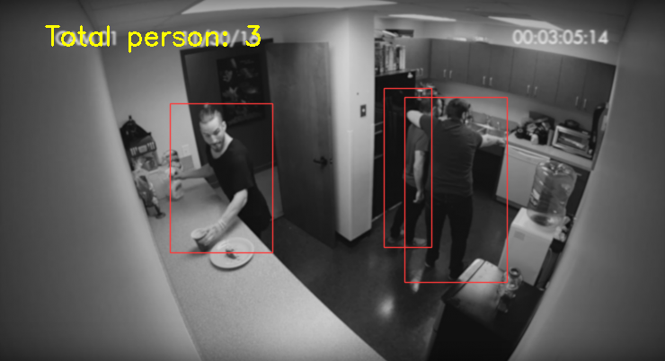
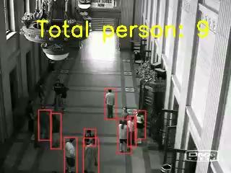
GitHub Repository Link & supporting diagrams, screenshots, if any
Github Repository link : https://github.com/swastika-projects/Video-Analytics
Screenshots and sample videos for count of people :

Slide 11
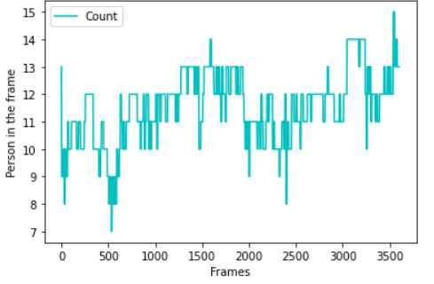
Graph for the analysis of traffic during different hours of the day(generated by the video in previous title) :

Slide 12
Thank You
Swastika
Dhruv Dubey

