Slide 1
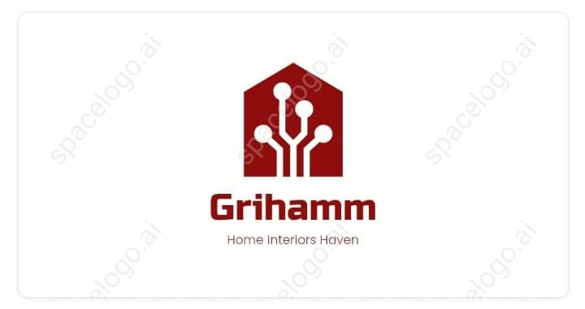



GRIHAMM: Revolutionizing the Interior Industry
GRIHAMM is a new platform that solves the problem of the unstructured interior industry by providing a phone app and web-based app that facilitate customers in choosing design models from the app AND connecting to nearby registered and verified designers as well as execution Teams. We will use the existing ecosystem of interior execution partners who are in the industry for 15 to 20 years but working in a discreet manner. We will enable the existing population of designers and execution team and take them in a polished and structured way to the market (LOT LIKE PRONTO)
by Rimjhiim Charaan

Slide 2
Overview of GRIHAMM
GRIHAMM is an innovative platform that revolutionizes the interior industry by providing customers with cutting-edge design solutions. With a user-friendly phone app and web-based app, GRIHAMM gives customers easy access to a wide range of design models and connects them to experienced and verified designers in their area.
EASY TO USE
RANGE OF OPTIONS
Simple, user-friendly interface for a seamless experience
Wide variety of design models to choose from
PROFESSIONAL DESIGNERS
SIMPLE BOOKING SYSTEM
Access to registered and verified designers in your area
Easy booking system for design execution
TRAINING BOOTHS FOR CONTRACTORS
Get access to our training booths, where you can learn about all the latest design styles, new hardware, and trending designs across India. Stay ahead of the competition and impress your clients with your knowledge and skills. Sign up now!

Slide 3




The Problem of Unstructured Interior Industry
In the traditional interior design industry, there is no standard process and no easy way for customers to find the right designer. As a result, customers are often left feeling frustrated and dissatisfied with their design experience.
Confused Customers
Frustrated Designers
Customers often struggle to find the right designer and are unsure about the process.
Designers often struggle to find clients and generate regular income.
Overwhelmed Industry
Undefined Stages of Milestone-Based Payment
The interior design industry is highly unstructured with no clear standard or process in place.
Without clearly defined stages of milestone-based payment, designers and clients may have different expectations, leading to disputes and unsatisfactory outcomes.
Lack of After-Sales Support and Audit
There is often no after-sales support or audit for interior design projects, leading to a lack of accountability and possible quality issues.

Slide 4

How GRIHAMM Will Solve the Problem
GRIHAMM is the solution to the unstructured interior industry. By providing a reliable and user-friendly platform, GRIHAMM connects customers with professional designers in their area. GRIHAMM also offers a simple booking system and payment management through the app, making the entire process easy and hassle-free for both customers and designers.
1
Reliable and Verified Designers
2
Easy Booking System
Access to verified and experienced designers in your area.
Simple process for booking design execution.
3
Payment Management Via App
4
Standard Process
Convenient payment management options available via the app.
Cleare standard and process for customers and designers.

Slide 5
Features of GRIHAMM Platform
GRIHAMM's phone app and web-based app provide users with a range of features that make the design experience easy, efficient, and enjoyable.
Geo-Based Execution Team Finder Tool
Find the perfect execution team for your project with GRIHAMM's geo-based finder tool! Simply input your location and project details and we'll match you with the best team nearby. Get started today!
Designer Finder Tool
Easily find reliable and verified designers nearby.
1
2
3
4
Design Model Library
Virtual Room Design Tool
Access to a rich library of design models to choose from.
Visualize your design in a virtual room to get a better idea of how it will look.

Slide 6
Features of GRIHAMM Platform
GRIHAMM's phone app and web-based app provide users with a range of features that make the design experience easy, efficient, and enjoyable.
Geo-Based Execution Team Finder Tool
Find the perfect execution team for your project with GRIHAMM's geo-based finder tool! Simply input your location and project details and we'll match you with the best team nearby. Get started today!
Designer Finder Tool
Easily find reliable and verified designers nearby.
1
2
3
4
5
Design Model Library
Virtual Room Design Tool
Audit of the Work Done
Access to a rich library of design models to choose from.
Want to make sure your project is on track? GRIHAMM's audit feature lets you track your project's progress and ensures that the work is being done to your satisfaction. Get started today!
Visualize your design in a virtual room to get a better idea of how it will look.

Slide 7

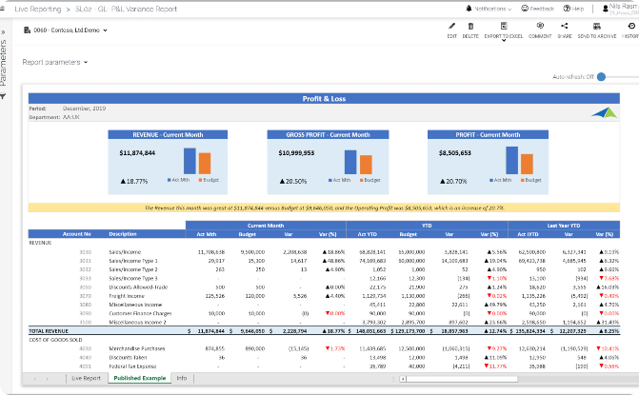
Project Cost Management with Wallet
Keep your project finances organized and transparent with GRIHAMM's wallet feature. The wallet allows you to easily manage project expenses and track your spending, ensuring that your project stays on budget. With real-time updates and detailed reports, you can stay informed and in control of your project finances at all times.
Manage project expenses and track spending in real-time with the wallet feature.
Stay informed and in control of your project finances with detailed reports.

Slide 8
Advantages for Customers
GRIHAMM's platform offers customers a range of advantages that make the design process easy, convenient, and enjoyable, with plenty of variety and choice, including:
1
Customer Satisfaction Guaranteed
2
Advanced Design Solutions
If customers are not satisfied with the execution partners, they can claim for Physical audit and refund on the part not done well.
Access to a rich library of design models and professional designers as per their GEO. Customers can also choose from a variety of execution partners to find the best fit for their project, with GRIHAMM's disclaimer.
3
User-Friendly Phone App
4
Flexible Payment Options
Easy-to-use app for selecting designs, choosing execution partners in nearby locations or as per requirement, and tracking progress. Customers can see the amount utilized per phase or work and a running cost.
GRIHAMM offers a variety of payment options to customers, including installment plans, credit card payments, and more, making it easy to choose a plan that works for their budget.
5
Loan Options for Home Improvement
6
Convenience, Variety, and Choice of Interior and Execution Partners
GRIHAMM's platform provides customers with access to loan options for home improvement projects directly through the app. This allows customers to easily finance their projects without needing to leave the platform or search for financing elsewhere.
Customers have the convenience and variety of choosing from a wide selection of interior and execution partners to find the best fit for their project, with GRIHAMM's disclaimer. This means customers have more choice and control over their project, with access to top-quality service providers and designers.

Slide 9
Advantages for Designers and Contractors
GRIHAMM's platform also offers advantages for other big designers and contractors, making it easier for them to generate regular income and find new clients.
Design Lead Generation
Regular income for designers and contractors via online or physical design leads.
Training booths for Contractors
Get access to our training booths, where you can learn about all the latest design styles, new hardware, and trending designs across India. Stay ahead of the competition and impress your clients with your knowledge and skills.
Design Execution Management
Simple and straightforward design execution management based on milestone payments from wallet of customers.
Regular Training on Budget Design
Stay on top of your game with our regular training programs on how to design within budget, so that you can provide the best value to your clients while staying profitable. Sign up now!

Slide 10
Freshers and Interns can Gain a Competitive Edge with Grihamm's Training Programs
Prepare for real industry challenges with our comprehensive training programs, available to book at all interior colleges. Our programs not only provide valuable experience, but also facilitate internships for hands-on execution. After completing our programs, we certify interns to be fit for hiring by other companies. Don't miss out on this opportunity to gain a unique advantage in the job market!
Grihamm's training programs can give college students a unique advantage in the job market. Grihamm will offer comprehensive training programs that prepare students for real industry challenges. Our programs are available to book at all interior colleges. Our training programs not only provide valuable experience, but also facilitate internships for hands-on execution. After completing our programs, we certify interns to be fit for being hired by other companies. Don't miss out on this opportunity to gain a competitive edge!

Slide 11
Future Prospects and Growth Potential
GRIHAMM has tremendous growth potential in the interior industry through its innovative platform and user-friendly and hassle-free design experience.
Market Growth
Big Data Analytics
Revenue Growth
GRIHAMM has an expanding and growing market in the interior design industry.
GRIHAMM can utilize analytics to provide insights and improve the design experience.
GRIHAMM's revenue will grow as the platform becomes more popular and usage increases.

Slide 12
1 MONTH PROJECTION ASSUMING 1 PROJECT VALUE OF 300000
City
Number of Projects BOOKING per Month
Project Value BOOOKING per Month
Yearly Projections
Bangalore
50
Rs 30,00,000
Rs 18,00,00,000
Pune
50
Rs 30,00,000
Rs 18,00,00,000
Chennai
50
Rs 30,00,000
Rs 18,00,00,000
Hyderabad
50
Rs 30,00,000
Rs 18,00,00,000
Goa
50
Rs 30,00,000
Rs 18,00,00,000
Surat
50
Rs 30,00,000
Rs 18,00,00,000
Indore
50
Rs 30,00,000
Rs 18,00,00,000
Nagpur
50
Rs 30,00,000
Rs 18,00,00,000
Cochin
50
Rs 30,00,000
Rs 18,00,00,000
Ahmedabad
50
Rs 30,00,000
Rs 18,00,00,000

Slide 13
THANK YOU

