Slide 1







Classification of different physical scatterers in weather radar data using machine learning techniques
Alakh Agrawal, Swasti Pahuja, Anjita Neelatt, J Indu
15 April, 2024
1

Slide 2



Problem Statement
To classify echoes from meteorological and biological targets using dual polarization Doppler weather radar data from the Next Generation Weather Radar (NEXRAD)
Implement and fine tune different ML models to distinguish multiple types of physical scatterers from each other
2

Slide 3



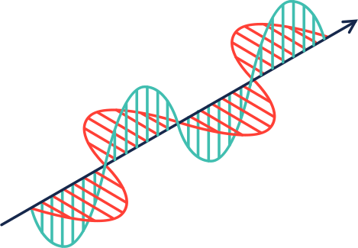


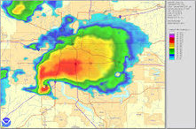
Case Study - I
Bats
Radar Beam
WCT & NEXRAD images
Doppler Weather Radar ( DWR )
3

Slide 4
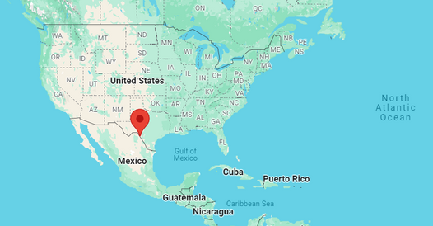
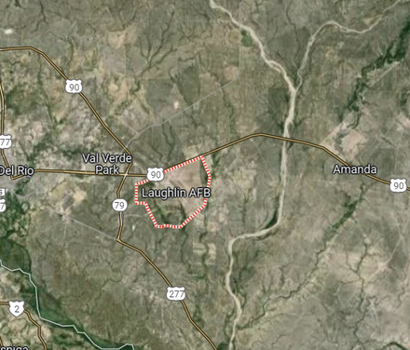
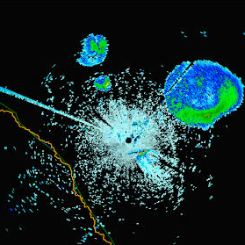




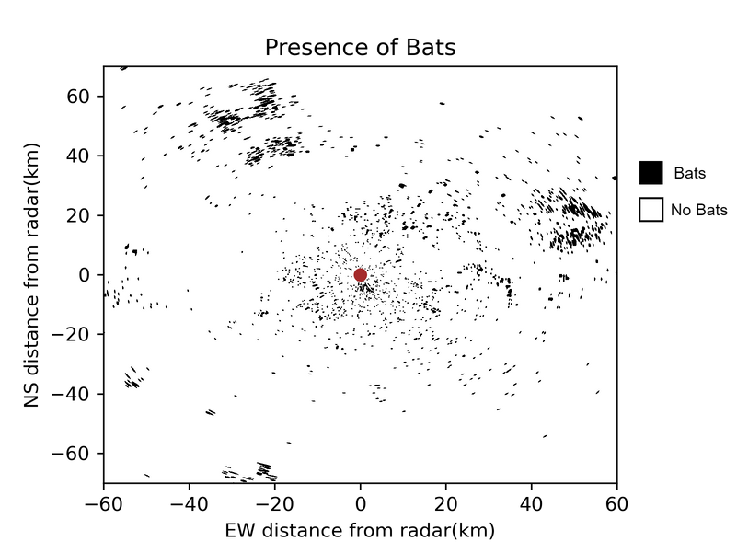
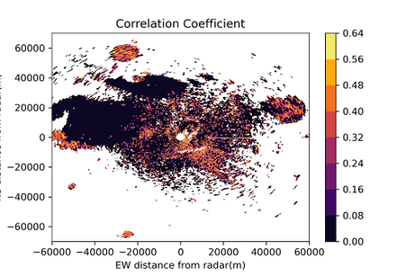
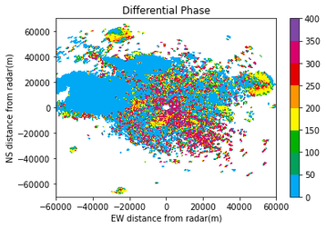
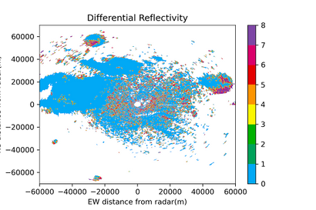

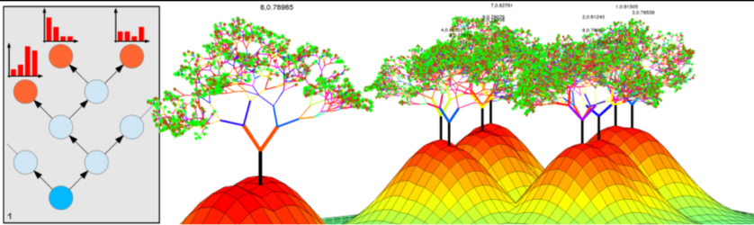
METHODOLOGY Bat Appearance at Laughlin, Texas on 01/04/2013 at 01:02 UTC
Properties
Values
Differential
Reflectivity (dBZ)
> 5
Correlation
Coefficient
<0.4
Differential
Phase (degrees)
> 140
4

Slide 5

Case Study - II
Precipitation
Radar Beam
WCT & NEXRAD images
Doppler Weather Radar ( DWR )
5

Slide 6
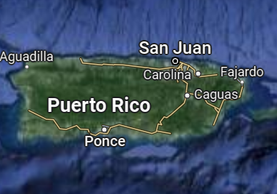
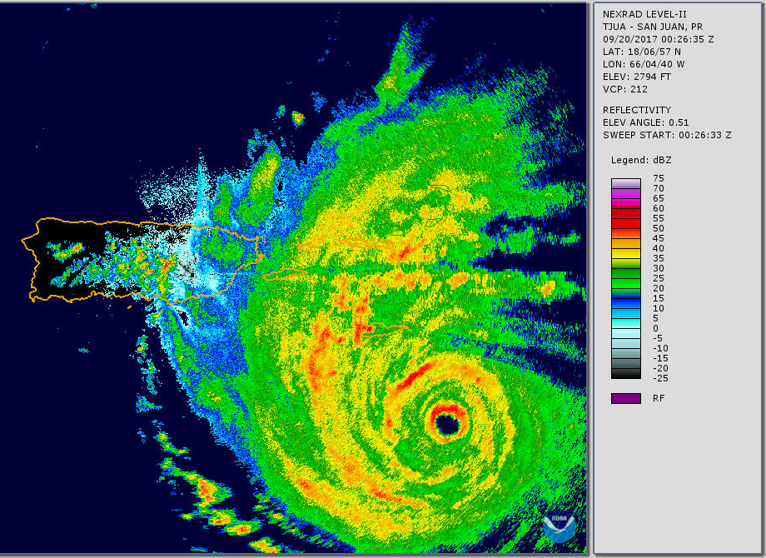
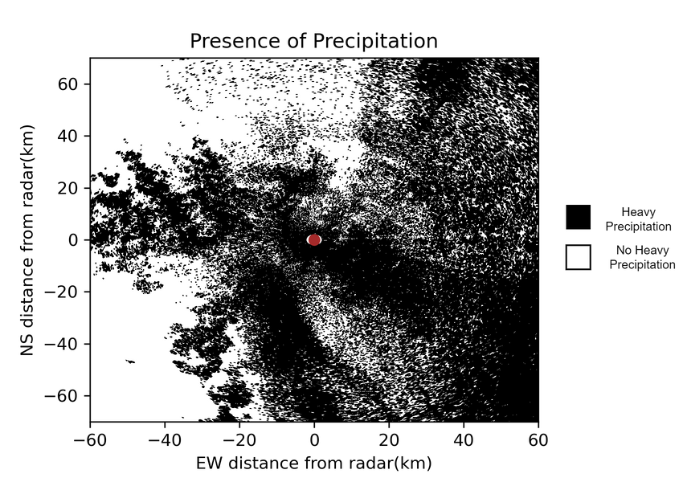
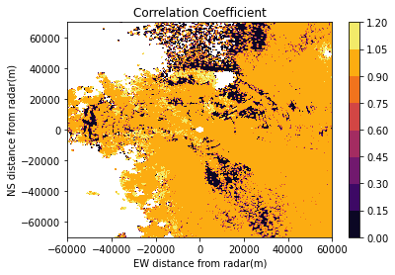
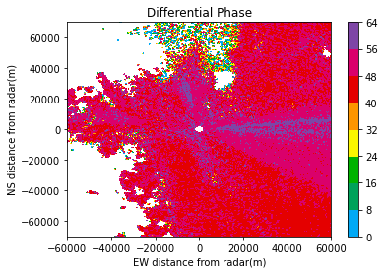
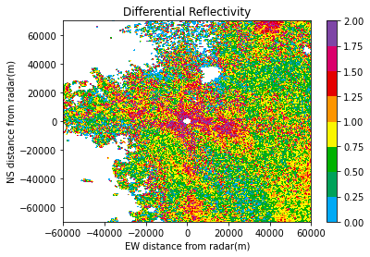
METHODOLOGY Hurricane Maria - Puerto Rico - 20 September 2017
Properties
Values
Differential
Reflectivity (dBZ)
0-2
Correlation
Coefficient
>0.99
Differential
Phase (degrees)
<60
6

Slide 7

Conclusion
Future Scope
Bat Classification model works well for larger patches in the same region
Precipitation model works well for a particular area, due to its uniformity in a region
Larger training data needs to be used for precipitation
Prepare a larger dataset for presence of bats and heavy precipitation
Compare multiple models and tune hyperparameters for the classification pipeline
7

Slide 8
● Prof. J Indu, Department of Civil Engineering, IIT Bombay
● Department of Civil Engineering and IoE Office, IIT Bombay
● Hydrometeorology and Remote Sensing Group (HMeRS)
Acknowledgement
8

Slide 9

Thank You
9

